Slide 1
Window Programming 10-6
Rectangle-shaped Magnifier
Yuan Ze University

Slide 2
Rectangle-shaped magnifier example
用DrawImage指令
  目標區域放大兩倍以達到矩形放大鏡效果

Slide 3
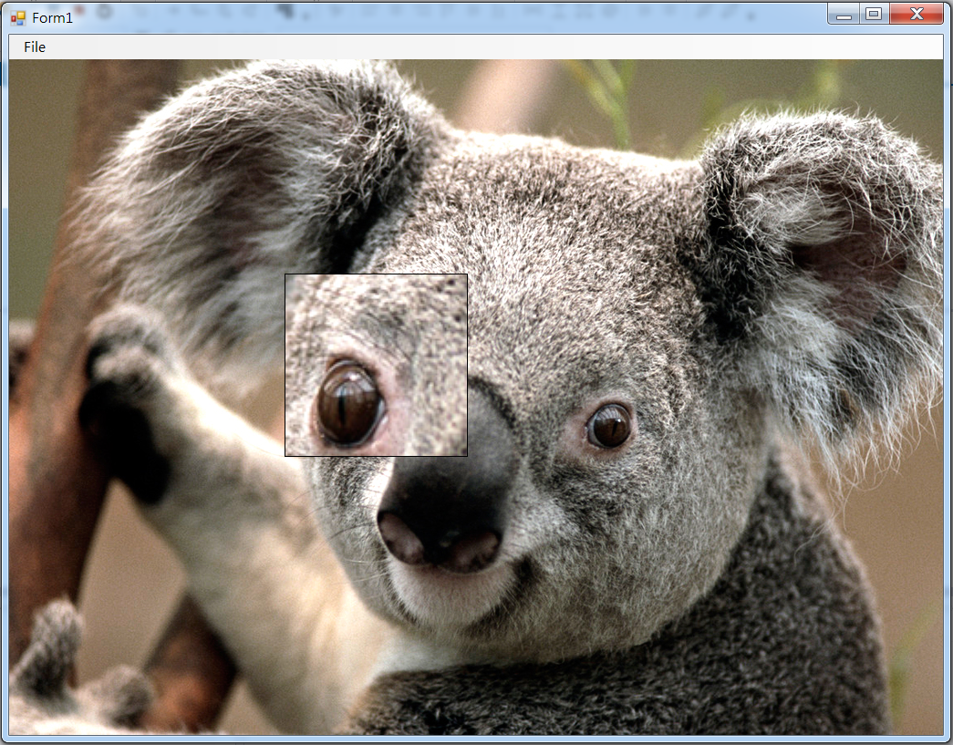
Rectangle-shaped magnifier example

Slide 4
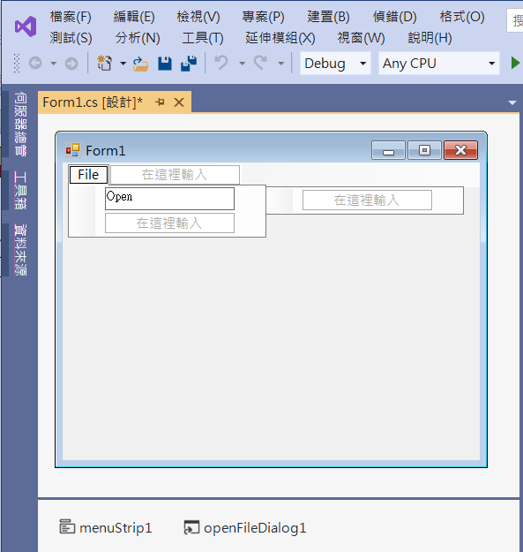
Rectangle-shaped magnifier example
2. Edit menuStrip1
1. Add menuStrip1
3. Add openFileDialog1

Slide 5
Rectangle-shaped magnifier example
public partial class Form1 : Form
{
Image img;
Point mousePos; // 滑鼠位置
int D = 100; // 放大鏡半徑
public Form1()
{
InitializeComponent();
DoubleBuffered = true; //雙暫存區以避免閃爍
}

Slide 6
Rectangle-shaped magnifier example
private void OpenToolStripMenuItem_Click(object sender, EventArgs e)
{
if (openFileDialog1.ShowDialog() == DialogResult.OK) // 開啟影像檔
{
String input = openFileDialog1.FileName;
img = Image.FromFile(input); // 產生一個Image物件
if ((ClientSize.Width < img.Width) || (ClientSize.Height < img.Height))
ClientSize = new Size(img.Width, img.Height);
Invalidate(); // 要求重畫
}
}

Slide 7
Rectangle-shaped magnifier example
private void Form1_Paint(object sender, PaintEventArgs e)
{
if (img!=null)
{
e.Graphics.DrawImage(img, 0, 0, img.Width, img.Height); // 呈現原圖
Rectangle rectDest = new Rectangle(mousePos.X - D, mousePos.Y - D, 2 * D, 2 * D); //目標區域放大兩倍
Rectangle rectSRC = new Rectangle(mousePos.X - D / 2, mousePos.Y - D / 2, D, D);
e.Graphics.DrawImage(img, rectDest, rectSRC, GraphicsUnit.Pixel); // 呈現原圖 放大區域
e.Graphics.DrawRectangle(Pens.Black, rectDest); // 放大鏡外框
}
}

Slide 8
Rectangle-shaped magnifier example
private void Form1_MouseMove(object sender, MouseEventArgs e)
{
mousePos = e.Location; // 記錄 滑鼠位置
Invalidate(); // 要求更新表單
}

Slide 9
Exercise#10-6

Slide 10
內容來源
  Visual C# 2012 視窗程式設計：繪圖與遊戲專題(鄞永傳/著; 松崗)

