Slide 1
Window Programming 11-3
Bitmap Image
SetPixel
Yuan Ze University

Slide 2
SetPixel (Bitmap)
Bitmap img, img2;
…
img2 = (Bitmap) img.Clone();
Color pixelColor = img2.GetPixel(x, y); // 得到圖素
Color newColor = Color.FromArgb(pixelColor.R, 0, 0);
img2.SetPixel(x, y, newColor); //設定圖素

Slide 3
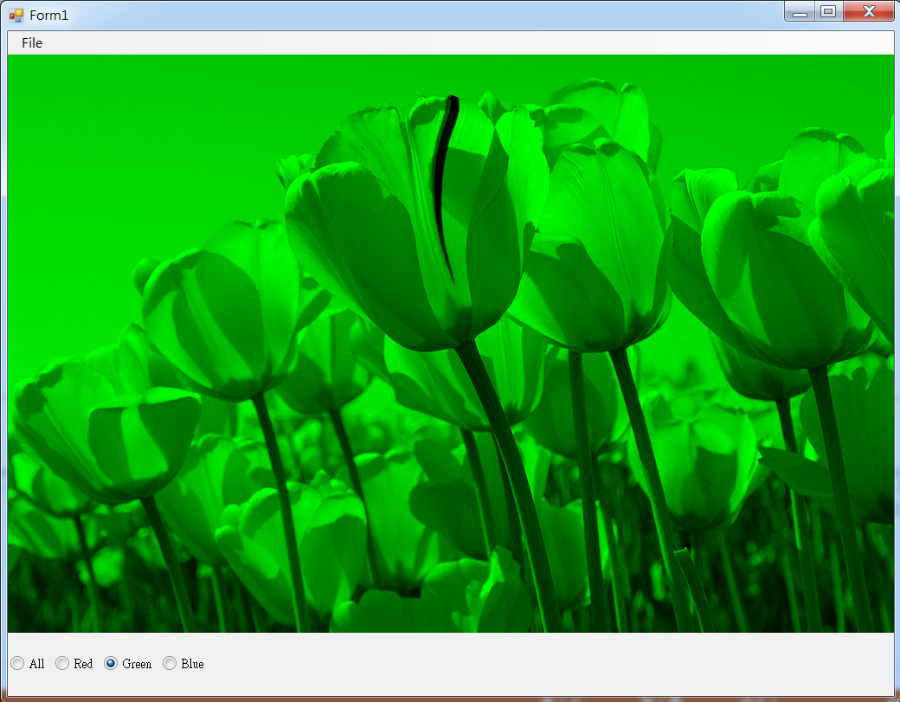
SetPixel example 1

Slide 4
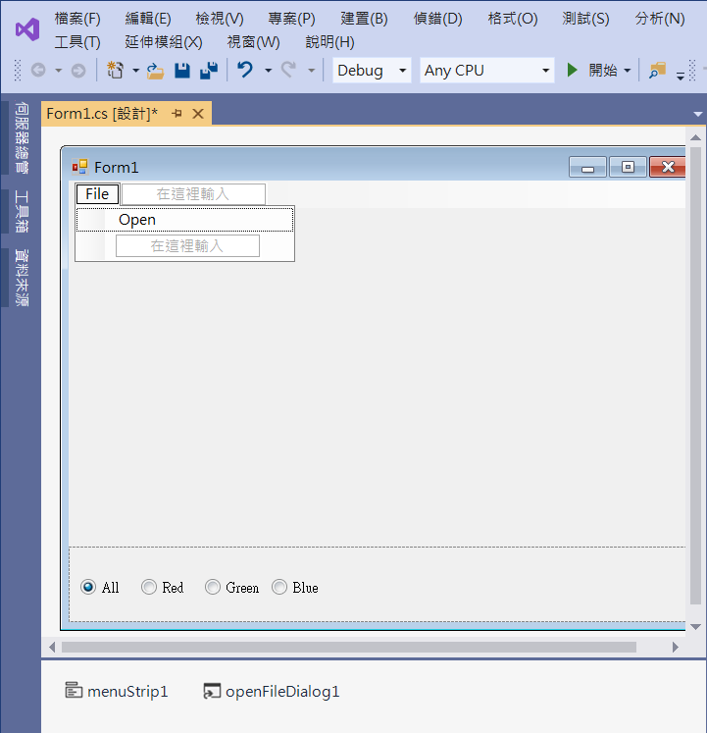
SetPixel example 1
1. panel1
Dock -> bottom
3. radioButton2
2. radioButton1
4. menuStrip1
5. openFileDialog1

Slide 5
SetPixel example 1
using System;
using System.Collections.Generic;
using System.ComponentModel;
using System.Data;
using System.Drawing;
using System.Linq;
using System.Text;
using System.Threading.Tasks;
using System.Windows.Forms;
using System.Drawing.Imaging;

Slide 6
SetPixel example 1
public partial class Form1 : Form
{
Bitmap img, img2; // 影像
public Form1()
{
InitializeComponent();
}

Slide 7
SetPixel example 1
private void OpenToolStripMenuItem_Click(object sender, EventArgs e)
{
if (openFileDialog1.ShowDialog() == DialogResult.OK) // 開啟影像檔
{
String input = openFileDialog1.FileName;
img = (Bitmap)Image.FromFile(input); // 產生一個Image物件
if ((ClientSize.Width < img.Width) || (ClientSize.Height < img.Height))
ClientSize = new Size(img.Width, img.Height);
imgClone();
Invalidate(); // 要求重畫
}
}

Slide 8
SetPixel example 1
// Method 1: SetPixel
void imgClone()
{
int x, y;
img2 = (Bitmap)img.Clone(); // 重設 img2 的 圖素
if (radioButton1.Checked==false)
{
int R_rate=0, G_rate=0, B_rate=0;
Color newColor;
if (radioButton2.Checked)
R_rate=1;
else if (radioButton3.Checked)
G_rate=1;
else if (radioButton4.Checked)
B_rate=1;

Slide 9
SetPixel example 1
for (x = 0; x < img2.Width; x++)
{
for (y = 0; y < img2.Height; y++)
{
Color pixelColor = img2.GetPixel(x, y); // 得到圖素
newColor = Color.FromArgb(pixelColor.R * R_rate, pixelColor.G * G_rate, pixelColor.B * B_rate);
img2.SetPixel(x, y, newColor); // 設定圖素
}
}
}
}

Slide 10
SetPixel example 1
// Method 2: ColorMatrix Quicker
void imgClone()
{
int x, y;
img2 = (Bitmap)img.Clone(); // 重設 img2 的 圖素
if (radioButton1.Checked==false)
{
float r, g, b;
if (radioButton2.Checked) r = 1;
else r = 0;
if (radioButton3.Checked) g = 1;
else g = 0;
if (radioButton4.Checked) b = 1;
else b = 0;

Slide 11
SetPixel example 1
float[][] cmArray1 =
{
new float[] {r, 0, 0, 0, 0},
new float[] {0, g, 0, 0, 0},
new float[] {0, 0, b, 0, 0},
new float[] {0, 0, 0, 1, 0},
new float[] {0, 0, 0, 0, 1}
};
ColorMatrix cm1 = new ColorMatrix(cmArray1);
ImageAttributes ia1 = new ImageAttributes();
ia1.SetColorMatrix(cm1,
ColorMatrixFlag.Default,
ColorAdjustType.Bitmap);

Slide 12
SetPixel example 1
Rectangle rectDest = new Rectangle(0, 0, img.Width, img.Height);
Graphics g2 = Graphics.FromImage(img2);
g2.DrawImage(img,
rectDest,
0, 0, img.Width, img.Height,
GraphicsUnit.Pixel, ia1);
}
}

Slide 13
SetPixel example 1
private void Form1_Paint(object sender, PaintEventArgs e)
{
if (img2 != null)
{
Rectangle rectDest = new Rectangle(0, 0, img2.Width, img2.Height);
e.Graphics.DrawImage(img2, rectDest);
}
}

Slide 14
SetPixel example 1
private void RadioButton1_CheckedChanged(object sender, EventArgs e)
{
if (img != null)
{
imgClone();
Invalidate();
}
}
For radioButton1~ radioButton4

Slide 15
Exercise#3

Slide 16
內容來源
  Visual C# 2012 視窗程式設計：繪圖與遊戲專題(鄞永傳/著; 松崗)

