Slide 1
Window Programming 11-5
Bitmap Image
SetPixel example 3
Yuan Ze University

Slide 2
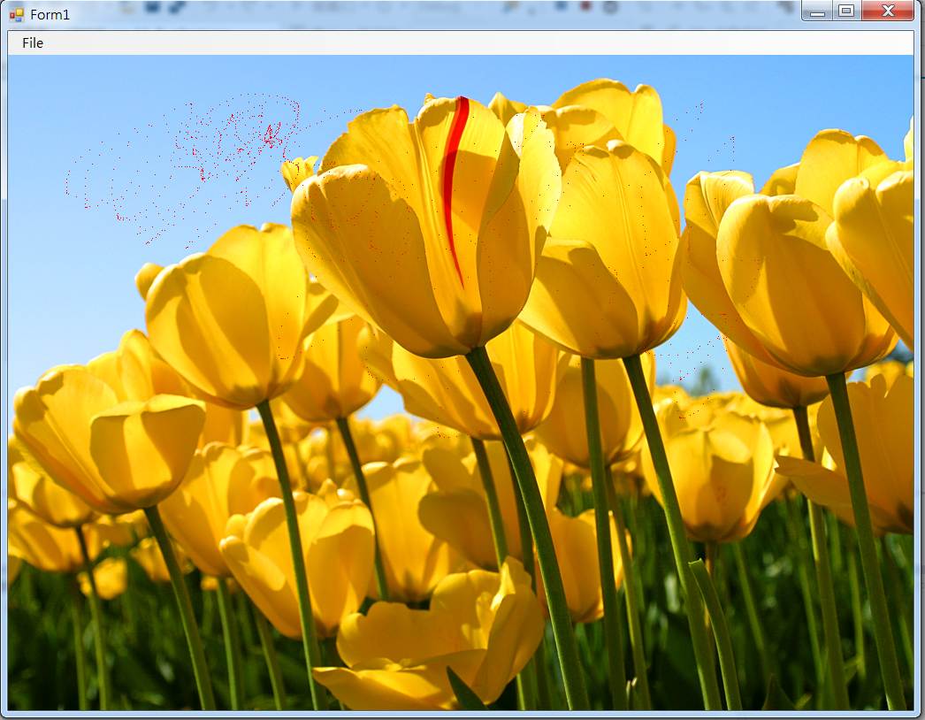

SetPixel example 3

Slide 3
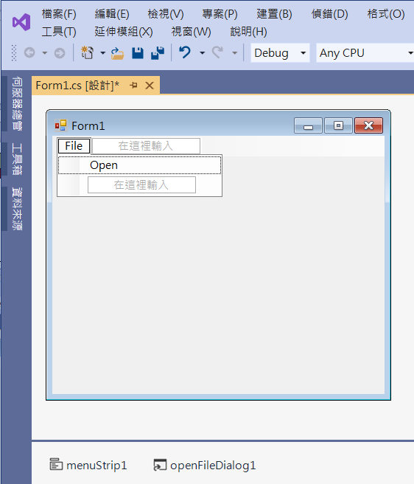
SetPixel example 3
menuStrip1
openFileDialog1

Slide 4
SetPixel example 3
public partial class Form1 : Form
{
Bitmap img, img2; // 影像
public Form1()
{
InitializeComponent();
DoubleBuffered = true;
}

Slide 5
SetPixel example 3
private void OpenToolStripMenuItem_Click(object sender, EventArgs e)
{
if (openFileDialog1.ShowDialog() == DialogResult.OK) // 開啟影像檔
{
String input = openFileDialog1.FileName;
img = (Bitmap)Image.FromFile(input); // 產生一個Image物件
if ((ClientSize.Width < img.Width) || (ClientSize.Height < img.Height))
ClientSize = new Size(img.Width, img.Height);
img2 = (Bitmap)img.Clone();
Invalidate(); // 要求重畫
}
}

Slide 6
SetPixel example 3
private void Form1_Paint(object sender, PaintEventArgs e)
{
if (img2 != null)
{
Rectangle rectDest = new Rectangle(0, 0, img2.Width, img2.Height);
e.Graphics.DrawImage(img2, rectDest);
}
}

Slide 7
SetPixel example 3
private void Form1_MouseMove(object sender, MouseEventArgs e)
{
if (img2 !=null)
{
if (e.Button == MouseButtons.Left) // 滑鼠的左鍵
{
if ((e.X < img2.Width) && (e.Y < img2.Height) && (e.X > 0) && (e.Y > 0))
{
img2.SetPixel(e.X, e.Y, Color.Red);
Invalidate();
}
}
}
}

Slide 8
Exercise#11-5

Slide 9
內容來源
  Visual C# 2012 視窗程式設計：繪圖與遊戲專題(鄞永傳/著; 松崗)

