Slide 1
Window Programming 12-4
陽春版小畫家範例
大小調整(重新取樣)
Yuan Ze University

Slide 2
影像大小調整
影像縮小
  略過某些像素點
  縮小一半
    4個像素點 -> 1個像素點
影像放大
  重複某些像素
  放大一倍
    1個像素點 -> 4個像素點

Slide 3
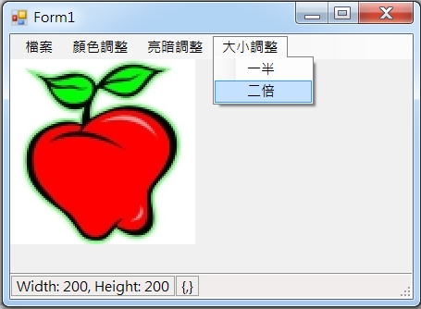
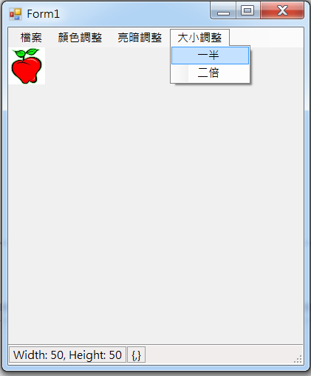
Example

Slide 4
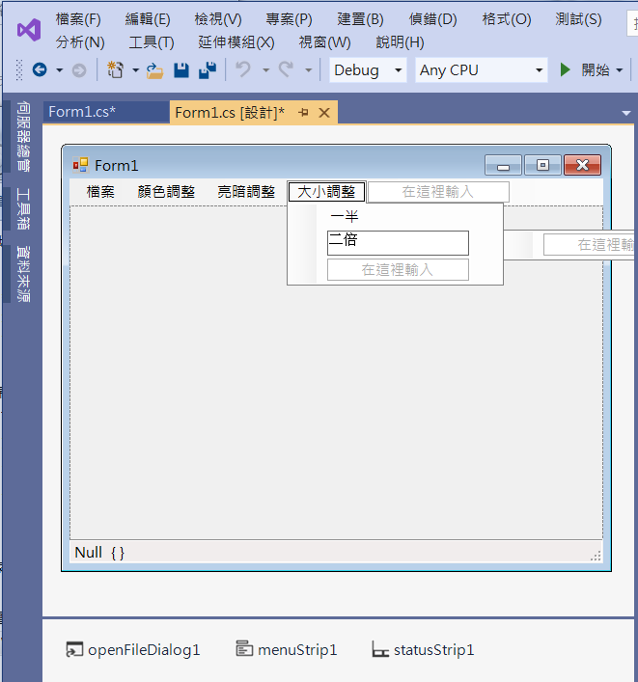
Example
Add menuItems

Slide 5
Example
private void 一半ToolStripMenuItem_Click(object sender, EventArgs e)
{
w = pictureBox1.Image.Width;
h = pictureBox1.Image.Height;
img1 = (Bitmap)pictureBox1.Image;
Bitmap p = new Bitmap(w / 2, h / 2);
for (int i = 0; i < w && (i+2 < w); i += 2)
for (int j = 0; j < h && (j+2 < h); j += 2)
{
Color c = img1.GetPixel(i, j);
int i2 = i / 2;
int j2 = j / 2;
p.SetPixel(i2, j2, c);
}

Slide 6
Example
pictureBox1.Image = p;
img1 = p;
w = p.Width;
h = p.Height;
pictureBox1.Refresh();
toolStripStatusLabel1.Text = "Width: " + w.ToString() + ", Height: " + h.ToString();
}

Slide 7
Example
private void 二倍ToolStripMenuItem_Click(object sender, EventArgs e)
{
w = pictureBox1.Image.Width;
h = pictureBox1.Image.Height;
Bitmap p = new Bitmap(w * 2, h * 2);
img1 = (Bitmap)pictureBox1.Image;
for (int i = 0; i < w; i++)
for (int j = 0; j < h; j++)
{
Color c = img1.GetPixel(i, j);
for (int ii = 0; ii < 2; ii++)
for (int jj = 0; jj < 2; jj++)
p.SetPixel(i * 2 + ii, j * 2 + jj, c); //垂直與水平方向都重複畫兩遍
}

Slide 8
Example
pictureBox1.Image = p;
img1 = p;
w = p.Width;
h = p.Height;
pictureBox1.Refresh();
toolStripStatusLabel1.Text = "Width: " + w.ToString() + ", Height: " + h.ToString();
if ((ClientSize.Width < w) || (ClientSize.Height < (h + 56)))
ClientSize = new Size(w, h + 56);
}

Slide 9
Exercise#12-4

Slide 10
內容來源
  Visual C# 2012 視窗程式設計：繪圖與遊戲專題(鄞永傳/著; 松崗)
  Visual C# 2013視窗程式設計(黃聰明/著; 松崗)
  跟著範例學會Visual C# 2015(張逸中/著; 博碩)

