Slide 1
Window Programming 3-1
Drawing I
GDI+ Data Structures & Drawing Functions
Yuan Ze University

Slide 2
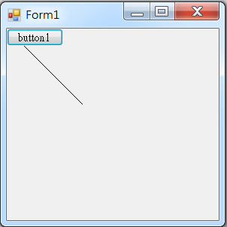
Create Graphics I
public partial class Form1 : Form
{
....
private void Button1_Click(object sender, EventArgs e)
{
Graphics g = this.CreateGraphics();
// Get Form1 as Graphics
g.DrawLine(Pens.Black, 0, 0, 100, 100);
//Draw a line on Form1
}
}

Slide 3
Create Graphics II
private void Form1_Paint(object sender, PaintEventArgs e)
{
Graphics g = e.Graphics; // Get Form1 as Graphics
g.DrawLine(Pens.Black, 0, 0, 100, 100); // Draw a line on Form1
}

Slide 4
Invalidate
Control.Invalidate();
public partial class Form1 : Form
{
....
private void function()
{
Invalidate(); // call Form1 Paint
}
}

Slide 5
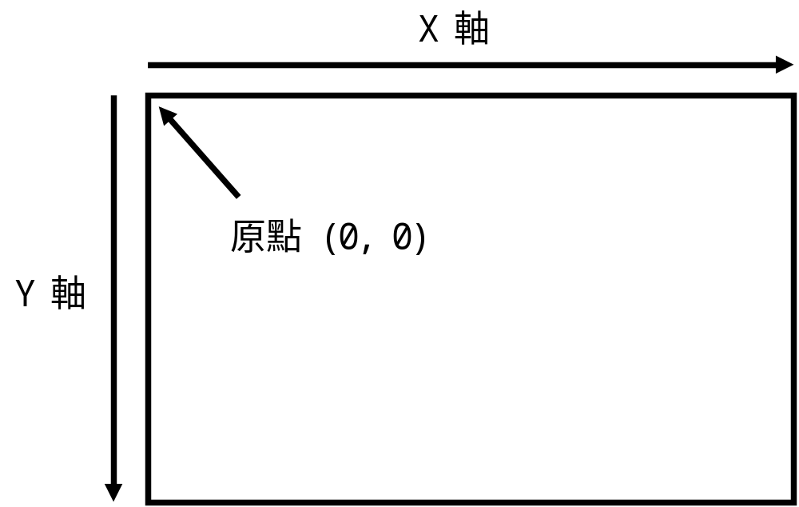
GDI+ coordinates

Slide 6
GDI+ Data Structures
結構 | 說明
Point | 用來記錄一個2D座標位置，有 X、Y兩個整數屬性
PointF | 同Point，不過X、Y是兩個實數屬性
Size | 用來記錄一個寬高性質，有 Width、Height兩個整數屬性
SizeF | 同Size，不過Width、Height是兩個實數屬性
Rectangle | 描述一個矩形區域，有 X、Y、Width、Height四個整數屬性
RectangleF | 同Rectangle，不過X、Y、Width、Height是四個實數屬性

Slide 7
Point
Point a = new Point(10, 20);
a.X = 30; // 存入
a.Y = 40;
Point a = new Point(10, 20);
int x1 = a.X; // 取出
int y1 = a.Y;
Point a = new Point(10, 20);
a.Offset(2, 3); // 偏移修正

Slide 8
PointF
PointF f = new PointF(3.14f, 6.59f);
f.X = 2.78f; // 存入
f.Y = 9.99f;
f = new PointF(2.78f, 9.99f);
float x1 = f.X; // 取出
float y1 = f.Y;

Slide 9
Data structure exchange
Point a = new Point(100, 200);
PointF f = (PointF) a; // (100.0f, 200.0f)
PointF f = new PointF(3.14f, 6.59f);
Point p1 = Point.Ceiling(f); // (4, 7)
Point p2 = Point.Round(f); // (3, 7)
Point p3 = Point.Truncate(f); // (3, 6)

Slide 10
Size
Size
  Width
  Height
Size a = new Size(100, 200);
a.Width=300;
a.Height=400;
a= new Size(400,500);

Slide 11
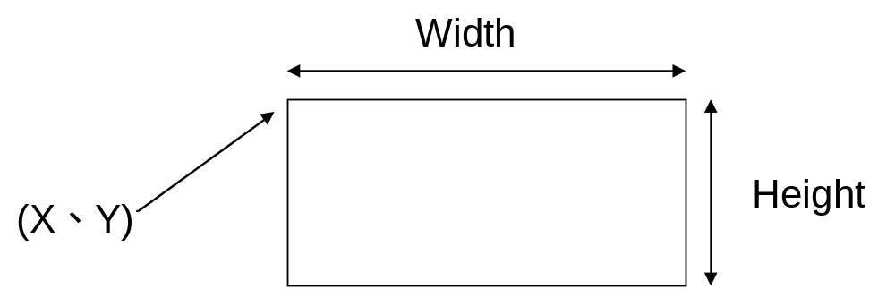
Rectangle
Rectangle a = new Rectangle(10, 20, 100, 200);
Point p =new Point(10,20);
Size s = new Size(100,200);
Rectangle b = new Rectangle(p, s);

Slide 12
Rectangle
Contains 包涵
IntersectsWith 是否交集
Union 聯集
Intersect 交集
  Rectangle A, B;
  Point p;
  bool pointInRect = A.Contains(p);
  bool intersect = A.IntersectsWith(B);
  Rectangle union =Rectangle.Union(rect1, rect2);
  Rectangle intersect =Rectangle.Intersect(rect1, rect2);
Inflate 擴展
  Rectangle rec = new Rectangle(50,50,100,100);
  rec.Inflate(20,30);

Slide 13
GDI+ Drawing Functions

Slide 14
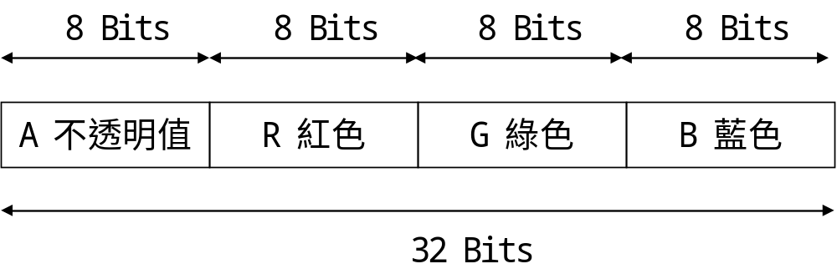
Color
GDI+ Color
  0~255

Slide 15
Default colors
Color c1 = Color.Black; // 黑色
Color c2 = Color.Green; // 綠色
Color c1 = Color.Red; // 紅色
Color c1 = Color.Silver; // 銀灰色
Color c1 = Color.White; // 白色
Color c1 = Color.Yellow; // 黃色

Slide 16
Color.FromArgb()
Color color = Color.FromArgb(128, 255, 0, 0);
Color color = Color.FromArgb(255, 255, 255, 0);
Color color = Color.FromArgb(255, 255, 0);

Slide 17
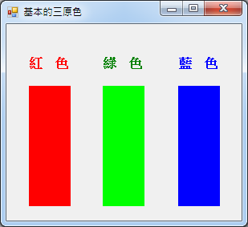
Example
private void Form1_Paint(object sender, PaintEventArgs e)
{
// 標籤元件的前景顏色
label1.ForeColor = Color.Red;
label2.ForeColor = Color.Green;
label3.ForeColor = Color.Blue;
// 面板元件的背景顏色
panel1.BackColor = Color.FromArgb(255, 0, 0);
panel2.BackColor = Color.FromArgb(0, 255, 0);
panel3.BackColor = Color.FromArgb(0, 0, 255);
}

Slide 18
Pen
Pen for drawing lines and curves
Pen pen1 = new Pen(Color.Red); // 紅色畫筆 粗細為 1
Pen pen2 = new Pen(Color.Red, 10); // 紅色畫筆 粗細為 10

Slide 19
DrawLine()
Pen myPen = new Pen(Color.Black, 10);
e.Graphics.DrawLine(myPen, 10, 20, 100, 200);
e.Graphics.DrawLine(myPen, new Point(10, 20), new Point(100, 200));
e.Graphics.DrawLine(myPen, 10.1f, 20.2f, 100.1f, 200.2f);
e.Graphics.DrawLine(myPen, new PointF(10.1f, 20.2f), new PointF(100.1f, 200.2f));

Slide 20
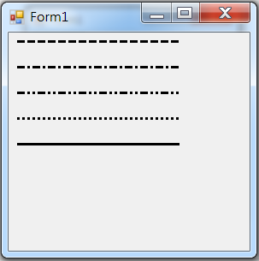
Pen DashStyle
using System.Drawing.Drawing2D;
…
Pen pen1 = new Pen(Color.Black);
pen1.DashStyle = DashStyle.Dash; //虛線
pen1.DashStyle = DashStyle.DashDot; // 虛線-點線
pen1.DashStyle = DashStyle.DashDotDot; // 虛線-點-點線
pen1.DashStyle = DashStyle.Dot; //點線
pen1.DashStyle = DashStyle.Solid; //實線

Slide 21
Pen DashStyle
using System.Drawing.Drawing2D;
private void Form1_Paint(object sender, PaintEventArgs e)
{
Pen pen1 = new Pen(Color.Black, 3); // 黑色畫筆 粗細為 3
pen1.DashStyle = DashStyle.Dash; //虛線
e.Graphics.DrawLine(pen1, 10,10,200,10);
pen1.DashStyle = DashStyle.DashDot; // 虛線-點線
e.Graphics.DrawLine(pen1, 10, 40, 200, 40);
pen1.DashStyle = DashStyle.DashDotDot; // 虛線-點-點線
e.Graphics.DrawLine(pen1, 10, 70, 200, 70);
pen1.DashStyle = DashStyle.Dot; //點線
e.Graphics.DrawLine(pen1, 10, 100, 200, 100);
pen1.DashStyle = DashStyle.Solid; //實線
e.Graphics.DrawLine(pen1, 10, 130, 200, 130);
}

Slide 22
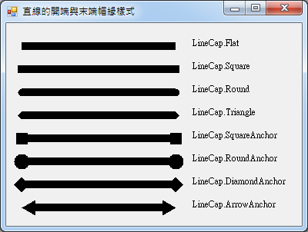
Pen Cap
Pen pen1 = new Pen(Color.Black, 10); // 黑色畫筆 粗細為 10
pen1.StartCap = LineCap.DiamondAnchor; // 箭頭形狀線條端點。開端
pen1.EndCap = LineCap.DiamondAnchor; // 箭頭形狀線條端點。末端

Slide 23
Pen Cap
using System.Drawing.Drawing2D;
private void Form1_Paint(object sender, PaintEventArgs e)
{
Pen pen2 = new Pen(Color.Black, 10); // 黑色畫筆 粗細為 10
int X = 10;
int Y = 160;
pen2.StartCap = LineCap.Flat; // 扁平線條端點。開端
pen2.EndCap = LineCap.Flat; // 扁平線條端點。末端
e.Graphics.DrawLine(pen2, X, Y, X+200, Y);
Y = Y + 30;
pen2.StartCap = LineCap.Square; // 方形線條端點。開端
pen2.EndCap = LineCap.Square; // 方形線條端點。末端
e.Graphics.DrawLine(pen2, X, Y, X + 200, Y);

Slide 24
Pen Cap
Y = Y + 30;
pen2.StartCap = LineCap.Round; // 圓形線條端點。開端
pen2.EndCap = LineCap.Round; // 圓形線條端點。末端
e.Graphics.DrawLine(pen2, X, Y, X + 200, Y);
Y = Y + 30;
pen2.StartCap = LineCap.Triangle; // 三角形線條端點。開端
pen2.EndCap = LineCap.Triangle; // 三角形線條端點。末端
e.Graphics.DrawLine(pen2, X, Y, X + 200, Y);
Y = Y + 30;
pen2.StartCap = LineCap.SquareAnchor; // 方形錨點線條端點。開端
pen2.EndCap = LineCap.SquareAnchor; // 方形錨點線條端點。末端
e.Graphics.DrawLine(pen2, X, Y, X + 200, Y);

Slide 25
Pen Cap
Y = Y + 30;
pen2.StartCap = LineCap.RoundAnchor; // 圓形錨點線條端點。開端
pen2.EndCap = LineCap.RoundAnchor; // 圓形錨點線條端點。末端
e.Graphics.DrawLine(pen2, X, Y, X + 200, Y);
Y = Y + 30;
pen2.StartCap = LineCap.DiamondAnchor; // 鑽石形線條端點。開端
pen2.EndCap = LineCap.DiamondAnchor; // 鑽石形線條端點。末端
e.Graphics.DrawLine(pen2, X, Y, X + 200, Y);
Y = Y + 30;
pen2.StartCap = LineCap.ArrowAnchor; // 箭頭形狀線條端點。開端
pen2.EndCap = LineCap.ArrowAnchor; // 箭頭形狀線條端點。末端
e.Graphics.DrawLine(pen2, X, Y, X + 200, Y);
}

Slide 26
Size
private void Form1_Load(object sender, EventArgs e)
{
Size = new Size(300, 450);
}

Slide 27
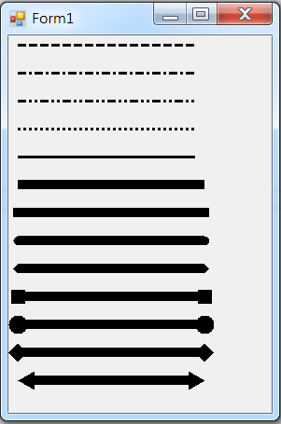
Exercise#3-1

Slide 28
內容來源
  Visual C# 2012 視窗程式設計：繪圖與遊戲專題(鄞永傳/著; 松崗)
  Visual C# 2013視窗程式設計(黃聰明/著; 松崗)
  跟著範例學會Visual C# 2015(張逸中/著; 博碩)

