Slide 1
Window Programming 6-2
An example of ToolStrip
Yuan Ze University

Slide 2
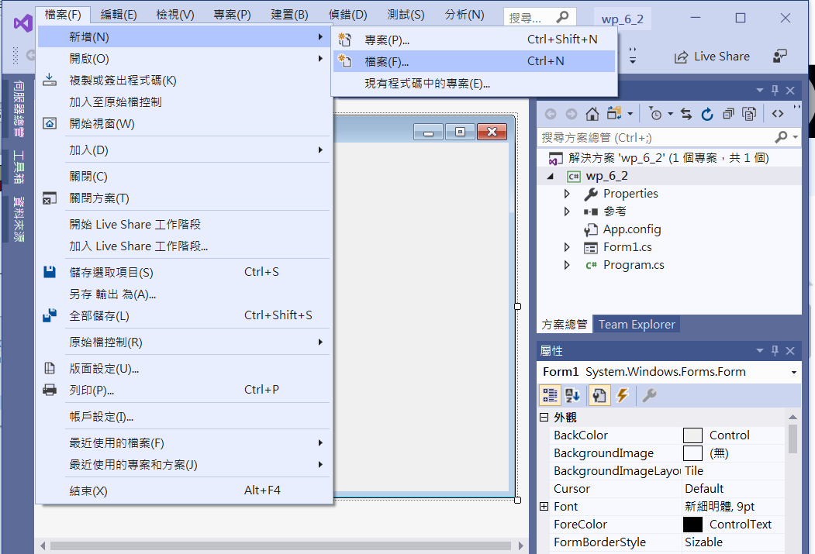
An Example of ToolStrip
Add bitmap for toolStripButton
Add a file

Slide 3
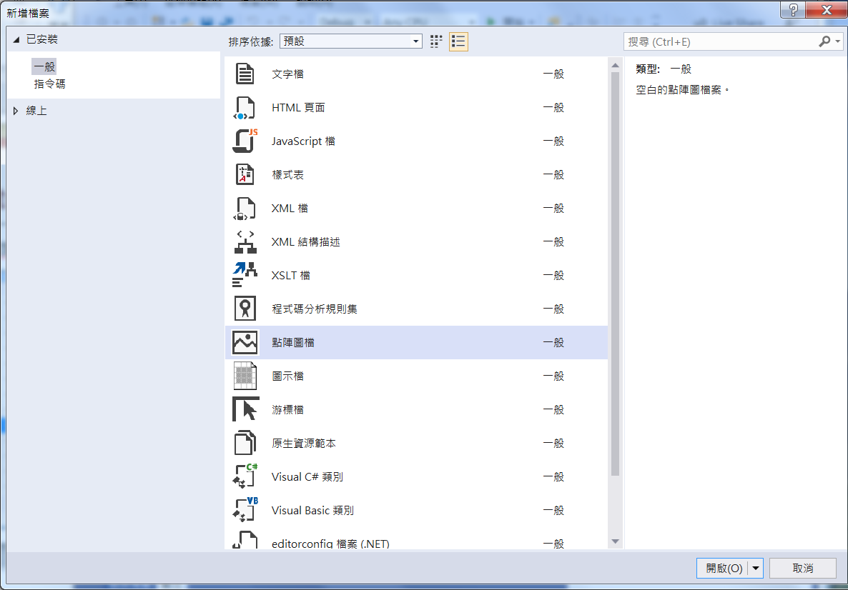
An Example of ToolStrip
Add bitmap for toolStripButton
1. Choose bitmap
2. open

Slide 4
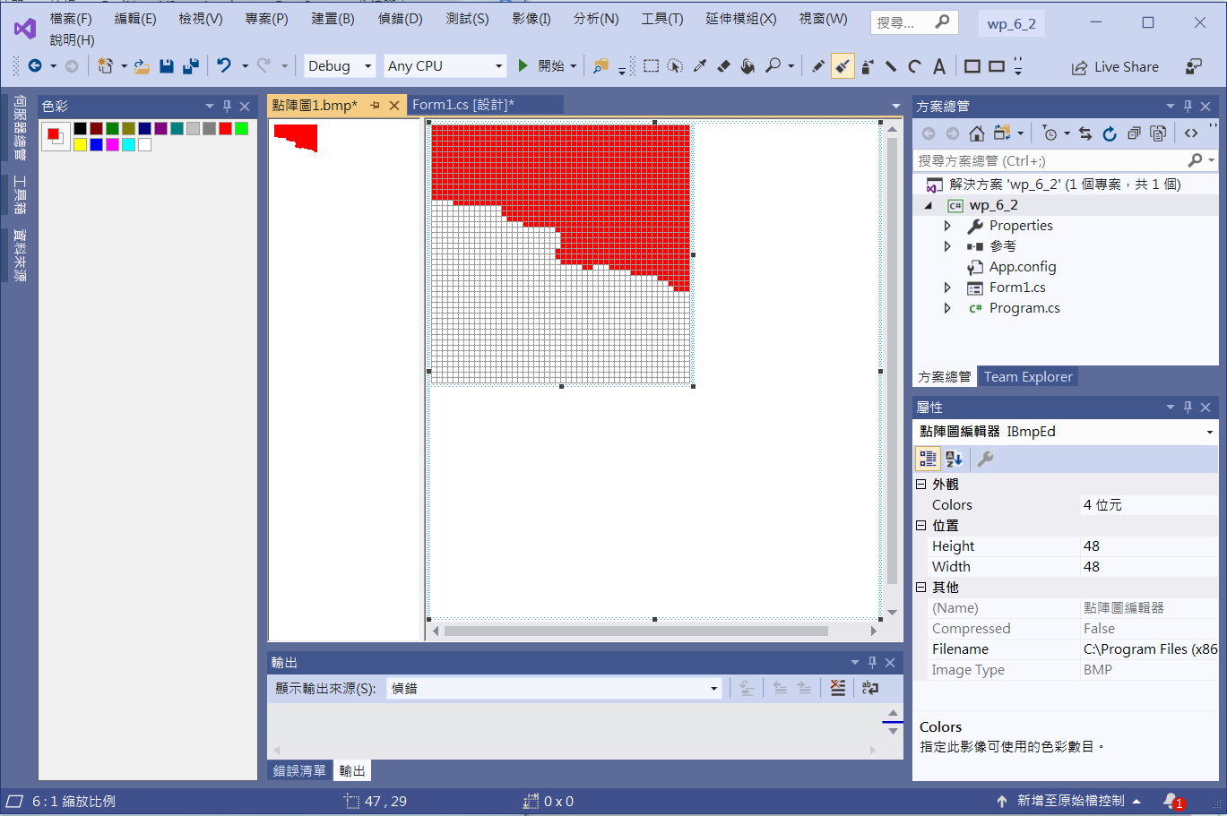
An Example of ToolStrip
1. Click brush
Add bitmap for toolStripButton
4. Save the bitmap
3. Draw the bitmap
2. Choose color

Slide 5
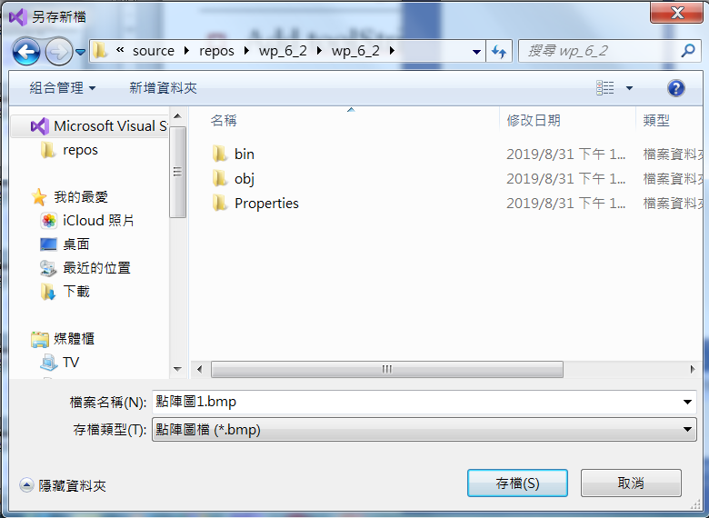
An Example of ToolStrip
Add bitmap for toolStripButton
Save Bitmap at project folder

Slide 6
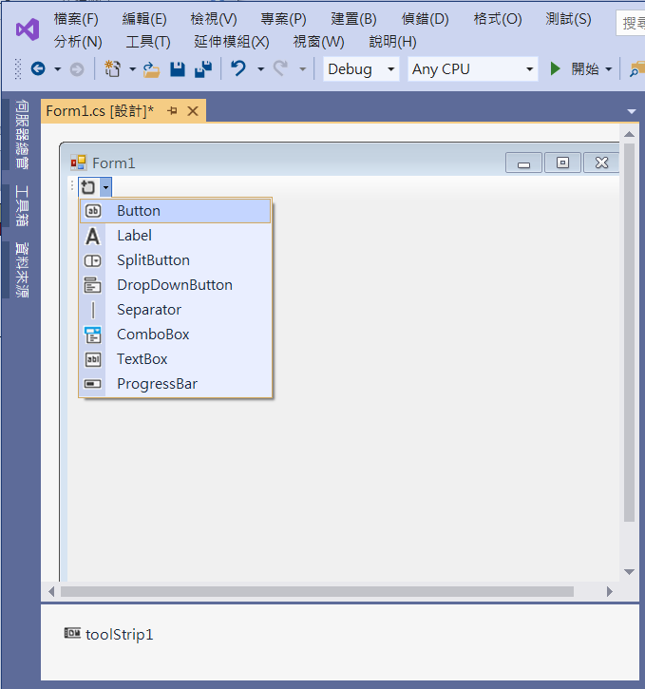
An Example of ToolStrip
Add toolStrip & toolStripButton
2. Add toolStripButton
1. Add toolStrip1

Slide 7
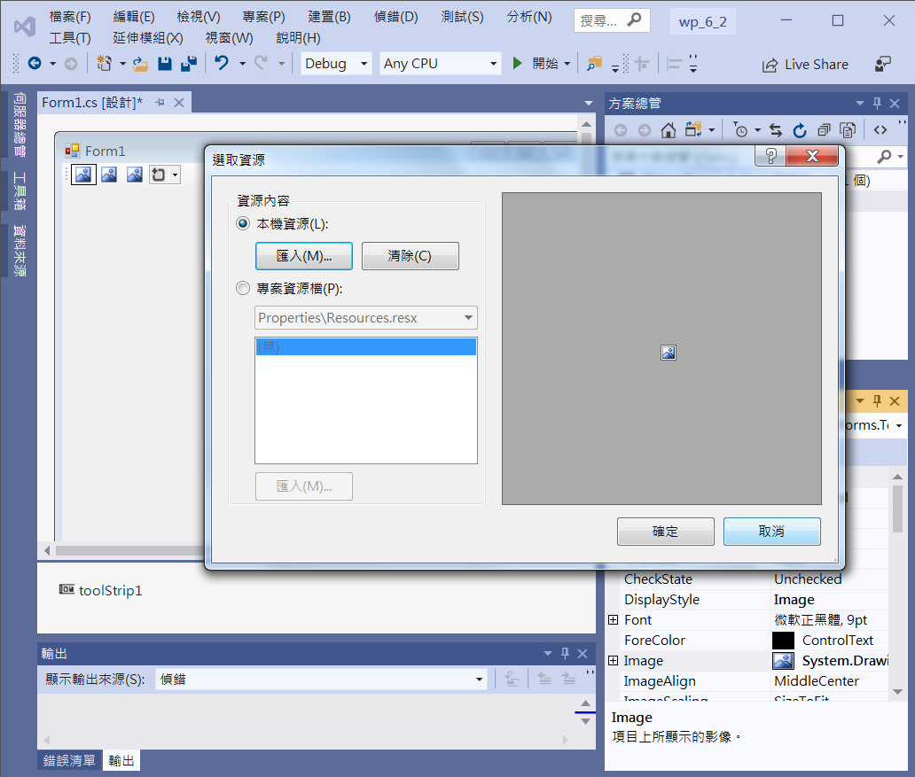
An Example of ToolStrip
Add toolStrip & toolButton
3. Load Bitmap
1. toolStripButton1
2. Image

Slide 8
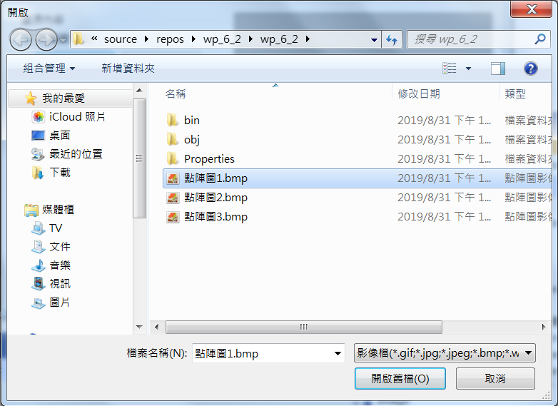
An Example of ToolStrip
Add toolStrip & toolButton
Load Bitmap

Slide 9
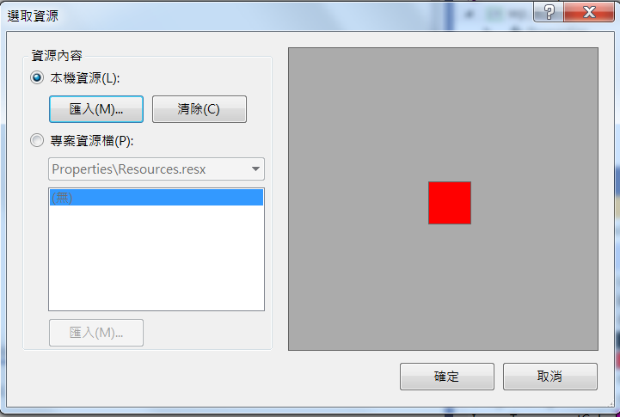
An Example of ToolStrip
Add toolStrip & toolButton
Load Bitmap

Slide 10
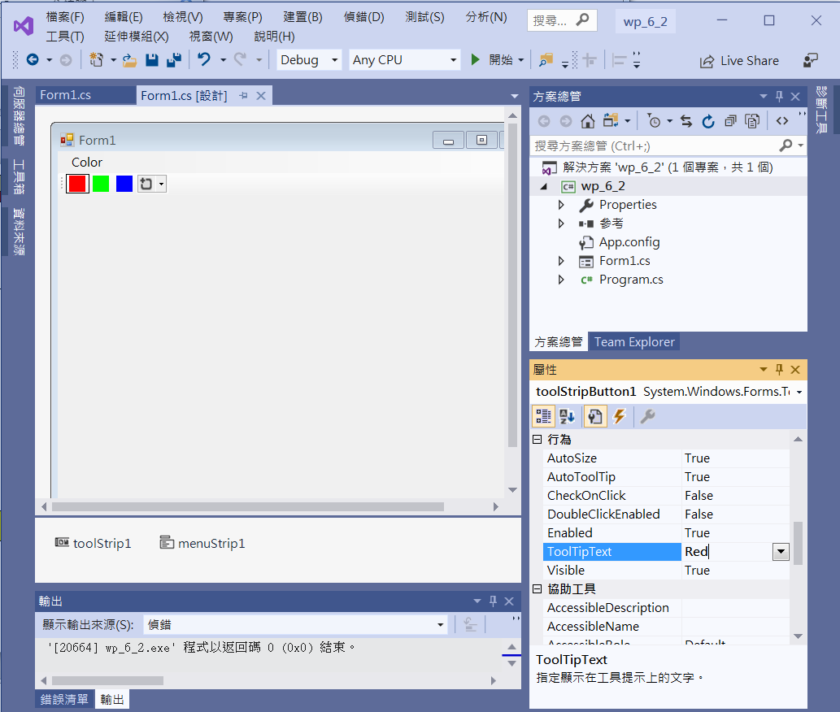
An Example of ToolStrip
Add toolStrip & toolButton
ToolTipText -> Red

Slide 11
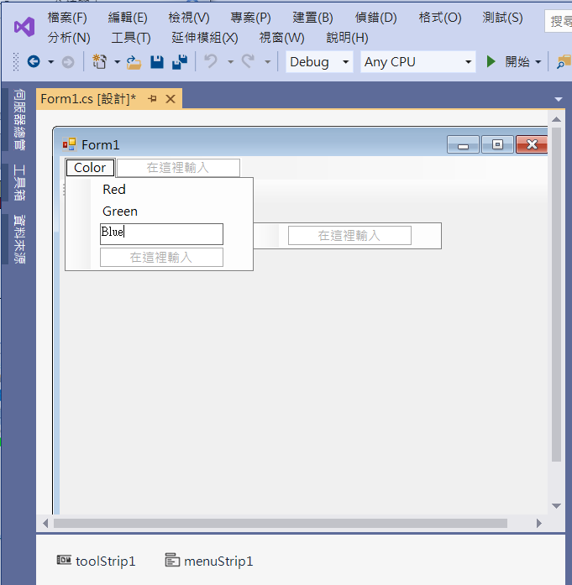
An Example of ToolStrip
Add menuTrip
2. Add 3 items
1. Add menuStrip1

Slide 12
An Example of ToolStrip
public partial class Form1 : Form
{
Color c = Color.Red;
List<Point> startPt= new List<Point>();
List<Point> endPt=new List<Point>();
List<Color> colorPt=new List<Color>();
Point p1;

Slide 13
An Example of ToolStrip
private void Form1_Load(object sender, EventArgs e)
{
redToolStripMenuItem.Checked = true;
toolStripButton1.Checked = true;
}

Slide 14
An Example of ToolStrip
private void RedToolStripMenuItem_Click(object sender, EventArgs e)
{
c = Color.Red;
redToolStripMenuItem.Checked = true;
greenToolStripMenuItem.Checked = false;
blueToolStripMenuItem.Checked = false;
toolStripButton1.Checked = true;
toolStripButton2.Checked = false;
toolStripButton3.Checked = false;
}

Slide 15
An Example of ToolStrip
private void GreenToolStripMenuItem_Click(object sender, EventArgs e)
{
c = Color.Green;
redToolStripMenuItem.Checked = false;
greenToolStripMenuItem.Checked = true;
blueToolStripMenuItem.Checked = false;
toolStripButton1.Checked = false;
toolStripButton2.Checked = true;
toolStripButton3.Checked = false;
}

Slide 16
An Example of ToolStrip
private void BlueToolStripMenuItem_Click(object sender, EventArgs e)
{
c = Color.Blue;
redToolStripMenuItem.Checked = false;
greenToolStripMenuItem.Checked = false;
blueToolStripMenuItem.Checked = true;
toolStripButton1.Checked = false;
toolStripButton2.Checked = false;
toolStripButton3.Checked = true;
}

Slide 17
An Example of ToolStrip
private void ToolStripButton1_Click(object sender, EventArgs e)
{
c = Color.Red;
redToolStripMenuItem.Checked = true;
greenToolStripMenuItem.Checked = false;
blueToolStripMenuItem.Checked = false;
toolStripButton1.Checked = true;
toolStripButton2.Checked = false;
toolStripButton3.Checked = false;
}

Slide 18
An Example of ToolStrip
private void ToolStripButton2_Click(object sender, EventArgs e)
{
c = Color.Green;
redToolStripMenuItem.Checked = false;
greenToolStripMenuItem.Checked = true;
blueToolStripMenuItem.Checked = false;
toolStripButton1.Checked = false;
toolStripButton2.Checked = true;
toolStripButton3.Checked = false;
}

Slide 19
An Example of ToolStrip
private void ToolStripButton3_Click(object sender, EventArgs e)
{
c = Color.Blue;
redToolStripMenuItem.Checked = false;
greenToolStripMenuItem.Checked = false;
blueToolStripMenuItem.Checked = true;
toolStripButton1.Checked = false;
toolStripButton2.Checked = false;
toolStripButton3.Checked = true;
}

Slide 20
An Example of ToolStrip
private void Form1_MouseDown(object sender, MouseEventArgs e)
{
p1 = e.Location;
}
private void Form1_MouseUp(object sender, MouseEventArgs e)
{
startPt.Add(p1);
endPt.Add(e.Location);
colorPt.Add(c);
Invalidate();
}

Slide 21
An Example of ToolStrip
private void Form1_Paint(object sender, PaintEventArgs e)
{
for (int i = 0; i < endPt.Count(); i++)
{
e.Graphics.DrawLine(new Pen(colorPt[i], 1), startPt[i], endPt[i]);
}
}

Slide 22
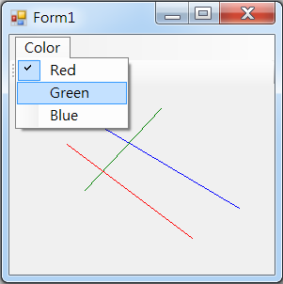
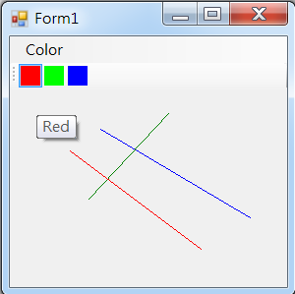
Exercise#6-2

Slide 23
內容來源
  Visual C# 2012 視窗程式設計：繪圖與遊戲專題(鄞永傳/著; 松崗)
  Visual C# 2013視窗程式設計(黃聰明/著; 松崗)
  跟著範例學會Visual C# 2015(張逸中/著; 博碩)

