Slide 1
Window Programming 7-1
Drawing II
Brush
Yuan Ze University

Slide 2
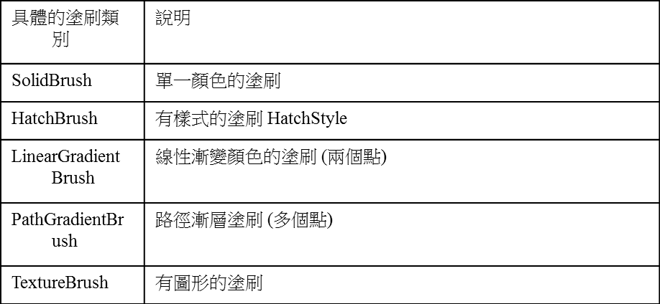
Brush

Slide 3
HatchBrush

Slide 4
HatchBrush
using System.Drawing.Drawing2D;
…
private void Form1_Paint(object sender, PaintEventArgs e)
{
HatchBrush myBrush = new HatchBrush(HatchStyle.Cross,
// 樣式
Color.Yellow , // 前景色彩
Color.Blue); // 背景色彩
e.Graphics.FillEllipse(myBrush, 10, 10, 100, 100);
}

Slide 5
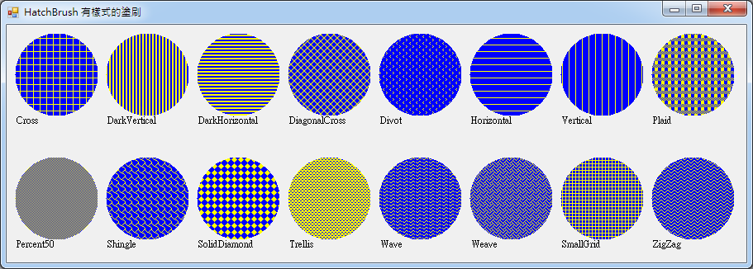
HatchBrush

Slide 6
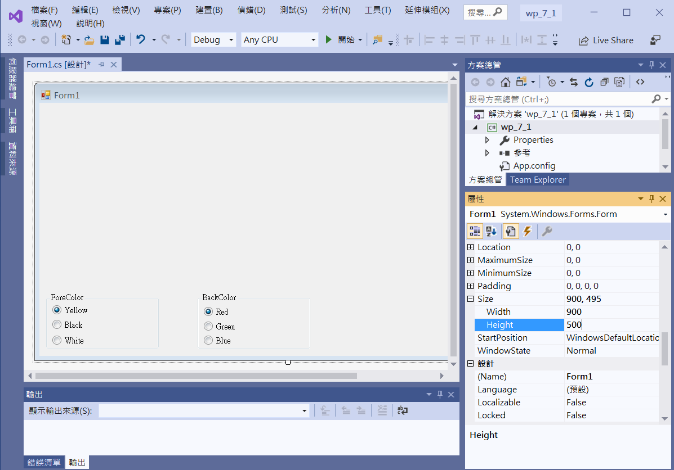
An example of HatchBrush
groupBox1
groupBox2
Form1
Size -> 900, 500
radioButton1
Checked -> true
radioButton4
Checked -> true
radioButton2
radioButton5
radioButton6
radioButton3

Slide 7
An example of HatchBrush
using System;
using System.Collections.Generic;
using System.ComponentModel;
using System.Data;
using System.Drawing;
using System.Linq;
using System.Text;
using System.Threading.Tasks;
using System.Windows.Forms;
using System.Drawing.Drawing2D;

Slide 8
An example of HatchBrush
public partial class Form1 : Form
{
Color color1 = Color.Yellow;
Color color2 = Color.Red;
public Form1()
{
InitializeComponent();
}

Slide 9
An example of HatchBrush
private void Form1_Paint(object sender, PaintEventArgs e)
{
HatchBrush myBrush = new HatchBrush(HatchStyle.Cross, color1, color2);
e.Graphics.FillEllipse(myBrush, 10, 10, 100, 100);
e.Graphics.DrawString("Cross", Font, Brushes.Black, 10, 110);
HatchBrush myBrush2 = new HatchBrush(HatchStyle.DarkVertical, color1, color2);
e.Graphics.FillEllipse(myBrush2, 120, 10, 100, 100);
e.Graphics.DrawString("DarkVertical", Font, Brushes.Black, 120, 110);
HatchBrush myBrush3 = new HatchBrush(HatchStyle.DarkHorizontal, color1, color2);
e.Graphics.FillEllipse(myBrush3, 230, 10, 100, 100);
e.Graphics.DrawString("DarkHorizontal", Font, Brushes.Black, 230, 110);

Slide 10
An example of HatchBrush
HatchBrush myBrush4 = new HatchBrush(HatchStyle.DiagonalCross, color1, color2);
e.Graphics.FillEllipse(myBrush4, 340, 10, 100, 100);
e.Graphics.DrawString("DiagonalCross", Font, Brushes.Black, 340, 110);
HatchBrush myBrush5 = new HatchBrush(HatchStyle.Divot, color1, color2);
e.Graphics.FillEllipse(myBrush5, 450, 10, 100, 100);
e.Graphics.DrawString("Divot", Font, Brushes.Black, 450, 110);
HatchBrush myBrush6 = new HatchBrush(HatchStyle.Horizontal, color1, color2);
e.Graphics.FillEllipse(myBrush6, 560, 10, 100, 100);
e.Graphics.DrawString("Horizontal", Font, Brushes.Black, 560, 110);
HatchBrush myBrush7 = new HatchBrush(HatchStyle.Vertical, color1, color2);
e.Graphics.FillEllipse(myBrush7, 670, 10, 100, 100);
e.Graphics.DrawString("Vertical", Font, Brushes.Black, 670, 110);

Slide 11
An example of HatchBrush
HatchBrush myBrush8 = new HatchBrush(HatchStyle.Plaid, color1, color2);
e.Graphics.FillEllipse(myBrush8, 780, 10, 100, 100);
e.Graphics.DrawString("Plaid", Font, Brushes.Black, 780, 110);
HatchBrush myBrush9 = new HatchBrush(HatchStyle.Percent50, color1, color2);
e.Graphics.FillEllipse(myBrush9, 10, 160, 100, 100);
e.Graphics.DrawString("Percent50", Font, Brushes.Black, 10, 260);
HatchBrush myBrush10 = new HatchBrush(HatchStyle.Shingle, color1, color2);
e.Graphics.FillEllipse(myBrush10, 120, 160, 100, 100);
e.Graphics.DrawString("Shingle", Font, Brushes.Black, 120, 260);
HatchBrush myBrush11 = new HatchBrush(HatchStyle.SolidDiamond, color1, color2);
e.Graphics.FillEllipse(myBrush11, 230, 160, 100, 100);
e.Graphics.DrawString("SolidDiamond", Font, Brushes.Black, 230, 260);

Slide 12
An example of HatchBrush
HatchBrush myBrush12 = new HatchBrush(HatchStyle.Trellis, color1, color2);
e.Graphics.FillEllipse(myBrush12, 340, 160, 100, 100);
e.Graphics.DrawString("Trellis", Font, Brushes.Black, 340, 260);
HatchBrush myBrush13 = new HatchBrush(HatchStyle.Wave, color1, color2);
e.Graphics.FillEllipse(myBrush13, 450, 160, 100, 100);
e.Graphics.DrawString("Wave", Font, Brushes.Black, 450, 260);
HatchBrush myBrush14 = new HatchBrush(HatchStyle.Weave, color1, color2);
e.Graphics.FillEllipse(myBrush14, 560, 160, 100, 100);
e.Graphics.DrawString("Weave", Font, Brushes.Black, 560, 260);

Slide 13
An example of HatchBrush
HatchBrush myBrush15 = new HatchBrush(HatchStyle.SmallGrid, color1, color2);
e.Graphics.FillEllipse(myBrush15, 670, 160, 100, 100);
e.Graphics.DrawString("SmallGrid", Font, Brushes.Black, 670, 260);
HatchBrush myBrush16 = new HatchBrush(HatchStyle.ZigZag, color1, color2);
e.Graphics.FillEllipse(myBrush16, 780, 160, 100, 100);
e.Graphics.DrawString("ZigZag", Font, Brushes.Black, 780, 260);
}
private void Form1_Load(object sender, EventArgs e)
{
Size = new Size(900, 500);
}

Slide 14
An example of HatchBrush
private void RadioButton1_CheckedChanged(object sender, EventArgs e)
{
color1 = Color.Yellow;
Invalidate();
}
private void RadioButton2_CheckedChanged(object sender, EventArgs e)
{
color1 = Color.Black;
Invalidate();
}

Slide 15
An example of HatchBrush
private void RadioButton3_CheckedChanged(object sender, EventArgs e)
{
color1 = Color.White;
Invalidate();
}
private void RadioButton4_CheckedChanged(object sender, EventArgs e)
{
color2 = Color.Red;
Invalidate();
}

Slide 16
An example of HatchBrush
private void RadioButton5_CheckedChanged(object sender, EventArgs e)
{
color2 = Color.Green;
Invalidate();
}
private void RadioButton6_CheckedChanged(object sender, EventArgs e)
{
color2 = Color.Blue;
Invalidate();
}

Slide 17
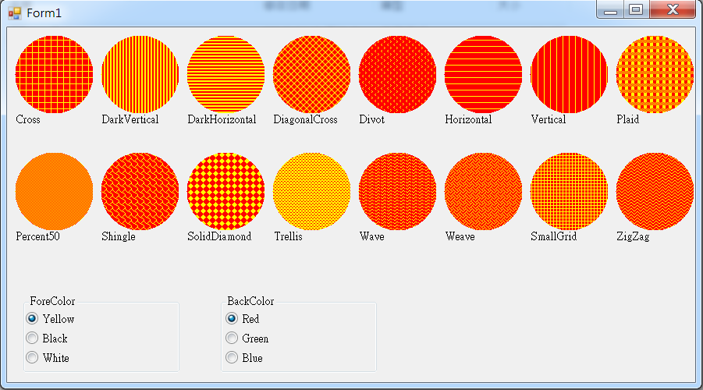

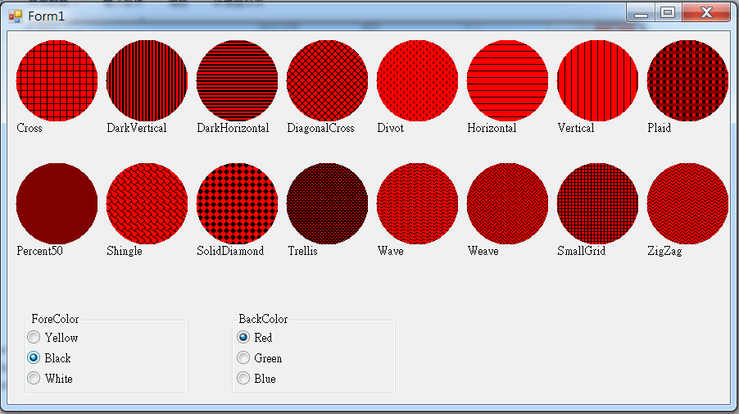
Exercise#7-1

Slide 18
內容來源
  Visual C# 2012 視窗程式設計：繪圖與遊戲專題(鄞永傳/著; 松崗)
  Visual C# 2013視窗程式設計(黃聰明/著; 松崗)
  跟著範例學會Visual C# 2015(張逸中/著; 博碩)

