Slide 1
Window Programming 7-2
LinearGardientBrush
Yuan Ze University

Slide 2
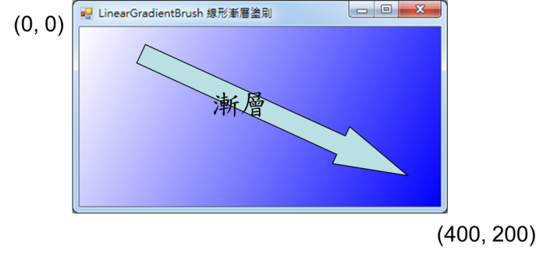
LinearGardientBrush(線形漸層塗刷)
using System.Drawing.Drawing2D;
…
private void Form1_Paint(object sender, PaintEventArgs e)
{
LinearGradientBrush lbrush = new LinearGradientBrush(
new Point(0, 0), // 開始的位置
new Point(400,200),// 結束的位置
Color.White, // 第一種顏色
Color.Blue); // 第二種顏色
e.Graphics.FillRectangle(lbrush, 0, 0, 400, 200);
}

Slide 3
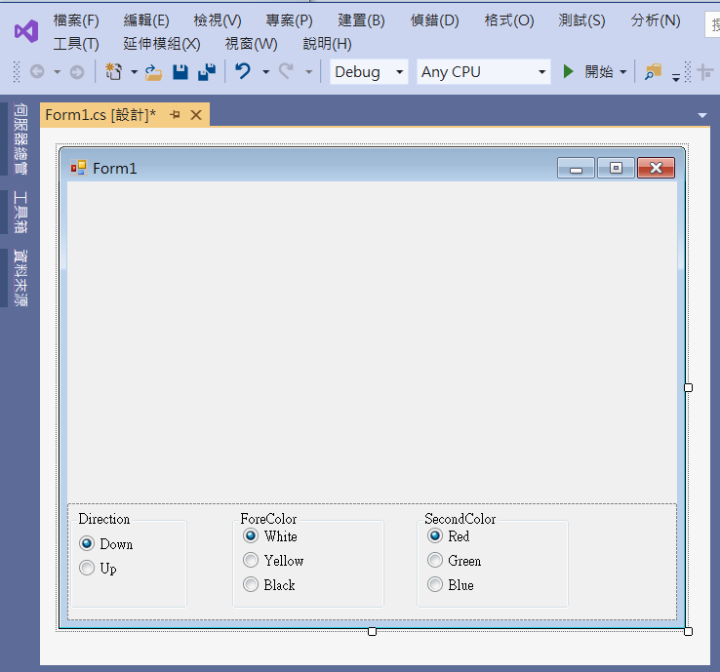
An example of LinearGardientBrush
2. groupBox1
1. panel1
Dock -> Bottom
3. groupBox2
4. groupBox3
radioButton1
Checked -> true
radioButton6
Checked -> true
radioButton2
radioButton7
radioButton8

Slide 4
An example of LinearGardientBrush
using System;
using System.Collections.Generic;
using System.ComponentModel;
using System.Data;
using System.Drawing;
using System.Linq;
using System.Text;
using System.Threading.Tasks;
using System.Windows.Forms;
using System.Drawing.Drawing2D;

Slide 5
An example of LinearGardientBrush
public partial class Form1 : Form
{
int x, y;
Color color1, color2;
Point p1, p2;
public Form1()
{
InitializeComponent();
}

Slide 6
An example of LinearGardientBrush
private void Form1_Paint(object sender, PaintEventArgs e)
{
LinearGradientBrush lb = new LinearGradientBrush(p1, p2, color1, color2);
e.Graphics.FillRectangle(lb, 0, 0, x, y);
}

Slide 7
An example of LinearGardientBrush
private void Form1_Load(object sender, EventArgs e)
{
x = 180;
y = 180;
color1 = Color.White;
color2 = Color.Red;
p1 = new Point(0, 0);
p2 = new Point(x, y);
Size = new Size(400, 400);
}

Slide 8
An example of LinearGardientBrush
private void RadioButton1_CheckedChanged(object sender, EventArgs e)
{
p1 = new Point(0, 0);
p2 = new Point(x, y);
Invalidate();
}
private void RadioButton2_CheckedChanged(object sender, EventArgs e)
{
p1 = new Point(x, y);
p2 = new Point(0, 0);
Invalidate();
}

Slide 9
An example of LinearGardientBrush
private void RadioButton3_CheckedChanged(object sender, EventArgs e)
{
color1 = Color.White;
Invalidate();
}
private void RadioButton4_CheckedChanged(object sender, EventArgs e)
{
color1 = Color.Yellow;
Invalidate();
}

Slide 10
An example of LinearGardientBrush
private void RadioButton5_CheckedChanged(object sender, EventArgs e)
{
color1 = Color.Black;
Invalidate();
}
private void RadioButton6_CheckedChanged(object sender, EventArgs e)
{
color2 = Color.Red;
Invalidate();
}

Slide 11
An example of LinearGardientBrush
private void RadioButton7_CheckedChanged(object sender, EventArgs e)
{
color2 = Color.Green;
Invalidate();
}
private void RadioButton8_CheckedChanged(object sender, EventArgs e)
{
color2 = Color.Blue;
Invalidate();
}

Slide 12

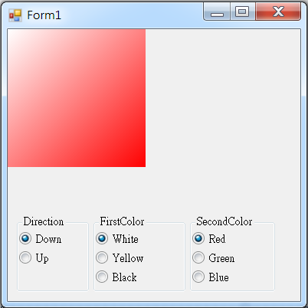
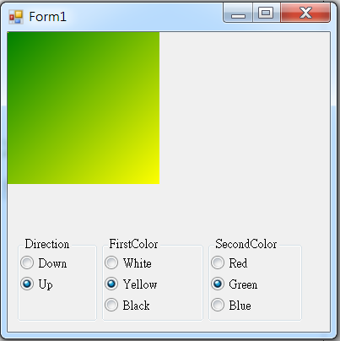
Exercise#7-2

Slide 13
內容來源
  Visual C# 2012 視窗程式設計：繪圖與遊戲專題(鄞永傳/著; 松崗)
  Visual C# 2013視窗程式設計(黃聰明/著; 松崗)
  跟著範例學會Visual C# 2015(張逸中/著; 博碩)

