Slide 1
Window Programming 9-2
Thumbnail
Yuan Ze University

Slide 2
Thumbnail
縮小圖
imgThumbnail = img.GetThumbnailImage(50, (int)(50 * img.Height / img.Width), null, (IntPtr)0);
等比例縮小

Slide 3
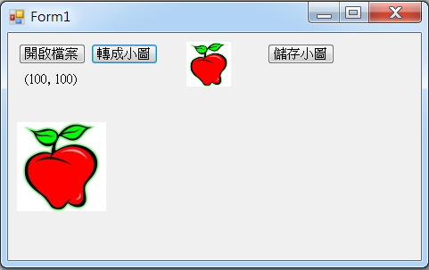
Thumbnail example

Slide 4
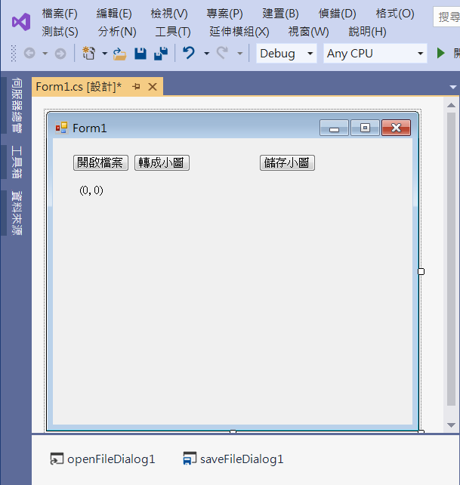
Thumbnail example
button2
button3
button1
label1
openFileDialog1
saveFileDialog1

Slide 5
Thumbnail example
public partial class Form1 : Form
{
Image img; // Image 影像
Image imgThumbnail; // Image 影像 小圖
public Form1()
{
InitializeComponent();
}

Slide 6
Thumbnail example
private void Button1_Click(object sender, EventArgs e)
{
if (openFileDialog1.ShowDialog() == DialogResult.OK) // 開啟影像檔
{
String input = openFileDialog1.FileName;
img = Image.FromFile(input); // 產生一個Image物件
// 呈現 影像 的寬高資訊
label1.Text = "(" + img.Width.ToString() + ", " + img.Height.ToString() + ")";
Invalidate(); // 要求重畫
}
}

Slide 7
Thumbnail example
private void Button2_Click(object sender, EventArgs e)
{
imgThumbnail = img.GetThumbnailImage(50, (int)(50 * img.Height / img.Width), null, (IntPtr)0);
Invalidate(); // 要求重畫
}

Slide 8
Thumbnail example
private void Button3_Click(object sender, EventArgs e)
{
if (saveFileDialog1.ShowDialog() == DialogResult.OK) // 儲存影像檔
{
String output = saveFileDialog1.FileName;
imgThumbnail.Save(output);
}
}

Slide 9
Thumbnail example
private void Form1_Paint(object sender, PaintEventArgs e)
{
if (img != null) // 呈現 Image 影像
e.Graphics.DrawImage(img, 10, 100, img.Width, img.Height);
if (imgThumbnail != null) // 呈現 Image 影像 小圖
e.Graphics.DrawImage(imgThumbnail, 200, 10, imgThumbnail.Width, imgThumbnail.Height);
}

Slide 10
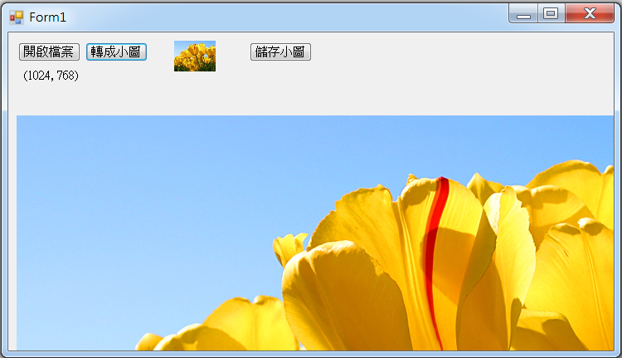
Exercise#9-2

Slide 11
內容來源
  Visual C# 2012 視窗程式設計：繪圖與遊戲專題(鄞永傳/著; 松崗)
  跟著範例學會Visual C# 2015(張逸中/著; 博碩)

