Slide 1
Window Programming 9-7
Integrated Image Example
Yuan Ze University

Slide 2
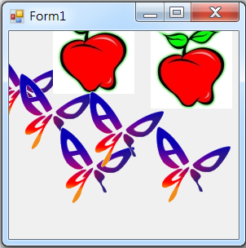
Integrated Image Example

Slide 3
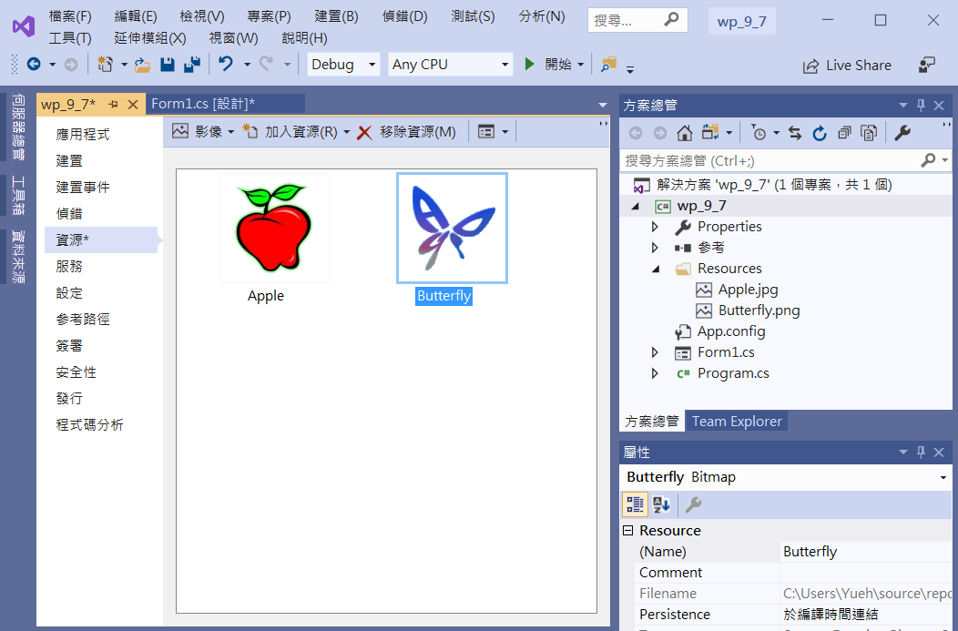
Integrated Image Example
Add 2 images to resource

Slide 4
Integrated Image Example
public partial class Form1 : Form
{
Image img1 = Properties.Resources.Apple;
Image img2 = Properties.Resources.Butterfly;
public Form1()
{
InitializeComponent();
}

Slide 5
Integrated Image Example
private void Form1_MouseDown(object sender, MouseEventArgs e)
{
if (e.Button==MouseButtons.Right) // Click at right button
{
Graphics g1=CreateGraphics();
g1.DrawImage(img1, e.X-img1.Width/2, e.Y-img1.Height/2, img1.Width, img1.Height);
}
else
{
Graphics g1 = CreateGraphics();
g1.DrawImage(img2, e.X - img2.Width / 2, e.Y - img2.Height / 2, img2.Width, img2.Height);
}
}

Slide 6
Exercise#9-7

Slide 7
內容來源
  Visual C# 2012 視窗程式設計：繪圖與遊戲專題(鄞永傳/著; 松崗)
  跟著範例學會Visual C# 2015(張逸中/著; 博碩)

