Slide 1
Window Programming 3-3
Drawing I
DrawRectangle
Yuan Ze University

Slide 2
DrawRectangle()
e.Graphics.DrawRectangle(Pens.Black, 30, 20, 300, 100);
Rectangle rec = new Rectangle(30, 20, 300, 100);
e.Graphics.DrawRectangle(Pens.Black, rec);
(30, 20)
100
300

Slide 3
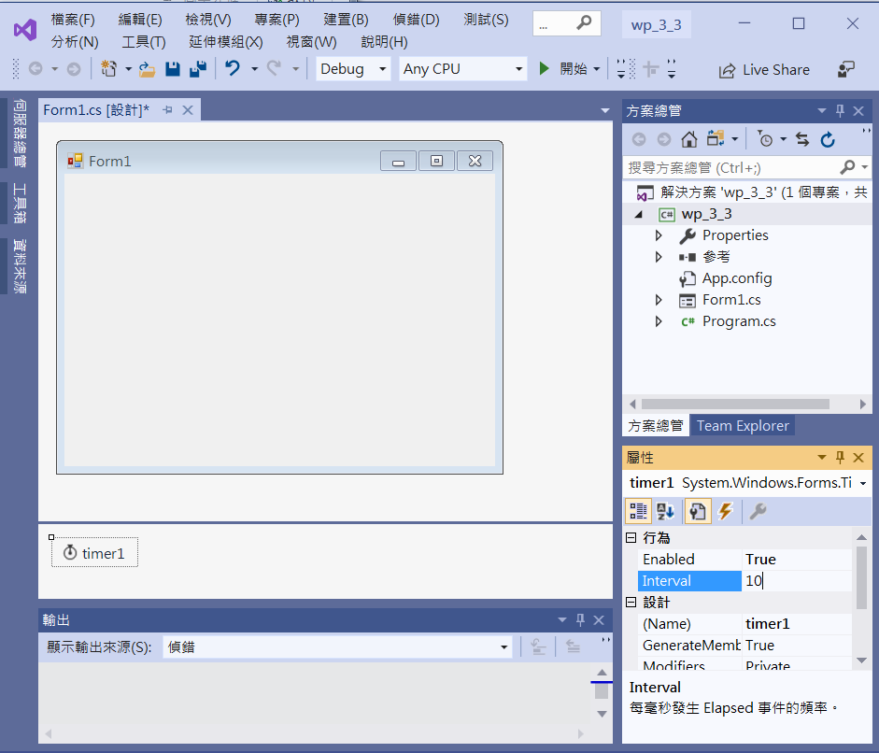
An example of DrawRectangle
Enabled -> True
timer1
Interval -> 10

Slide 4
An example of DrawRectangle
public partial class Form1 : Form
{ Rectangle rect; // 矩形區域
int D = 1; // 增加的速度
public Form1()
{
InitializeComponent();
int x = this.ClientSize.Width / 2; // 視窗客戶區的中心點
int y = this.ClientSize.Height / 2;
rect = new Rectangle(x - 50, y - 50, 100, 100); // 寬高100的矩形區域
}
// 表單重畫
private void Form1_Paint(object sender, PaintEventArgs e)
{
e.Graphics.DrawRectangle(Pens.Black, rect); // 繪出矩形
}

Slide 5
An example of DrawRectangle
// 計時器函數
private void Timer1_Tick(object sender, EventArgs e)
{
if (rect.Bottom >= this.ClientSize.Height ||
rect.Top <= 0 || rect.Left <=0 || rect.Right >= this.ClientSize.Width)
// 已經擴張到邊界
D = -1; // 反向 收縮
else if (rect.Height < 10) // 已經收縮到 高為 10
D = 1; // 反向 擴張
rect.Inflate(D, D); // 擴張 或 收縮 矩形區域
Invalidate(); // 要求重畫
}
}

Slide 6
An example of DrawRectangle
private void Form1_Resize(object sender, EventArgs e)
{
int x = this.ClientSize.Width / 2; // 視窗客戶區的中心點
int y = this.ClientSize.Height / 2;
rect = new Rectangle(x - 50, y - 50, 100, 100); // 寬高100的矩形區域
}

Slide 7
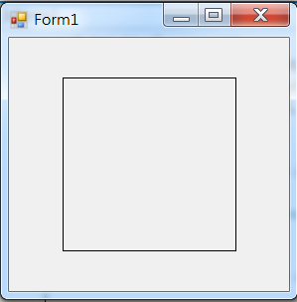
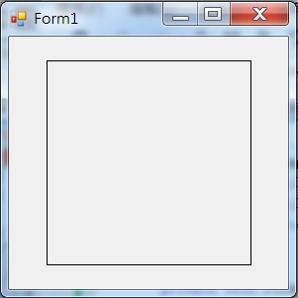
Exercise#3-3

Slide 8
內容來源
  Visual C# 2012 視窗程式設計：繪圖與遊戲專題(鄞永傳/著; 松崗)
  Visual C# 2013視窗程式設計(黃聰明/著; 松崗)
  跟著範例學會Visual C# 2015(張逸中/著; 博碩)

