Slide 1
Window Programming 7-3
PathGradienBrush
Yuan Ze University

Slide 2
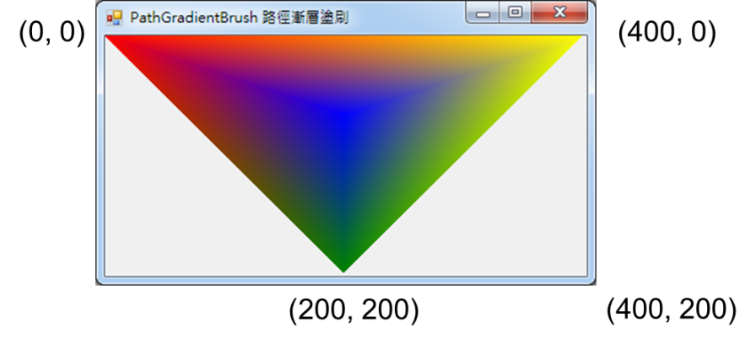
PathGradienBrush(路徑漸層塗刷)
using System.Drawing.Drawing2D;
…
private void Form1_Paint(object sender, PaintEventArgs e)
{
Point[] pt = new Point[3]; // 路徑
pt[0] = new Point(0, 0);
pt[1] = new Point(200, 200);
pt[2] = new Point(400, 0);
PathGradientBrush lbrush = new PathGradientBrush(pt);
lbrush.CenterColor = Color.Blue; // 中央顏色
Color[] colorArray = new Color[] {
Color.Red,
Color.Green,
Color.Yellow};
lbrush.SurroundColors = colorArray; // 路徑周遭各個點座標的顏色
e.Graphics.FillRectangle(lbrush, 0, 0, 400, 200);
}

Slide 3
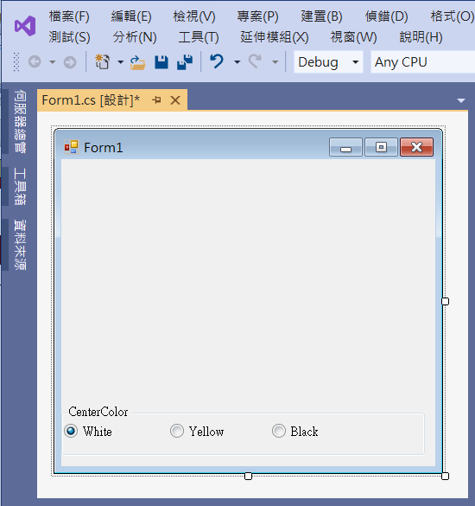
An example of PathGradienBrush
1. groupBox1
radioButton2
radioButton1
Checked -> true
radioButton3

Slide 4
An example of PathGradienBrush
using System;
using System.Collections.Generic;
using System.ComponentModel;
using System.Data;
using System.Drawing;
using System.Linq;
using System.Text;
using System.Threading.Tasks;
using System.Windows.Forms;
using System.Drawing.Drawing2D;

Slide 5
An example of PathGradienBrush
public partial class Form1 : Form
{
Color c;
public Form1()
{
InitializeComponent();
}
private void Form1_Load(object sender, EventArgs e)
{
c = Color.White;
Size = new Size(320, 320);
}

Slide 6
An example of PathGradienBrush
private void Form1_Paint(object sender, PaintEventArgs e)
{
Point[] pt = new Point[3];
pt[0] = new Point(0, 0);
pt[1] = new Point(150, 150);
pt[2] = new Point(300, 0);
PathGradientBrush pb = new PathGradientBrush(pt);
pb.CenterColor = c;
Color[] colorArray = new Color[] { Color.Red, Color.Green, Color.Blue};
pb.SurroundColors = colorArray;
e.Graphics.FillRectangle(pb, 0, 0, 300, 150);
}

Slide 7
An example of PathGradienBrush
private void RadioButton1_CheckedChanged(object sender, EventArgs e)
{
c = Color.White;
Invalidate();
}
private void RadioButton2_CheckedChanged(object sender, EventArgs e)
{
c = Color.Yellow;
Invalidate();
}

Slide 8
An example of PathGradienBrush
private void RadioButton3_CheckedChanged(object sender, EventArgs e)
{
c = Color.Black;
Invalidate();
}

Slide 9
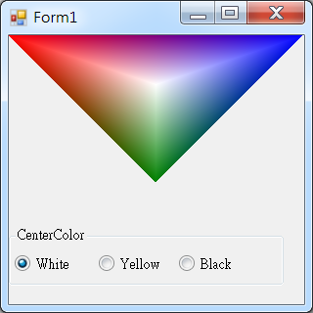
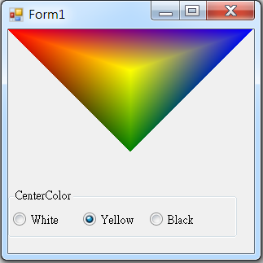
Exercise#7-3

Slide 10
內容來源
  Visual C# 2012 視窗程式設計：繪圖與遊戲專題(鄞永傳/著; 松崗)
  Visual C# 2013視窗程式設計(黃聰明/著; 松崗)
  跟著範例學會Visual C# 2015(張逸中/著; 博碩)

