Slide 1
Window Programming 7-5
An example of TextureBrush(刮刮樂)
Yuan Ze University

Slide 2
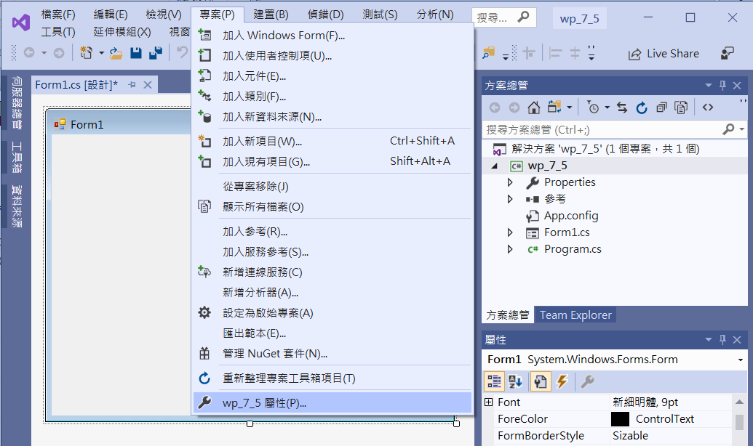
An example of TextureBrush (刮刮樂)
1. Click project
2. Click Property

Slide 3
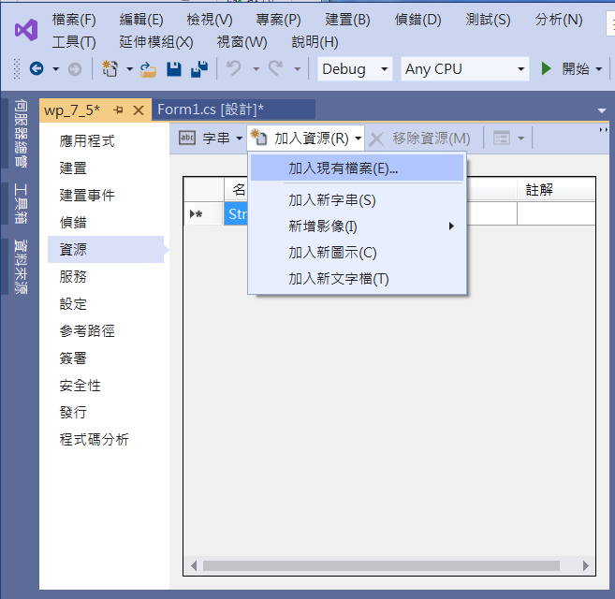
An example of TextureBrush
2. Click
Add a File
1. Click resource

Slide 4
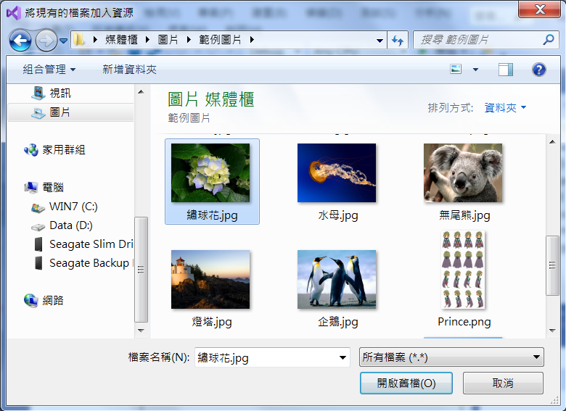
An example of TextureBrush
1. Click a file
2. Click
open the File

Slide 5
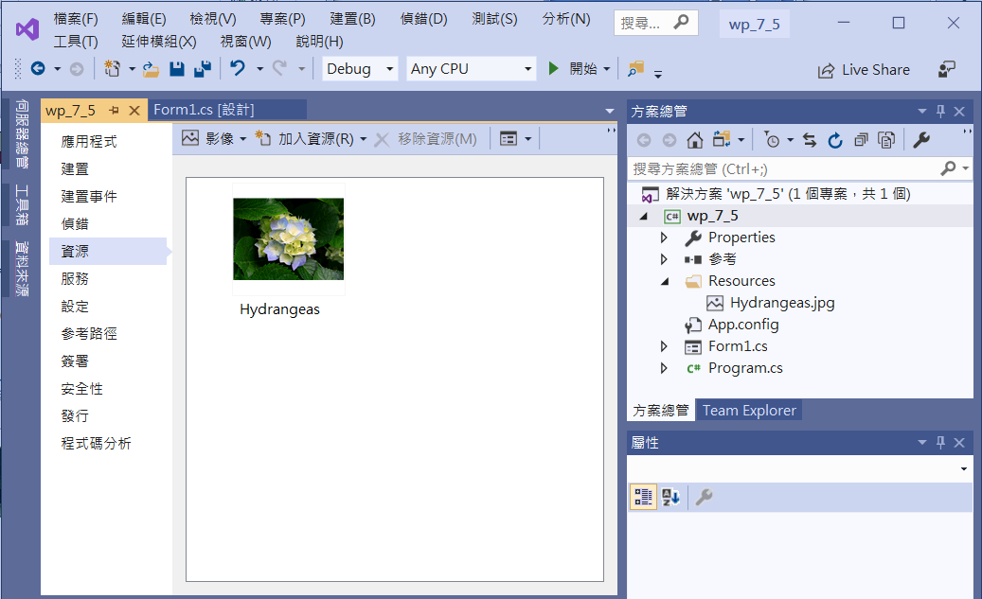
An example of TextureBrush

Slide 6
An example of TextureBrush
public partial class Form1 : Form
{
Bitmap image;
TextureBrush textureBrush;
Pen myPen;
int x, y; // 紀錄上一個筆畫的起始點
Graphics G; // 畫布物件

Slide 7
An example of TextureBrush
public Form1()
{
InitializeComponent();
image = new Bitmap(Properties.Resources.Hydrangeas);
textureBrush = new TextureBrush(image);
myPen = new Pen(textureBrush, 40);
ClientSize = new Size(image.Width, image.Height);
}

Slide 8
An example of TextureBrush
private void Form1_MouseDown(object sender, MouseEventArgs e)
{
x = e.X; // 紀錄筆畫的起始點
y = e.Y;
}

Slide 9
An example of TextureBrush
private void Form1_MouseMove(object sender, MouseEventArgs e)
{
if (e.Button == MouseButtons.Left) // 滑鼠的左鍵
{
G = CreateGraphics();
G.DrawLine(myPen, x, y, e.X, e.Y); // 寫到 buffer
x = e.X; // 結束點 就是 下一次的 開始點
y = e.Y;
}
}

Slide 10

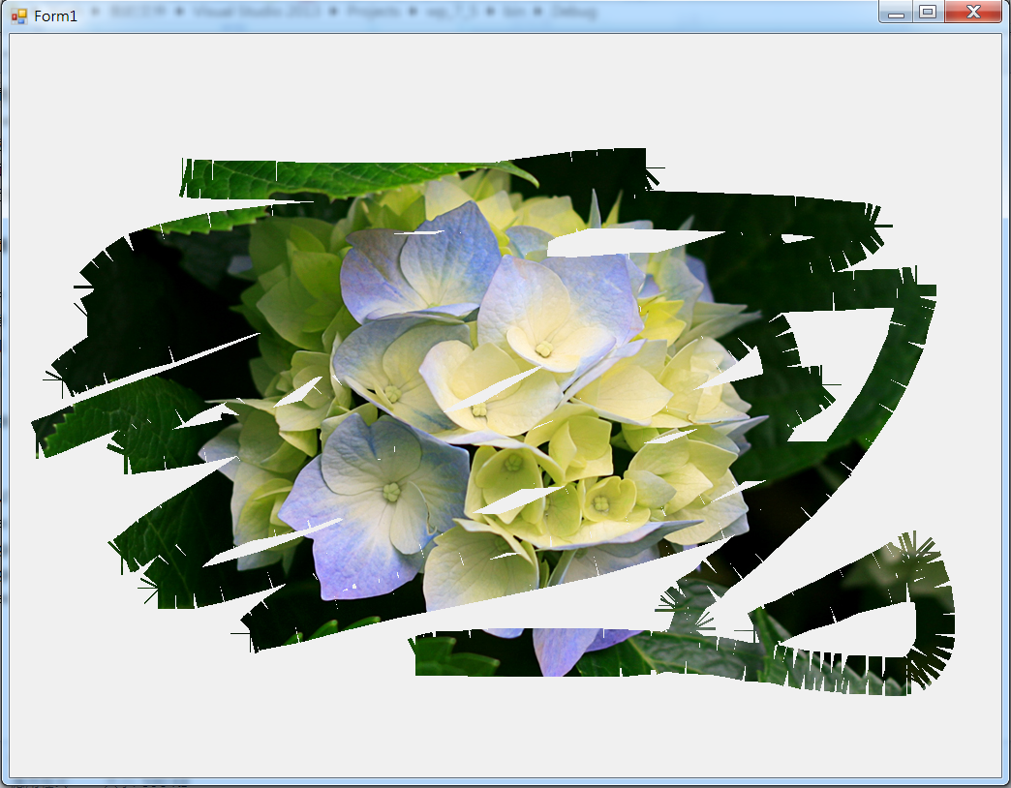
Exercise#7-5

Slide 11
內容來源
  Visual C# 2012 視窗程式設計：繪圖與遊戲專題(鄞永傳/著; 松崗)
  Visual C# 2013視窗程式設計(黃聰明/著; 松崗)
  跟著範例學會Visual C# 2015(張逸中/著; 博碩)

