Slide 1
Window Programming 8-8
Drawing III
Clock example 2
Yuan Ze University

Slide 2
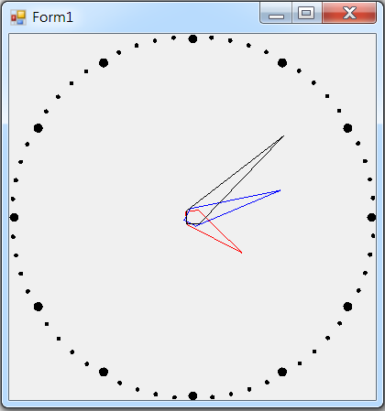
Clock example 2

Slide 3
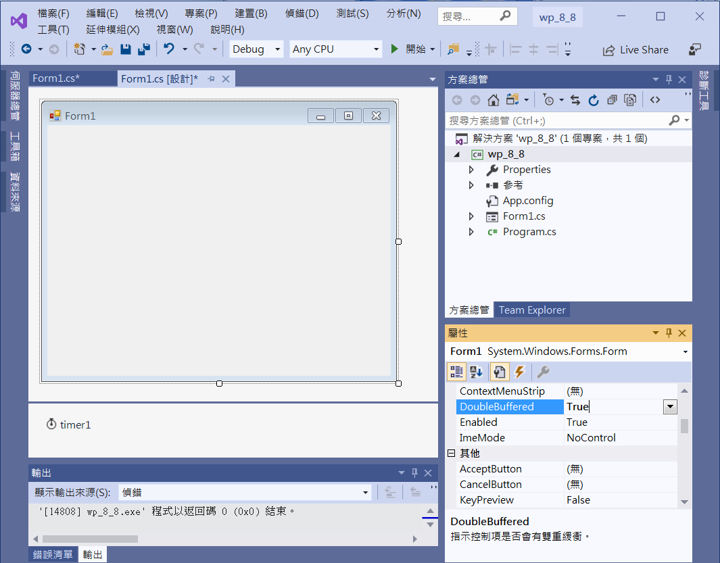
Clock example 2
Form1
DoubleBuffered -> True
timer1

Slide 4
Clock example 2
using System;
using System.Collections.Generic;
using System.ComponentModel;
using System.Data;
using System.Drawing;
using System.Linq;
using System.Text;
using System.Threading.Tasks;
using System.Windows.Forms;
using System.Drawing.Drawing2D;

Slide 5
Clock example 2
public partial class Form1 : Form
{
Point[] pt1 = new Point[4];
Point[] pt2 = new Point[4];
Point[] pt3 = new Point[4];
int len;

Slide 6
Clock example 2
void adjustSize()
{
len = this.ClientSize.Width > this.ClientSize.Height ? this.ClientSize.Height : this.ClientSize.Width;
pt1[0] = new Point(0, 10);
pt1[1] = new Point(10, 0);
pt1[2] = new Point(0, -len / 6);
pt1[3] = new Point(-10, 0);
pt2[0] = new Point(0, 10);
pt2[1] = new Point(10, 0);
pt2[2] = new Point(0, -len / 4);
pt2[3] = new Point(-10, 0);
pt3[0] = new Point(0, 10);
pt3[1] = new Point(10, 0);
pt3[2] = new Point(0, -len / 3);
pt3[3] = new Point(-10, 0);
}

Slide 7
Clock example 2
private void Form1_Load(object sender, EventArgs e)
{
ClientSize = new Size(400, 400);
timer1.Interval = 1000;
timer1.Start();
adjustSize();
}
private void Timer1_Tick(object sender, EventArgs e)
{
Invalidate(); // 要求重畫
}

Slide 8
Clock example 2
private void Form1_Paint(object sender, PaintEventArgs e)
{
e.Graphics.TranslateTransform(this.ClientSize.Width / 2,
this.ClientSize.Height / 2);
for(int i=0;i<60;i++)
{
int size=i%5==0?10:5;
e.Graphics.FillEllipse(new SolidBrush(Color.Black), 0 - size / 2, len / 2 - size, size, size);
e.Graphics.RotateTransform(6);
}
DateTime t = DateTime.Now; // 目前的時間
// 繪出 時針
e.Graphics.ResetTransform();
e.Graphics.TranslateTransform(this.ClientSize.Width / 2, this.ClientSize.Height / 2);
// 旋轉表單畫布 1個小時為30度 要把分鐘轉為小時的小數部分
e.Graphics.RotateTransform(((t.Hour % 12) + (t.Minute / 60.0f)) * 30.0f);
e.Graphics.DrawPolygon(new Pen(Color.Red), pt1);

Slide 9
Clock example 2
// 繪出 分針
e.Graphics.ResetTransform();
e.Graphics.TranslateTransform(this.ClientSize.Width / 2, this.ClientSize.Height / 2);
// 旋轉表單畫布 1分鐘為6度 要把秒數轉為分鐘的小數部分
e.Graphics.RotateTransform((t.Minute + t.Second / 60.0f) * 6.0f);
e.Graphics.DrawPolygon(new Pen(Color.Blue), pt2);
// 繪出 秒針
e.Graphics.ResetTransform();
e.Graphics.TranslateTransform(this.ClientSize.Width / 2, this.ClientSize.Height / 2);
// 旋轉表單畫布 1秒鐘為6度
e.Graphics.RotateTransform(t.Second * 6.0f);
e.Graphics.DrawPolygon(new Pen(Color.Black), pt3);
}

Slide 10
Clock example 2
private void Form1_Resize(object sender, EventArgs e)
{
adjustSize();
Invalidate();
}

Slide 11
Exercise#8-8

Slide 12
內容來源
  Visual C# 2012 視窗程式設計：繪圖與遊戲專題(鄞永傳/著; 松崗)
  Visual C# 2013視窗程式設計(黃聰明/著; 松崗)
  跟著範例學會Visual C# 2015(張逸中/著; 博碩)

