Slide 1
Window Programming 11-6
Region
Union, Intersect, Exclude, XOR
Yuan Ze University

Slide 2
Region
圖形軌跡(GraphicsPath)的區域表面
  GraphicsPath gp= new GraphicsPath();
  …
  Region rgn;
  Rgn= new Region(gp);
IsVisible
  是否在區域內部
聯集
  Region r1 = new Region(gp1); // Region 區域表面 物件
  Region r2 = new Region(gp2); // Region 區域表面 物件
  r1.Union(r2);

Slide 3
Region
交集
  r1.Intersect(r2);
排除
  r1.Exclude(r2);
XOR
  r1.XOR(r2);

Slide 4
Region
FillRegion 以畫刷填滿區域
e.Graphics.FillRegion(Brushes.Red, region1);

Slide 5
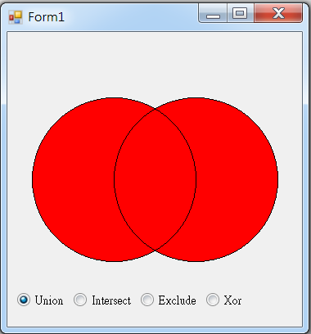
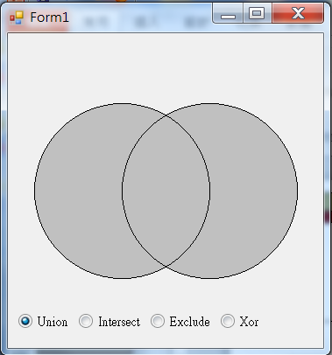
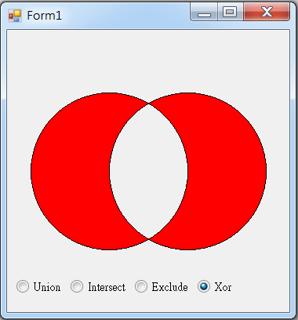
Region example

Slide 6
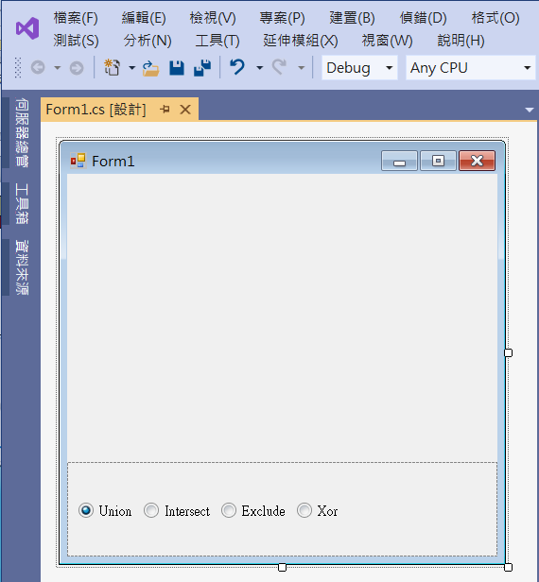
Region example
panel1
Dock -> bottom
radioButton2
radioButton1

Slide 7
Region example
using System;
using System.Collections.Generic;
using System.ComponentModel;
using System.Data;
using System.Drawing;
using System.Linq;
using System.Text;
using System.Threading.Tasks;
using System.Windows.Forms;
using System.Drawing.Drawing2D;

Slide 8
Region example
public partial class Form1 : Form
{
Region r1, r2;
bool inRegion=false;
GraphicsPath gp1, gp2;
public Form1()
{
InitializeComponent();
ClientSize = new Size(360, 360);
generateRegion();
}

Slide 9
Region example
void generateRegion()
{
int Cx = ClientSize.Width / 2; // 視窗客戶區的中心點
int Cy = ClientSize.Height / 2;
gp1 = new GraphicsPath(); // 圖形軌跡
gp1.AddEllipse(Cx - 50 - 100, Cy - 100, 200, 200);
gp2 = new GraphicsPath(); // 圖形軌跡
gp2.AddEllipse(Cx + 50 - 100, Cy - 100, 200, 200);
r1 = new Region(gp1); // Region 區域表面 物件
r2 = new Region(gp2); // Region 區域表面 物件

Slide 10
Region example
if (radioButton1.Checked)
r1.Union(r2); // r1 = r1 + r2 聯集
else if (radioButton2.Checked)
r1.Intersect(r2); // r1 = r1 - r2 交集
else if (radioButton3.Checked)
r1.Exclude(r2); // r1 = r1 - r2 排除
else
if (radioButton4.Checked)
r1.Xor(r2); // r1 = r1 + r2 - (r1 Intersect r2) 互斥
}

Slide 11
Region example
private void Form1_Paint(object sender, PaintEventArgs e)
{
if (inRegion)
e.Graphics.FillRegion(Brushes.Red, r1); // r1 區域表面 繪出
else
e.Graphics.FillRegion(Brushes.Silver, r1); // r1 區域表面 繪出
e.Graphics.DrawPath(Pens.Black, gp1); // 圖形軌跡 繪出
e.Graphics.DrawPath(Pens.Black, gp2); // 圖形軌跡 繪出
}

Slide 12
Region example
private void RadioButton1_CheckedChanged(object sender, EventArgs e)
{
generateRegion();
Invalidate();
}
private void Form1_Resize(object sender, EventArgs e)
{
generateRegion();
Invalidate();
}
For radioButton1~ radioButton4

Slide 13
Region example
private void Form1_MouseMove(object sender, MouseEventArgs e)
{
if (r1.IsVisible(e.Location) && (inRegion == false))
{
inRegion = true;
Invalidate();
}
else if (!r1.IsVisible(e.Location) && (inRegion == true))
{
inRegion = false;
Invalidate();
}
}

Slide 14
Exercise#11-6

Slide 15
內容來源
  Visual C# 2012 視窗程式設計：繪圖與遊戲專題(鄞永傳/著; 松崗)

