Slide 1
Window Programming 13-5
RichTextBox記事本範例
RTF、讀檔、存檔、另存新檔
Yuan Ze University

Slide 2
RichTextBox
RTF (Rich Text Format)格式
可儲存顏色、字型、圖片
Message
  Clear
  LoadFile
  SaveFile
Attributes
  Rtf

Slide 3
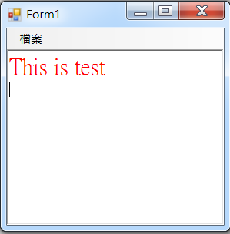
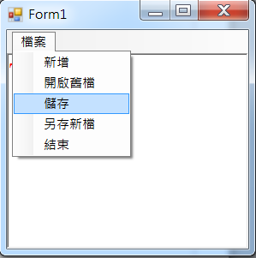
RichTextBox記事本範例

Slide 4
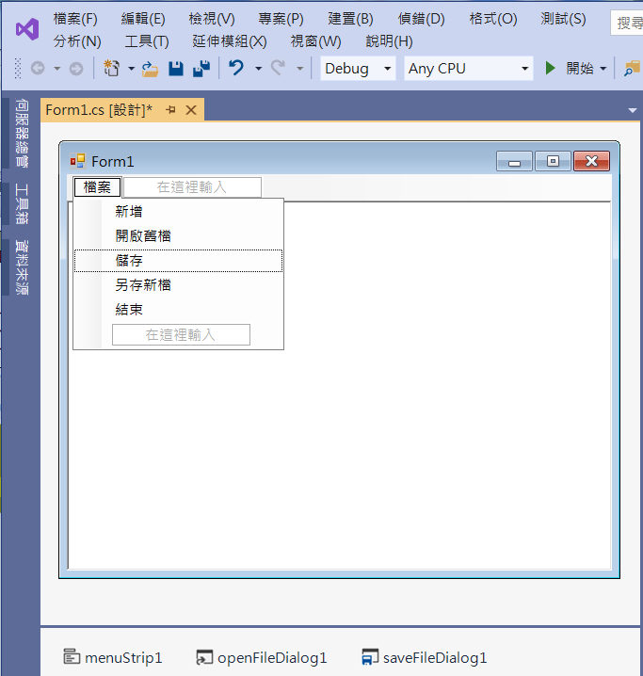
RichTextBox記事本範例
5. richTextBox1
Dock -> fill
2. Add menuitems
3. openFileDialog1
4. saveFileDialog1
1. menuStrip1

Slide 5
RichTextBox記事本範例
using System;
using System.Collections.Generic;
using System.ComponentModel;
using System.Data;
using System.Drawing;
using System.Linq;
using System.Text;
using System.Threading.Tasks;
using System.Windows.Forms;
using System.IO; //File

Slide 6
RichTextBox記事本範例
private void 新增ToolStripMenuItem_Click(object sender, EventArgs e)
{
openFileDialog1.FileName = "";
richTextBox1.Clear();
}

Slide 7
RichTextBox記事本範例
private void 開啟舊檔ToolStripMenuItem_Click(object sender, EventArgs e)
{
if (openFileDialog1.ShowDialog() == DialogResult.OK)
{
if (Path.GetExtension(openFileDialog1.FileName) == ".txt")
richTextBox1.LoadFile(openFileDialog1.FileName, RichTextBoxStreamType.PlainText);
else
richTextBox1.LoadFile(openFileDialog1.FileName);
}
}

Slide 8
RichTextBox記事本範例
private void 儲存ToolStripMenuItem_Click(object sender, EventArgs e)
{
if (openFileDialog1.FileName == "")
{
if (saveFileDialog1.ShowDialog() == DialogResult.OK)
{
richTextBox1.SaveFile(saveFileDialog1.FileName);
openFileDialog1.FileName = saveFileDialog1.FileName;
}
}
else
{
richTextBox1.SaveFile(openFileDialog1.FileName);
}
}

Slide 9
RichTextBox記事本範例
private void 另存新檔ToolStripMenuItem_Click(object sender, EventArgs e)
{
if (saveFileDialog1.ShowDialog() == DialogResult.OK)
{
richTextBox1.SaveFile(saveFileDialog1.FileName);
openFileDialog1.FileName = saveFileDialog1.FileName;
}
}

Slide 10
RichTextBox記事本範例
private void 結束ToolStripMenuItem_Click(object sender, EventArgs e)
{
Application.Exit();
}
private void Form1_Load(object sender, EventArgs e)
{
openFileDialog1.FileName = "";
openFileDialog1.Filter = "RTF檔案(*.rtf); 純文字檔案(*.txt)|*.rtf;*.txt";
saveFileDialog1.Filter = "RTF檔案|*.rtf";
}

Slide 11
Exercise#13-5

Slide 12
內容來源
  跟著範例學會Visual C# 2015(張逸中/著; 博碩)
  Visual C# 2013視窗程式設計(黃聰明/著; 松崗)

