Slide 1
Window Programming 4-6
Menu
ContextMenuStrip
Yuan Ze University

Slide 2
ContextMenuStrip
Connect to any component
Click at right button on the component
Component
  Attribute: ContextMenuStrip

Slide 3
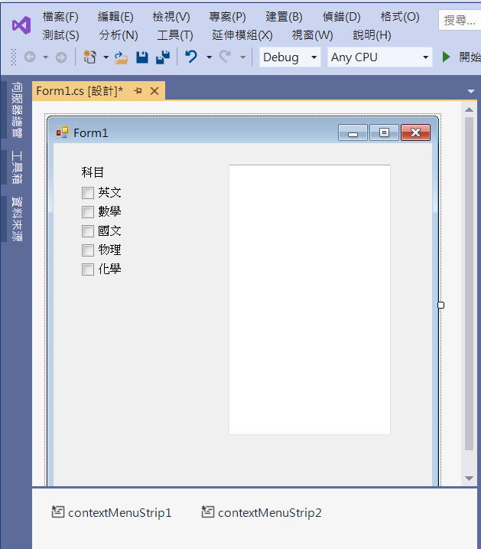
An example of ContextMenuStrip
label1
textBox1
Multiline -> true
checkBox1
checkBox5
contextMenuStrip1
contextMenuStrip2

Slide 4
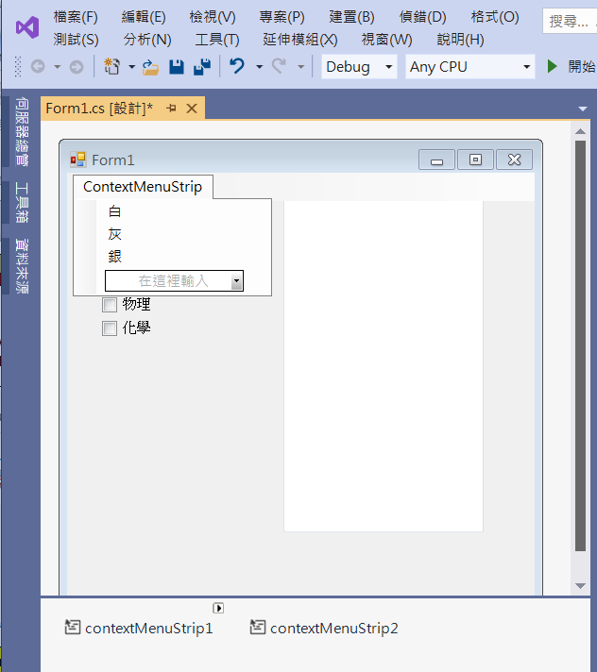
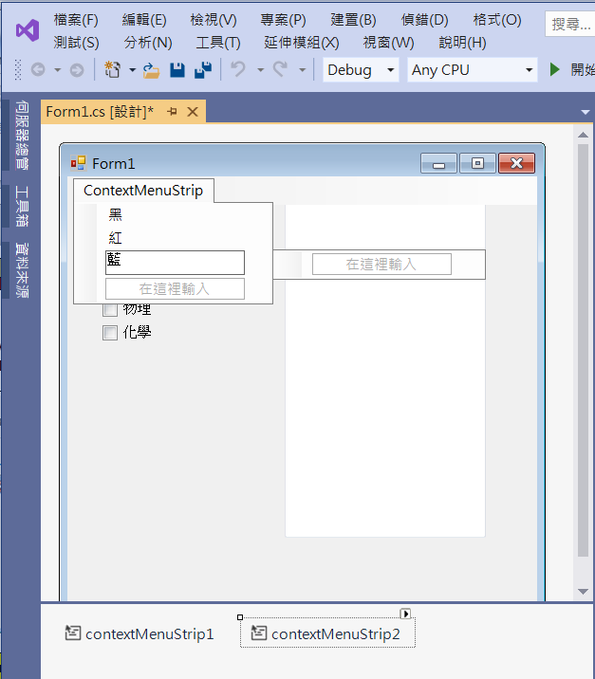
An example of ContextMenuStrip
contextMenuStrip1
contextMenuStrip2

Slide 5
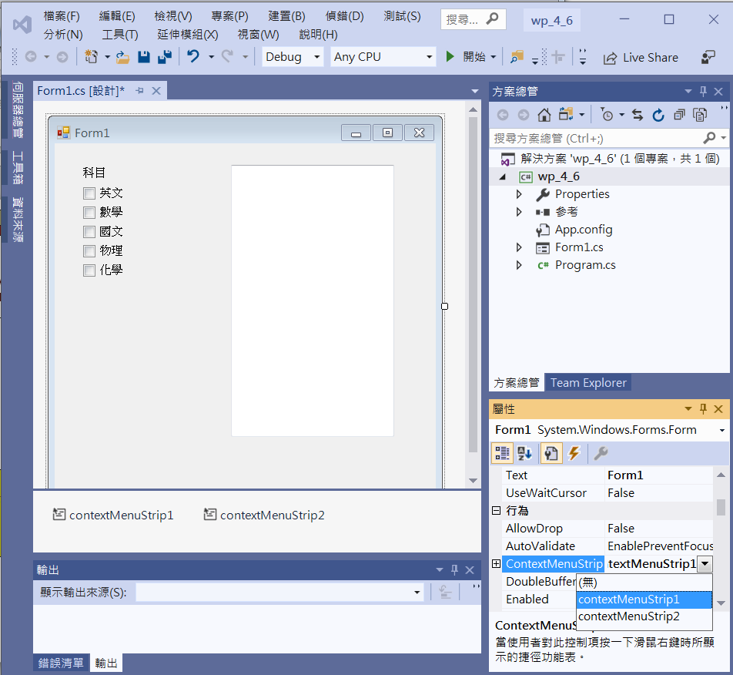
An example of ContextMenuStrip
Connect
contextMenuStrip1
to
Form1

Slide 6
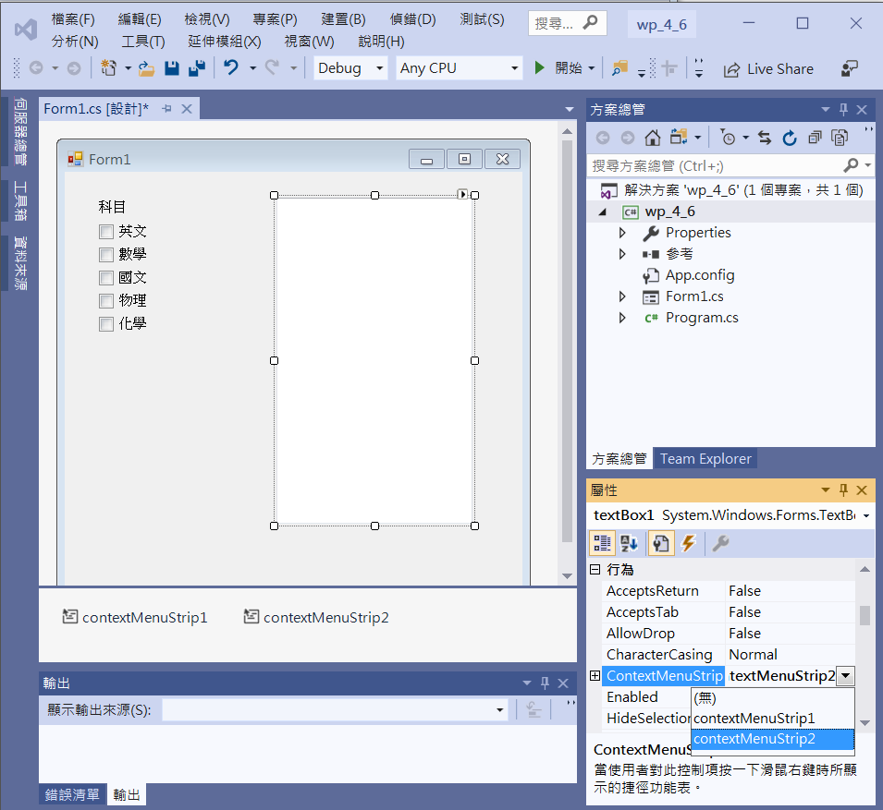
An example of ContextMenuStrip
Connect
contextMenuStrip2
to
textBox1

Slide 7
An example of ContextMenuStrip
private void Form1_Load(object sender, EventArgs e)
{
this.BackColor=Color.White;
白ToolStripMenuItem.Checked = true;
黑ToolStripMenuItem.Checked = true;
}

Slide 8
An example of ContextMenuStrip
private void 白ToolStripMenuItem_Click(object sender, EventArgs e)
{
this.BackColor = Color.White;
白ToolStripMenuItem.Checked = true;
灰ToolStripMenuItem.Checked = false;
銀ToolStripMenuItem.Checked = false;
}
private void 灰ToolStripMenuItem_Click(object sender, EventArgs e)
{
this.BackColor = Color.Gray;
白ToolStripMenuItem.Checked = false;
灰ToolStripMenuItem.Checked = true;
銀ToolStripMenuItem.Checked = false;
}

Slide 9
An example of ContextMenuStrip
private void 銀ToolStripMenuItem_Click(object sender, EventArgs e)
{
this.BackColor = Color.Silver;
白ToolStripMenuItem.Checked = false;
灰ToolStripMenuItem.Checked = false;
銀ToolStripMenuItem.Checked = true;
}
private void 黑ToolStripMenuItem_Click(object sender, EventArgs e)
{
textBox1.ForeColor = Color.Black;
黑ToolStripMenuItem.Checked = true;
紅ToolStripMenuItem.Checked = false;
藍ToolStripMenuItem.Checked = false;
}

Slide 10
An example of ContextMenuStrip
private void 紅ToolStripMenuItem_Click(object sender, EventArgs e)
{
textBox1.ForeColor = Color.Red;
黑ToolStripMenuItem.Checked = false;
紅ToolStripMenuItem.Checked = true;
藍ToolStripMenuItem.Checked = false;
}
private void 藍ToolStripMenuItem_Click(object sender, EventArgs e)
{
textBox1.ForeColor = Color.Blue;
黑ToolStripMenuItem.Checked = false;
紅ToolStripMenuItem.Checked = false;
藍ToolStripMenuItem.Checked = true;
}

Slide 11
An example of ContextMenuStrip
Add CheckedChanged Event of checkBox1
  checkBox1.CheckedChanged
private void CheckBox1_CheckedChanged(object sender, EventArgs e)
{
textBox1.Text="";
if (checkBox1.Checked == true)
textBox1.Text += "英文 ";
if (checkBox2.Checked == true)
textBox1.Text += "數學 ";
if (checkBox3.Checked == true)
textBox1.Text += "國文 ";
if (checkBox4.Checked == true)
textBox1.Text += "物理 ";
if (checkBox5.Checked == true)
textBox1.Text += "化學 ";
}

Slide 12
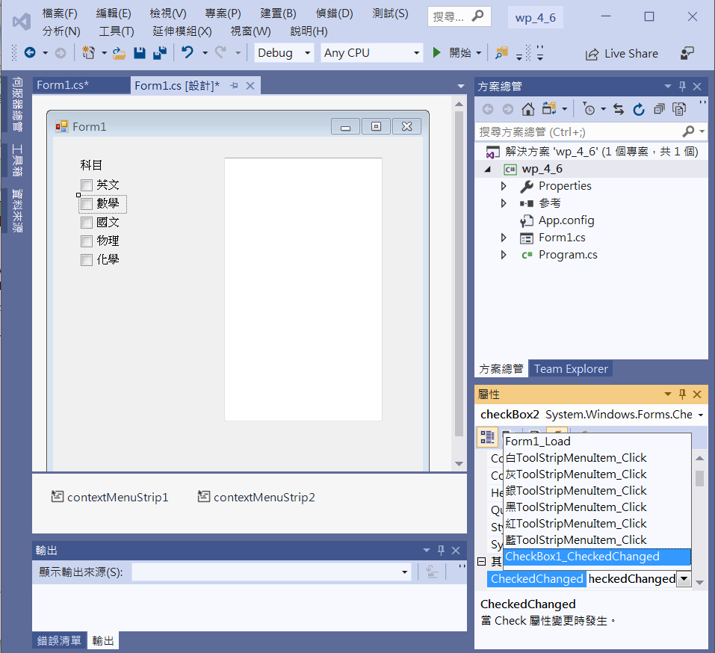
An example of ContextMenuStrip
CheckedChanged Event of All checkBox ->
  checkBox1.CheckedChanged

Slide 13
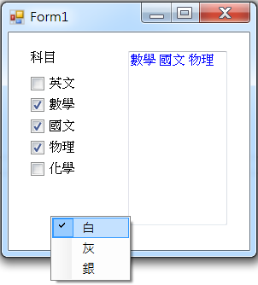
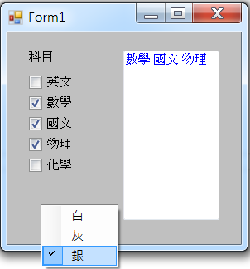
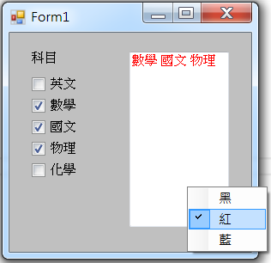
Exercise#4-6

Slide 14
內容來源
  Visual C# 2012 視窗程式設計：繪圖與遊戲專題(鄞永傳/著; 松崗)
  Visual C# 2013視窗程式設計(黃聰明/著; 松崗)
  跟著範例學會Visual C# 2015(張逸中/著; 博碩)

