Slide 1
Window Programming 6-3
StatusStrip
Yuan Ze University

Slide 2
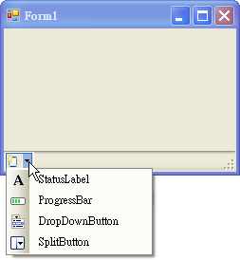
StatusStrip
Displaying information or items for inputing
  StatusLabel
    Text
  ProgressBar
  DropDownButtons
  SplitButton

Slide 3
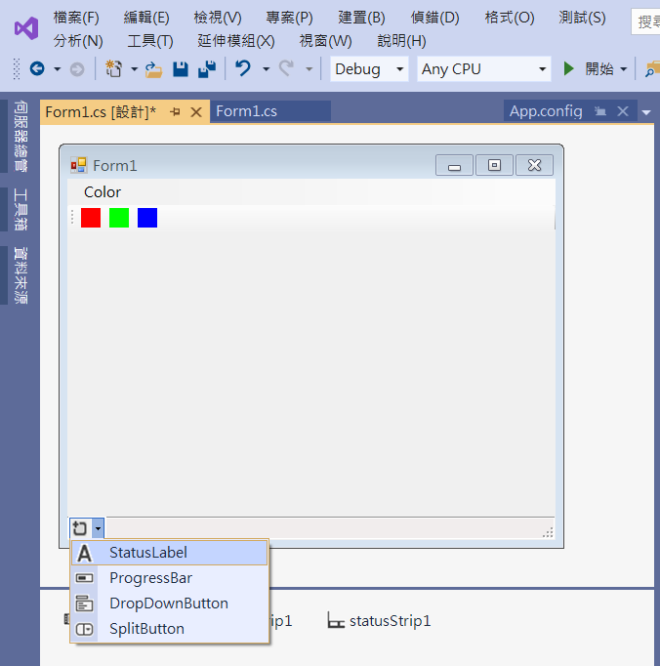
Adding StatusStrip
2. Add statusLabel
1. Add statusStrip1

Slide 4
Adding StatusStrip
private void Form1_Load(object sender, EventArgs e)
{
redToolStripMenuItem.Checked = true;
toolStripButton1.Checked = true;
toolStripStatusLabel1.Text = "Red";
}

Slide 5
Adding StatusStrip
private void RedToolStripMenuItem_Click(object sender, EventArgs e)
{
c = Color.Red;
redToolStripMenuItem.Checked = true;
greenToolStripMenuItem.Checked = false;
blueToolStripMenuItem.Checked = false;
toolStripButton1.Checked = true;
toolStripButton2.Checked = false;
toolStripButton3.Checked = false;
toolStripStatusLabel1.Text = "Red";
}

Slide 6
Adding StatusStrip
private void GreenToolStripMenuItem_Click(object sender, EventArgs e)
{
c = Color.Green;
redToolStripMenuItem.Checked = false;
greenToolStripMenuItem.Checked = true;
blueToolStripMenuItem.Checked = false;
toolStripButton1.Checked = false;
toolStripButton2.Checked = true;
toolStripButton3.Checked = false;
toolStripStatusLabel1.Text = "Green";
}

Slide 7
Adding StatusStrip
private void BlueToolStripMenuItem_Click(object sender, EventArgs e)
{
c = Color.Blue;
redToolStripMenuItem.Checked = false;
greenToolStripMenuItem.Checked = false;
blueToolStripMenuItem.Checked = true;
toolStripButton1.Checked = false;
toolStripButton2.Checked = false;
toolStripButton3.Checked = true;
toolStripStatusLabel1.Text = "Blue";
}

Slide 8
Adding StatusStrip
private void ToolStripButton1_Click(object sender, EventArgs e)
{
c = Color.Red;
redToolStripMenuItem.Checked = true;
greenToolStripMenuItem.Checked = false;
blueToolStripMenuItem.Checked = false;
toolStripButton1.Checked = true;
toolStripButton2.Checked = false;
toolStripButton3.Checked = false;
toolStripStatusLabel1.Text = "Red";
}

Slide 9
Adding StatusStrip
private void ToolStripButton2_Click(object sender, EventArgs e)
{
c = Color.Green;
redToolStripMenuItem.Checked = false;
greenToolStripMenuItem.Checked = true;
blueToolStripMenuItem.Checked = false;
toolStripButton1.Checked = false;
toolStripButton2.Checked = true;
toolStripButton3.Checked = false;
toolStripStatusLabel1.Text = "Green";
}

Slide 10
Adding StatusStrip
private void ToolStripButton3_Click(object sender, EventArgs e)
{
c = Color.Blue;
redToolStripMenuItem.Checked = false;
greenToolStripMenuItem.Checked = false;
blueToolStripMenuItem.Checked = true;
toolStripButton1.Checked = false;
toolStripButton2.Checked = false;
toolStripButton3.Checked = true;
toolStripStatusLabel1.Text = "Blue";
}

Slide 11

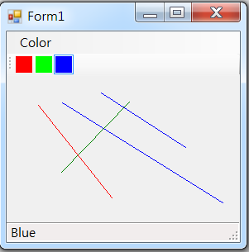
Exercise#6-3

Slide 12
內容來源
  Visual C# 2012 視窗程式設計：繪圖與遊戲專題(鄞永傳/著; 松崗)
  Visual C# 2013視窗程式設計(黃聰明/著; 松崗)
  跟著範例學會Visual C# 2015(張逸中/著; 博碩)

