Slide 1
Window Programming 6-6
An Example of StatusStrip & Timer
Yuan Ze University

Slide 2
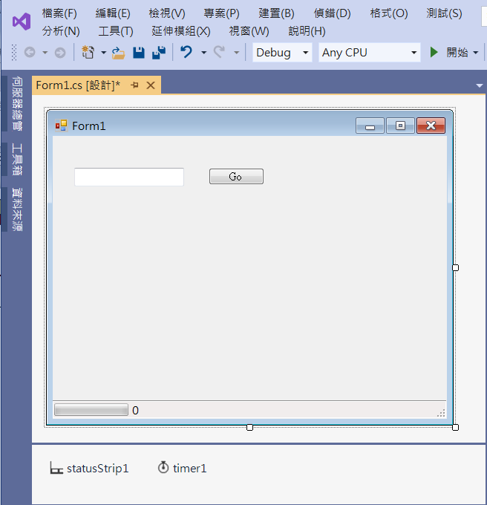
An Example of StatusStrip & Timer
1. Add textBox1
2. Add button1
6. Add toolStripStatusLabel1
Text -> "0"
5. Add toolStripProgressBar1
3. Add statusStrip1
4. Add timer1

Slide 3
An Example of StatusStrip & Timer
public partial class Form1 : Form
{
int num1 = 0;
int num2 = 0;
public Form1()
{
InitializeComponent();
}

Slide 4
An Example of StatusStrip & Timer
private void Button1_Click(object sender, EventArgs e)
{
timer1.Interval = 1000;
num1 = Convert.ToInt32(textBox1.Text);
toolStripProgressBar1.Maximum = num1;
toolStripProgressBar1.Step = 1;
toolStripStatusLabel1.Text = "0";
toolStripProgressBar1.Value = 0;
num2 = 0;
timer1.Start();
}

Slide 5
An Example of StatusStrip & Timer
private void Timer1_Tick(object sender, EventArgs e)
{
if (num2 < num1)
{
num2++;
toolStripProgressBar1.Value++;
toolStripStatusLabel1.Text = num2.ToString();
}
else
{
timer1.Stop();
toolStripStatusLabel1.Text = "Done";
}
}

Slide 6
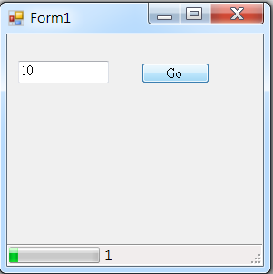
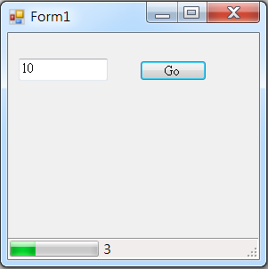
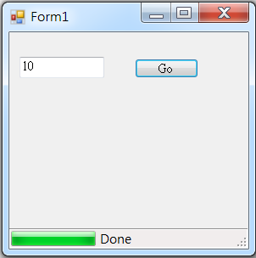
Exercise#6-6

Slide 7
內容來源
  Visual C# 2012 視窗程式設計：繪圖與遊戲專題(鄞永傳/著; 松崗)
  Visual C# 2013視窗程式設計(黃聰明/著; 松崗)
  跟著範例學會Visual C# 2015(張逸中/著; 博碩)

