Slide 1
CHAPTER 7 7.1 · Analysis
The quiz-score problem
01
A school records five quiz scores, each from 0 to 20.
02
Input: five valid scores. Process: total, mean and highest.
03
Output: the mean and highest score. Store results if they must survive closing the program.
CHECK Which details could you abstract away?
IGCSE 0478 2026–2028 / Answers in speaker notes
1 / 26
Notes:
MODEL ANSWER
The colour of the classroom walls is irrelevant; the number of scores and valid range are essential.
TEACHING PROMPT
Starter: ask pairs to write the input, process, output and storage requirements before showing the model.
SOURCES
User-supplied Cambridge IGCSE Computer Science 0478 syllabus 2026–2028 Version 6, chapter 7 and Paper 2 conventions, in resources/chapters/07/syllabus.pdf. CUP second edition and Hodder Education 2021 chapter 7. Exact source-page mappings: resources/catalog.json.
Original teaching examples and model answers unless a textbook figure is credited. Model answers are not official mark schemes.

Slide 2
CHAPTER 7 7.1 · Requirements
Inputs, processes, outputs and storage
Five scores must lie between 0 and 20.
Saving the result is a separate requirement from displaying it.
Part | Quiz-score system
Input | Five integer scores
Process | Validate, total, divide, find highest
Output | Mean and highest score
Storage | Saved summary for the next session
CHECK Which part checks that 24 is unacceptable?
IGCSE 0478 2026–2028 / Answers in speaker notes
2 / 26
Notes:
MODEL ANSWER
The input-validation process rejects 24.
TEACHING PROMPT
Ask students to predict first, explain their reasoning, then compare with the model answer. Use the linked chapter workbook for independent practice.
SOURCES
User-supplied Cambridge IGCSE Computer Science 0478 syllabus 2026–2028 Version 6, chapter 7 and Paper 2 conventions, in resources/chapters/07/syllabus.pdf. CUP second edition and Hodder Education 2021 chapter 7. Exact source-page mappings: resources/catalog.json.
Original teaching examples and model answers unless a textbook figure is credited. Model answers are not official mark schemes.

Slide 3
CHAPTER 7 7.1 · Life cycle
The development life cycle
01
Analysis defines requirements using abstraction and decomposition.
02
Design uses structure diagrams, flowcharts and pseudocode.
03
Coding implements and tests components; testing checks the completed solution against requirements.
CHECK A correct-looking program fails when the input is 20. Which stage needs revisiting?
IGCSE 0478 2026–2028 / Answers in speaker notes
3 / 26
Notes:
MODEL ANSWER
Testing reveals the failure. Revisit the design or implementation, correct it and retest the requirement.
TEACHING PROMPT
Ask students to predict first, explain their reasoning, then compare with the model answer. Use the linked chapter workbook for independent practice.
SOURCES
User-supplied Cambridge IGCSE Computer Science 0478 syllabus 2026–2028 Version 6, chapter 7 and Paper 2 conventions, in resources/chapters/07/syllabus.pdf. CUP second edition and Hodder Education 2021 chapter 7. Exact source-page mappings: resources/catalog.json.
Original teaching examples and model answers unless a textbook figure is credited. Model answers are not official mark schemes.

Slide 4
CHAPTER 7 7.2 · Design
Decomposition and design methods
Main task: process a set of quiz scores.
Sub-tasks: read a valid score; calculate statistics; display results.
A structure diagram shows the hierarchy. A flowchart shows execution order and decisions.
Representation | What it communicates
Structure diagram | Main task → smaller sub-tasks
Flowchart | Sequence, decisions and repetition
Pseudocode | Precise language-independent steps
CHECK Which sub-task could be reused for each of five scores?
IGCSE 0478 2026–2028 / Answers in speaker notes
4 / 26
Notes:
MODEL ANSWER
ReadValidScore can be called repeatedly instead of copying validation code.
TEACHING PROMPT
Students draw a hierarchy and a flowchart for input validation. Use the linked official conventions PDF for terminal, process, input/output, decision and flow-line symbols.
SOURCES
User-supplied Cambridge IGCSE Computer Science 0478 syllabus 2026–2028 Version 6, chapter 7 and Paper 2 conventions, in resources/chapters/07/syllabus.pdf. CUP second edition and Hodder Education 2021 chapter 7. Exact source-page mappings: resources/catalog.json.
Original teaching examples and model answers unless a textbook figure is credited. Model answers are not official mark schemes.

Slide 5
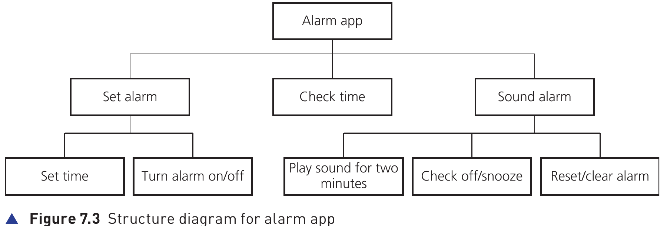
CHAPTER 7 7.2 · Structure diagrams
A structure diagram shows the parts
The root names the complete system.
Each lower level breaks a task into smaller tasks.
Branches describe responsibility, not execution order.
Hodder p.262, Figure 7.3
CHECK Which branch handles switching the alarm on?
IGCSE 0478 2026–2028 / Answers in speaker notes
5 / 26
Notes:
MODEL ANSWER
Set alarm contains Turn alarm on/off.
TEACHING PROMPT
Ask students to predict first, explain their reasoning, then compare with the model answer. Use the linked chapter workbook for independent practice.
SOURCES
User-supplied Cambridge IGCSE Computer Science 0478 syllabus 2026–2028 Version 6, chapter 7 and Paper 2 conventions, in resources/chapters/07/syllabus.pdf. CUP second edition and Hodder Education 2021 chapter 7. Exact source-page mappings: resources/catalog.json. Image: Hodder p.262, Figure 7.3; cropped from the supplied textbook.
Original teaching examples and model answers unless a textbook figure is credited. Model answers are not official mark schemes.

Slide 6
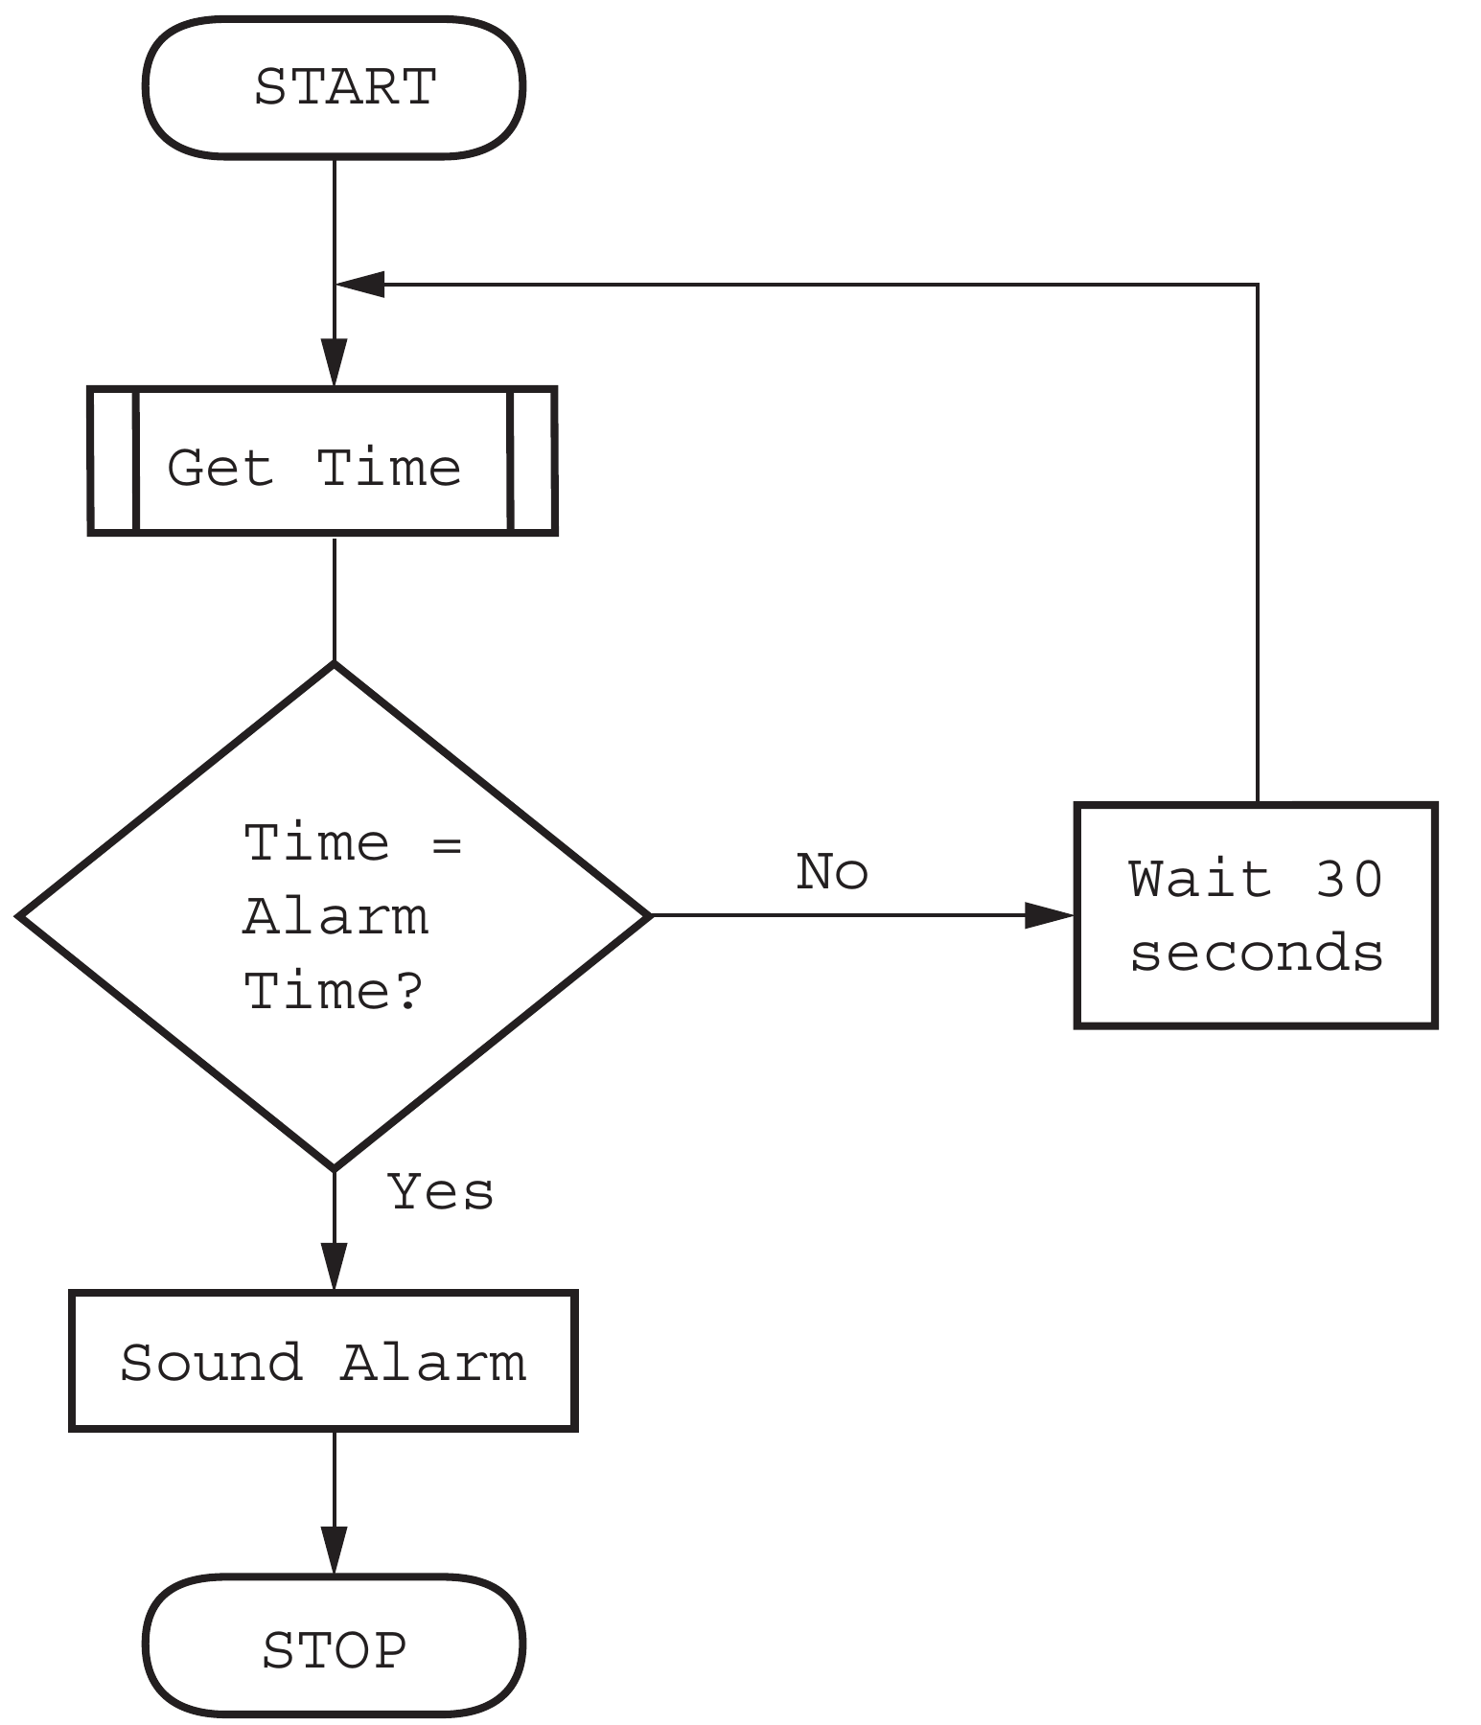
CHAPTER 7 7.2 · Flowcharts
A flowchart shows the next step
Follow the arrows from START.
A decision selects a labelled branch.
Here, No waits and checks again. Yes sounds the alarm.
Hodder p.262, Figure 7.4
CHECK What happens when the current time does not match?
IGCSE 0478 2026–2028 / Answers in speaker notes
6 / 26
Notes:
MODEL ANSWER
Wait 30 seconds, get the time again, then repeat the comparison.
TEACHING PROMPT
Ask students to predict first, explain their reasoning, then compare with the model answer. Use the linked chapter workbook for independent practice.
SOURCES
User-supplied Cambridge IGCSE Computer Science 0478 syllabus 2026–2028 Version 6, chapter 7 and Paper 2 conventions, in resources/chapters/07/syllabus.pdf. CUP second edition and Hodder Education 2021 chapter 7. Exact source-page mappings: resources/catalog.json. Image: Hodder p.262, Figure 7.4; cropped from the supplied textbook.
Original teaching examples and model answers unless a textbook figure is credited. Model answers are not official mark schemes.

Slide 7
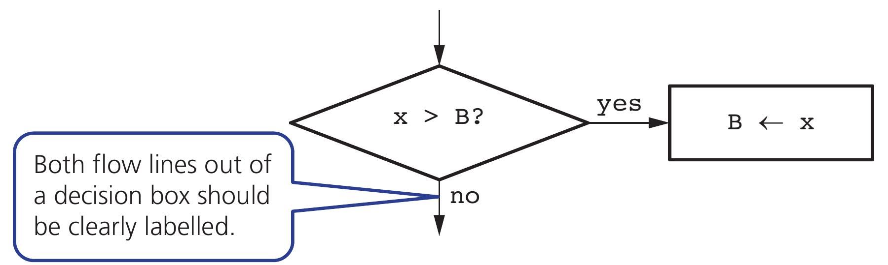
CHAPTER 7 7.2 · Flowchart tracing
Decision symbols and assignments
The diamond contains a condition.
Yes and No must lead to the correct next instruction.
The rectangle changes the stored value.
Hodder p.263, Figure 7.8
CHECK Trace the diagram for X = 9 and B = 6.
IGCSE 0478 2026–2028 / Answers in speaker notes
7 / 26
Notes:
MODEL ANSWER
The comparison is true. B becomes 9.
TEACHING PROMPT
Ask students to predict first, explain their reasoning, then compare with the model answer. Use the linked chapter workbook for independent practice.
SOURCES
User-supplied Cambridge IGCSE Computer Science 0478 syllabus 2026–2028 Version 6, chapter 7 and Paper 2 conventions, in resources/chapters/07/syllabus.pdf. CUP second edition and Hodder Education 2021 chapter 7. Exact source-page mappings: resources/catalog.json. Image: Hodder p.263, Figure 7.8; cropped from the supplied textbook.
Original teaching examples and model answers unless a textbook figure is credited. Model answers are not official mark schemes.

Slide 8
CHAPTER 7 7.4 · Standard algorithms
Totalling, counting and averaging
Initialise the accumulator before the loop.
Total ← 0
Count ← 0
FOR Index ← 1 TO 3
INPUT Score
Total ← Total + Score
Count ← Count + 1
NEXT Index
OUTPUT Total / Count
Count records by adding 1; total values by adding the value.
Divide only when the count is greater than zero.
CHECK For inputs 4, 7, 2, what is the final mean?
IGCSE 0478 2026–2028 / Answers in speaker notes
8 / 26
Notes:
MODEL ANSWER
Total = 13, Count = 3, Mean = 13 / 3. A count is not the total.
TEACHING PROMPT
Ask students to trace before revealing results.
SOURCES
User-supplied Cambridge IGCSE Computer Science 0478 syllabus 2026–2028 Version 6, chapter 7 and Paper 2 conventions, in resources/chapters/07/syllabus.pdf. CUP second edition and Hodder Education 2021 chapter 7. Exact source-page mappings: resources/catalog.json.
Original teaching examples and model answers unless a textbook figure is credited. Model answers are not official mark schemes.

Slide 9
CHAPTER 7 7.7 · Trace tables
A complete accumulator trace
Follow the algorithm exactly, including errors.
Record variable changes, prompts and output in execution order.
Do not silently repair code while tracing it.
Step | Score | Total | Count | Output
Initialise | — | 0 | 0 | —
Iteration 1 | 4 | 4 | 1 | —
Iteration 2 | 7 | 11 | 2 | —
Iteration 3 | 2 | 13 | 3 | —
After loop | — | 13 | 3 | 13 / 3
CHECK What would change if Total were reset inside the loop?
IGCSE 0478 2026–2028 / Answers in speaker notes
9 / 26
Notes:
MODEL ANSWER
The final total would be 2 because earlier inputs would be discarded.
TEACHING PROMPT
Ask students to predict first, explain their reasoning, then compare with the model answer. Use the linked chapter workbook for independent practice.
SOURCES
User-supplied Cambridge IGCSE Computer Science 0478 syllabus 2026–2028 Version 6, chapter 7 and Paper 2 conventions, in resources/chapters/07/syllabus.pdf. CUP second edition and Hodder Education 2021 chapter 7. Exact source-page mappings: resources/catalog.json.
Original teaching examples and model answers unless a textbook figure is credited. Model answers are not official mark schemes.

Slide 10
CHAPTER 7 7.4 · Maximum and minimum
Maximum and minimum
Initialise Highest from the first item in a non-empty array.
Highest ← Scores[1]
FOR Index ← 2 TO 5
IF Scores[Index] > Highest THEN
Highest ← Scores[Index]
ENDIF
NEXT Index
OUTPUT Highest
Compare each remaining item with the current highest.
For a minimum, change the comparison to <.
CHECK Why is Highest ← 0 unsafe for arbitrary data?
IGCSE 0478 2026–2028 / Answers in speaker notes
10 / 26
Notes:
MODEL ANSWER
If all values are negative, zero is not in the list and is incorrectly reported as the maximum.
TEACHING PROMPT
Ask students to predict first, explain their reasoning, then compare with the model answer. Use the linked chapter workbook for independent practice.
SOURCES
User-supplied Cambridge IGCSE Computer Science 0478 syllabus 2026–2028 Version 6, chapter 7 and Paper 2 conventions, in resources/chapters/07/syllabus.pdf. CUP second edition and Hodder Education 2021 chapter 7. Exact source-page mappings: resources/catalog.json.
Original teaching examples and model answers unless a textbook figure is credited. Model answers are not official mark schemes.

Slide 11
CHAPTER 7 7.4 · Maximum trace
Maximum: a worked trace
Start with the first value, even when it is negative.
Replace Highest only when a larger value appears.
Step | Value | Highest after step
Initial value | −8 | −8
Compare next | −3 | −3
Compare next | −11 | −3
Compare next | −5 | −3
CHECK What comparison would find the minimum?
IGCSE 0478 2026–2028 / Answers in speaker notes
11 / 26
Notes:
MODEL ANSWER
Use Value < Lowest, with Lowest initially equal to the first value.
TEACHING PROMPT
Ask students to predict first, explain their reasoning, then compare with the model answer. Use the linked chapter workbook for independent practice.
SOURCES
User-supplied Cambridge IGCSE Computer Science 0478 syllabus 2026–2028 Version 6, chapter 7 and Paper 2 conventions, in resources/chapters/07/syllabus.pdf. CUP second edition and Hodder Education 2021 chapter 7. Exact source-page mappings: resources/catalog.json.
Original teaching examples and model answers unless a textbook figure is credited. Model answers are not official mark schemes.

Slide 12
CHAPTER 7 7.4 · Linear search
Linear search pseudocode
Compare the target with one element at a time.
Position ← 0
Index ← 1
WHILE Index <= 5 AND Position = 0 DO
IF Scores[Index] = Target THEN
Position ← Index
ENDIF
Index ← Index + 1
ENDWHILE
Stop when a match is found or the list is exhausted.
This version records the first matching position, or 0 for not found.
CHECK For [4, 7, 2, 7, 9], searching for 7 returns what?
IGCSE 0478 2026–2028 / Answers in speaker notes
12 / 26
Notes:
MODEL ANSWER
Position 2, because the loop stops at the first match.
TEACHING PROMPT
Ask students to predict first, explain their reasoning, then compare with the model answer. Use the linked chapter workbook for independent practice.
SOURCES
User-supplied Cambridge IGCSE Computer Science 0478 syllabus 2026–2028 Version 6, chapter 7 and Paper 2 conventions, in resources/chapters/07/syllabus.pdf. CUP second edition and Hodder Education 2021 chapter 7. Exact source-page mappings: resources/catalog.json.
Original teaching examples and model answers unless a textbook figure is credited. Model answers are not official mark schemes.

Slide 13
CHAPTER 7 7.4 · Search trace
Linear search: found and not found
Data: [4, 7, 2, 7, 9]. Indexing starts at 1.
The first matching index is the result.
If every comparison fails, Position remains 0.
Target | Indexes checked | Result
7 | 1, 2 | Position = 2
9 | 1, 2, 3, 4, 5 | Position = 5
6 | 1, 2, 3, 4, 5 | Position = 0
CHECK How many comparisons locate 9?
IGCSE 0478 2026–2028 / Answers in speaker notes
13 / 26
Notes:
MODEL ANSWER
Five. A missing target also needs five comparisons in this list.
TEACHING PROMPT
Ask students to predict first, explain their reasoning, then compare with the model answer. Use the linked chapter workbook for independent practice.
SOURCES
User-supplied Cambridge IGCSE Computer Science 0478 syllabus 2026–2028 Version 6, chapter 7 and Paper 2 conventions, in resources/chapters/07/syllabus.pdf. CUP second edition and Hodder Education 2021 chapter 7. Exact source-page mappings: resources/catalog.json.
Original teaching examples and model answers unless a textbook figure is credited. Model answers are not official mark schemes.

Slide 14
CHAPTER 7 7.4 · Swap trace
Swapping preserves both values
A temporary variable stores the value about to be overwritten.
Each assignment uses the values from the preceding row.
Instruction | A | B | Temp
Initial values | 7 | 2 | —
Temp ← A | 7 | 2 | 7
A ← B | 2 | 2 | 7
B ← Temp | 2 | 7 | 7
CHECK What goes wrong without Temp?
IGCSE 0478 2026–2028 / Answers in speaker notes
14 / 26
Notes:
MODEL ANSWER
After A becomes 2, copying A into B also gives 2. The original 7 is lost.
TEACHING PROMPT
Ask students to predict first, explain their reasoning, then compare with the model answer. Use the linked chapter workbook for independent practice.
SOURCES
User-supplied Cambridge IGCSE Computer Science 0478 syllabus 2026–2028 Version 6, chapter 7 and Paper 2 conventions, in resources/chapters/07/syllabus.pdf. CUP second edition and Hodder Education 2021 chapter 7. Exact source-page mappings: resources/catalog.json.
Original teaching examples and model answers unless a textbook figure is credited. Model answers are not official mark schemes.

Slide 15
CHAPTER 7 7.4 · Bubble sort pass 1
Bubble sort: the first pass
Compare adjacent values from left to right.
Swap only when the left value exceeds the right value.
Comparison | List after comparison | Action
Start | 4 7 2 1 | —
4 and 7 | 4 7 2 1 | Keep
7 and 2 | 4 2 7 1 | Swap
7 and 1 | 4 2 1 7 | Swap
CHECK Is the list fully sorted at the end of this pass?
IGCSE 0478 2026–2028 / Answers in speaker notes
15 / 26
Notes:
MODEL ANSWER
No. The largest value is in place, but 4, 2 and 1 still need sorting.
TEACHING PROMPT
Ask students to predict first, explain their reasoning, then compare with the model answer. Use the linked chapter workbook for independent practice.
SOURCES
User-supplied Cambridge IGCSE Computer Science 0478 syllabus 2026–2028 Version 6, chapter 7 and Paper 2 conventions, in resources/chapters/07/syllabus.pdf. CUP second edition and Hodder Education 2021 chapter 7. Exact source-page mappings: resources/catalog.json.
Original teaching examples and model answers unless a textbook figure is credited. Model answers are not official mark schemes.

Slide 16
CHAPTER 7 7.4 · Bubble sort termination
Bubble sort: later passes
Each pass moves another large value towards the right.
The simple version stops after a complete pass makes no swaps.
Pass | List at end | Any swaps?
1 | 4 2 1 7 | TRUE
2 | 2 1 4 7 | TRUE
3 | 1 2 4 7 | TRUE
4 | 1 2 4 7 | FALSE
CHECK Why does this version execute pass 4?
IGCSE 0478 2026–2028 / Answers in speaker notes
16 / 26
Notes:
MODEL ANSWER
It confirms that there are no swaps. The loop stops using Swapped, not by looking at the list.
TEACHING PROMPT
Ask students to predict first, explain their reasoning, then compare with the model answer. Use the linked chapter workbook for independent practice.
SOURCES
User-supplied Cambridge IGCSE Computer Science 0478 syllabus 2026–2028 Version 6, chapter 7 and Paper 2 conventions, in resources/chapters/07/syllabus.pdf. CUP second edition and Hodder Education 2021 chapter 7. Exact source-page mappings: resources/catalog.json.
Original teaching examples and model answers unless a textbook figure is credited. Model answers are not official mark schemes.

Slide 17
CHAPTER 7 7.4 · Bubble sort
Bubble sort pseudocode
Compare neighbours and swap if they are in the wrong order.
REPEAT
Swapped ← FALSE
FOR Index ← 1 TO N - 1
IF A[Index] > A[Index + 1] THEN
Temp ← A[Index]
A[Index] ← A[Index + 1]
A[Index + 1] ← Temp
Swapped ← TRUE
ENDIF
NEXT Index
UNTIL Swapped = FALSE
After one ascending pass, the largest value is at the right end.
Repeat until a full pass makes no swaps.
CHECK One pass over [4, 7, 2, 1] produces which list?
IGCSE 0478 2026–2028 / Answers in speaker notes
17 / 26
Notes:
MODEL ANSWER
[4, 2, 1, 7]. One pass does not necessarily sort the entire list.
TEACHING PROMPT
Ask students to predict first, explain their reasoning, then compare with the model answer. Use the linked chapter workbook for independent practice.
SOURCES
User-supplied Cambridge IGCSE Computer Science 0478 syllabus 2026–2028 Version 6, chapter 7 and Paper 2 conventions, in resources/chapters/07/syllabus.pdf. CUP second edition and Hodder Education 2021 chapter 7. Exact source-page mappings: resources/catalog.json.
Original teaching examples and model answers unless a textbook figure is credited. Model answers are not official mark schemes.

Slide 18
CHAPTER 7 7.5 · Validation
Validation checks
A value can pass validation and still be factually wrong.
Combine checks where necessary: presence, type and range serve different purposes.
Check | Example
Range / type | Integer score from 0 to 20
Length / format | Code has 6 characters / pattern AB1234
Presence | Name is not empty
Check digit | Recalculate an appended digit to detect some entry errors
CHECK A student types 12 instead of 13; both are valid ages. Will a range check detect it?
IGCSE 0478 2026–2028 / Answers in speaker notes
18 / 26
Notes:
MODEL ANSWER
No. A range check tests acceptability, not whether the value matches the source.
TEACHING PROMPT
A check digit cannot guarantee error-free entry; discuss its limits.
SOURCES
User-supplied Cambridge IGCSE Computer Science 0478 syllabus 2026–2028 Version 6, chapter 7 and Paper 2 conventions, in resources/chapters/07/syllabus.pdf. CUP second edition and Hodder Education 2021 chapter 7. Exact source-page mappings: resources/catalog.json.
Original teaching examples and model answers unless a textbook figure is credited. Model answers are not official mark schemes.

Slide 19
CHAPTER 7 7.5 · Validation examples
Choosing a suitable validation check
Choose a rule that matches the requirement.
A value may satisfy one check and fail another.
Requirement | Check | Rejected example
Integer score | Type | 12.5
Score from 0 to 20 | Range | 21
Exactly 6 characters | Length | AB123
Name required | Presence | Empty entry
Two letters, four digits | Format | 1234AB
CHECK Which checks suit a required six-character code?
IGCSE 0478 2026–2028 / Answers in speaker notes
19 / 26
Notes:
MODEL ANSWER
Presence and length. Add a format check if letters and digits must follow a specific pattern.
TEACHING PROMPT
Ask students to predict first, explain their reasoning, then compare with the model answer. Use the linked chapter workbook for independent practice.
SOURCES
User-supplied Cambridge IGCSE Computer Science 0478 syllabus 2026–2028 Version 6, chapter 7 and Paper 2 conventions, in resources/chapters/07/syllabus.pdf. CUP second edition and Hodder Education 2021 chapter 7. Exact source-page mappings: resources/catalog.json.
Original teaching examples and model answers unless a textbook figure is credited. Model answers are not official mark schemes.

Slide 20
CHAPTER 7 7.5 · Check digit
Check digits detect some entry errors
A rule calculates an extra digit from the other digits.
The program recalculates it when the identifier is entered.
A match does not guarantee that the identifier is correct.
Stage | Illustrative classroom rule
Data digits | 2, 4, 6
Calculate | (2 + 4 + 6) MOD 10 = 2
Stored code | 2462
Mistyped code | 2463 fails the final-digit check
CHECK Can a check digit prove that the product is the one intended?
IGCSE 0478 2026–2028 / Answers in speaker notes
20 / 26
Notes:
MODEL ANSWER
No. A different valid identifier may still pass the rule.
TEACHING PROMPT
This simple sum rule is an original teaching example. It is not the ISBN or payment-card algorithm.
SOURCES
User-supplied Cambridge IGCSE Computer Science 0478 syllabus 2026–2028 Version 6, chapter 7 and Paper 2 conventions, in resources/chapters/07/syllabus.pdf. CUP second edition and Hodder Education 2021 chapter 7. Exact source-page mappings: resources/catalog.json.
Original teaching examples and model answers unless a textbook figure is credited. Model answers are not official mark schemes.

Slide 21
CHAPTER 7 7.5 · Verification
Verification checks
01
Visual check: compare entered data with the original source.
02
Double entry: enter data twice and compare the entries.
03
Neither method proves the original source is correct.
CHECK Two identical incorrect entries pass double entry. Why?
IGCSE 0478 2026–2028 / Answers in speaker notes
21 / 26
Notes:
MODEL ANSWER
The entries agree with each other. Agreement does not establish that either matches the intended value.
TEACHING PROMPT
Ask students to predict first, explain their reasoning, then compare with the model answer. Use the linked chapter workbook for independent practice.
SOURCES
User-supplied Cambridge IGCSE Computer Science 0478 syllabus 2026–2028 Version 6, chapter 7 and Paper 2 conventions, in resources/chapters/07/syllabus.pdf. CUP second edition and Hodder Education 2021 chapter 7. Exact source-page mappings: resources/catalog.json.
Original teaching examples and model answers unless a textbook figure is credited. Model answers are not official mark schemes.

Slide 22
CHAPTER 7 7.6 · Test data
Normal, abnormal, extreme and boundary data
For an integer score from 0 to 20 inclusive, test both accepted limits and adjacent rejected values.
A test plan needs input, expected result, actual result and a judgement.
Category | Input | Expected
Normal | 12 | Accept
Abnormal | 21 or "hello" | Reject
Extreme | 0 and 20 | Accept both
Boundary | −1, 0, 20, 21 | Reject, accept, accept, reject
CHECK Are extreme and boundary data identical?
IGCSE 0478 2026–2028 / Answers in speaker notes
22 / 26
Notes:
MODEL ANSWER
Extreme data are the accepted limits. Boundary data also include the neighbouring rejected values.
TEACHING PROMPT
Ask students to predict first, explain their reasoning, then compare with the model answer. Use the linked chapter workbook for independent practice.
SOURCES
User-supplied Cambridge IGCSE Computer Science 0478 syllabus 2026–2028 Version 6, chapter 7 and Paper 2 conventions, in resources/chapters/07/syllabus.pdf. CUP second edition and Hodder Education 2021 chapter 7. Exact source-page mappings: resources/catalog.json.
Original teaching examples and model answers unless a textbook figure is credited. Model answers are not official mark schemes.

Slide 23
CHAPTER 7 7.6 · Test plan
A test plan makes expectations explicit
The accepted integer interval is 0 to 20 inclusive.
Choose expected results before running the program.
Input | Purpose | Expected
12 | Normal | Accept
−1 | Below lower boundary | Reject
0 | Lower extreme | Accept
20 | Upper extreme | Accept
21 | Above upper boundary | Reject
CHECK If 20 is rejected, which part of the condition may be wrong?
IGCSE 0478 2026–2028 / Answers in speaker notes
23 / 26
Notes:
MODEL ANSWER
A strict < 20 may have replaced <= 20.
TEACHING PROMPT
Ask students to predict first, explain their reasoning, then compare with the model answer. Use the linked chapter workbook for independent practice.
SOURCES
User-supplied Cambridge IGCSE Computer Science 0478 syllabus 2026–2028 Version 6, chapter 7 and Paper 2 conventions, in resources/chapters/07/syllabus.pdf. CUP second edition and Hodder Education 2021 chapter 7. Exact source-page mappings: resources/catalog.json.
Original teaching examples and model answers unless a textbook figure is credited. Model answers are not official mark schemes.

Slide 24
CHAPTER 7 7.8–7.9 · Error correction
Correcting a faulty condition
Requirement: reject any integer outside 0 to 20.
IF Score < 0 AND Score > 20 THEN
OUTPUT "Invalid"
ENDIF
The condition below rejects no number.
Correct the Boolean logic and test all four boundary values.
CHECK Replace the faulty condition with a correct condition.
IGCSE 0478 2026–2028 / Answers in speaker notes
24 / 26
Notes:
MODEL ANSWER
Use Score < 0 OR Score > 20. A number cannot be below 0 AND above 20 simultaneously.
TEACHING PROMPT
Exit task: write a complete five-score algorithm with validation, total, highest and mean. Compare against the downloadable teacher solution. Homework: Hodder chapter 7 workbook, then PMT 7 questions.
SOURCES
User-supplied Cambridge IGCSE Computer Science 0478 syllabus 2026–2028 Version 6, chapter 7 and Paper 2 conventions, in resources/chapters/07/syllabus.pdf. CUP second edition and Hodder Education 2021 chapter 7. Exact source-page mappings: resources/catalog.json.
Original teaching examples and model answers unless a textbook figure is credited. Model answers are not official mark schemes.

Slide 25
CHAPTER 7 7.9 · Independent task
Independent task: five valid scores
01
Read five integer scores, each from 0 to 20.
02
Reject invalid values without counting them.
03
Output the total, mean and highest score.
CHECK For inputs 4, 21, 7, 2, 1, 6, what should the outputs be?
IGCSE 0478 2026–2028 / Answers in speaker notes
25 / 26
Notes:
MODEL ANSWER
Reject 21. The five valid scores total 20, the mean is 4 and the maximum is 7.
TEACHING PROMPT
Allow 8–10 minutes. Ask students to annotate their validation loop and accumulator initialisation. Use the next slide to discuss a possible solution.
SOURCES
User-supplied Cambridge IGCSE Computer Science 0478 syllabus 2026–2028 Version 6, chapter 7 and Paper 2 conventions, in resources/chapters/07/syllabus.pdf. CUP second edition and Hodder Education 2021 chapter 7. Exact source-page mappings: resources/catalog.json.
Original teaching examples and model answers unless a textbook figure is credited. Model answers are not official mark schemes.

Slide 26
CHAPTER 7 7.9 · Model answer
Five scores: model algorithm
Zero is a safe initial maximum for scores from 0 to 20.
Total ← 0
Highest ← 0
FOR Index ← 1 TO 5
REPEAT
INPUT Score
UNTIL Score >= 0 AND Score <= 20
Total ← Total + Score
IF Score > Highest THEN
Highest ← Score
ENDIF
NEXT Index
OUTPUT Total, Total / 5, Highest
Only a valid score leaves the inner loop.
CHECK Why does an invalid entry not increase Index?
IGCSE 0478 2026–2028 / Answers in speaker notes
26 / 26
Notes:
MODEL ANSWER
REPEAT continues inside the current FOR iteration until the value is valid.
TEACHING PROMPT
Ask students to predict first, explain their reasoning, then compare with the model answer. Use the linked chapter workbook for independent practice.
SOURCES
User-supplied Cambridge IGCSE Computer Science 0478 syllabus 2026–2028 Version 6, chapter 7 and Paper 2 conventions, in resources/chapters/07/syllabus.pdf. CUP second edition and Hodder Education 2021 chapter 7. Exact source-page mappings: resources/catalog.json.
Original teaching examples and model answers unless a textbook figure is credited. Model answers are not official mark schemes.

