Slide 1
CHAPTER 8 8.1 · Data and declarations
Variables, constants and data types
A variable can change; a constant retains its value.
Use meaningful identifiers and declare types explicitly in pseudocode.
Type | Example
INTEGER / REAL | Count = 5 / Mean = 12.4
CHAR / STRING | Grade = 'A' / Name = "Ada"
BOOLEAN | Complete = TRUE
CHECK What type suits a score average? What type suits a phone number?
IGCSE 0478 2026–2028 / Answers in speaker notes
1 / 31
Notes:
MODEL ANSWER
Average: REAL. Phone number: STRING, because leading zeros matter and arithmetic is inappropriate.
TEACHING PROMPT
Classroom Python is provided separately; most exam coding responses must use pseudocode.
SOURCES
User-supplied Cambridge IGCSE Computer Science 0478 syllabus 2026–2028 Version 6, chapter 8 and Paper 2 conventions, in resources/chapters/08/syllabus.pdf. CUP second edition and Hodder Education 2021 chapter 8. Exact source-page mappings: resources/catalog.json.
Original teaching examples and model answers unless a textbook figure is credited. Model answers are not official mark schemes.

Slide 2
CHAPTER 8 8.1 · Declarations
Declarations and meaningful names
A declaration states the identifier and its data type.
CONSTANT MaxScore = 20
DECLARE Score, Count : INTEGER
DECLARE Mean : REAL
DECLARE StudentName : STRING
DECLARE Grade : CHAR
DECLARE Valid : BOOLEAN
A named constant makes a fixed rule easy to find.
CHECK Why is MaxScore clearer than M?
IGCSE 0478 2026–2028 / Answers in speaker notes
2 / 31
Notes:
MODEL ANSWER
Its name describes the value’s purpose without requiring the reader to guess.
TEACHING PROMPT
Ask students to predict first, explain their reasoning, then compare with the model answer. Use the linked chapter workbook for independent practice.
SOURCES
User-supplied Cambridge IGCSE Computer Science 0478 syllabus 2026–2028 Version 6, chapter 8 and Paper 2 conventions, in resources/chapters/08/syllabus.pdf. CUP second edition and Hodder Education 2021 chapter 8. Exact source-page mappings: resources/catalog.json.
Original teaching examples and model answers unless a textbook figure is credited. Model answers are not official mark schemes.

Slide 3
CHAPTER 8 8.1 · Sequence
Sequence, input and output
Instructions execute in order unless a control structure changes the flow.
DECLARE Price, Cost : REAL
DECLARE Quantity : INTEGER
INPUT Price
INPUT Quantity
Cost ← Price * Quantity
OUTPUT "Cost: ", Cost
Assignment stores a value; OUTPUT displays it.
CHECK What does the final OUTPUT show if Price = 8.5 and Quantity = 3?
IGCSE 0478 2026–2028 / Answers in speaker notes
3 / 31
Notes:
MODEL ANSWER
25.5. Changing the order to calculate before input would use undefined or old values.
TEACHING PROMPT
Ask students to predict first, explain their reasoning, then compare with the model answer. Use the linked chapter workbook for independent practice.
SOURCES
User-supplied Cambridge IGCSE Computer Science 0478 syllabus 2026–2028 Version 6, chapter 8 and Paper 2 conventions, in resources/chapters/08/syllabus.pdf. CUP second edition and Hodder Education 2021 chapter 8. Exact source-page mappings: resources/catalog.json.
Original teaching examples and model answers unless a textbook figure is credited. Model answers are not official mark schemes.

Slide 4
CHAPTER 8 8.1 · Assignment trace
Assignment changes the current value
Evaluate the right side using the current values.
Then replace the value stored on the left.
Instruction | X | Y
X ← 2 | 2 | —
Y ← X + 3 | 2 | 5
X ← Y + 1 | 6 | 5
OUTPUT X | 6 | 5
CHECK What does OUTPUT X display?
IGCSE 0478 2026–2028 / Answers in speaker notes
4 / 31
Notes:
MODEL ANSWER
6. Y remains 5 because it stored the earlier value of X + 3.
TEACHING PROMPT
Ask students to predict first, explain their reasoning, then compare with the model answer. Use the linked chapter workbook for independent practice.
SOURCES
User-supplied Cambridge IGCSE Computer Science 0478 syllabus 2026–2028 Version 6, chapter 8 and Paper 2 conventions, in resources/chapters/08/syllabus.pdf. CUP second edition and Hodder Education 2021 chapter 8. Exact source-page mappings: resources/catalog.json.
Original teaching examples and model answers unless a textbook figure is credited. Model answers are not official mark schemes.

Slide 5
CHAPTER 8 8.1 · Selection
IF selects a branch
The condition produces TRUE or FALSE.
IF Mark >= 50 THEN
OUTPUT "Pass"
ELSE
OUTPUT "Try again"
ENDIF
Only the selected branch runs.
CHECK Which output appears for Mark = 50?
IGCSE 0478 2026–2028 / Answers in speaker notes
5 / 31
Notes:
MODEL ANSWER
Pass, because 50 >= 50 is TRUE.
TEACHING PROMPT
Ask students to predict first, explain their reasoning, then compare with the model answer. Use the linked chapter workbook for independent practice.
SOURCES
User-supplied Cambridge IGCSE Computer Science 0478 syllabus 2026–2028 Version 6, chapter 8 and Paper 2 conventions, in resources/chapters/08/syllabus.pdf. CUP second edition and Hodder Education 2021 chapter 8. Exact source-page mappings: resources/catalog.json.
Original teaching examples and model answers unless a textbook figure is credited. Model answers are not official mark schemes.

Slide 6
CHAPTER 8 8.1 · Selection
CASE selects a matching value
IF can test a Boolean expression or a range.
CASE OF Choice
1 : OUTPUT "Add"
2 : OUTPUT "Search"
OTHERWISE OUTPUT "Invalid choice"
ENDCASE
CASE is useful when one value selects among discrete choices.
The optional OTHERWISE branch handles unmatched values.
CHECK What is output for Choice = 3?
IGCSE 0478 2026–2028 / Answers in speaker notes
6 / 31
Notes:
MODEL ANSWER
Invalid choice. Only 1 and 2 have matching branches.
TEACHING PROMPT
Ask students to predict first, explain their reasoning, then compare with the model answer. Use the linked chapter workbook for independent practice.
SOURCES
User-supplied Cambridge IGCSE Computer Science 0478 syllabus 2026–2028 Version 6, chapter 8 and Paper 2 conventions, in resources/chapters/08/syllabus.pdf. CUP second edition and Hodder Education 2021 chapter 8. Exact source-page mappings: resources/catalog.json.
Original teaching examples and model answers unless a textbook figure is credited. Model answers are not official mark schemes.

Slide 7
CHAPTER 8 8.1 · Nested statements
Nested selection
An inner IF runs only when its outer branch runs.
IF Member = TRUE THEN
IF Age < 16 THEN
OUTPUT "Junior member"
ELSE
OUTPUT "Adult member"
ENDIF
ELSE
OUTPUT "Standard"
ENDIF
Indentation shows which ENDIF closes each IF.
CHECK What happens when Member = FALSE and Age = 12?
IGCSE 0478 2026–2028 / Answers in speaker notes
7 / 31
Notes:
MODEL ANSWER
The outer ELSE outputs Standard. The inner age comparison does not run.
TEACHING PROMPT
Ask students to predict first, explain their reasoning, then compare with the model answer. Use the linked chapter workbook for independent practice.
SOURCES
User-supplied Cambridge IGCSE Computer Science 0478 syllabus 2026–2028 Version 6, chapter 8 and Paper 2 conventions, in resources/chapters/08/syllabus.pdf. CUP second edition and Hodder Education 2021 chapter 8. Exact source-page mappings: resources/catalog.json.
Original teaching examples and model answers unless a textbook figure is credited. Model answers are not official mark schemes.

Slide 8
CHAPTER 8 8.1 · Iteration
Choosing a loop
FOR suits a known number of repetitions.
WHILE tests before the body and may run zero times.
REPEAT tests after the body and runs at least once.
Loop | Condition meaning
FOR Index ← 1 TO 5 | Execute for indexes 1, 2, 3, 4, 5
WHILE Score < 0 DO | Continue while the condition is TRUE
REPEAT … UNTIL Score >= 0 | Stop when the condition becomes TRUE
CHECK Which loop naturally fits prompting until input is valid?
IGCSE 0478 2026–2028 / Answers in speaker notes
8 / 31
Notes:
MODEL ANSWER
REPEAT…UNTIL. Input must be requested at least once; stop when the valid condition is TRUE.
TEACHING PROMPT
Ask students to predict first, explain their reasoning, then compare with the model answer. Use the linked chapter workbook for independent practice.
SOURCES
User-supplied Cambridge IGCSE Computer Science 0478 syllabus 2026–2028 Version 6, chapter 8 and Paper 2 conventions, in resources/chapters/08/syllabus.pdf. CUP second edition and Hodder Education 2021 chapter 8. Exact source-page mappings: resources/catalog.json.
Original teaching examples and model answers unless a textbook figure is credited. Model answers are not official mark schemes.

Slide 9
CHAPTER 8 8.1 · Count-controlled loop
FOR loops: the counter and total
The counter changes automatically at NEXT.
Initialise Total before entering the loop.
Total ← 0
FOR Index ← 1 TO 3
Total ← Total + Index
NEXT Index
OUTPUT Total
Index | Total after addition
1 | 1
2 | 3
3 | 6
CHECK What is Total after the third iteration?
IGCSE 0478 2026–2028 / Answers in speaker notes
9 / 31
Notes:
MODEL ANSWER
6, because 1 + 2 + 3 = 6.
TEACHING PROMPT
Ask students to predict first, explain their reasoning, then compare with the model answer. Use the linked chapter workbook for independent practice.
SOURCES
User-supplied Cambridge IGCSE Computer Science 0478 syllabus 2026–2028 Version 6, chapter 8 and Paper 2 conventions, in resources/chapters/08/syllabus.pdf. CUP second edition and Hodder Education 2021 chapter 8. Exact source-page mappings: resources/catalog.json.
Original teaching examples and model answers unless a textbook figure is credited. Model answers are not official mark schemes.

Slide 10
CHAPTER 8 8.1 · Loop conditions
Pre-condition and post-condition loops
WHILE tests before the body.
X ← 5
WHILE X < 3 DO
X ← X + 1
ENDWHILE
X ← 5
REPEAT
X ← X + 1
UNTIL X >= 3
REPEAT tests after the body.
The same starting value can lead to a different number of executions.
CHECK If X starts at 5, how many times does each body run?
IGCSE 0478 2026–2028 / Answers in speaker notes
10 / 31
Notes:
MODEL ANSWER
WHILE runs zero times. REPEAT runs once and leaves X equal to 6.
TEACHING PROMPT
Ask students to predict first, explain their reasoning, then compare with the model answer. Use the linked chapter workbook for independent practice.
SOURCES
User-supplied Cambridge IGCSE Computer Science 0478 syllabus 2026–2028 Version 6, chapter 8 and Paper 2 conventions, in resources/chapters/08/syllabus.pdf. CUP second edition and Hodder Education 2021 chapter 8. Exact source-page mappings: resources/catalog.json.
Original teaching examples and model answers unless a textbook figure is credited. Model answers are not official mark schemes.

Slide 11
CHAPTER 8 8.1 · Nested control
A validation loop
The stopping condition describes valid input.
REPEAT
OUTPUT "Enter score, 0 to 20"
INPUT Score
UNTIL Score >= 0 AND Score <= 20
Both lower and upper limits must be satisfied.
This example assumes the input is already an integer.
CHECK Why use AND in UNTIL but OR in a rejection condition?
IGCSE 0478 2026–2028 / Answers in speaker notes
11 / 31
Notes:
MODEL ANSWER
A valid value must meet both limits. An invalid value only needs to violate one limit.
TEACHING PROMPT
Type checking is a separate requirement. In classroom Python, catch a conversion error before checking the numeric range.
SOURCES
User-supplied Cambridge IGCSE Computer Science 0478 syllabus 2026–2028 Version 6, chapter 8 and Paper 2 conventions, in resources/chapters/08/syllabus.pdf. CUP second edition and Hodder Education 2021 chapter 8. Exact source-page mappings: resources/catalog.json.
Original teaching examples and model answers unless a textbook figure is credited. Model answers are not official mark schemes.

Slide 12
CHAPTER 8 8.1 · Operators
Arithmetic, relational and logical operators
Arithmetic calculates; relational operators compare; logical operators combine conditions.
In pseudocode, = compares and ← assigns.
Use parentheses to make a compound condition explicit.
Family | Operators
Arithmetic | + − * / ^ DIV MOD
Relational | = <> < <= > >=
Logical | AND OR NOT
CHECK Evaluate 17 DIV 5 and 17 MOD 5.
IGCSE 0478 2026–2028 / Answers in speaker notes
12 / 31
Notes:
MODEL ANSWER
3 and 2: 17 = 3 × 5 + 2.
TEACHING PROMPT
Ask students to contrast Python assignment = and comparison == with pseudocode notation.
SOURCES
User-supplied Cambridge IGCSE Computer Science 0478 syllabus 2026–2028 Version 6, chapter 8 and Paper 2 conventions, in resources/chapters/08/syllabus.pdf. CUP second edition and Hodder Education 2021 chapter 8. Exact source-page mappings: resources/catalog.json.
Original teaching examples and model answers unless a textbook figure is credited. Model answers are not official mark schemes.

Slide 13
CHAPTER 8 8.1 · Arithmetic example
DIV and MOD divide a quantity differently
17 objects can fill three groups of five.
DIV gives the whole-number quotient. MOD gives the remainder.
Expression | Value | Meaning
17 / 5 | 3.4 | Ordinary division
17 DIV 5 | 3 | Complete groups
17 MOD 5 | 2 | Objects left over
5 * 3 + 2 | 17 | Reconstruct the original quantity
CHECK What are 23 DIV 4 and 23 MOD 4?
IGCSE 0478 2026–2028 / Answers in speaker notes
13 / 31
Notes:
MODEL ANSWER
5 and 3. Check: 4 × 5 + 3 = 23.
TEACHING PROMPT
Ask students to predict first, explain their reasoning, then compare with the model answer. Use the linked chapter workbook for independent practice.
SOURCES
User-supplied Cambridge IGCSE Computer Science 0478 syllabus 2026–2028 Version 6, chapter 8 and Paper 2 conventions, in resources/chapters/08/syllabus.pdf. CUP second edition and Hodder Education 2021 chapter 8. Exact source-page mappings: resources/catalog.json.
Original teaching examples and model answers unless a textbook figure is credited. Model answers are not official mark schemes.

Slide 14
CHAPTER 8 8.1 · String handling
String functions
Declare the indexing convention before taking a substring.
Code ← "Cambridge"
OUTPUT LENGTH(Code) // 9
OUTPUT UCASE(Code) // CAMBRIDGE
OUTPUT LCASE(Code) // cambridge
OUTPUT SUBSTRING(Code, 1, 3) // Cam
Cambridge examples generally use position 1 for the first character.
A substring uses a start position and a length, not an end position.
CHECK With Code = "Cambridge", what is SUBSTRING(Code, 4, 3)?
IGCSE 0478 2026–2028 / Answers in speaker notes
14 / 31
Notes:
MODEL ANSWER
"bri". Positions 4, 5 and 6 are selected.
TEACHING PROMPT
Ask students to predict first, explain their reasoning, then compare with the model answer. Use the linked chapter workbook for independent practice.
SOURCES
User-supplied Cambridge IGCSE Computer Science 0478 syllabus 2026–2028 Version 6, chapter 8 and Paper 2 conventions, in resources/chapters/08/syllabus.pdf. CUP second edition and Hodder Education 2021 chapter 8. Exact source-page mappings: resources/catalog.json.
Original teaching examples and model answers unless a textbook figure is credited. Model answers are not official mark schemes.

Slide 15
CHAPTER 8 8.1 · String trace
Substring positions
This example uses position 1 for the first character.
The third argument of SUBSTRING gives a length.
Position | 1 | 2 | 3 | 4 | 5 | 6 | 7 | 8 | 9
Character | C | a | m | b | r | i | d | g | e
CHECK What is SUBSTRING("Cambridge", 4, 3)?
IGCSE 0478 2026–2028 / Answers in speaker notes
15 / 31
Notes:
MODEL ANSWER
bri, using positions 4, 5 and 6.
TEACHING PROMPT
Ask students to predict first, explain their reasoning, then compare with the model answer. Use the linked chapter workbook for independent practice.
SOURCES
User-supplied Cambridge IGCSE Computer Science 0478 syllabus 2026–2028 Version 6, chapter 8 and Paper 2 conventions, in resources/chapters/08/syllabus.pdf. CUP second edition and Hodder Education 2021 chapter 8. Exact source-page mappings: resources/catalog.json.
Original teaching examples and model answers unless a textbook figure is credited. Model answers are not official mark schemes.

Slide 16
CHAPTER 8 8.1 · Procedures
Procedures perform a task
Parameters supply values to a reusable task.
PROCEDURE Greet(Name : STRING)
OUTPUT "Hello ", Name
ENDPROCEDURE
CALL Greet("Ada")
CALL runs the procedure.
CHECK What output follows this call?
IGCSE 0478 2026–2028 / Answers in speaker notes
16 / 31
Notes:
MODEL ANSWER
Hello Ada.
TEACHING PROMPT
Ask students to predict first, explain their reasoning, then compare with the model answer. Use the linked chapter workbook for independent practice.
SOURCES
User-supplied Cambridge IGCSE Computer Science 0478 syllabus 2026–2028 Version 6, chapter 8 and Paper 2 conventions, in resources/chapters/08/syllabus.pdf. CUP second edition and Hodder Education 2021 chapter 8. Exact source-page mappings: resources/catalog.json.
Original teaching examples and model answers unless a textbook figure is credited. Model answers are not official mark schemes.

Slide 17
CHAPTER 8 8.1 · Subprograms
Functions return a value
A procedure is called to carry out a task.
FUNCTION Double(X : INTEGER) RETURNS INTEGER
RETURN X * 2
ENDFUNCTION
OUTPUT Double(Scores[1])
OUTPUT Double(10)
A function returns a value that can be used in an expression.
Parameters carry values into the subprogram.
CHECK Which item is the parameter, and which values are arguments?
IGCSE 0478 2026–2028 / Answers in speaker notes
17 / 31
Notes:
MODEL ANSWER
X is the parameter in the definition. Scores[1] and 10 are arguments in the calls.
TEACHING PROMPT
Add a procedure example orally: PROCEDURE ShowScore(Value : INTEGER), OUTPUT Value, ENDPROCEDURE; invoke with CALL ShowScore(10).
SOURCES
User-supplied Cambridge IGCSE Computer Science 0478 syllabus 2026–2028 Version 6, chapter 8 and Paper 2 conventions, in resources/chapters/08/syllabus.pdf. CUP second edition and Hodder Education 2021 chapter 8. Exact source-page mappings: resources/catalog.json.
Original teaching examples and model answers unless a textbook figure is credited. Model answers are not official mark schemes.

Slide 18
CHAPTER 8 8.1 · Function trace
A function call: arguments and return value
Arguments fill the parameters for one call.
FUNCTION MeanOfTwo(A : REAL, B : REAL)
RETURNS REAL
RETURN (A + B) / 2
ENDFUNCTION
Result ← MeanOfTwo(8, 12)
OUTPUT Result
RETURN sends one result back to the calling expression.
CHECK What value does MeanOfTwo(8, 12) return?
IGCSE 0478 2026–2028 / Answers in speaker notes
18 / 31
Notes:
MODEL ANSWER
10. The returned value can be assigned, displayed or used in another calculation.
TEACHING PROMPT
Ask students to predict first, explain their reasoning, then compare with the model answer. Use the linked chapter workbook for independent practice.
SOURCES
User-supplied Cambridge IGCSE Computer Science 0478 syllabus 2026–2028 Version 6, chapter 8 and Paper 2 conventions, in resources/chapters/08/syllabus.pdf. CUP second edition and Hodder Education 2021 chapter 8. Exact source-page mappings: resources/catalog.json.
Original teaching examples and model answers unless a textbook figure is credited. Model answers are not official mark schemes.

Slide 19
CHAPTER 8 8.1 · Scope and maintainability
Local and global scope
01
A local variable is accessible within its subprogram.
02
A global variable can be accessed across the program in its declared scope.
03
Prefer parameters and return values when they make dependencies clearer.
CHECK Why is changing an unrelated global Total inside a function risky?
IGCSE 0478 2026–2028 / Answers in speaker notes
19 / 31
Notes:
MODEL ANSWER
Other parts of the program may depend on Total. The side effect makes behaviour harder to trace and reuse.
TEACHING PROMPT
Maintenance checklist: meaningful names; short subprograms; comments explaining non-obvious purpose; consistent indentation. Avoid comments that merely repeat every line.
SOURCES
User-supplied Cambridge IGCSE Computer Science 0478 syllabus 2026–2028 Version 6, chapter 8 and Paper 2 conventions, in resources/chapters/08/syllabus.pdf. CUP second edition and Hodder Education 2021 chapter 8. Exact source-page mappings: resources/catalog.json.
Original teaching examples and model answers unless a textbook figure is credited. Model answers are not official mark schemes.

Slide 20
CHAPTER 8 8.1 · Library routines
ROUND and RANDOM
Version 6 permits ROUND on an identifier or an expression.
Mean ← ROUND(Total / Count, 2)
R ← RANDOM()
Remainder ← 17 MOD 5
Quotient ← 17 DIV 5
RANDOM() returns a value from 0 to 1 inclusive in Cambridge pseudocode.
Different programming languages have different random-number APIs.
CHECK Does ROUND(RANDOM() * 6, 0) model a fair six-sided die?
IGCSE 0478 2026–2028 / Answers in speaker notes
20 / 31
Notes:
MODEL ANSWER
No. It can return 0 and the rounding intervals are not equally wide. In classroom Python, use randint(1, 6) for a die.
TEACHING PROMPT
Source: 2026–2028 syllabus Version 6, page 41. Count must be positive before the division. The die is a reasoning extension, not an extra required library routine.
SOURCES
User-supplied Cambridge IGCSE Computer Science 0478 syllabus 2026–2028 Version 6, chapter 8 and Paper 2 conventions, in resources/chapters/08/syllabus.pdf. CUP second edition and Hodder Education 2021 chapter 8. Exact source-page mappings: resources/catalog.json.
Original teaching examples and model answers unless a textbook figure is credited. Model answers are not official mark schemes.

Slide 21
CHAPTER 8 8.1 · Maintainability
Maintainable programs
Names describe the data or task.
Comments explain a rule or reason.
A subprogram keeps one reusable task in one place.
Less clear | More informative
X | TotalMinutes
P1 | ReadValidScore
20 in several conditions | Named constant MaxScore
// add 1 | // count one accepted entry
CHECK Which comment explains the reason for the calculation?
IGCSE 0478 2026–2028 / Answers in speaker notes
21 / 31
Notes:
MODEL ANSWER
“Convert minutes to hours for the report” explains purpose more clearly than “divide by 60”.
TEACHING PROMPT
Ask students to predict first, explain their reasoning, then compare with the model answer. Use the linked chapter workbook for independent practice.
SOURCES
User-supplied Cambridge IGCSE Computer Science 0478 syllabus 2026–2028 Version 6, chapter 8 and Paper 2 conventions, in resources/chapters/08/syllabus.pdf. CUP second edition and Hodder Education 2021 chapter 8. Exact source-page mappings: resources/catalog.json.
Original teaching examples and model answers unless a textbook figure is credited. Model answers are not official mark schemes.

Slide 22
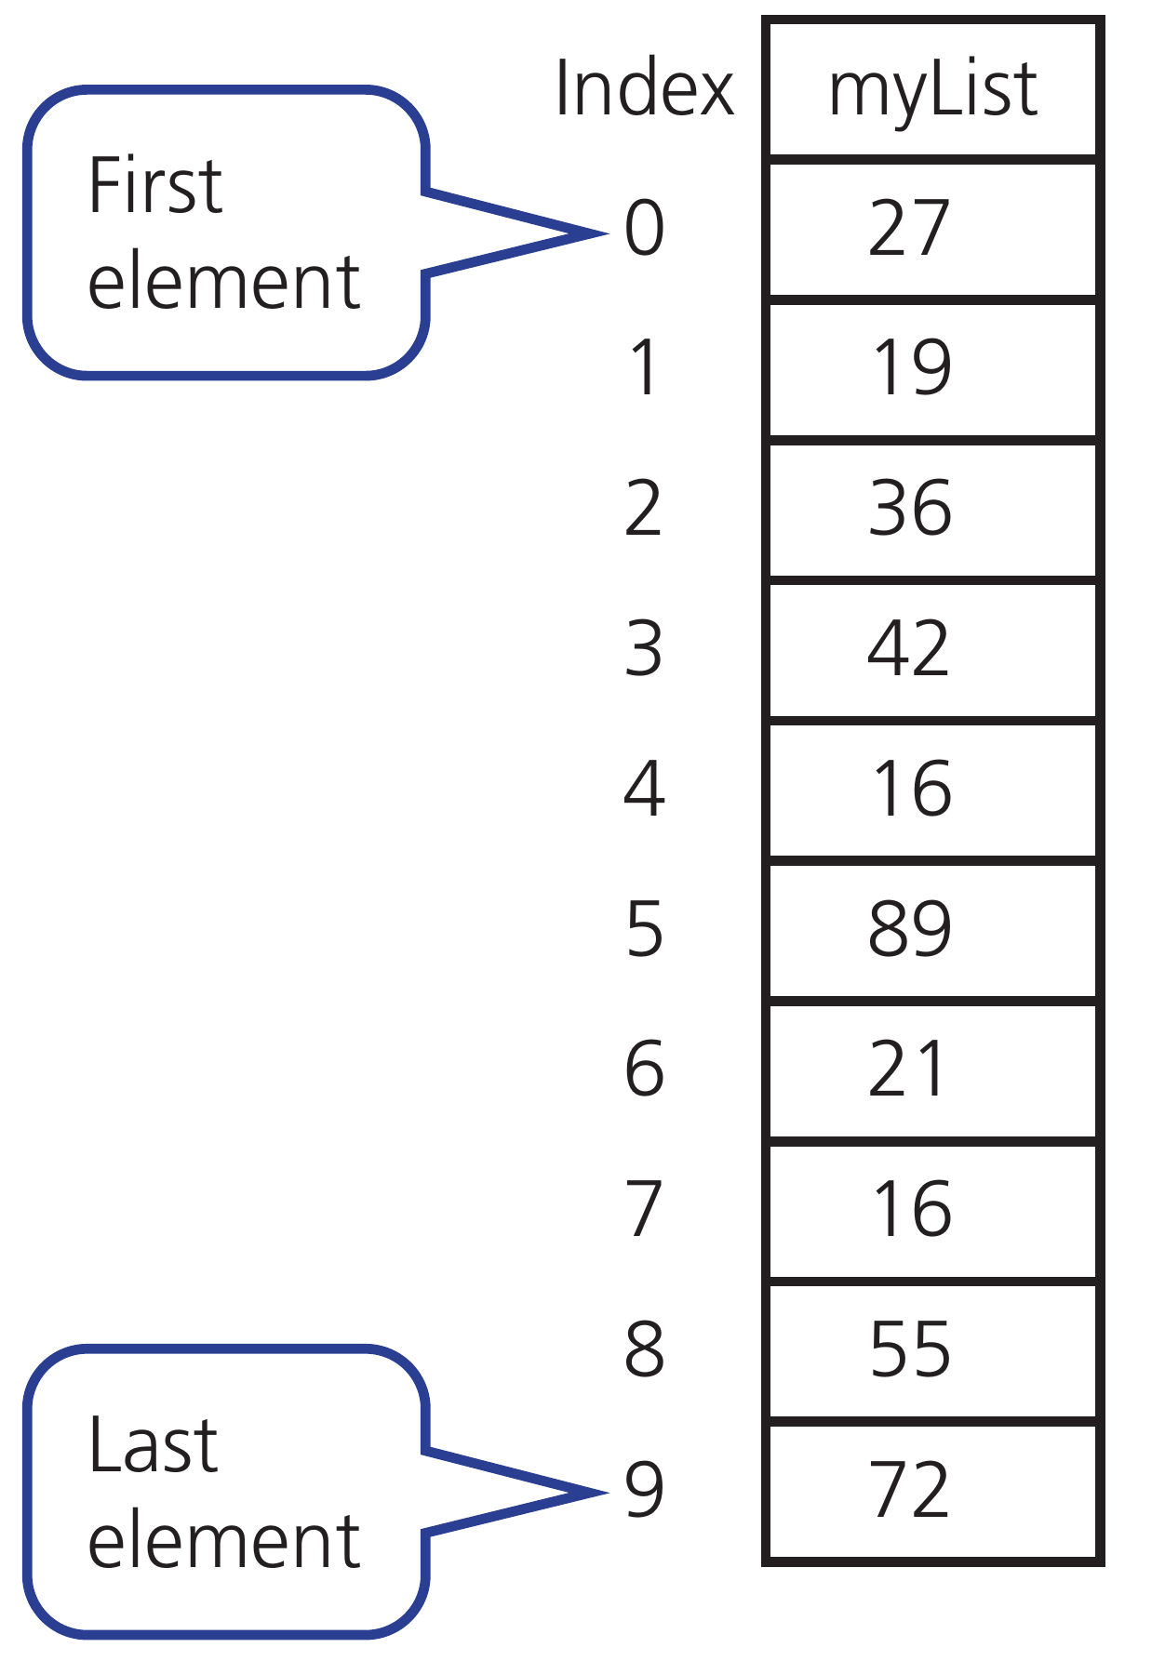
CHAPTER 8 8.2 · Array indexing
One-dimensional arrays
One index identifies one element.
This textbook example uses indexes 0 to 9.
The ten elements have the same data type.
Hodder p.330, Figure 8.10
CHECK What value is stored at index 1 in the diagram?
IGCSE 0478 2026–2028 / Answers in speaker notes
22 / 31
Notes:
MODEL ANSWER
19. Index 1 is the second element in this zero-based array.
TEACHING PROMPT
Ask students to predict first, explain their reasoning, then compare with the model answer. Use the linked chapter workbook for independent practice.
SOURCES
User-supplied Cambridge IGCSE Computer Science 0478 syllabus 2026–2028 Version 6, chapter 8 and Paper 2 conventions, in resources/chapters/08/syllabus.pdf. CUP second edition and Hodder Education 2021 chapter 8. Exact source-page mappings: resources/catalog.json. Image: Hodder p.330, Figure 8.10; cropped from the supplied textbook.
Original teaching examples and model answers unless a textbook figure is credited. Model answers are not official mark schemes.

Slide 23
CHAPTER 8 8.2 · One-dimensional arrays
Declaring and traversing an array
One identifier names a collection of elements with one data type.
DECLARE Scores : ARRAY[1:5] OF INTEGER
FOR Index ← 1 TO 5
INPUT Scores[Index]
NEXT Index
OUTPUT Scores[3]
An index selects an element. Keep every index within the declared bounds.
CHECK Which index is invalid for Scores: 0, 1 or 5?
IGCSE 0478 2026–2028 / Answers in speaker notes
23 / 31
Notes:
MODEL ANSWER
0 is invalid for the declared 1…5 bounds. Zero-based arrays are also allowed if used consistently.
TEACHING PROMPT
Use a row of five labelled boxes on the classroom board and trace reads and writes.
SOURCES
User-supplied Cambridge IGCSE Computer Science 0478 syllabus 2026–2028 Version 6, chapter 8 and Paper 2 conventions, in resources/chapters/08/syllabus.pdf. CUP second edition and Hodder Education 2021 chapter 8. Exact source-page mappings: resources/catalog.json.
Original teaching examples and model answers unless a textbook figure is credited. Model answers are not official mark schemes.

Slide 24
CHAPTER 8 8.2 · Bounds
Array bounds and element count
The declaration determines every legal index.
For inclusive bounds, count = upper − lower + 1.
Declaration | Legal indexes | Elements
ARRAY[1:5] | 1 through 5 | 5
ARRAY[0:4] | 0 through 4 | 5
ARRAY[1:3, 1:2] | Rows 1–3, columns 1–2 | 6
CHECK How many elements does ARRAY[0:4] contain?
IGCSE 0478 2026–2028 / Answers in speaker notes
24 / 31
Notes:
MODEL ANSWER
Five, at indexes 0, 1, 2, 3 and 4.
TEACHING PROMPT
Ask students to predict first, explain their reasoning, then compare with the model answer. Use the linked chapter workbook for independent practice.
SOURCES
User-supplied Cambridge IGCSE Computer Science 0478 syllabus 2026–2028 Version 6, chapter 8 and Paper 2 conventions, in resources/chapters/08/syllabus.pdf. CUP second edition and Hodder Education 2021 chapter 8. Exact source-page mappings: resources/catalog.json.
Original teaching examples and model answers unless a textbook figure is credited. Model answers are not official mark schemes.

Slide 25
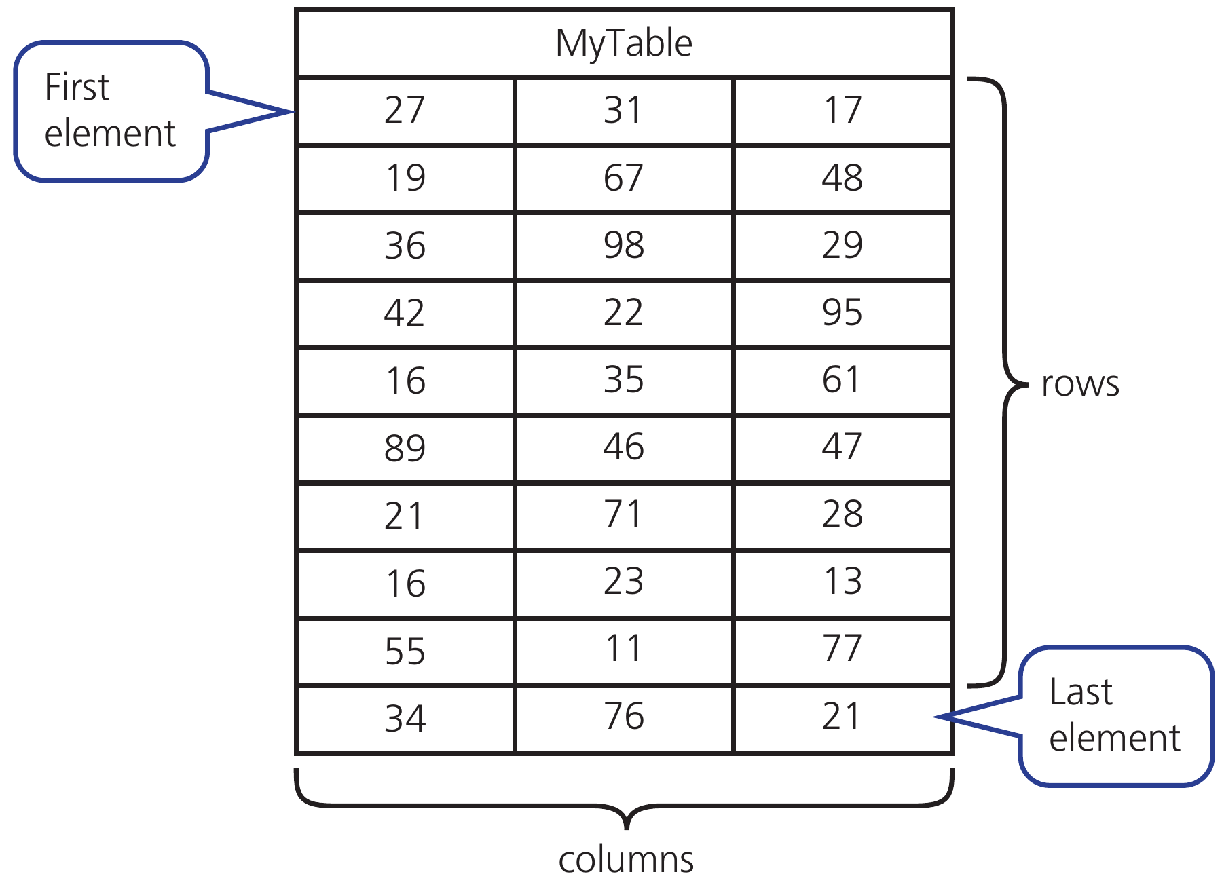
CHAPTER 8 8.2 · Two indexes
Two-dimensional arrays
The first index selects a row. The second selects a column.
This textbook diagram uses row and column indexes starting at 0.
Hodder p.331, Figure 8.11
CHECK What is MyTable[1, 2] in the diagram?
IGCSE 0478 2026–2028 / Answers in speaker notes
25 / 31
Notes:
MODEL ANSWER
48, in the second row and third column.
TEACHING PROMPT
Ask students to predict first, explain their reasoning, then compare with the model answer. Use the linked chapter workbook for independent practice.
SOURCES
User-supplied Cambridge IGCSE Computer Science 0478 syllabus 2026–2028 Version 6, chapter 8 and Paper 2 conventions, in resources/chapters/08/syllabus.pdf. CUP second edition and Hodder Education 2021 chapter 8. Exact source-page mappings: resources/catalog.json. Image: Hodder p.331, Figure 8.11; cropped from the supplied textbook.
Original teaching examples and model answers unless a textbook figure is credited. Model answers are not official mark schemes.

Slide 26
CHAPTER 8 8.2 · Two-dimensional arrays
Nested iteration through a 2D array
Rows identify students; columns identify quiz attempts.
DECLARE Mark : ARRAY[1:3, 1:2] OF INTEGER
// Assume Mark has already been populated
FOR Student ← 1 TO 3
Total ← 0
FOR Quiz ← 1 TO 2
Total ← Total + Mark[Student, Quiz]
NEXT Quiz
OUTPUT Total
NEXT Student
Use nested iteration to visit every cell.
Reset a row total inside the outer loop, before the inner loop.
CHECK How many additions are performed for 3 students and 2 quizzes?
IGCSE 0478 2026–2028 / Answers in speaker notes
26 / 31
Notes:
MODEL ANSWER
Six additions. Each of the three row totals receives two values.
TEACHING PROMPT
Assume all array values have been populated before this fragment. Ask what happens if Total is initialised only once before both loops.
SOURCES
User-supplied Cambridge IGCSE Computer Science 0478 syllabus 2026–2028 Version 6, chapter 8 and Paper 2 conventions, in resources/chapters/08/syllabus.pdf. CUP second edition and Hodder Education 2021 chapter 8. Exact source-page mappings: resources/catalog.json.
Original teaching examples and model answers unless a textbook figure is credited. Model answers are not official mark schemes.

Slide 27
CHAPTER 8 8.2 · Nested-loop trace
A row-total trace
Mark contains rows [4, 7], [2, 20], [0, 6].
Reset Total when a new student starts.
Student | Quiz 1 | Quiz 2 | Output Total
1 | 4 | 7 | 11
2 | 2 | 20 | 22
3 | 0 | 6 | 6
CHECK What would happen if Total were initialised only once?
IGCSE 0478 2026–2028 / Answers in speaker notes
27 / 31
Notes:
MODEL ANSWER
The outputs would be cumulative: 11, 33 and 39 instead of 11, 22 and 6.
TEACHING PROMPT
Ask students to predict first, explain their reasoning, then compare with the model answer. Use the linked chapter workbook for independent practice.
SOURCES
User-supplied Cambridge IGCSE Computer Science 0478 syllabus 2026–2028 Version 6, chapter 8 and Paper 2 conventions, in resources/chapters/08/syllabus.pdf. CUP second edition and Hodder Education 2021 chapter 8. Exact source-page mappings: resources/catalog.json.
Original teaching examples and model answers unless a textbook figure is credited. Model answers are not official mark schemes.

Slide 28
CHAPTER 8 8.3 · Writing a file
Writing persistent data
Open the file in WRITE mode before writing.
OPENFILE "summary.txt" FOR WRITE
Line ← "Ada,20"
WRITEFILE "summary.txt", Line
CLOSEFILE "summary.txt"
Close it when the operation finishes.
WRITE can replace existing contents.
CHECK What should the file contain after this code?
IGCSE 0478 2026–2028 / Answers in speaker notes
28 / 31
Notes:
MODEL ANSWER
A line containing Ada,20. Reopen the file in READ mode to check it.
TEACHING PROMPT
Ask students to predict first, explain their reasoning, then compare with the model answer. Use the linked chapter workbook for independent practice.
SOURCES
User-supplied Cambridge IGCSE Computer Science 0478 syllabus 2026–2028 Version 6, chapter 8 and Paper 2 conventions, in resources/chapters/08/syllabus.pdf. CUP second edition and Hodder Education 2021 chapter 8. Exact source-page mappings: resources/catalog.json.
Original teaching examples and model answers unless a textbook figure is credited. Model answers are not official mark schemes.

Slide 29
CHAPTER 8 8.3 · File handling
Reading a file until the end
Variables normally disappear when a program finishes; files preserve data.
OPENFILE "scores.txt" FOR READ
WHILE NOT EOF("scores.txt") DO
READFILE "scores.txt", Line
OUTPUT Line
ENDWHILE
CLOSEFILE "scores.txt"
Open a file in the intended mode, read or write, then close it.
Writing to a file may replace its previous contents.
CHECK What must be checked before reading repeatedly to the end of a file?
IGCSE 0478 2026–2028 / Answers in speaker notes
29 / 31
Notes:
MODEL ANSWER
Use an end-of-file check so the program does not attempt to read past the final line.
TEACHING PROMPT
Writing counterpart: OPENFILE "result.txt" FOR WRITE; WRITEFILE "result.txt", Line; CLOSEFILE "result.txt". Student task: read a name, save it, reopen and display it.
SOURCES
User-supplied Cambridge IGCSE Computer Science 0478 syllabus 2026–2028 Version 6, chapter 8 and Paper 2 conventions, in resources/chapters/08/syllabus.pdf. CUP second edition and Hodder Education 2021 chapter 8. Exact source-page mappings: resources/catalog.json.
Original teaching examples and model answers unless a textbook figure is credited. Model answers are not official mark schemes.

Slide 30
CHAPTER 8 8.3 · Read trace
The file cursor and EOF
Suppose the file has two lines: Ada,20 and Ben,15.
Check for end of file before reading another line.
Before reading | EOF? | Action
At first line | FALSE | Read and output Ada,20
At second line | FALSE | Read and output Ben,15
After final line | TRUE | Leave loop and close file
CHECK Why should the program check EOF before READFILE?
IGCSE 0478 2026–2028 / Answers in speaker notes
30 / 31
Notes:
MODEL ANSWER
There may be no next line to read, including when the file is empty.
TEACHING PROMPT
Ask students to predict first, explain their reasoning, then compare with the model answer. Use the linked chapter workbook for independent practice.
SOURCES
User-supplied Cambridge IGCSE Computer Science 0478 syllabus 2026–2028 Version 6, chapter 8 and Paper 2 conventions, in resources/chapters/08/syllabus.pdf. CUP second edition and Hodder Education 2021 chapter 8. Exact source-page mappings: resources/catalog.json.
Original teaching examples and model answers unless a textbook figure is credited. Model answers are not official mark schemes.

Slide 31
CHAPTER 8 8.1–8.3 · Integration
Complete programming task
01
Read five validated scores into an array.
02
Calculate total, mean and highest using named subprograms.
03
Save a summary; then reopen it to confirm the result.
CHECK Which tests cover both validation and calculation?
IGCSE 0478 2026–2028 / Answers in speaker notes
31 / 31
Notes:
MODEL ANSWER
Try all zeros, all twenties, mixed scores, a rejected −1 and 21, and invalid text. Verify expected totals, means, highest values and saved output.
TEACHING PROMPT
Suggested lesson 4: practical project. Start with the student brief and use the supplied Python model only after planning. For the exam 15-mark scenario, pseudocode, Python, Visual Basic or Java are allowed; use pseudocode for other coding questions.
SOURCES
User-supplied Cambridge IGCSE Computer Science 0478 syllabus 2026–2028 Version 6, chapter 8 and Paper 2 conventions, in resources/chapters/08/syllabus.pdf. CUP second edition and Hodder Education 2021 chapter 8. Exact source-page mappings: resources/catalog.json.
Original teaching examples and model answers unless a textbook figure is credited. Model answers are not official mark schemes.

