Slide 1
CHAPTER 10 10.1–10.2 · Foundations
Boolean values and logic gates
01
Use 0 / 1 or FALSE / TRUE consistently.
02
A gate maps input values to one output.
03
NOT has one input; the other required gates have two inputs.
CHECK How many input combinations are possible for three independent inputs?
IGCSE 0478 2026–2028 / Answers in speaker notes
1 / 22
Notes:
MODEL ANSWER
2³ = 8 combinations, from 000 through 111.
TEACHING PROMPT
Open the existing practice page for the six standard gate-symbol diagrams and compare with syllabus page 33.
SOURCES
User-supplied Cambridge IGCSE Computer Science 0478 syllabus 2026–2028 Version 6, chapter 10 and Paper 2 conventions, in resources/chapters/10/syllabus.pdf. CUP second edition and Hodder Education 2021 chapter 10. Exact source-page mappings: resources/catalog.json.
Original teaching examples and model answers unless a textbook figure is credited. Model answers are not official mark schemes.

Slide 2
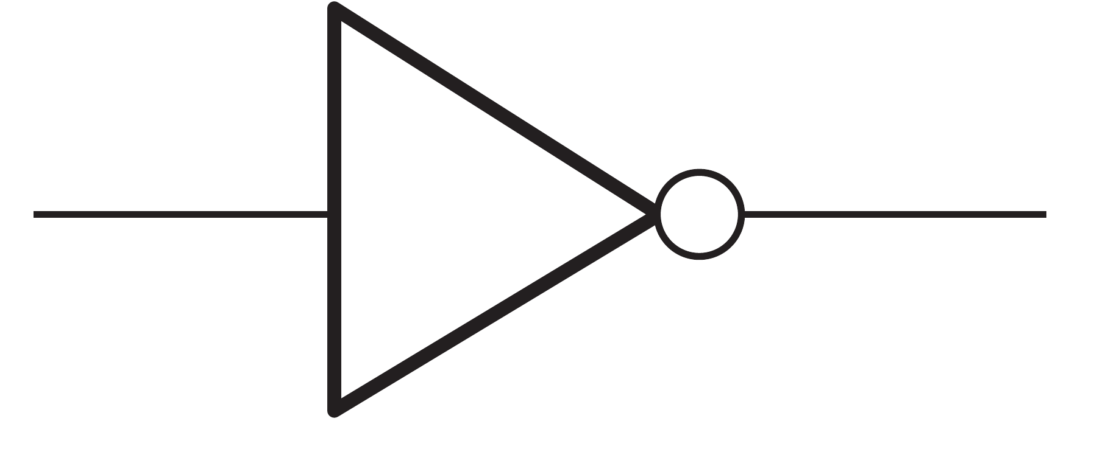
CHAPTER 10 10.1–10.2 · NOT
NOT gate
The output reverses the input.
Read inputs on the left and the output on the right.
A | X
0 | 1
1 | 0
Hodder p.357, Figure 10.1, NOT
CHECK If A = 0, what is X?
IGCSE 0478 2026–2028 / Answers in speaker notes
2 / 22
Notes:
MODEL ANSWER
1.
TEACHING PROMPT
Ask students to predict first, explain their reasoning, then compare with the model answer. Use the linked chapter workbook for independent practice.
SOURCES
User-supplied Cambridge IGCSE Computer Science 0478 syllabus 2026–2028 Version 6, chapter 10 and Paper 2 conventions, in resources/chapters/10/syllabus.pdf. CUP second edition and Hodder Education 2021 chapter 10. Exact source-page mappings: resources/catalog.json. Image: Hodder p.357, Figure 10.1, NOT; cropped from the supplied textbook.
Original teaching examples and model answers unless a textbook figure is credited. Model answers are not official mark schemes.

Slide 3
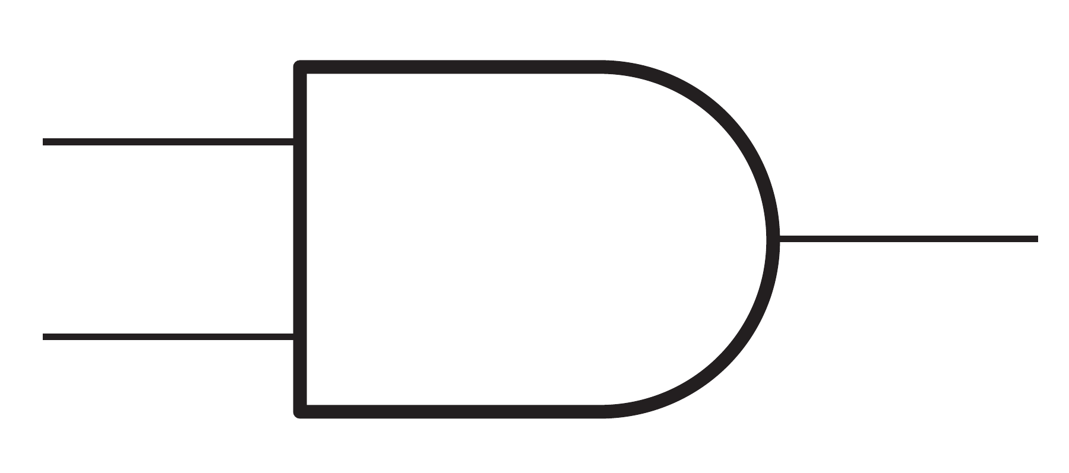
CHAPTER 10 10.1–10.2 · AND
AND gate
Both inputs must be 1.
Read inputs on the left and the output on the right.
A | B | X
0 | 0 | 0
0 | 1 | 0
1 | 0 | 0
1 | 1 | 1
Hodder p.357, Figure 10.1, AND
CHECK What is X for A = 1 and B = 0?
IGCSE 0478 2026–2028 / Answers in speaker notes
3 / 22
Notes:
MODEL ANSWER
0.
TEACHING PROMPT
Ask students to predict first, explain their reasoning, then compare with the model answer. Use the linked chapter workbook for independent practice.
SOURCES
User-supplied Cambridge IGCSE Computer Science 0478 syllabus 2026–2028 Version 6, chapter 10 and Paper 2 conventions, in resources/chapters/10/syllabus.pdf. CUP second edition and Hodder Education 2021 chapter 10. Exact source-page mappings: resources/catalog.json. Image: Hodder p.357, Figure 10.1, AND; cropped from the supplied textbook.
Original teaching examples and model answers unless a textbook figure is credited. Model answers are not official mark schemes.

Slide 4
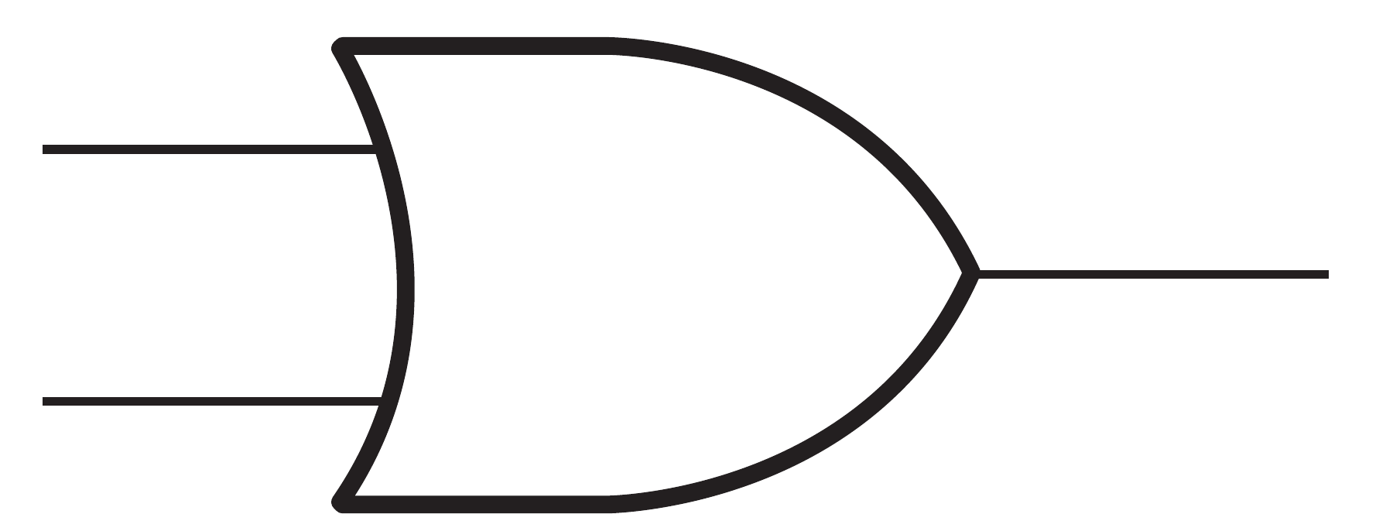
CHAPTER 10 10.1–10.2 · OR
OR gate
At least one input must be 1.
Read inputs on the left and the output on the right.
A | B | X
0 | 0 | 0
0 | 1 | 1
1 | 0 | 1
1 | 1 | 1
Hodder p.357, Figure 10.1, OR
CHECK Does OR include the case where both inputs are 1?
IGCSE 0478 2026–2028 / Answers in speaker notes
4 / 22
Notes:
MODEL ANSWER
Yes. OR is inclusive.
TEACHING PROMPT
Ask students to predict first, explain their reasoning, then compare with the model answer. Use the linked chapter workbook for independent practice.
SOURCES
User-supplied Cambridge IGCSE Computer Science 0478 syllabus 2026–2028 Version 6, chapter 10 and Paper 2 conventions, in resources/chapters/10/syllabus.pdf. CUP second edition and Hodder Education 2021 chapter 10. Exact source-page mappings: resources/catalog.json. Image: Hodder p.357, Figure 10.1, OR; cropped from the supplied textbook.
Original teaching examples and model answers unless a textbook figure is credited. Model answers are not official mark schemes.

Slide 5

CHAPTER 10 10.1–10.2 · XOR
XOR gate
Exactly one input must be 1.
Read inputs on the left and the output on the right.
A | B | X
0 | 0 | 0
0 | 1 | 1
1 | 0 | 1
1 | 1 | 0
Hodder p.357, Figure 10.1, XOR
CHECK How do OR and XOR differ for 11?
IGCSE 0478 2026–2028 / Answers in speaker notes
5 / 22
Notes:
MODEL ANSWER
OR gives 1. XOR gives 0.
TEACHING PROMPT
Ask students to predict first, explain their reasoning, then compare with the model answer. Use the linked chapter workbook for independent practice.
SOURCES
User-supplied Cambridge IGCSE Computer Science 0478 syllabus 2026–2028 Version 6, chapter 10 and Paper 2 conventions, in resources/chapters/10/syllabus.pdf. CUP second edition and Hodder Education 2021 chapter 10. Exact source-page mappings: resources/catalog.json. Image: Hodder p.357, Figure 10.1, XOR; cropped from the supplied textbook.
Original teaching examples and model answers unless a textbook figure is credited. Model answers are not official mark schemes.

Slide 6

CHAPTER 10 10.1–10.2 · NAND
NAND gate
Invert the output of AND.
Read inputs on the left and the output on the right.
A | B | X
0 | 0 | 1
0 | 1 | 1
1 | 0 | 1
1 | 1 | 0
Hodder p.357, Figure 10.1, NAND
CHECK Which input pair gives a NAND output of 0?
IGCSE 0478 2026–2028 / Answers in speaker notes
6 / 22
Notes:
MODEL ANSWER
11.
TEACHING PROMPT
Ask students to predict first, explain their reasoning, then compare with the model answer. Use the linked chapter workbook for independent practice.
SOURCES
User-supplied Cambridge IGCSE Computer Science 0478 syllabus 2026–2028 Version 6, chapter 10 and Paper 2 conventions, in resources/chapters/10/syllabus.pdf. CUP second edition and Hodder Education 2021 chapter 10. Exact source-page mappings: resources/catalog.json. Image: Hodder p.357, Figure 10.1, NAND; cropped from the supplied textbook.
Original teaching examples and model answers unless a textbook figure is credited. Model answers are not official mark schemes.

Slide 7

CHAPTER 10 10.1–10.2 · NOR
NOR gate
Invert the output of OR.
Read inputs on the left and the output on the right.
A | B | X
0 | 0 | 1
0 | 1 | 0
1 | 0 | 0
1 | 1 | 0
Hodder p.357, Figure 10.1, NOR
CHECK Which input pair gives a NOR output of 1?
IGCSE 0478 2026–2028 / Answers in speaker notes
7 / 22
Notes:
MODEL ANSWER
00.
TEACHING PROMPT
Ask students to predict first, explain their reasoning, then compare with the model answer. Use the linked chapter workbook for independent practice.
SOURCES
User-supplied Cambridge IGCSE Computer Science 0478 syllabus 2026–2028 Version 6, chapter 10 and Paper 2 conventions, in resources/chapters/10/syllabus.pdf. CUP second edition and Hodder Education 2021 chapter 10. Exact source-page mappings: resources/catalog.json. Image: Hodder p.357, Figure 10.1, NOR; cropped from the supplied textbook.
Original teaching examples and model answers unless a textbook figure is credited. Model answers are not official mark schemes.

Slide 8
CHAPTER 10 10.2 · Gate functions
Comparing the five two-input gates
AND: both 1. OR: at least one 1. XOR: exactly one 1.
NAND is NOT AND; NOR is NOT OR.
NOT reverses its single input: 0 → 1 and 1 → 0.
A | B | AND | OR | XOR | NAND | NOR
0 | 0 | 0 | 0 | 0 | 1 | 1
0 | 1 | 0 | 1 | 1 | 1 | 0
1 | 0 | 0 | 1 | 1 | 1 | 0
1 | 1 | 1 | 1 | 0 | 0 | 0
CHECK Which gates give 1 when both inputs are 1?
IGCSE 0478 2026–2028 / Answers in speaker notes
8 / 22
Notes:
MODEL ANSWER
AND and OR. NAND, NOR and XOR give 0 for 11.
TEACHING PROMPT
Ask students to predict first, explain their reasoning, then compare with the model answer. Use the linked chapter workbook for independent practice.
SOURCES
User-supplied Cambridge IGCSE Computer Science 0478 syllabus 2026–2028 Version 6, chapter 10 and Paper 2 conventions, in resources/chapters/10/syllabus.pdf. CUP second edition and Hodder Education 2021 chapter 10. Exact source-page mappings: resources/catalog.json.
Original teaching examples and model answers unless a textbook figure is credited. Model answers are not official mark schemes.

Slide 9
CHAPTER 10 10.3 · Input enumeration
Truth-table input combinations
For n independent inputs, list 2^n combinations.
Three inputs require eight rows, from 000 to 111.
A | B | C
0 | 0 | 0
0 | 0 | 1
0 | 1 | 0
0 | 1 | 1
1 | 0 | 0
1 | 0 | 1
1 | 1 | 0
1 | 1 | 1
CHECK What changes fastest in this ordering?
IGCSE 0478 2026–2028 / Answers in speaker notes
9 / 22
Notes:
MODEL ANSWER
C changes every row. B changes every two rows. A changes every four rows.
TEACHING PROMPT
Ask students to predict first, explain their reasoning, then compare with the model answer. Use the linked chapter workbook for independent practice.
SOURCES
User-supplied Cambridge IGCSE Computer Science 0478 syllabus 2026–2028 Version 6, chapter 10 and Paper 2 conventions, in resources/chapters/10/syllabus.pdf. CUP second edition and Hodder Education 2021 chapter 10. Exact source-page mappings: resources/catalog.json.
Original teaching examples and model answers unless a textbook figure is credited. Model answers are not official mark schemes.

Slide 10
CHAPTER 10 10.3 · Statement to expression
An alarm problem statement
A = door sensor active; B = window sensor active; C = alarm disabled.
P = A OR B
Q = NOT C
X = P AND Q
The alarm sounds if either sensor is active AND the alarm is not disabled.
Write the expression before drawing the circuit.
CHECK Write the alarm expression using A, B and C.
IGCSE 0478 2026–2028 / Answers in speaker notes
10 / 22
Notes:
MODEL ANSWER
X = (A OR B) AND NOT C. OR is inclusive: both sensors may be active.
TEACHING PROMPT
For a circuit, connect A and B to OR; connect C to NOT; connect the two intermediate outputs to AND. Do not simplify away gates specified by the statement.
SOURCES
User-supplied Cambridge IGCSE Computer Science 0478 syllabus 2026–2028 Version 6, chapter 10 and Paper 2 conventions, in resources/chapters/10/syllabus.pdf. CUP second edition and Hodder Education 2021 chapter 10. Exact source-page mappings: resources/catalog.json.
Original teaching examples and model answers unless a textbook figure is credited. Model answers are not official mark schemes.

Slide 11
CHAPTER 10 10.3 · Worked evaluation
Alarm: intermediate values
A = door active. B = window active. C = alarm disabled.
P = A OR B. Q = NOT C. X = P AND Q.
Case | A | B | C | P | Q | X
No sensor active | 0 | 0 | 0 | 0 | 1 | 0
Door active | 1 | 0 | 0 | 1 | 1 | 1
Door active, disabled | 1 | 0 | 1 | 1 | 0 | 0
CHECK For A = 1, B = 0, C = 1, find P, Q and X.
IGCSE 0478 2026–2028 / Answers in speaker notes
11 / 22
Notes:
MODEL ANSWER
P = 1, Q = 0, X = 0. Disabling the alarm prevents the sensor from sounding it.
TEACHING PROMPT
Ask students to predict first, explain their reasoning, then compare with the model answer. Use the linked chapter workbook for independent practice.
SOURCES
User-supplied Cambridge IGCSE Computer Science 0478 syllabus 2026–2028 Version 6, chapter 10 and Paper 2 conventions, in resources/chapters/10/syllabus.pdf. CUP second edition and Hodder Education 2021 chapter 10. Exact source-page mappings: resources/catalog.json.
Original teaching examples and model answers unless a textbook figure is credited. Model answers are not official mark schemes.

Slide 12
CHAPTER 10 10.3 · Expression to table
Alarm: the complete truth table
List all eight inputs in binary counting order.
Compute P and Q before computing X.
A complete truth table includes every combination once.
A | B | C | P = A OR B | Q = NOT C | X
0 | 0 | 0 | 0 | 1 | 0
0 | 0 | 1 | 0 | 0 | 0
0 | 1 | 0 | 1 | 1 | 1
0 | 1 | 1 | 1 | 0 | 0
1 | 0 | 0 | 1 | 1 | 1
1 | 0 | 1 | 1 | 0 | 0
1 | 1 | 0 | 1 | 1 | 1
1 | 1 | 1 | 1 | 0 | 0
CHECK Why is X = 0 for A = 1, B = 1, C = 1?
IGCSE 0478 2026–2028 / Answers in speaker notes
12 / 22
Notes:
MODEL ANSWER
The alarm is disabled: Q = NOT C = 0. Therefore P AND Q = 0.
TEACHING PROMPT
Ask students to predict first, explain their reasoning, then compare with the model answer. Use the linked chapter workbook for independent practice.
SOURCES
User-supplied Cambridge IGCSE Computer Science 0478 syllabus 2026–2028 Version 6, chapter 10 and Paper 2 conventions, in resources/chapters/10/syllabus.pdf. CUP second edition and Hodder Education 2021 chapter 10. Exact source-page mappings: resources/catalog.json.
Original teaching examples and model answers unless a textbook figure is credited. Model answers are not official mark schemes.

Slide 13
CHAPTER 10 10.3 · Table to expression
An expression from output-1 rows
01
For each output-1 row, create an AND term matching its input values.
02
Use NOT for a 0 input and the unchanged variable for a 1 input.
03
Join those row terms with OR.
CHECK For two inputs, only 01 and 10 give output 1. Write an expression.
IGCSE 0478 2026–2028 / Answers in speaker notes
13 / 22
Notes:
MODEL ANSWER
(NOT A AND B) OR (A AND NOT B). This has XOR behaviour; follow the requested form when drawing a circuit.
TEACHING PROMPT
Ask students to predict first, explain their reasoning, then compare with the model answer. Use the linked chapter workbook for independent practice.
SOURCES
User-supplied Cambridge IGCSE Computer Science 0478 syllabus 2026–2028 Version 6, chapter 10 and Paper 2 conventions, in resources/chapters/10/syllabus.pdf. CUP second edition and Hodder Education 2021 chapter 10. Exact source-page mappings: resources/catalog.json.
Original teaching examples and model answers unless a textbook figure is credited. Model answers are not official mark schemes.

Slide 14
CHAPTER 10 10.3 · Table to expression
Truth table to expression: a worked example
The only output-1 rows are 01 and 10.
Write one AND term for each selected row, then join with OR.
A | B | X | Term for an output-1 row
0 | 0 | 0 | —
0 | 1 | 1 | NOT A AND B
1 | 0 | 1 | A AND NOT B
1 | 1 | 0 | —
CHECK Write an expression without using XOR.
IGCSE 0478 2026–2028 / Answers in speaker notes
14 / 22
Notes:
MODEL ANSWER
(NOT A AND B) OR (A AND NOT B).
TEACHING PROMPT
Ask students to predict first, explain their reasoning, then compare with the model answer. Use the linked chapter workbook for independent practice.
SOURCES
User-supplied Cambridge IGCSE Computer Science 0478 syllabus 2026–2028 Version 6, chapter 10 and Paper 2 conventions, in resources/chapters/10/syllabus.pdf. CUP second edition and Hodder Education 2021 chapter 10. Exact source-page mappings: resources/catalog.json.
Original teaching examples and model answers unless a textbook figure is credited. Model answers are not official mark schemes.

Slide 15
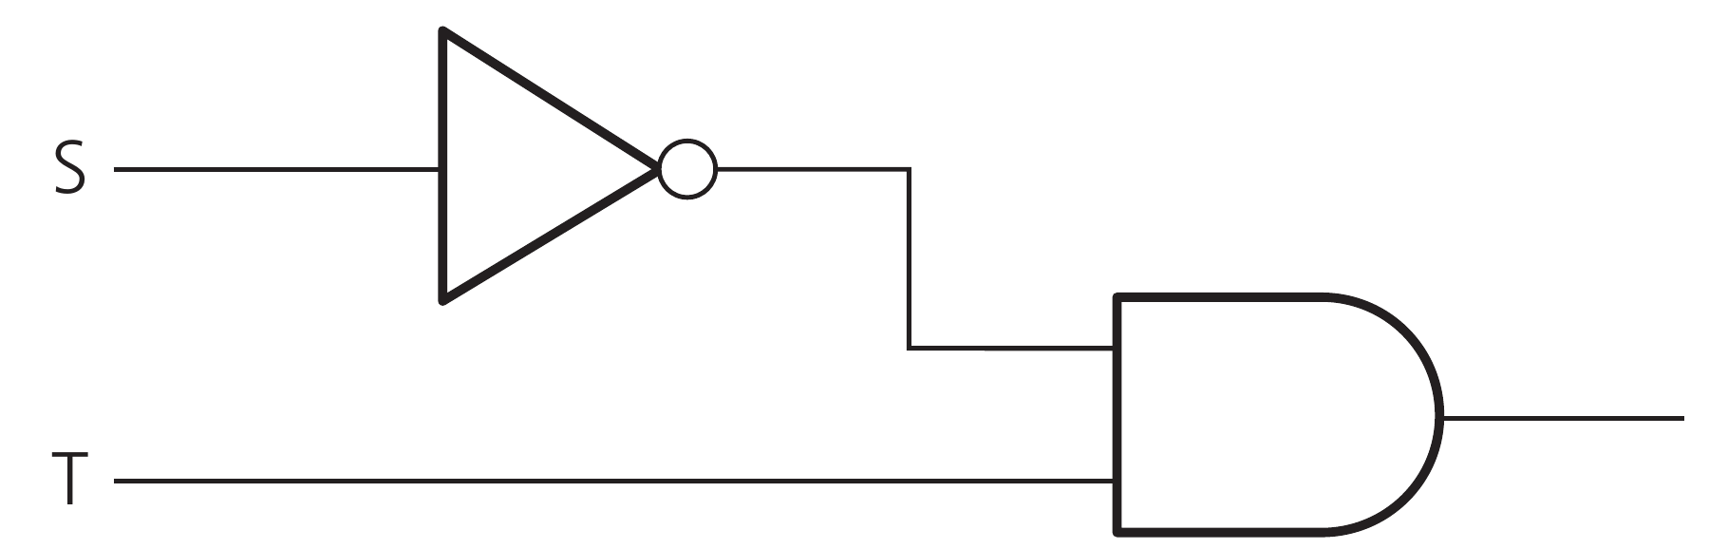
CHAPTER 10 10.3 · Expression to circuit
An expression becomes a circuit
This branch represents (NOT S AND T).
S passes through NOT before entering AND.
T enters the other AND input directly.
Hodder p.373, Figure 10.28
CHECK For S = 0 and T = 1, what is the branch output?
IGCSE 0478 2026–2028 / Answers in speaker notes
15 / 22
Notes:
MODEL ANSWER
1. NOT S = 1, and 1 AND 1 = 1.
TEACHING PROMPT
Ask students to predict first, explain their reasoning, then compare with the model answer. Use the linked chapter workbook for independent practice.
SOURCES
User-supplied Cambridge IGCSE Computer Science 0478 syllabus 2026–2028 Version 6, chapter 10 and Paper 2 conventions, in resources/chapters/10/syllabus.pdf. CUP second edition and Hodder Education 2021 chapter 10. Exact source-page mappings: resources/catalog.json. Image: Hodder p.373, Figure 10.28; cropped from the supplied textbook.
Original teaching examples and model answers unless a textbook figure is credited. Model answers are not official mark schemes.

Slide 16
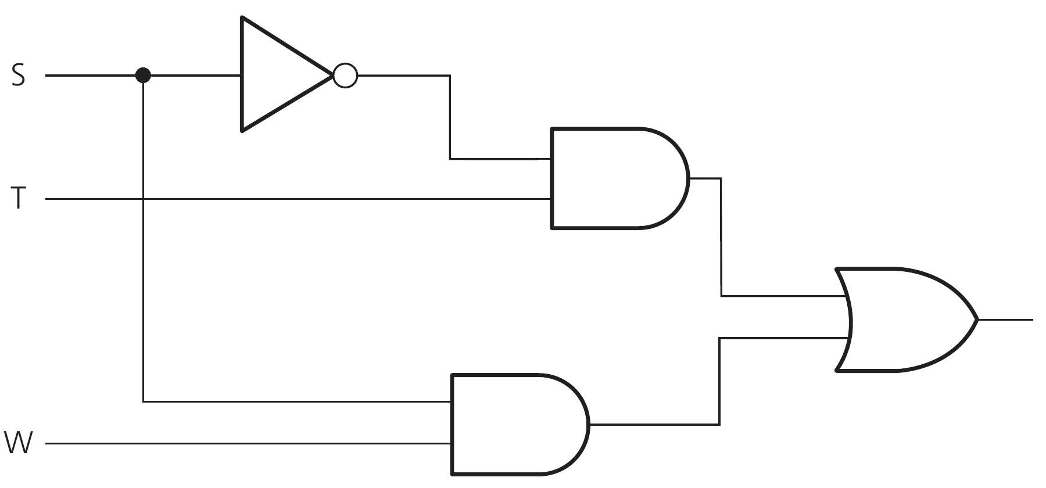
CHAPTER 10 10.3 · Circuit to expression
Combining two branches
The upper branch is NOT S AND T.
The lower branch is S AND W.
OR combines their two outputs.
Hodder p.373, Figure 10.31
CHECK Write the expression shown by this circuit.
IGCSE 0478 2026–2028 / Answers in speaker notes
16 / 22
Notes:
MODEL ANSWER
(NOT S AND T) OR (S AND W).
TEACHING PROMPT
Ask students to predict first, explain their reasoning, then compare with the model answer. Use the linked chapter workbook for independent practice.
SOURCES
User-supplied Cambridge IGCSE Computer Science 0478 syllabus 2026–2028 Version 6, chapter 10 and Paper 2 conventions, in resources/chapters/10/syllabus.pdf. CUP second edition and Hodder Education 2021 chapter 10. Exact source-page mappings: resources/catalog.json. Image: Hodder p.373, Figure 10.31; cropped from the supplied textbook.
Original teaching examples and model answers unless a textbook figure is credited. Model answers are not official mark schemes.

Slide 17
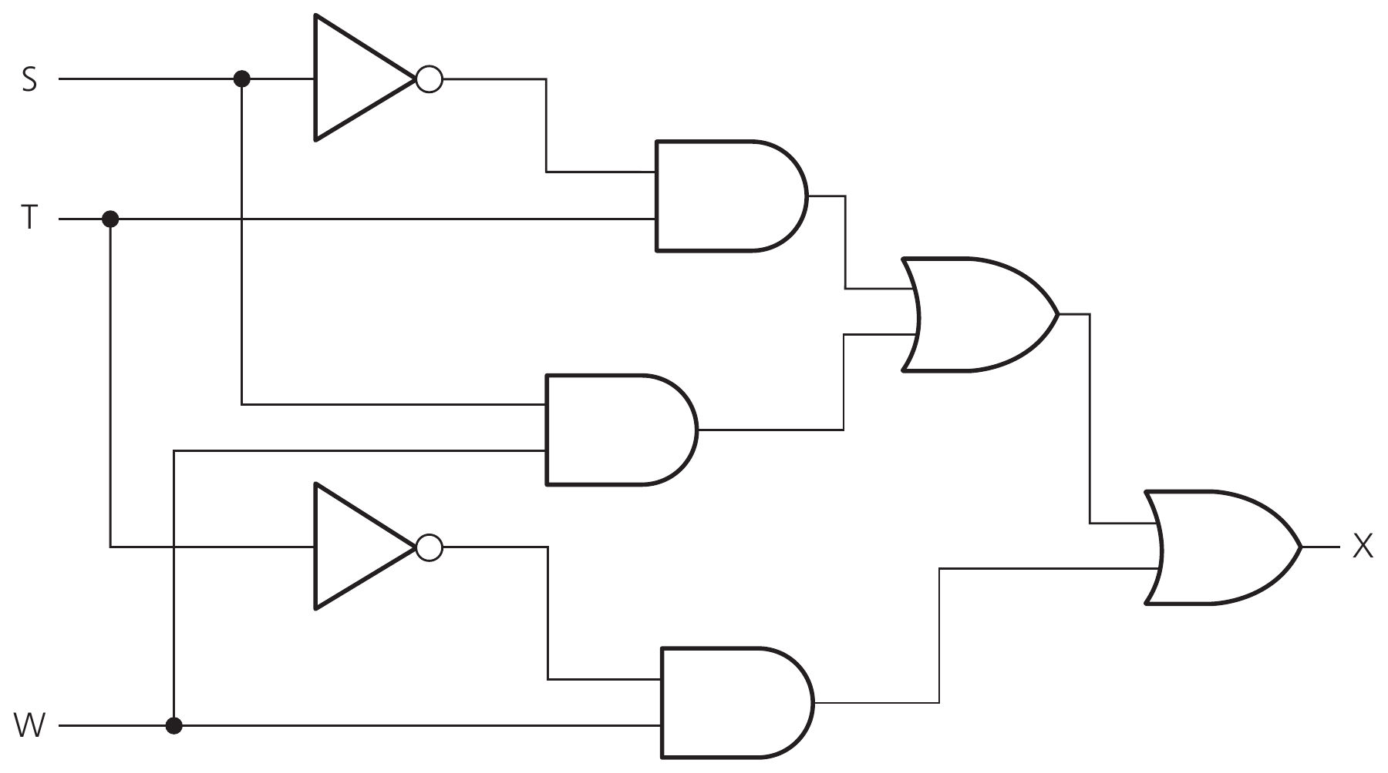
CHAPTER 10 10.3 · Complete circuit
A circuit with three inputs
A third branch adds (NOT T AND W).
Two-input OR gates join the three branch results.
The circuit retains every branch in the given expression.
Hodder p.374, Figure 10.32
CHECK How many NOT, AND and OR gates appear?
IGCSE 0478 2026–2028 / Answers in speaker notes
17 / 22
Notes:
MODEL ANSWER
Two NOT gates, three AND gates and two OR gates.
TEACHING PROMPT
Ask students to predict first, explain their reasoning, then compare with the model answer. Use the linked chapter workbook for independent practice.
SOURCES
User-supplied Cambridge IGCSE Computer Science 0478 syllabus 2026–2028 Version 6, chapter 10 and Paper 2 conventions, in resources/chapters/10/syllabus.pdf. CUP second edition and Hodder Education 2021 chapter 10. Exact source-page mappings: resources/catalog.json. Image: Hodder p.374, Figure 10.32; cropped from the supplied textbook.
Original teaching examples and model answers unless a textbook figure is credited. Model answers are not official mark schemes.

Slide 18
CHAPTER 10 10.3 · Circuit to truth table
Circuit trace: named intermediate values
P = NOT S AND T. Q = S AND W. R = NOT T AND W.
Final output X = (P OR Q) OR R.
S | T | W | P | Q | R | X
0 | 0 | 0 | 0 | 0 | 0 | 0
0 | 0 | 1 | 0 | 0 | 1 | 1
0 | 1 | 0 | 1 | 0 | 0 | 1
0 | 1 | 1 | 1 | 0 | 0 | 1
1 | 0 | 0 | 0 | 0 | 0 | 0
1 | 0 | 1 | 0 | 1 | 1 | 1
1 | 1 | 0 | 0 | 0 | 0 | 0
1 | 1 | 1 | 0 | 1 | 0 | 1
CHECK For S = 0, T = 1, W = 0, which branch makes X equal 1?
IGCSE 0478 2026–2028 / Answers in speaker notes
18 / 22
Notes:
MODEL ANSWER
P = 1. Q and R are both 0.
TEACHING PROMPT
Ask students to predict first, explain their reasoning, then compare with the model answer. Use the linked chapter workbook for independent practice.
SOURCES
User-supplied Cambridge IGCSE Computer Science 0478 syllabus 2026–2028 Version 6, chapter 10 and Paper 2 conventions, in resources/chapters/10/syllabus.pdf. CUP second edition and Hodder Education 2021 chapter 10. Exact source-page mappings: resources/catalog.json.
Original teaching examples and model answers unless a textbook figure is credited. Model answers are not official mark schemes.

Slide 19
CHAPTER 10 10.3 · Expression to circuit
Constructing a circuit from an expression
Use at most two inputs per non-NOT gate.
P = A AND B
Q = NOT A
R = Q AND C
X = P OR R
Build longer expressions from a sequence of two-input gates.
For 2026–2028, draw the statement as given without simplification.
CHECK How do you build (A AND B) OR (NOT A AND C)?
IGCSE 0478 2026–2028 / Answers in speaker notes
19 / 22
Notes:
MODEL ANSWER
Create the two AND results separately, including NOT A, then feed their outputs into an OR gate.
TEACHING PROMPT
Ask students to predict first, explain their reasoning, then compare with the model answer. Use the linked chapter workbook for independent practice.
SOURCES
User-supplied Cambridge IGCSE Computer Science 0478 syllabus 2026–2028 Version 6, chapter 10 and Paper 2 conventions, in resources/chapters/10/syllabus.pdf. CUP second edition and Hodder Education 2021 chapter 10. Exact source-page mappings: resources/catalog.json.
Original teaching examples and model answers unless a textbook figure is credited. Model answers are not official mark schemes.

Slide 20
CHAPTER 10 10.3 · Independent practice
Independent circuit task
01
Name every intermediate output.
02
Trace one test input through all gates.
03
Then complete the truth table and compare it with the problem statement.
CHECK For (A AND B) OR (NOT A AND C), find X when A = 0, B = 1, C = 1.
IGCSE 0478 2026–2028 / Answers in speaker notes
20 / 22
Notes:
MODEL ANSWER
P = 0, Q = 1, R = 1, X = 1. The unselected branch cannot change this OR result.
TEACHING PROMPT
Exit task: draw the circuit, enumerate all eight rows, then explain in words when X is 1. Homework: Hodder chapter 10 workbook then PMT 10. Full adders in the textbook are enrichment, not an extra 2026–2028 requirement.
SOURCES
User-supplied Cambridge IGCSE Computer Science 0478 syllabus 2026–2028 Version 6, chapter 10 and Paper 2 conventions, in resources/chapters/10/syllabus.pdf. CUP second edition and Hodder Education 2021 chapter 10. Exact source-page mappings: resources/catalog.json.
Original teaching examples and model answers unless a textbook figure is credited. Model answers are not official mark schemes.

Slide 21
CHAPTER 10 10.3 · Model answer
Circuit task: model truth table
P = A AND B. Q = NOT A. R = Q AND C.
X = P OR R. All eight combinations appear once.
A | B | C | P | Q | R | X
0 | 0 | 0 | 0 | 1 | 0 | 0
0 | 0 | 1 | 0 | 1 | 1 | 1
0 | 1 | 0 | 0 | 1 | 0 | 0
0 | 1 | 1 | 0 | 1 | 1 | 1
1 | 0 | 0 | 0 | 0 | 0 | 0
1 | 0 | 1 | 0 | 0 | 0 | 0
1 | 1 | 0 | 1 | 0 | 0 | 1
1 | 1 | 1 | 1 | 0 | 0 | 1
CHECK Describe how A controls the result.
IGCSE 0478 2026–2028 / Answers in speaker notes
21 / 22
Notes:
MODEL ANSWER
When A = 1, X follows B. When A = 0, X follows C. Keep the original gates when the question asks for the unsimplified circuit.
TEACHING PROMPT
Ask students to predict first, explain their reasoning, then compare with the model answer. Use the linked chapter workbook for independent practice.
SOURCES
User-supplied Cambridge IGCSE Computer Science 0478 syllabus 2026–2028 Version 6, chapter 10 and Paper 2 conventions, in resources/chapters/10/syllabus.pdf. CUP second edition and Hodder Education 2021 chapter 10. Exact source-page mappings: resources/catalog.json.
Original teaching examples and model answers unless a textbook figure is credited. Model answers are not official mark schemes.

Slide 22
CHAPTER 10 10.3 · Review
Logic-circuit checks
01
Use one input for NOT and two for each other required gate.
02
Label external inputs, intermediate results and the final output.
03
Keep all branches required by the original statement.
CHECK What does a small circle on a gate’s output mean?
IGCSE 0478 2026–2028 / Answers in speaker notes
22 / 22
Notes:
MODEL ANSWER
Inversion. It changes each 0 to 1 and each 1 to 0.
TEACHING PROMPT
Check one complete input trace before completing the whole truth table. Use the chapter workbook and PMT Topic 10 questions for further practice.
SOURCES
User-supplied Cambridge IGCSE Computer Science 0478 syllabus 2026–2028 Version 6, chapter 10 and Paper 2 conventions, in resources/chapters/10/syllabus.pdf. CUP second edition and Hodder Education 2021 chapter 10. Exact source-page mappings: resources/catalog.json.
Original teaching examples and model answers unless a textbook figure is credited. Model answers are not official mark schemes.

