Slide 1
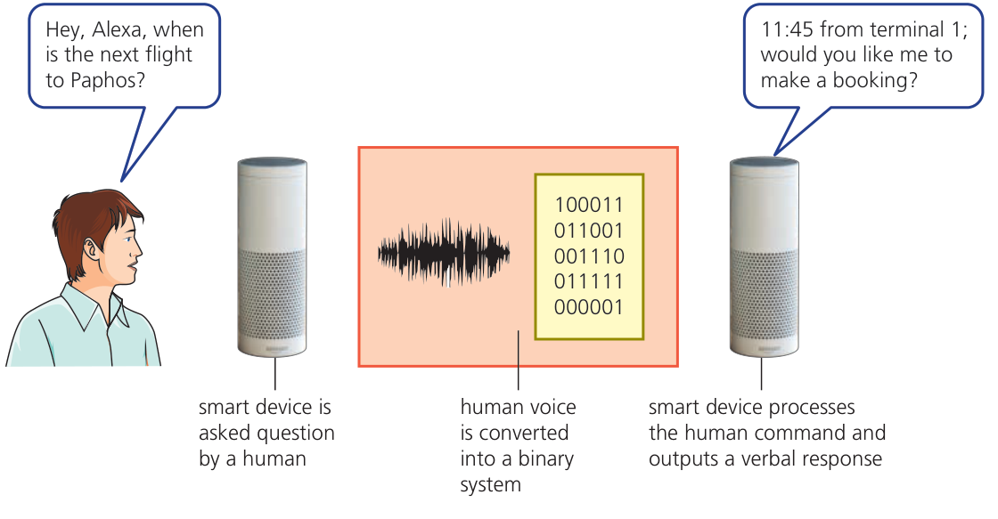
CHAPTER 6 6.3 · Overview
Artificial intelligence
Computer systems can simulate intelligent behaviour.
Syllabus 6.3: expert systems and machine learning.
Hodder p.242, Figure 6.21
CHECK Which part of this example involves interpreting data?
IGCSE 0478 2026–2028 / Answers in speaker notes
1 / 16
Notes:
MODEL ANSWER
The system processes the spoken request and determines a suitable response.
TEACHING PROMPT
Students explain their reasoning before opening the model answer. Accept equivalent precise wording.
SOURCES
Syllabus 6.3. Hodder pp.241–243. Cambridge pp.136–137.
User-supplied Cambridge IGCSE Computer Science 0478 syllabus 2026–2028, Version 6, PDF page 24. User-supplied Hodder Education 2021 Computer Science textbook and Cambridge University Press second-edition Computer Science Coursebook. Image: Hodder p.242, Figure 6.21, extracted from the supplied textbook.
Original teaching examples and model answers unless identified as a textbook figure. Model answers are not official mark schemes.

Slide 2
CHAPTER 6 6.3 · Characteristics
Characteristics of AI
01
An AI system collects data and uses rules or processes to work with it.
02
Reasoning uses available information to reach conclusions.
03
Some AI systems can learn and adapt, but learning is not required in every AI system.
CHECK Does a rule-based expert system have to learn automatically?
IGCSE 0478 2026–2028 / Answers in speaker notes
2 / 16
Notes:
MODEL ANSWER
No. It can simulate expert reasoning using facts and rules supplied by people.
TEACHING PROMPT
Students explain their reasoning before opening the model answer. Accept equivalent precise wording.
SOURCES
Syllabus 6.3, objectives 1–2. Cambridge p.137.
User-supplied Cambridge IGCSE Computer Science 0478 syllabus 2026–2028, Version 6, PDF page 24. User-supplied Hodder Education 2021 Computer Science textbook and Cambridge University Press second-edition Computer Science Coursebook.
Original teaching examples and model answers unless identified as a textbook figure. Model answers are not official mark schemes.

Slide 3
CHAPTER 6 6.3 · Applications
AI tasks and their data
The data must be relevant to the task the system performs.
Task | Input data | Possible output
Speech recognition | Recorded speech | Recognised words
Image recognition | Image pixels | An object label
Fault diagnosis | Observed symptoms | A likely cause or next check
Spam detection | Message features | Spam or legitimate
CHECK What data could help a system identify a spoken command?
IGCSE 0478 2026–2028 / Answers in speaker notes
3 / 16
Notes:
MODEL ANSWER
An audio recording or digital representation of the speech, together with processes trained or programmed to recognise words.
TEACHING PROMPT
Students explain their reasoning before opening the model answer. Accept equivalent precise wording.
SOURCES
Cambridge pp.136–137. Hodder pp.243,247.
User-supplied Cambridge IGCSE Computer Science 0478 syllabus 2026–2028, Version 6, PDF page 24. User-supplied Hodder Education 2021 Computer Science textbook and Cambridge University Press second-edition Computer Science Coursebook.
Original teaching examples and model answers unless identified as a textbook figure. Model answers are not official mark schemes.

Slide 4
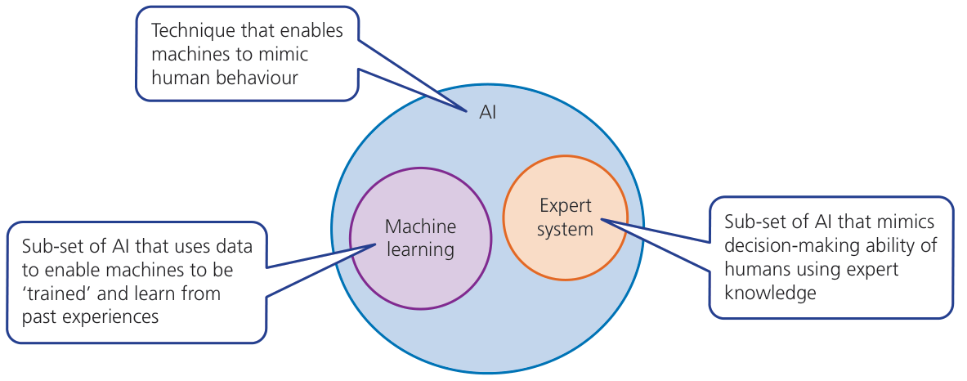
CHAPTER 6 6.3 · AI systems
Expert systems and machine learning
Both are within the scope of AI in this syllabus.
An expert system applies specialist knowledge and rules.
Machine learning adapts processes or data using experience or examples.
Hodder p.246, Figure 6.25
CHECK Which approach can update its model from training examples?
IGCSE 0478 2026–2028 / Answers in speaker notes
4 / 16
Notes:
MODEL ANSWER
Machine learning.
TEACHING PROMPT
Students explain their reasoning before opening the model answer. Accept equivalent precise wording.
SOURCES
Hodder p.246, Figure 6.25. Syllabus 6.3.
User-supplied Cambridge IGCSE Computer Science 0478 syllabus 2026–2028, Version 6, PDF page 24. User-supplied Hodder Education 2021 Computer Science textbook and Cambridge University Press second-edition Computer Science Coursebook. Image: Hodder p.246, Figure 6.25, extracted from the supplied textbook.
Original teaching examples and model answers unless identified as a textbook figure. Model answers are not official mark schemes.

Slide 5
CHAPTER 6 6.3 · Expert systems
The four expert-system components
An expert system simulates the decisions of an expert in a specific subject.
Component | Role
Knowledge base | Stores specialist facts and knowledge
Rule base | Stores rules that link facts to conclusions
Inference engine | Applies rules to available facts and user input
Interface | Accepts input and presents questions or conclusions
CHECK Which component applies the rules?
IGCSE 0478 2026–2028 / Answers in speaker notes
5 / 16
Notes:
MODEL ANSWER
The inference engine.
TEACHING PROMPT
Students explain their reasoning before opening the model answer. Accept equivalent precise wording.
SOURCES
Syllabus 6.3. Hodder pp.244–245. Cambridge p.139.
User-supplied Cambridge IGCSE Computer Science 0478 syllabus 2026–2028, Version 6, PDF page 24. User-supplied Hodder Education 2021 Computer Science textbook and Cambridge University Press second-edition Computer Science Coursebook.
Original teaching examples and model answers unless identified as a textbook figure. Model answers are not official mark schemes.

Slide 6
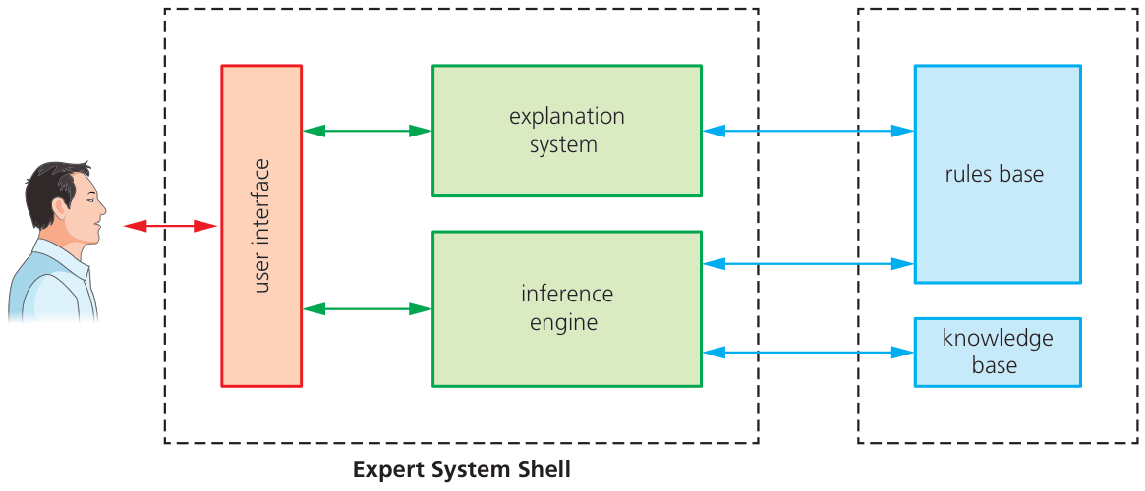
CHAPTER 6 6.3 · Expert-system structure
How the components interact
The interface collects the user’s answers.
The inference engine uses the knowledge and rules to choose the next question or conclusion.
The diagram also shows an explanation system, which is outside the required component list.
Hodder p.244, Figure 6.23
CHECK Which two stored resources does the inference engine use?
IGCSE 0478 2026–2028 / Answers in speaker notes
6 / 16
Notes:
MODEL ANSWER
The knowledge base and the rule base.
TEACHING PROMPT
Students explain their reasoning before opening the model answer. Accept equivalent precise wording.
SOURCES
Hodder p.244, Figure 6.23. Syllabus 6.3 lists four required components.
User-supplied Cambridge IGCSE Computer Science 0478 syllabus 2026–2028, Version 6, PDF page 24. User-supplied Hodder Education 2021 Computer Science textbook and Cambridge University Press second-edition Computer Science Coursebook. Image: Hodder p.244, Figure 6.23, extracted from the supplied textbook.
Original teaching examples and model answers unless identified as a textbook figure. Model answers are not official mark schemes.

Slide 7
CHAPTER 6 6.3 · Worked example
Printer diagnosis: information and rules
This original classroom system diagnoses a printer that will not print.
Item | Example
User input | Power light on, paper warning on
Stored fact | The paper warning indicates a paper supply problem
Rule | IF paper warning is on THEN check the paper tray
Conclusion | Load paper if the tray is empty, then test again
CHECK Is “the paper tray is empty” a fact or a rule?
IGCSE 0478 2026–2028 / Answers in speaker notes
7 / 16
Notes:
MODEL ANSWER
A fact. A rule links a condition such as an empty tray to an action such as loading paper.
TEACHING PROMPT
Students explain their reasoning before opening the model answer. Accept equivalent precise wording.
SOURCES
Original example based on Cambridge p.139.
User-supplied Cambridge IGCSE Computer Science 0478 syllabus 2026–2028, Version 6, PDF page 24. User-supplied Hodder Education 2021 Computer Science textbook and Cambridge University Press second-edition Computer Science Coursebook.
Original teaching examples and model answers unless identified as a textbook figure. Model answers are not official mark schemes.

Slide 8
CHAPTER 6 6.3 · Rule trace
Tracing an inference
The engine applies the rule whose conditions match the known facts.
A new answer may determine the next question.
Rule | Condition | Suggested action
1 | Power light off | Check the power connection
2 | Power on AND tray empty | Load paper
3 | Power on AND tray has paper | Check for a paper jam
CHECK Power is on and the tray is empty. Which rule applies?
IGCSE 0478 2026–2028 / Answers in speaker notes
8 / 16
Notes:
MODEL ANSWER
Rule 2. The system suggests loading paper. It should then check whether the printer works.
TEACHING PROMPT
Students explain their reasoning before opening the model answer. Accept equivalent precise wording.
SOURCES
Original simplified classroom rules, not a complete diagnostic system.
User-supplied Cambridge IGCSE Computer Science 0478 syllabus 2026–2028, Version 6, PDF page 24. User-supplied Hodder Education 2021 Computer Science textbook and Cambridge University Press second-edition Computer Science Coursebook.
Original teaching examples and model answers unless identified as a textbook figure. Model answers are not official mark schemes.

Slide 9
CHAPTER 6 6.3 · Development
Building an expert system
01
Experts provide reliable knowledge about a specific subject.
02
Developers express the reasoning as rules and create an interface.
03
Testing compares the system’s conclusions with known cases, then corrects faults.
CHECK Why should experts review the rules after an update?
IGCSE 0478 2026–2028 / Answers in speaker notes
9 / 16
Notes:
MODEL ANSWER
An incorrect or outdated rule can lead the inference engine to a wrong conclusion.
TEACHING PROMPT
Ask students to add one new printer symptom and a rule. Use a known case to test the rule.
SOURCES
Hodder p.245.
User-supplied Cambridge IGCSE Computer Science 0478 syllabus 2026–2028, Version 6, PDF page 24. User-supplied Hodder Education 2021 Computer Science textbook and Cambridge University Press second-edition Computer Science Coursebook.
Original teaching examples and model answers unless identified as a textbook figure. Model answers are not official mark schemes.

Slide 10
CHAPTER 6 6.3 · Evaluation
Limits of expert systems
01
The same input and rules can give consistent advice.
02
Wrong input, missing facts or outdated rules can produce a poor conclusion.
03
The system works within the knowledge and rules available to it.
CHECK Why should a user question a surprising result?
IGCSE 0478 2026–2028 / Answers in speaker notes
10 / 16
Notes:
MODEL ANSWER
The result depends on the entered data and the stored knowledge and rules. They may be incomplete or incorrect.
TEACHING PROMPT
Students explain their reasoning before opening the model answer. Accept equivalent precise wording.
SOURCES
Hodder pp.243–244. Original explanation avoids assuming systems are always accurate or unbiased.
User-supplied Cambridge IGCSE Computer Science 0478 syllabus 2026–2028, Version 6, PDF page 24. User-supplied Hodder Education 2021 Computer Science textbook and Cambridge University Press second-edition Computer Science Coursebook.
Original teaching examples and model answers unless identified as a textbook figure. Model answers are not official mark schemes.

Slide 11
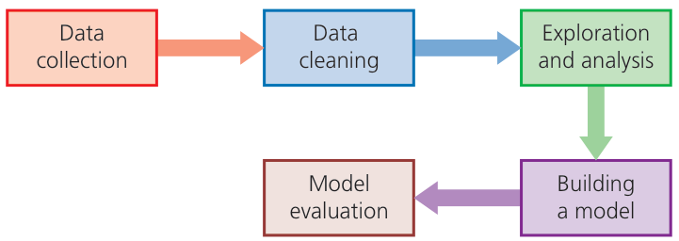
CHAPTER 6 6.3 · Machine learning
Machine learning
A machine-learning program can automatically adapt its processes or data.
Training examples help a model learn patterns.
Evaluation checks how well it performs on suitable data.
Hodder p.248, Figure 6.27
CHECK What changes during learning?
IGCSE 0478 2026–2028 / Answers in speaker notes
11 / 16
Notes:
MODEL ANSWER
The model’s stored data, parameters or processing behaviour changes as a result of training or experience.
TEACHING PROMPT
Students explain their reasoning before opening the model answer. Accept equivalent precise wording.
SOURCES
Syllabus 6.3. Hodder pp.247–248. Cambridge pp.137–138.
User-supplied Cambridge IGCSE Computer Science 0478 syllabus 2026–2028, Version 6, PDF page 24. User-supplied Hodder Education 2021 Computer Science textbook and Cambridge University Press second-edition Computer Science Coursebook. Image: Hodder p.248, Figure 6.27, extracted from the supplied textbook.
Original teaching examples and model answers unless identified as a textbook figure. Model answers are not official mark schemes.

Slide 12
CHAPTER 6 6.3 · Worked example
Learning to identify spam
A training set contains examples of legitimate and spam email.
The system learns useful patterns in message features.
Stage | Spam-filter example
Collect | Gather representative examples with known categories
Train | Learn patterns in content and message information
Test | Classify different examples and compare with known labels
Improve | Use suitable new examples to address errors
CHECK Why is a hand-written list of blocked words alone insufficient evidence of learning?
IGCSE 0478 2026–2028 / Answers in speaker notes
12 / 16
Notes:
MODEL ANSWER
A fixed list may only apply rules. Learning requires the program to adapt its processes or data using examples or experience.
TEACHING PROMPT
Students explain their reasoning before opening the model answer. Accept equivalent precise wording.
SOURCES
Hodder p.247. Original stage summary.
User-supplied Cambridge IGCSE Computer Science 0478 syllabus 2026–2028, Version 6, PDF page 24. User-supplied Hodder Education 2021 Computer Science textbook and Cambridge University Press second-edition Computer Science Coursebook.
Original teaching examples and model answers unless identified as a textbook figure. Model answers are not official mark schemes.

Slide 13
CHAPTER 6 6.3 · Testing
Unseen data and mistakes
A model must work on new inputs, not only the examples used for training.
Training data that misses important cases can produce poor predictions.
Message | Correct category | Possible mistake
Normal school announcement | Legitimate | Wrongly sent to spam
A deceptive prize message | Spam | Wrongly left in the inbox
A new type of message | Depends on its content | Model may need better examples
CHECK Why can a filter make mistakes even after training?
IGCSE 0478 2026–2028 / Answers in speaker notes
13 / 16
Notes:
MODEL ANSWER
Training examples may be limited, data may be misleading, and new messages may differ from the patterns it learned.
TEACHING PROMPT
The correct labels in this table are teaching assumptions. Discuss the costs of the two types of error without introducing unnecessary technical terminology.
SOURCES
Original examples applying syllabus 6.3 and Hodder pp.247–248.
User-supplied Cambridge IGCSE Computer Science 0478 syllabus 2026–2028, Version 6, PDF page 24. User-supplied Hodder Education 2021 Computer Science textbook and Cambridge University Press second-edition Computer Science Coursebook.
Original teaching examples and model answers unless identified as a textbook figure. Model answers are not official mark schemes.

Slide 14
CHAPTER 6 6.3 · Comparison
Expert rules and learning compared
The distinction concerns how the system uses and changes knowledge.
Aspect | Conventional expert system | Machine learning
Knowledge | Experts supply facts and rules | Model learns patterns from data
Main process | Apply rules to facts and input | Use learned patterns on new input
Improvement | People update facts and rules | Training adapts the model
Shared limitation | Poor knowledge can mislead | Poor training data can mislead
CHECK Does every expert system automatically improve after each use?
IGCSE 0478 2026–2028 / Answers in speaker notes
14 / 16
Notes:
MODEL ANSWER
No. A conventional expert system usually needs people to update its facts and rules.
TEACHING PROMPT
Students explain their reasoning before opening the model answer. Accept equivalent precise wording.
SOURCES
Syllabus 6.3. Cambridge pp.137–139. Hodder pp.243–248.
User-supplied Cambridge IGCSE Computer Science 0478 syllabus 2026–2028, Version 6, PDF page 24. User-supplied Hodder Education 2021 Computer Science textbook and Cambridge University Press second-edition Computer Science Coursebook.
Original teaching examples and model answers unless identified as a textbook figure. Model answers are not official mark schemes.

Slide 15
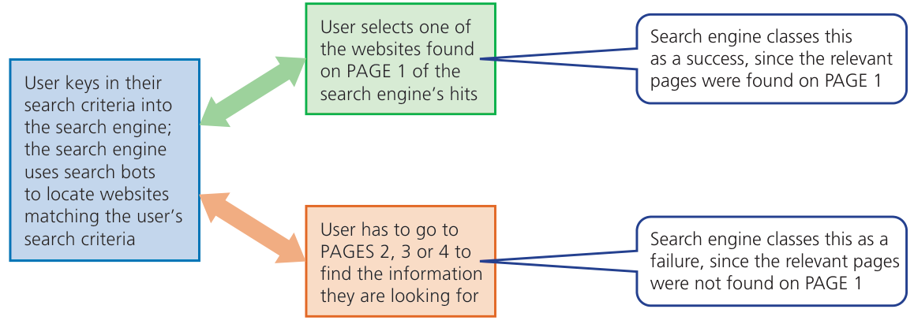
CHAPTER 6 6.3 · Learning from feedback
Feedback can help a model adapt
The textbook shows a simplified search-engine example.
User choices can provide feedback about the results.
A click is only a signal. It does not prove that a page answered the question correctly.
Hodder p.247, Figure 6.26
CHECK What further evidence could improve the feedback?
IGCSE 0478 2026–2028 / Answers in speaker notes
15 / 16
Notes:
MODEL ANSWER
For example, whether the user found the information useful. No single signal guarantees relevance.
TEACHING PROMPT
Students explain their reasoning before opening the model answer. Accept equivalent precise wording.
SOURCES
Hodder p.247, Figure 6.26. Qualification and check are original teaching commentary.
User-supplied Cambridge IGCSE Computer Science 0478 syllabus 2026–2028, Version 6, PDF page 24. User-supplied Hodder Education 2021 Computer Science textbook and Cambridge University Press second-edition Computer Science Coursebook. Image: Hodder p.247, Figure 6.26, extracted from the supplied textbook.
Original teaching examples and model answers unless identified as a textbook figure. Model answers are not official mark schemes.

Slide 16
CHAPTER 6 6.3 · Review
Exit check
01
Name all four components of an expert system and state each role.
02
Explain machine learning using the spam-filter example.
03
Describe one way poor data could lead to a wrong conclusion.
CHECK What is the main difference between inference and learning?
IGCSE 0478 2026–2028 / Answers in speaker notes
16 / 16
Notes:
MODEL ANSWER
Inference uses available knowledge or a learned model to reach a conclusion. Learning changes the model’s processes or data using examples or experience.
TEACHING PROMPT
Keep the lesson at syllabus level. Neural-network architecture and the explanation system are extension material rather than required content.
SOURCES
Syllabus 6.3. Original retrieval question and model answer.
User-supplied Cambridge IGCSE Computer Science 0478 syllabus 2026–2028, Version 6, PDF page 24. User-supplied Hodder Education 2021 Computer Science textbook and Cambridge University Press second-edition Computer Science Coursebook.
Original teaching examples and model answers unless identified as a textbook figure. Model answers are not official mark schemes.

