Slide 1
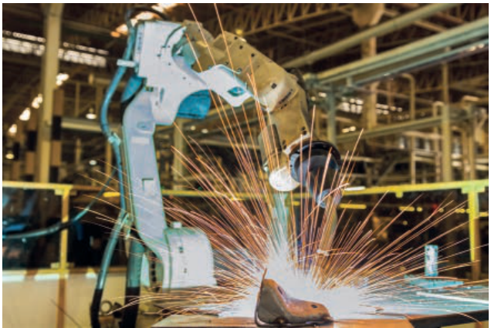
CHAPTER 6 6.2 · Overview
Robotics
How programmable machines sense and act.
Syllabus 6.2: robot characteristics, uses and evaluation.
Hodder p.230, Figure 6.12
CHECK What makes this welding machine a robot?
IGCSE 0478 2026–2028 / Answers in speaker notes
1 / 16
Notes:
MODEL ANSWER
It has a mechanical structure, electrical components and a program that controls its actions.
TEACHING PROMPT
Students explain their reasoning before opening the model answer. Accept equivalent precise wording.
SOURCES
Hodder pp.230–231. Cambridge pp.132–135.
User-supplied Cambridge IGCSE Computer Science 0478 syllabus 2026–2028, Version 6, PDF page 24. User-supplied Hodder Education 2021 Computer Science textbook and Cambridge University Press second-edition Computer Science Coursebook. Image: Hodder p.230, Figure 6.12, extracted from the supplied textbook.
Original teaching examples and model answers unless identified as a textbook figure. Model answers are not official mark schemes.

Slide 2
CHAPTER 6 6.2 · Characteristics
Characteristics of a robot
A robot combines physical parts with a program that controls its actions.
Characteristic | Example in a mobile robot
Mechanical structure | Chassis, wheels and a gripping arm
Electrical components | Sensors, microprocessor and actuators
Programmable | Instructions control movement and decisions
CHECK What tells the robot which sequence of actions to perform?
IGCSE 0478 2026–2028 / Answers in speaker notes
2 / 16
Notes:
MODEL ANSWER
The program, which the controller executes.
TEACHING PROMPT
Students explain their reasoning before opening the model answer. Accept equivalent precise wording.
SOURCES
Hodder p.231. Cambridge p.132.
User-supplied Cambridge IGCSE Computer Science 0478 syllabus 2026–2028, Version 6, PDF page 24. User-supplied Hodder Education 2021 Computer Science textbook and Cambridge University Press second-edition Computer Science Coursebook.
Original teaching examples and model answers unless identified as a textbook figure. Model answers are not official mark schemes.

Slide 3
CHAPTER 6 6.2 · Components
Sensors, processing and action
A warehouse robot detects a box and places it on a shelf.
Each component has a different role in this original example.
Part | Role in the warehouse
Sensor | Measures distance to the shelf
Microprocessor | Compares the distance with the required position
Actuator | Operates the motor that moves the arm
CHECK Which part decides whether to stop the motor?
IGCSE 0478 2026–2028 / Answers in speaker notes
3 / 16
Notes:
MODEL ANSWER
The microprocessor processes the sensor reading and sends a control signal to the actuator.
TEACHING PROMPT
Students explain their reasoning before opening the model answer. Accept equivalent precise wording.
SOURCES
Hodder pp.231–232. Cambridge p.132.
User-supplied Cambridge IGCSE Computer Science 0478 syllabus 2026–2028, Version 6, PDF page 24. User-supplied Hodder Education 2021 Computer Science textbook and Cambridge University Press second-edition Computer Science Coursebook.
Original teaching examples and model answers unless identified as a textbook figure. Model answers are not official mark schemes.

Slide 4
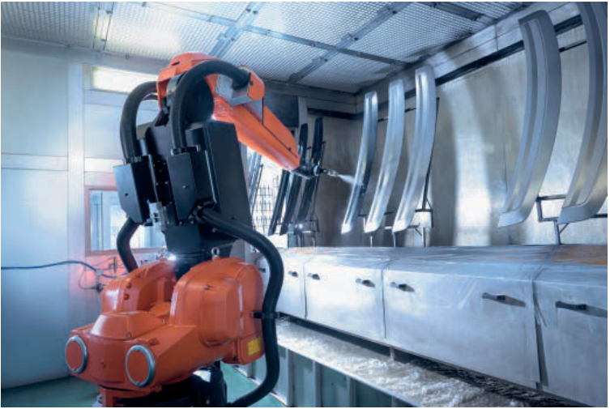
CHAPTER 6 6.2 · Programming
Programming a robot arm
A program specifies the arm movements and when to spray.
An operator can teach a sequence of movements for the controller to record.
Sensors help the controller respond when no car body is present.
Hodder p.232, Figure 6.18
CHECK Why should the robot check for a car before spraying?
IGCSE 0478 2026–2028 / Answers in speaker notes
4 / 16
Notes:
MODEL ANSWER
It avoids wasting paint and spraying into an empty or unsafe area.
TEACHING PROMPT
Students explain their reasoning before opening the model answer. Accept equivalent precise wording.
SOURCES
Hodder p.232.
User-supplied Cambridge IGCSE Computer Science 0478 syllabus 2026–2028, Version 6, PDF page 24. User-supplied Hodder Education 2021 Computer Science textbook and Cambridge University Press second-edition Computer Science Coursebook. Image: Hodder p.232, Figure 6.18, extracted from the supplied textbook.
Original teaching examples and model answers unless identified as a textbook figure. Model answers are not official mark schemes.

Slide 5
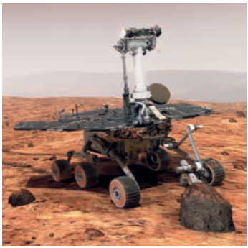
CHAPTER 6 6.2 · Control
Autonomous and human-controlled robots
An autonomous robot uses its program and sensor readings to act without direct human control.
A remotely controlled robot follows instructions from an operator.
A robot can combine automatic actions with human supervision.
Hodder p.231, Figure 6.16
CHECK Does every robot need artificial intelligence?
IGCSE 0478 2026–2028 / Answers in speaker notes
5 / 16
Notes:
MODEL ANSWER
No. Many robots repeat programmed tasks without learning or simulating intelligent reasoning.
TEACHING PROMPT
Compare a programmed factory arm, a remotely controlled drone and an autonomous rover. Keep robotics and AI distinct.
SOURCES
Hodder p.231. Cambridge p.132.
User-supplied Cambridge IGCSE Computer Science 0478 syllabus 2026–2028, Version 6, PDF page 24. User-supplied Hodder Education 2021 Computer Science textbook and Cambridge University Press second-edition Computer Science Coursebook. Image: Hodder p.231, Figure 6.16, extracted from the supplied textbook.
Original teaching examples and model answers unless identified as a textbook figure. Model answers are not official mark schemes.

Slide 6
CHAPTER 6 6.2 · Industry
Robots in industry
A factory uses robots for welding, painting and placing components.
Evaluation links a feature to its effect on this factory.
Feature | Possible effect
Precise repetition | More consistent welds and less waste
Hazardous work | Less worker exposure to heat or fumes
Setup and upkeep cost | Requires funding and skilled technicians
Changed staffing needs | Some jobs disappear and other jobs require retraining
CHECK Why can a high initial cost still be worthwhile?
IGCSE 0478 2026–2028 / Answers in speaker notes
6 / 16
Notes:
MODEL ANSWER
If output and consistency improve enough over time, the savings may outweigh purchase, programming and maintenance costs.
TEACHING PROMPT
Students explain their reasoning before opening the model answer. Accept equivalent precise wording.
SOURCES
Hodder pp.232–233. Cambridge p.134.
User-supplied Cambridge IGCSE Computer Science 0478 syllabus 2026–2028, Version 6, PDF page 24. User-supplied Hodder Education 2021 Computer Science textbook and Cambridge University Press second-edition Computer Science Coursebook.
Original teaching examples and model answers unless identified as a textbook figure. Model answers are not official mark schemes.

Slide 7
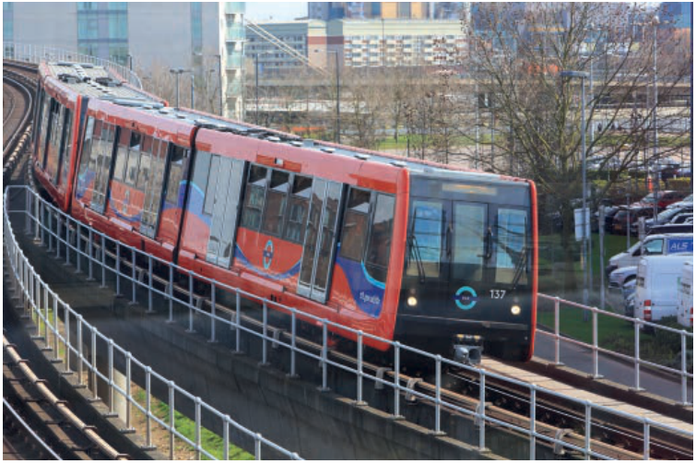
CHAPTER 6 6.2 · Transport
Robots in transport
An autonomous train uses control systems to manage movement and stopping.
Consistent speed control can improve punctuality.
A control fault may disrupt services, so safe stopping and human response procedures matter.
Hodder p.235, Figure 6.19
CHECK Give a transport benefit with a clear reason.
IGCSE 0478 2026–2028 / Answers in speaker notes
7 / 16
Notes:
MODEL ANSWER
Consistent automatic speed and stopping control can keep the service closer to its timetable.
TEACHING PROMPT
Students explain their reasoning before opening the model answer. Accept equivalent precise wording.
SOURCES
Hodder pp.234–235. Cambridge p.134.
User-supplied Cambridge IGCSE Computer Science 0478 syllabus 2026–2028, Version 6, PDF page 24. User-supplied Hodder Education 2021 Computer Science textbook and Cambridge University Press second-edition Computer Science Coursebook. Image: Hodder p.235, Figure 6.19, extracted from the supplied textbook.
Original teaching examples and model answers unless identified as a textbook figure. Model answers are not official mark schemes.

Slide 8
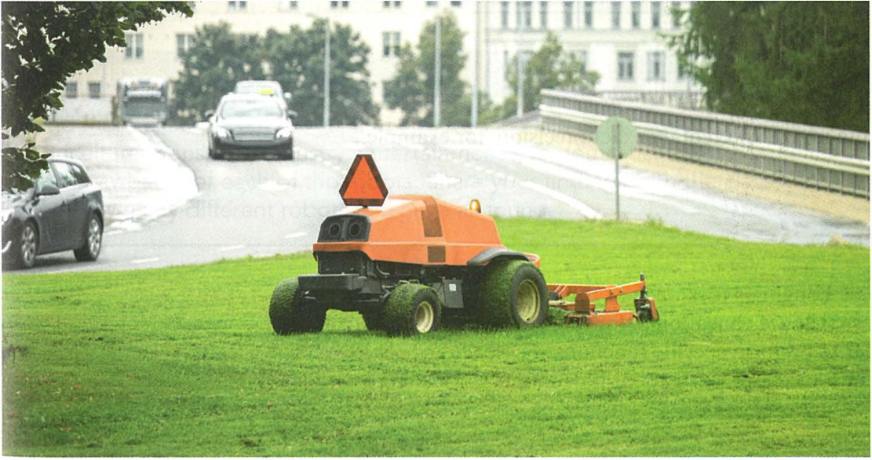
CHAPTER 6 6.2 · Agriculture
Robots in agriculture
Robots can mow, plant or remove weeds along a planned route.
Precise repeated work can save time and reduce wasted materials.
Uneven ground, obstacles and changing conditions make sensing important.
Cambridge University Press p.133, Figure 6.8
CHECK Why is an obstacle sensor useful on an automatic mower?
IGCSE 0478 2026–2028 / Answers in speaker notes
8 / 16
Notes:
MODEL ANSWER
It detects an object or person so the controller can stop or change direction.
TEACHING PROMPT
Students explain their reasoning before opening the model answer. Accept equivalent precise wording.
SOURCES
Hodder p.236. Cambridge p.133.
User-supplied Cambridge IGCSE Computer Science 0478 syllabus 2026–2028, Version 6, PDF page 24. User-supplied Hodder Education 2021 Computer Science textbook and Cambridge University Press second-edition Computer Science Coursebook. Image: Cambridge University Press p.133, Figure 6.8, extracted from the supplied textbook.
Original teaching examples and model answers unless identified as a textbook figure. Model answers are not official mark schemes.

Slide 9
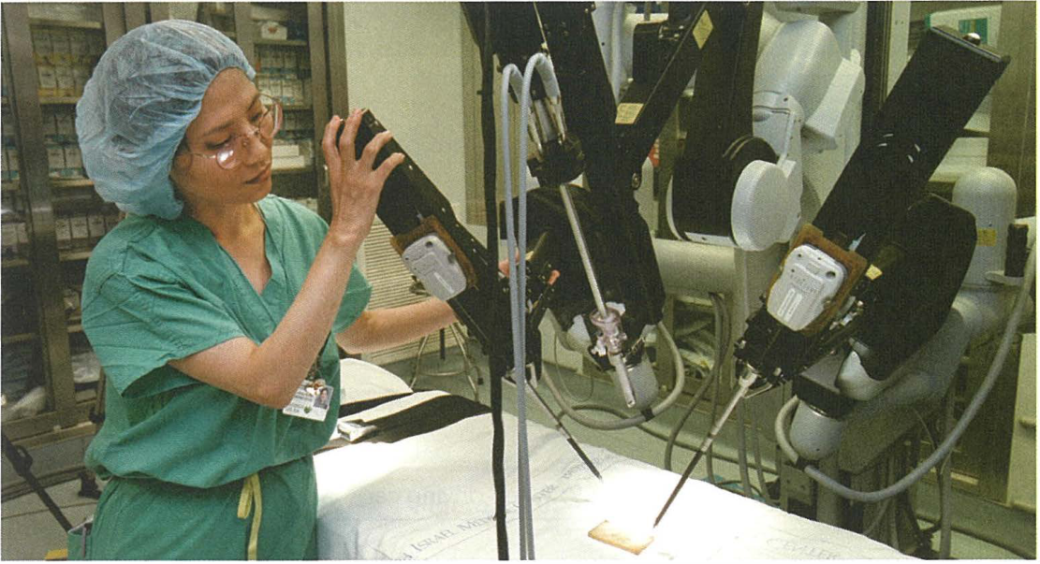
CHAPTER 6 6.2 · Medicine
Robots in medicine
A surgeon can control robotic instruments for precise movements.
Remote control can give access to a specialist who is elsewhere.
Equipment faults or connection loss require a safe response and a backup plan.
Cambridge University Press p.133, Figure 6.7
CHECK Why is “robots always improve safety” too strong?
IGCSE 0478 2026–2028 / Answers in speaker notes
9 / 16
Notes:
MODEL ANSWER
Faulty software, failed equipment or communication problems can introduce risks, even when precision improves.
TEACHING PROMPT
Students explain their reasoning before opening the model answer. Accept equivalent precise wording.
SOURCES
Hodder pp.237–238. Cambridge pp.132–133.
User-supplied Cambridge IGCSE Computer Science 0478 syllabus 2026–2028, Version 6, PDF page 24. User-supplied Hodder Education 2021 Computer Science textbook and Cambridge University Press second-edition Computer Science Coursebook. Image: Cambridge University Press p.133, Figure 6.7, extracted from the supplied textbook.
Original teaching examples and model answers unless identified as a textbook figure. Model answers are not official mark schemes.

Slide 10
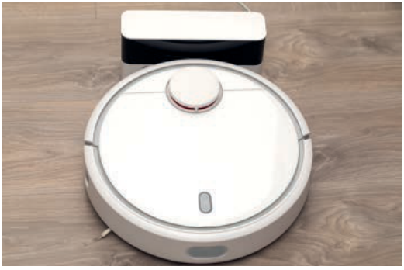
CHAPTER 6 6.2 · Domestic use
Domestic robots
A vacuum robot uses sensors to detect obstacles and control its route.
It saves the user time on repetitive cleaning.
It still needs charging, emptying and monitoring, and may struggle with steps.
Hodder p.230, Figure 6.13
CHECK Name one sensor input and one actuator output.
IGCSE 0478 2026–2028 / Answers in speaker notes
10 / 16
Notes:
MODEL ANSWER
Input: distance to an obstacle. Output: a motor turns a wheel to change direction.
TEACHING PROMPT
Students explain their reasoning before opening the model answer. Accept equivalent precise wording.
SOURCES
Hodder pp.238–239. Cambridge p.135.
User-supplied Cambridge IGCSE Computer Science 0478 syllabus 2026–2028, Version 6, PDF page 24. User-supplied Hodder Education 2021 Computer Science textbook and Cambridge University Press second-edition Computer Science Coursebook. Image: Hodder p.230, Figure 6.13, extracted from the supplied textbook.
Original teaching examples and model answers unless identified as a textbook figure. Model answers are not official mark schemes.

Slide 11
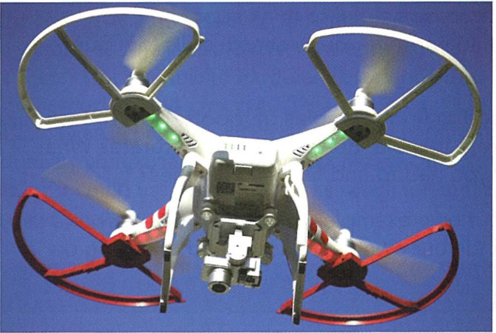
CHAPTER 6 6.2 · Entertainment
Robots in entertainment
A camera drone can record a view from above.
Programmable robots can move characters or cameras repeatedly.
Loss of control can cause a collision, so safe operation matters.
Cambridge University Press p.135, Figure 6.10
CHECK What connects a robot toy and an industrial robot?
IGCSE 0478 2026–2028 / Answers in speaker notes
11 / 16
Notes:
MODEL ANSWER
Both have a physical structure, electrical components and programmable control, although their tasks differ.
TEACHING PROMPT
Students explain their reasoning before opening the model answer. Accept equivalent precise wording.
SOURCES
Hodder p.239. Cambridge pp.134–135.
User-supplied Cambridge IGCSE Computer Science 0478 syllabus 2026–2028, Version 6, PDF page 24. User-supplied Hodder Education 2021 Computer Science textbook and Cambridge University Press second-edition Computer Science Coursebook. Image: Cambridge University Press p.135, Figure 6.10, extracted from the supplied textbook.
Original teaching examples and model answers unless identified as a textbook figure. Model answers are not official mark schemes.

Slide 12
CHAPTER 6 6.2 · Exam technique
Benefits and limitations in context
A useful answer explains how a feature affects the named task.
Weak general point | Explanation linked to a task
Robots are accurate | A welding robot repeats the required position, reducing faulty joins
Robots are expensive | A small farm may struggle to pay for the machine and maintenance
Robots are dangerous | A failed obstacle sensor may allow a mobile robot to collide
CHECK Improve “the robot is faster” for a packing line.
IGCSE 0478 2026–2028 / Answers in speaker notes
12 / 16
Notes:
MODEL ANSWER
The robot can repeat the packing movement quickly and consistently, increasing the number of boxes packed per hour.
TEACHING PROMPT
Students explain their reasoning before opening the model answer. Accept equivalent precise wording.
SOURCES
Syllabus 6.2, objective 3. Original teaching examples.
User-supplied Cambridge IGCSE Computer Science 0478 syllabus 2026–2028, Version 6, PDF page 24. User-supplied Hodder Education 2021 Computer Science textbook and Cambridge University Press second-edition Computer Science Coursebook.
Original teaching examples and model answers unless identified as a textbook figure. Model answers are not official mark schemes.

Slide 13
CHAPTER 6 6.2 · Independent task
Warehouse design task
01
A robot moves boxes between a conveyor and shelves.
02
Explain its structure, one sensor and one actuator.
03
Evaluate one benefit and one limitation for this warehouse.
CHECK How could the robot handle an obstructed route?
IGCSE 0478 2026–2028 / Answers in speaker notes
13 / 16
Notes:
MODEL ANSWER
A proximity sensor detects the obstruction. The controller stops the drive motor or selects a safe alternative route.
TEACHING PROMPT
Give pairs three minutes to draw or describe the system. Require a specific component and a reason for each evaluation point.
SOURCES
Original task applying syllabus 6.2.
User-supplied Cambridge IGCSE Computer Science 0478 syllabus 2026–2028, Version 6, PDF page 24. User-supplied Hodder Education 2021 Computer Science textbook and Cambridge University Press second-edition Computer Science Coursebook.
Original teaching examples and model answers unless identified as a textbook figure. Model answers are not official mark schemes.

Slide 14
CHAPTER 6 6.2 · Worked answer
Warehouse model answer
Each point refers to the warehouse task.
Point | Example answer
Structure | Wheeled chassis and a gripping arm carry boxes
Input and output | Distance sensor checks position, motors move the arm
Benefit | Repetitive lifting reduces workers’ exposure to heavy loads
Limitation | A breakdown may stop deliveries until technicians repair it
CHECK Why is “sensor detects a box” incomplete as a full control explanation?
IGCSE 0478 2026–2028 / Answers in speaker notes
14 / 16
Notes:
MODEL ANSWER
It describes the input only. A full answer also explains processing and the resulting actuator action.
TEACHING PROMPT
Students explain their reasoning before opening the model answer. Accept equivalent precise wording.
SOURCES
Original model answer, not an official mark scheme.
User-supplied Cambridge IGCSE Computer Science 0478 syllabus 2026–2028, Version 6, PDF page 24. User-supplied Hodder Education 2021 Computer Science textbook and Cambridge University Press second-edition Computer Science Coursebook.
Original teaching examples and model answers unless identified as a textbook figure. Model answers are not official mark schemes.

Slide 15
CHAPTER 6 6.2 · Retrieval
Key terms
Use each term for its precise role.
Term | Meaning
Robotics | Design, construction and operation of robots
Sensor | Device that measures a physical property
Actuator | Component that produces physical action
Autonomous | Operates without direct human control
Programmable | Can execute stored instructions for a task
CHECK Which term describes the study of designing and operating robots?
IGCSE 0478 2026–2028 / Answers in speaker notes
15 / 16
Notes:
MODEL ANSWER
Robotics.
TEACHING PROMPT
Students explain their reasoning before opening the model answer. Accept equivalent precise wording.
SOURCES
Syllabus 6.2. Hodder pp.230–231. Cambridge p.132.
User-supplied Cambridge IGCSE Computer Science 0478 syllabus 2026–2028, Version 6, PDF page 24. User-supplied Hodder Education 2021 Computer Science textbook and Cambridge University Press second-edition Computer Science Coursebook.
Original teaching examples and model answers unless identified as a textbook figure. Model answers are not official mark schemes.

Slide 16
CHAPTER 6 6.2 · Review
Exit check
01
Describe the three main characteristics of a robot.
02
Choose one application and explain a benefit and a drawback.
03
Explain why a robot might use sensors even when it does not use AI.
CHECK What should a complete evaluation include?
IGCSE 0478 2026–2028 / Answers in speaker notes
16 / 16
Notes:
MODEL ANSWER
A specific use, a benefit with its reason, and a limitation with its effect in that context.
TEACHING PROMPT
Use students’ answers to decide whether to revisit components, applications or contextual evaluation.
SOURCES
Syllabus 6.2. Original retrieval questions.
User-supplied Cambridge IGCSE Computer Science 0478 syllabus 2026–2028, Version 6, PDF page 24. User-supplied Hodder Education 2021 Computer Science textbook and Cambridge University Press second-edition Computer Science Coursebook.
Original teaching examples and model answers unless identified as a textbook figure. Model answers are not official mark schemes.

