Slide 1

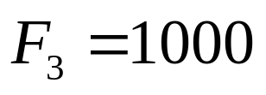

Example 1
It is a cantilever with tip load 1000 N. It is of length 1m and formed by a straight segment. Two points are sufficient to specify the structure. The input file name is cantilever1.dat.
1
2

Slide 2

Example 2
It is a cantilever formed with two straight segments, as sketched, with tip load 1000 N. The 1st segment is of length 1m and the 2nd segment is of length 0.5m.The 2nd segment rotated about the 1st segment anticlockwise around 30 degrees. The input file name is cantilever2.dat.
1
2
3

Slide 3
Example 3
It is a beam clamped at both ends with a concentrated load 1000 N at the middle. It is of length 1m. Three points are needed to specify the structure. The input file name is cantilever3.dat.
2
1
3

Slide 4
Example 4
It is a cantilever under uniform distributed load 1000 N/m. The input file name is cantilever4.dat.
1000N/m
1
2

Slide 5
Example 5
It is a cantilever analyzed in the 1st example with a support at the middle to constrain the vertical displacement at this point. The input file name is cantilever5.dat.
2
1
3

Slide 6
Example 6
It is a cantilever with a portion under uniform distributed load. The input file name is cantilever6.dat.
1000N/m
0.3m
0.3m
1
2

Slide 7
Example 7
It is a beam clamped at both ends with a uniform distributed load. The input file name is cantilever7.dat.
1000N/m
1
2

Slide 8
Example 8
It is a beam simply supported at one end and clamped at another end with a linearly distributed load. The input file name is cantilever8.dat.
1000N/m

Slide 9
Example 9
It is a cantilever fork formed by three straight segments, as sketched, with tip load 1000 N at each fork. The horizontal segment is of length 1m and the inclined segments are of length 0.5m. The inclined segments each form a 30 degree angle with the horizontal segment. The input file name is fork.dat.
4
1
2
3

Slide 10
Example 10
It is a straight beam element simply supported at both ends with a concentrated load 1000 N at the middle. It is of length 1m. The input file name is ss.dat.
1
2
3

Slide 11

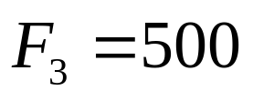
Example 11
Max simplified model for joined wing, detailed description please see Max SDM 2008 paper. The input file name is jw.dat.
1
2
3

Slide 12
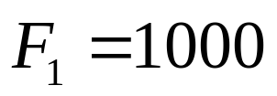
Example 12
A square formed by four straight beam segments. All the segments are rigidly connected. The input file name is square.dat.
2
3
1
4

