Slide 1


智周万物 道济天下
Nanjing University of Aeronautics and Astronautics
PAR: A Power-Aware Routing Algorithm for UAV Networks
Wenbin Zhai, Liang Liu*, Jianfei Peng, Youwei Ding, and Wanying Lu
College of Computer Science and Technology
Nanjing University of Aeronautics and Astronautics

Slide 2

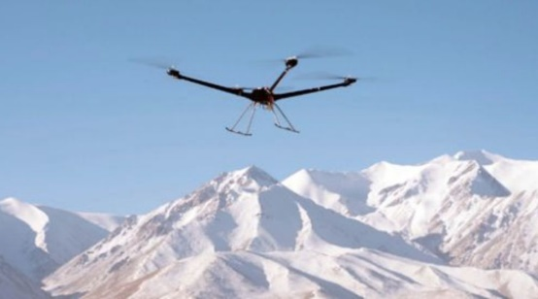
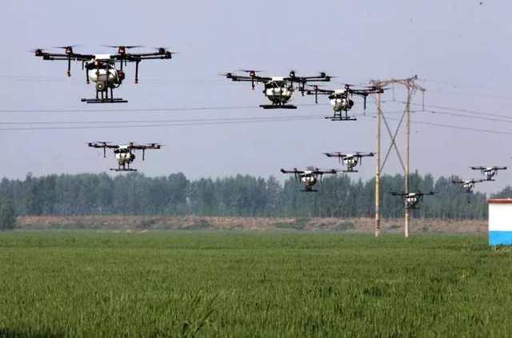
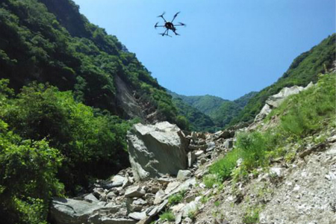

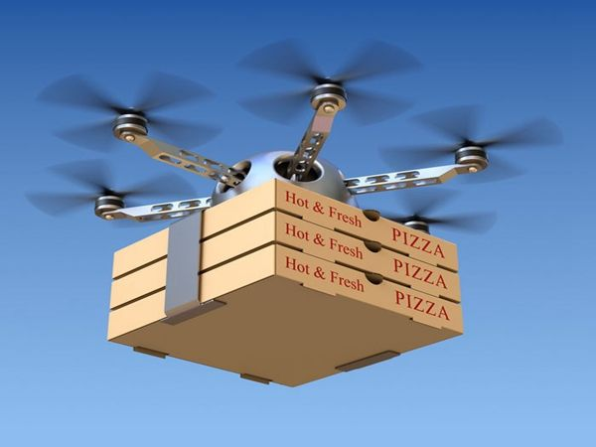
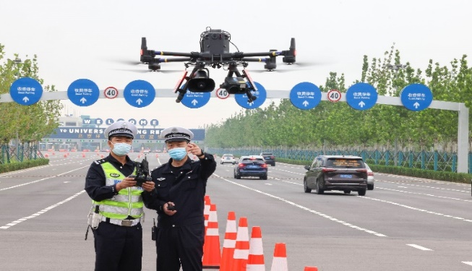
Background
Unmanned Aerial Vehicles (UAVs)
Background
System Model
PAR
border patrol
farmland monitoring
disaster response
Performance Evaluation
Conclusion
animal monitoring
logistics and transportation
traffic monitoring
2

Slide 3
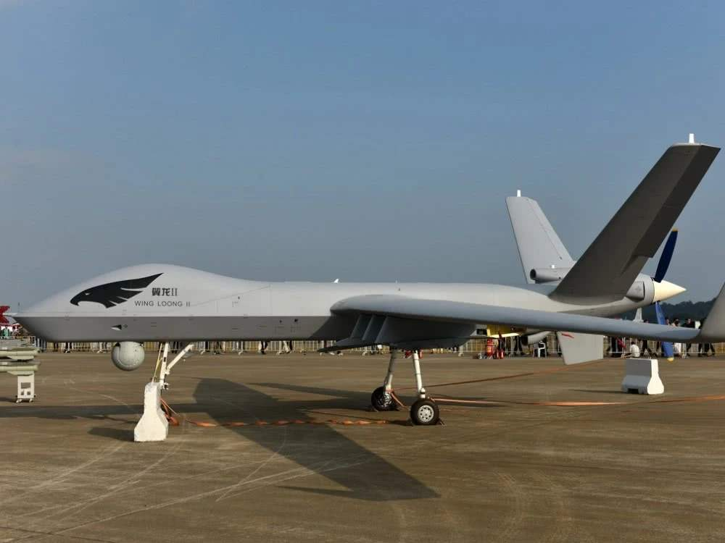

Background
UAV Networks
Background
System Model
PAR
single UAV system
multi-hop UAV network
Performance Evaluation
Conclusion
3

Slide 4
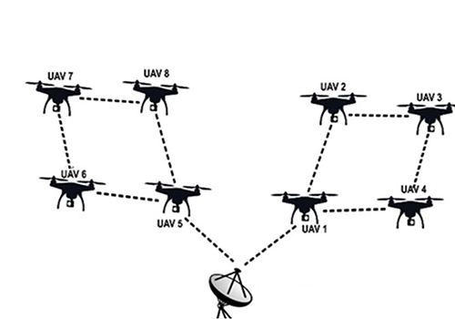
Background
UAV Networks
Background
System Model
PAR
single UAV system
multi-hop UAV network
Performance Evaluation
Network Communication and Routing Protocol
Conclusion
4

Slide 5
Background
Objectives and Challenges
Background
Optimization Objectives
System Model
1
Energy Consumption
PAR
Performance Evaluation
Conclusion
5

Slide 6
Background
Objectives and Challenges
Background
Optimization Objectives
PAR
System Model
1
Energy Consumption
Energy Consumption Minimization
PAR
Performance Evaluation
Conclusion
6

Slide 7
Background
Objectives and Challenges
Background
Optimization Objectives
PAR
System Model
1
Energy Consumption
Energy Consumption Minimization
2
Delivery Delay
PAR
Performance Evaluation
Conclusion
7

Slide 8
Background
Objectives and Challenges
Background
Optimization Objectives
PAR
System Model
1
Energy Consumption
Energy Consumption Minimization
2
Delivery Delay
Delay Constraint T
PAR
Performance Evaluation
Conclusion
8

Slide 9
Background
Objectives and Challenges
Background
Optimization Objectives
PAR
System Model
1
Energy Consumption
Energy Consumption Minimization
2
Delivery Delay
Delay Constraint T
PAR
Challenges
1
Sparse Nodes and Intermittent Communications
Performance Evaluation
2
High mobility of nodes and high dynamic of topology
Conclusion
3
Non-Cross-Layer
9

Slide 10
Background
Objectives and Challenges
Background
Optimization Objectives
PAR
System Model
1
Energy Consumption
Energy Consumption Minimization
2
Delivery Delay
Delay Constraint T
PAR
Challenges
PAR
1
Sparse Nodes and Intermittent Communications
Store-Carry-Forward Mechanism
Performance Evaluation
2
High mobility of nodes and high dynamic of topology
Pre-planned Trajectory Information
Conclusion
3
Non-Cross-Layer
Power-Aware Characteristic at the physical layer
10

Slide 11
System Model
Network Model
Background
1
Hybrid Communication Model
System Model
2
Availability of Position and Trajectory Information
PAR
3
Power Awareness
Performance Evaluation
Conclusion
11

Slide 12
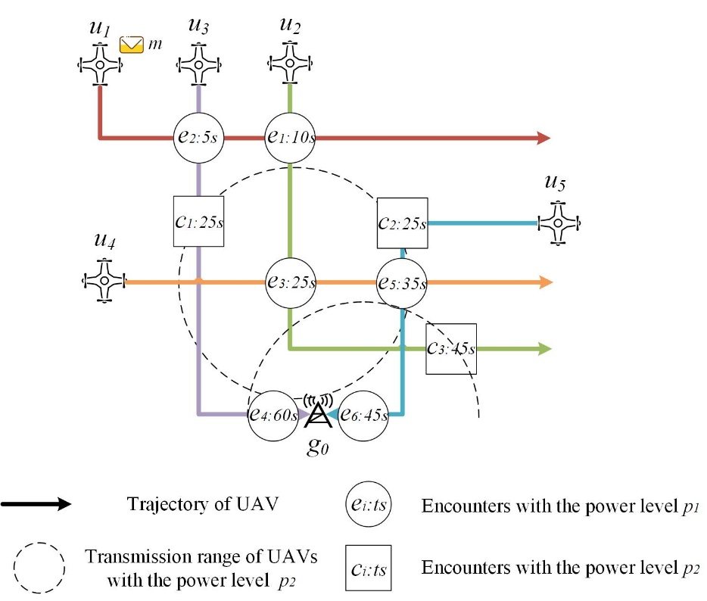

System Model
Encounter and Path Model
Background
Each UAV has two different power levels p1 and p2
System Model
Encounters at the power level p1 are abstracted as points
PAR
Performance Evaluation
Conclusion
12

Slide 13
PAR
Power-aware Encounter Tree
Background
System Model
Node: UAV or Ground Station
PAR
Directed Edge: Encounter
Performance Evaluation
Conclusion
13

Slide 14
PAR
Power-aware Encounter Tree
Background
System Model
Node: UAV or Ground Station
PAR
Directed Edge: Encounter
Performance Evaluation
Conclusion
14

Slide 15
PAR
Power-aware Encounter Tree
Background
System Model
Node: UAV or Ground Station
PAR
Directed Edge: Encounter
Performance Evaluation
Conclusion
15

Slide 16
PAR
Power-aware Encounter Tree
Background
Energy Consumption Metric
System Model
Node: UAV or Ground Station
Encounter Time
Child nodes: after encountering its parent node within the delay constraint
PAR
Directed Edge: Encounter
Performance Evaluation
Conclusion
16

Slide 17
PAR
Construction Procedure
Background
Expanding the tree by adding new pairs of nodes and edges into it one by one
System Model
A priority queue PQ is used to assist the insertion
PAR
The head node in the priority queue has the smallest energy consumption metric
Nodes can be inserted repeatedly due to multiple power levels while encounters must be unique
Performance Evaluation
Each time the head node is removed from the priority queue and inserted into the tree, its children are added to the priority queue at the same time.
Conclusion
17

Slide 18
PAR
Construction Procedure
Background
Expanding the tree by adding new pairs of nodes and edges into it one by one
System Model
A priority queue PQ is used to assist the insertion
PAR
The head node in the priority queue has the smallest energy consumption metric
Nodes can be inserted repeatedly due to multiple power levels while encounters must be unique
Performance Evaluation
Each time the head node is removed from the priority queue and inserted into the tree, its children are added to the priority queue at the same time.
Conclusion
18

Slide 19
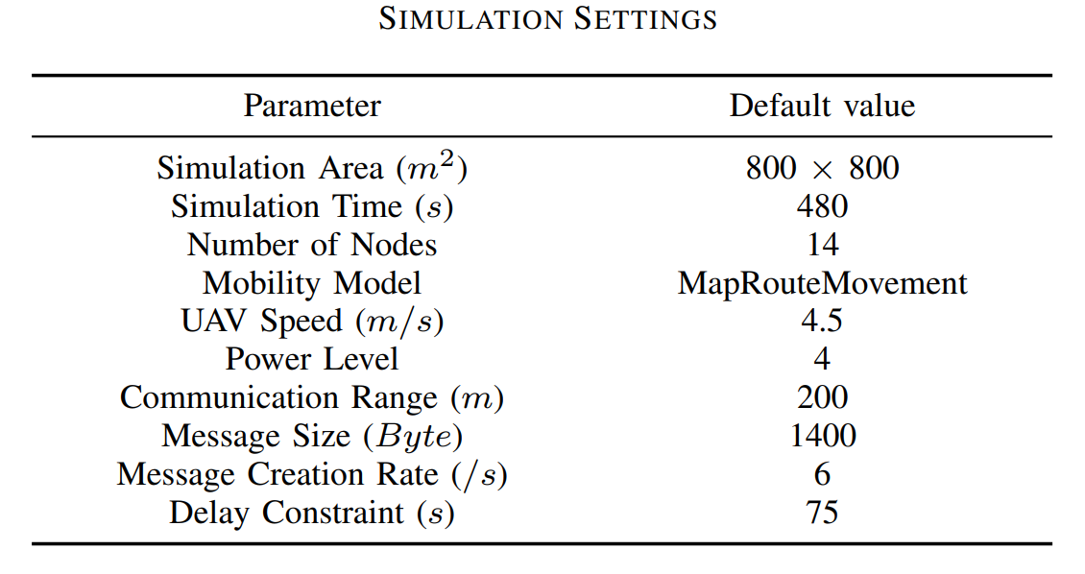
Performance Evaluation
Simulation Setup
Background
Compared Algorithms
System Model
Three classic routing algorithms in [1]:
DTNgeo, DTNclose, DTNload.
PAR
Evaluation Metrics
Delivery Ratio
Performance Evaluation
Energy Consumption
Overhead Ratio
Conclusion
[1] M. Asadpour, K. A. Hummel, D. Giustiniano, and S. Draskovic, “Route or carry: Motion-driven packet forwarding in micro aerial vehicle networks,” IEEE Transactions on Mobile Computing, vol. 16, no. 3, pp. 843–856, 2016.
19

Slide 20
Performance Evaluation
Simulation Scenario
Background
System Model
PAR
Performance Evaluation
Conclusion
20

Slide 21
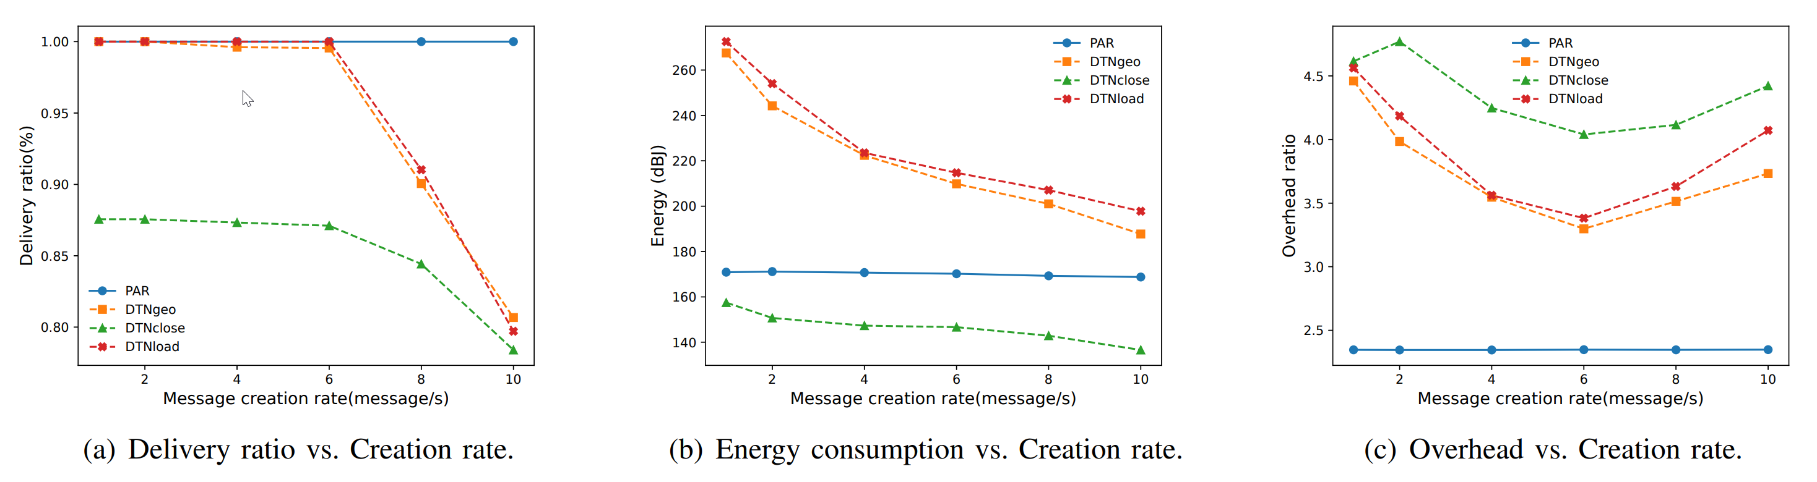
Performance Evaluation
Impact of Message Creation Rate
Background
System Model
PAR
Performance Evaluation
PAR firstly guarantees the timely delivery of messages, and then minimizes the energy consumption.
Conclusion
PAR can improve the power level and increase the energy consumption to ensure the timely delivery of messages.
21

Slide 22
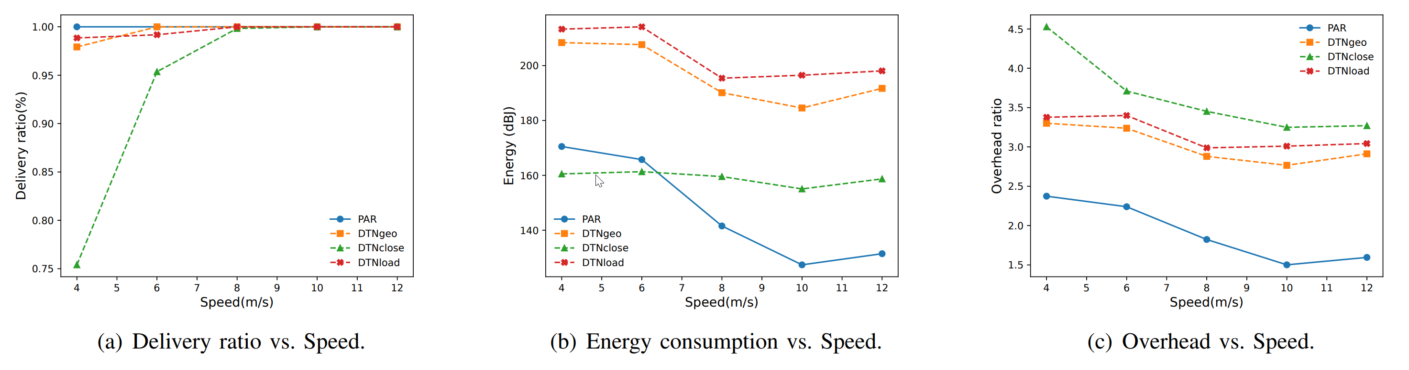
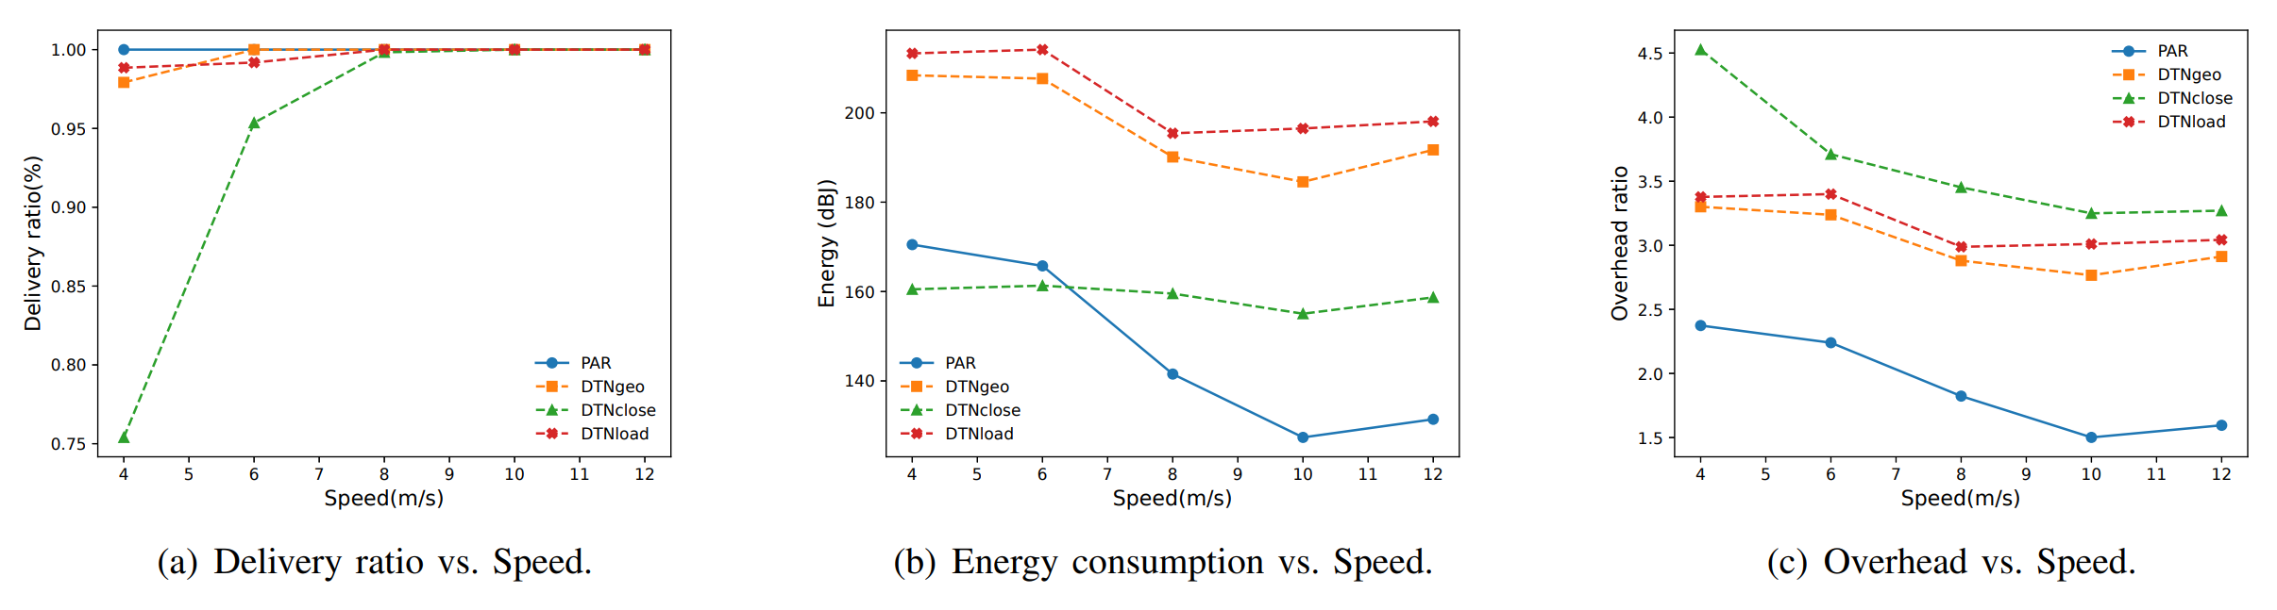
Performance Evaluation
Impact of UAV Speed
Background
System Model
PAR
Performance Evaluation
DTNclose does not guarantee the timely delivery of packets.
Conclusion
When the delivery ratios of PAR and DTNclose are the same, the energy consumption of PAR is much smaller than that of DTNclose.
22

Slide 23
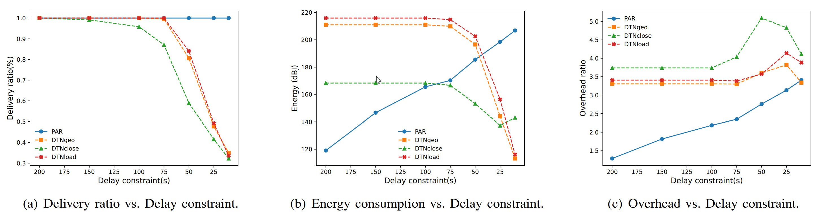
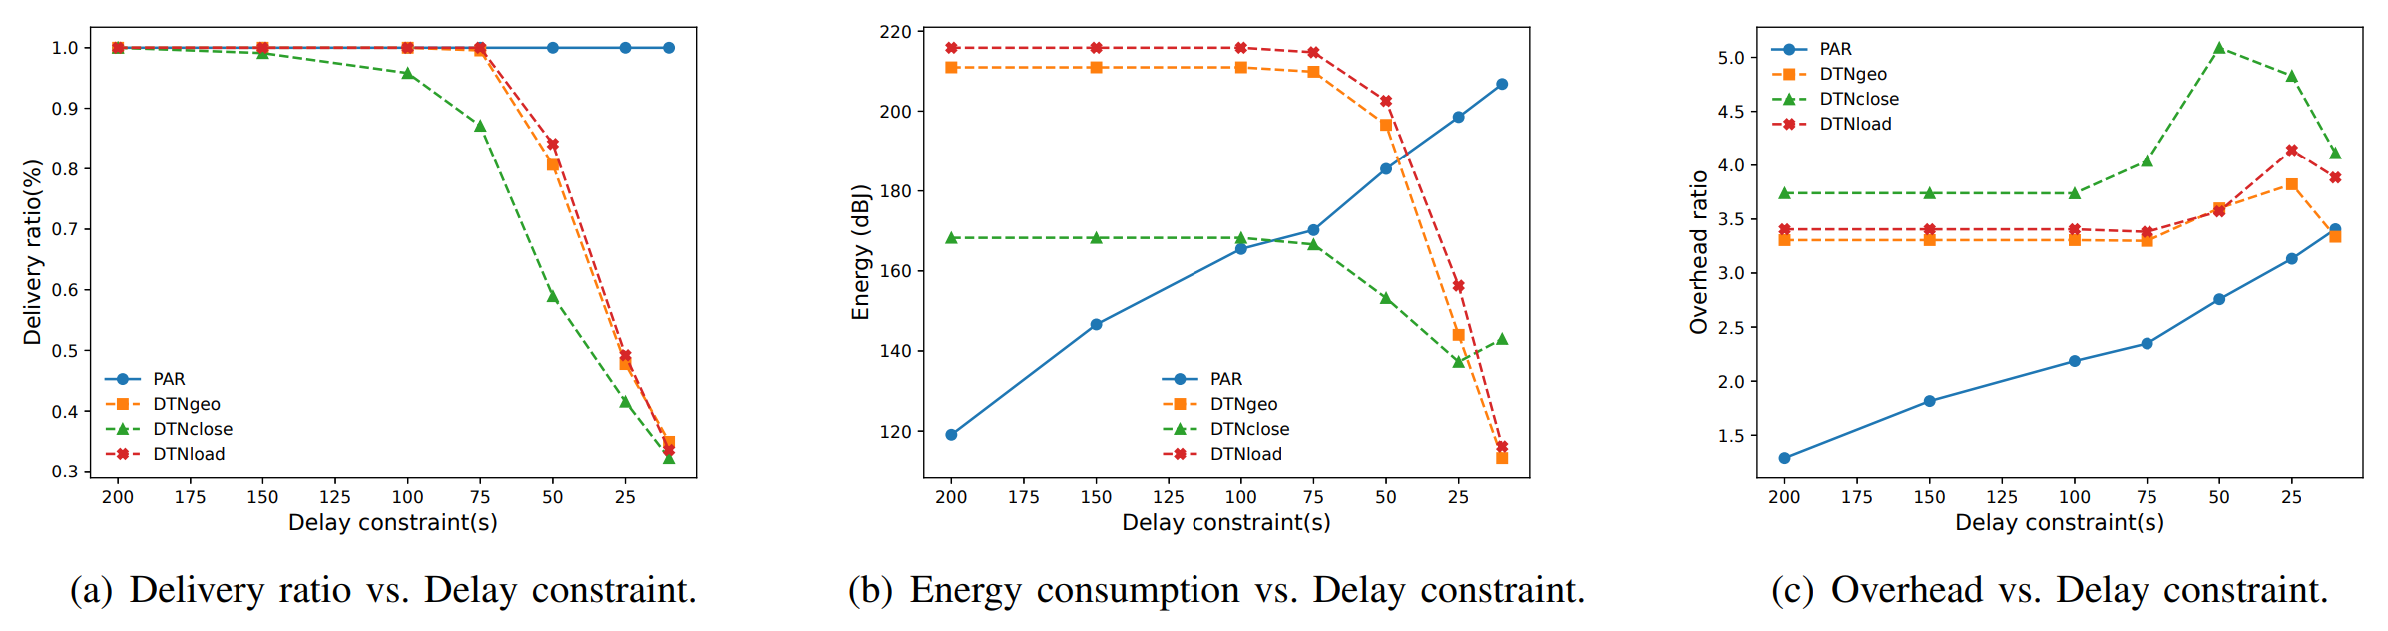
Performance Evaluation
Impact of Delay Constraint
Background
System Model
PAR
Performance Evaluation
When the delay constraint is small, PAR increases the power level to ensure the timely delivery of message.
Conclusion
As the delay constraint tends to be relaxed, PAR gradually decreases the power level to minimize the energy consumption.
23

Slide 24
Conclusion
Background
1
Our paper proposes a power-aware routing algorithm (PAR) for UAV networks to minimize energy consumption within the delay constraint.
System Model
2
PAR utilize the power-aware characteristic and pre-planned trajectory information of UAV networks to optimize routing protocols.
PAR
3
The experimental results show that PAR significantly reduces the energy consumption and improves the network performance compared with three classic algorithms.
Performance Evaluation
Conclusion
24

Slide 25


