Slide 1
论文: Medical Image Retrieval using Deep Convolutional Neural Network
wenbo 2018.5.13

Slide 2
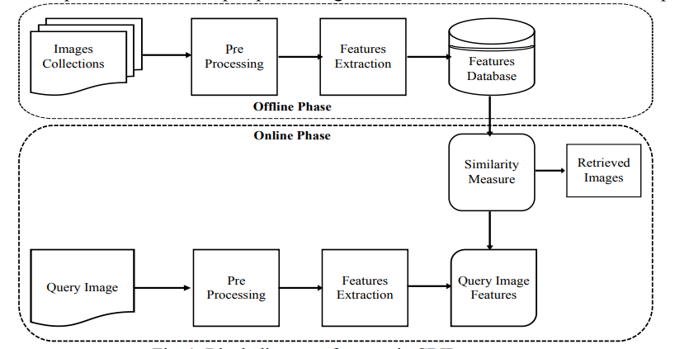
Content Based Image Retrieval (CBIR)

Slide 3
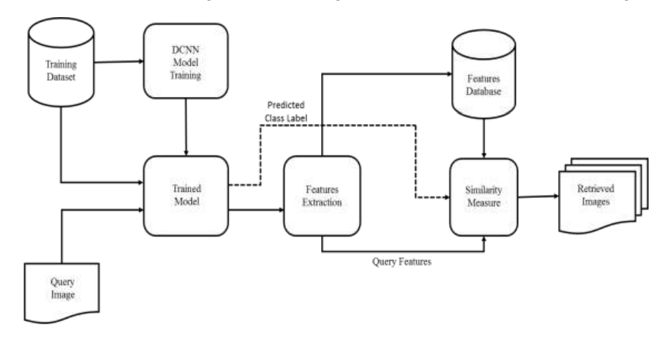
CBMIR Using DCNN

Slide 4
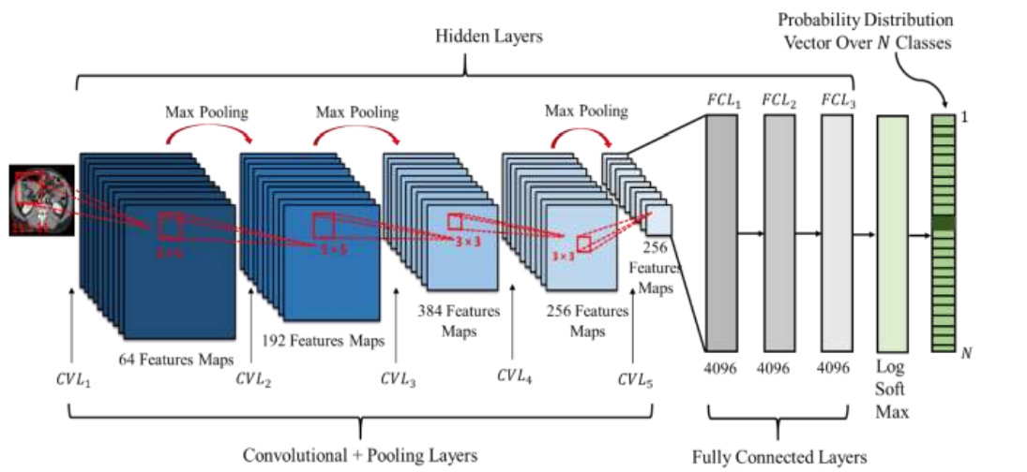
Classification

Slide 5
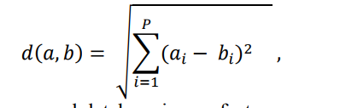
Features Extraction for CBMIR
Comparative analysis is performed for features representations extracted from FCL1, FCL2, FCL3

Slide 6
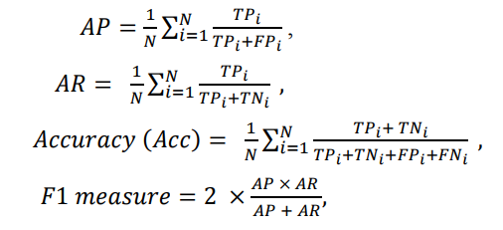
Classification Performance
TPi: 预测为i类，结果也是i类图像数
FPi: 预测为i类，结果不是i类图像数
TNi: 预测不为i类，结果也不是i类图像数
FNi: 预测不为i类，结果是i类图像数
on the training data and the testing set was tested 100 times giving an AP, AR and average F1 measure of 99.76, 99.77 and 99.76 respectively

Slide 7
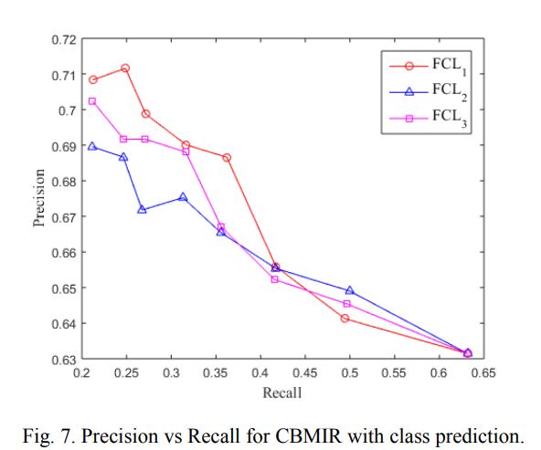
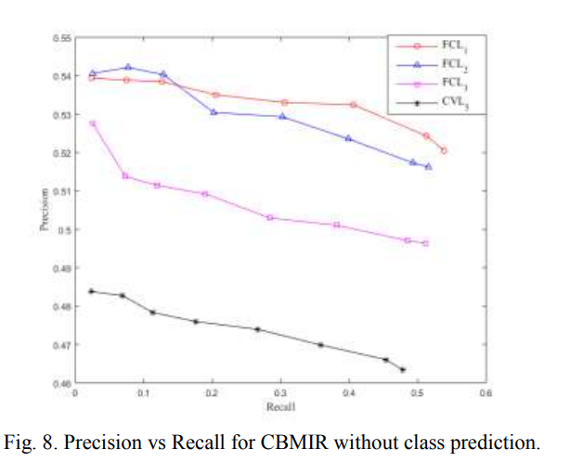
Retrieval Performance

Slide 8
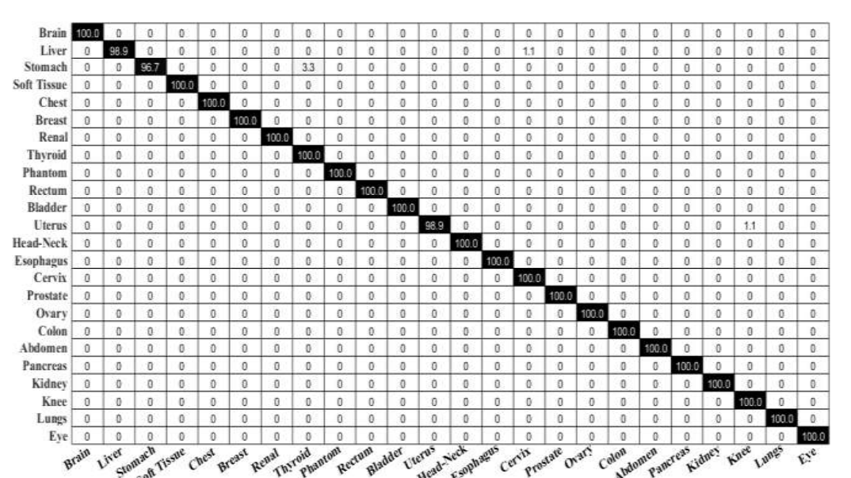
Classification Performance

Slide 9
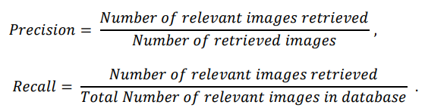
Retrieval Performance

Slide 10
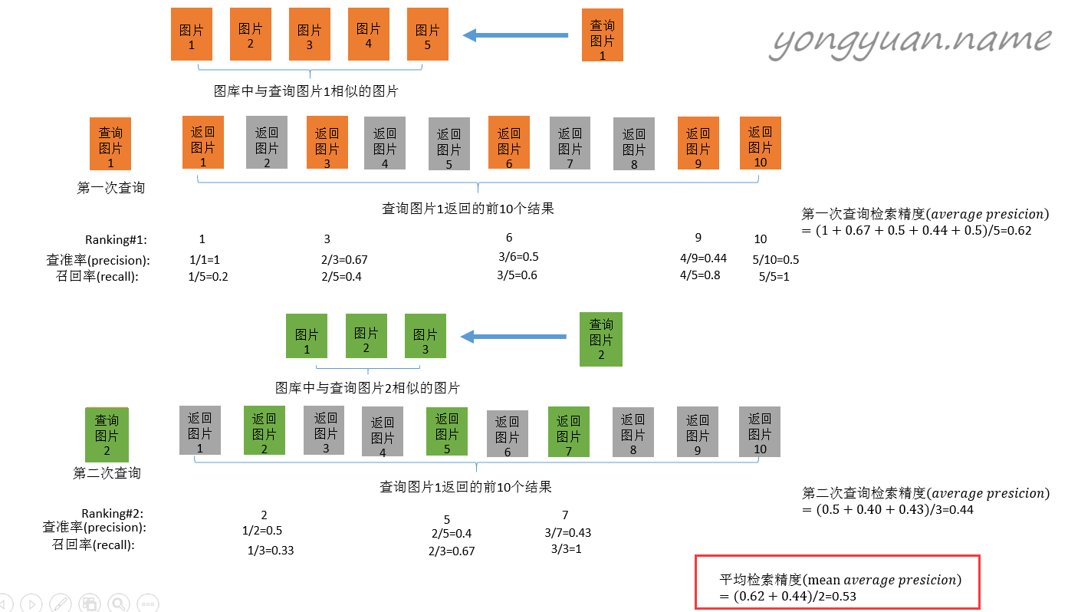
mAP

Slide 11
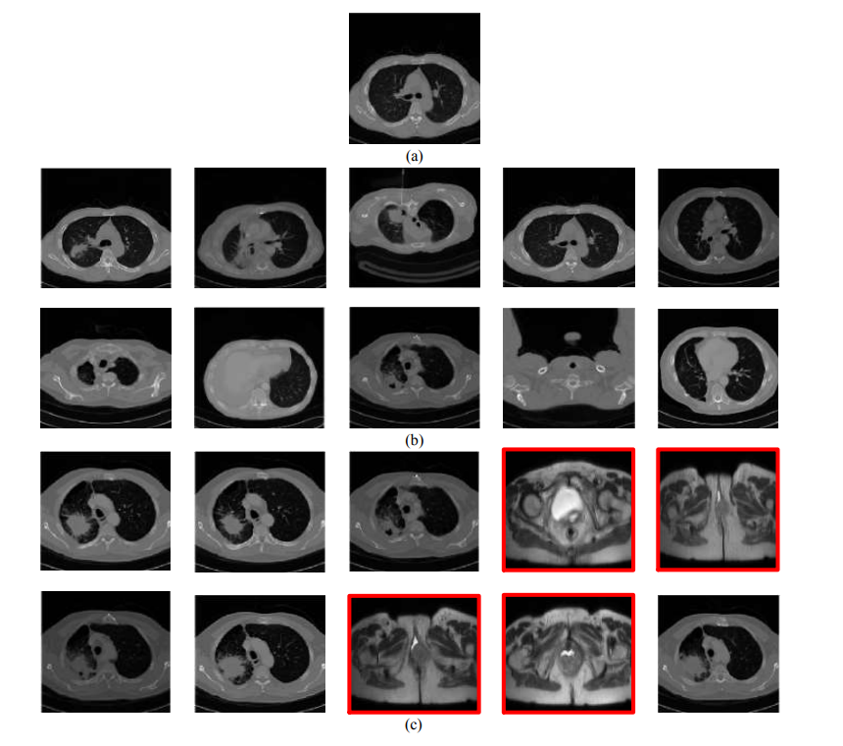
Retrieval Performance
query image
retrieved images using class prediction
retrieved images without using class prediction

Slide 12
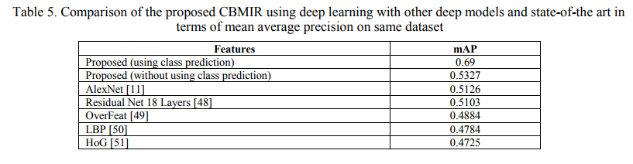
Retrieval Performance

Slide 13
论文: Deep Learning of Binary Hash Codes for Fast Image Retrieval
wenbo 2018.5.13

Slide 14
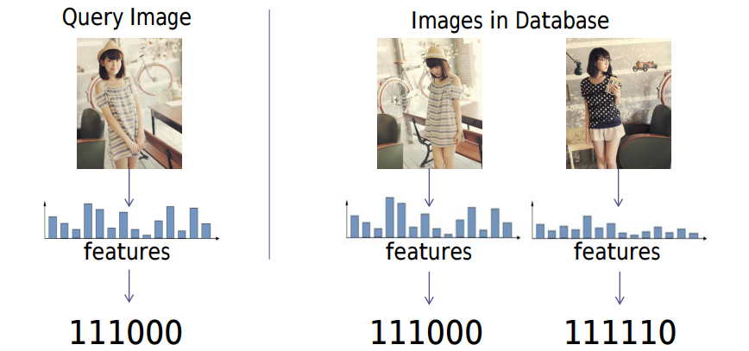
Search Strategy:Binary Codes
Images are represented by binary codes:
Fast search can be carried out via Hamming distance measurement. (XOR operation)

Slide 15
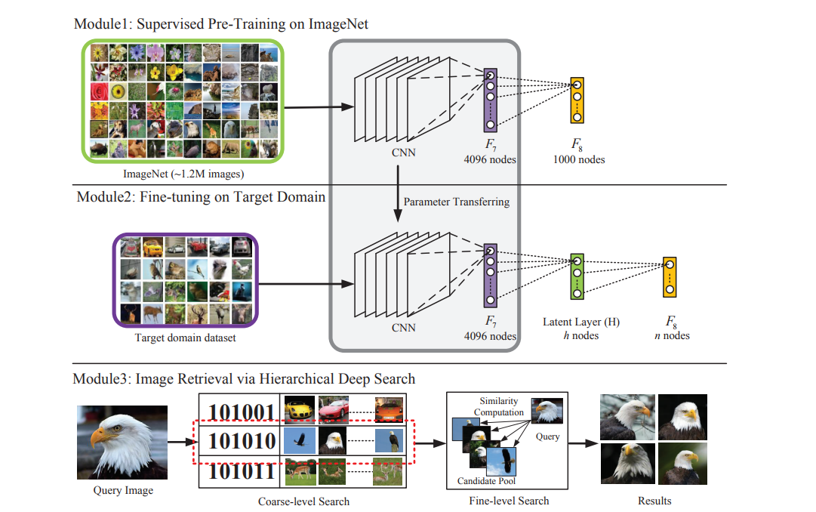
Method

Slide 16
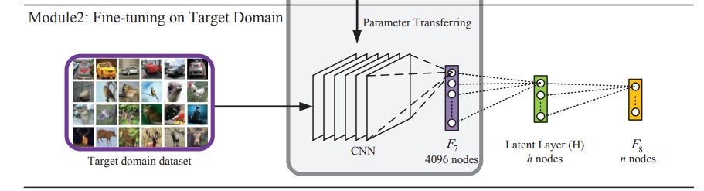
Learning Hash-like Binary Codes
sigmoid functions so the activations are approximated to {0, 1}

Slide 17




Image Retrieval：coarse-to-fine
（latent layer ）H层首先被二值化：
粗糙检索是用H层的二分哈希码，相似性用hamming距离衡量。待检索图像设为I，将I和所有的图像的对应H层编码进行比对后，选择出hamming距离小于一个阈值的m个构成一个池，其中包含了这m个比较相似的图像。
dataset: 每张图对应的二值码:
m candidates: P =

Slide 18

Image Retrieval：coarse-to-fine
细致检索则用到的是fc7层的特征，相似性用欧氏距离衡量。距离越小，则越相似。从粗糙检索得到的m个图像池中选出最相似的前k个图像作为最后的检索结果。每两张图128维的H层哈希码距离计算速度是0.113ms，4096维的fc7层特征的距离计算需要109.767ms，因此可见二值化哈希码检索的速度优势。
Vq denote the feature vectors of the query image q .

Slide 19
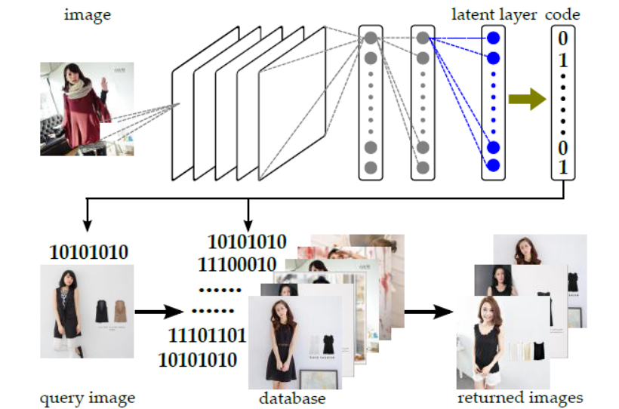
Image Retrieval

Slide 20
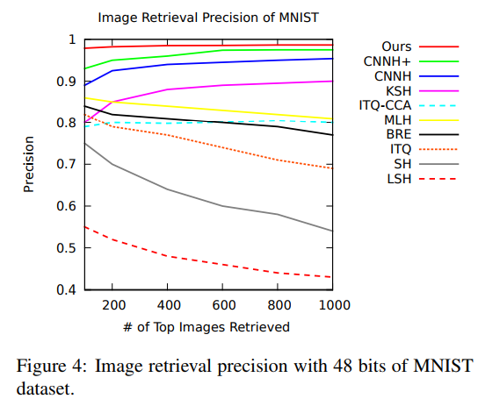
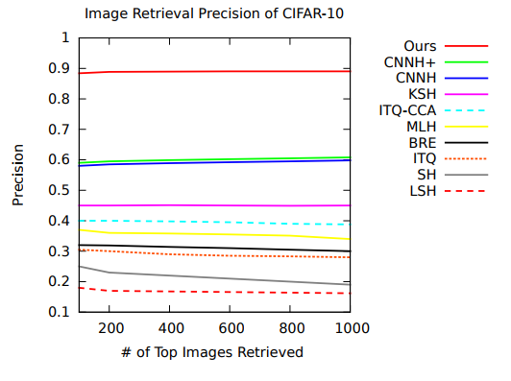


Evaluation
表示查询图像和i的相关性 （0, 1）

