Slide 1
Are language features associated with psychosis risk universal? A study in Mandarin-speaking youths at clinical high risk for psychosis – WP 2022
Results

Slide 2
Participants
Table 1. Demographics and clinical variables of the cohorts.
 | Category | CHR |  | Healthy Controls | Statistics
Demographics | Sex |  | 20 (11 females) | 25 (12 females) | Chi-Square: 0.22, p=0.64
 | Age |  | 19.6 +/- 6.4 | 24.9 +/- 1.9 | KS-test: 0.75, p=1E-6
 | Race |  | 100% Chinese | 100% Chinese | --
 | Education in years |  | 11.4 +/- 4.0 | 16.7 +/- 1.4 | KS-test: 0.7, p=1E-5
SIPS/SOPS scores | Negative Symptoms |  | 10.2 +/- 5.4 | -- | --
 | Positive Symptoms |  | 9.1 +/- 4.0 | -- | --

Slide 3
Table 2. Summary of the extracted features for the analysis

Slide 4
Figure 1 Classification performance results. Bars indicate the mean performance value and error bars indicates the 95% confidence interval across 20 runs. Accuracy and AUC values are shown in the left and right side, respectively. Different shades of bar are used to indicate the type of feature used in the model.

Slide 5
Figure 2 Top 5 relevant features of best models for each type of feature. Features were selected based on the normalized weight of only Linear SVM models. Bars indicate the mean normalized weight value and error bars indicates the 95% confidence interval across 20 runs for the Linear SVM models. Positive weights indicate that feature values are higher for CHR, and negative weights indicate that the feature values are higher for HC. a) Results of only using acoustic features in the models, b) Results of only using English-based linguistic features in the models, and c) Results of only using Mandarin-based linguistic features in the models,.

Slide 6
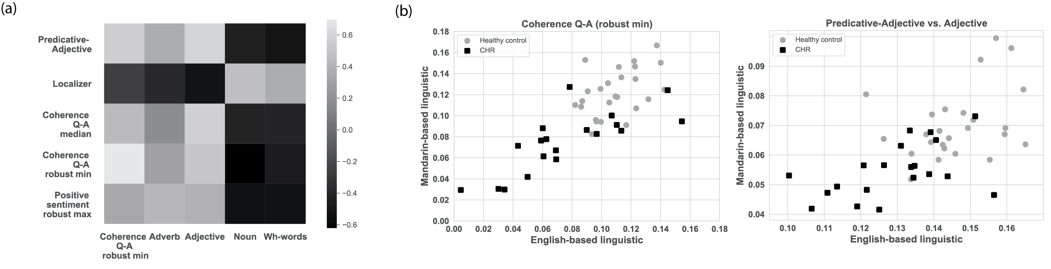
Figure 3 Comparison between relevant features of English-based and Mandarin-based linguistic features. a) Heatmap of the correlation between both types of features, b) Comparison between both types of features of coherence Q-A (robust minimum), and c) Comparison between predicative-adjective and adjective.

Slide 7
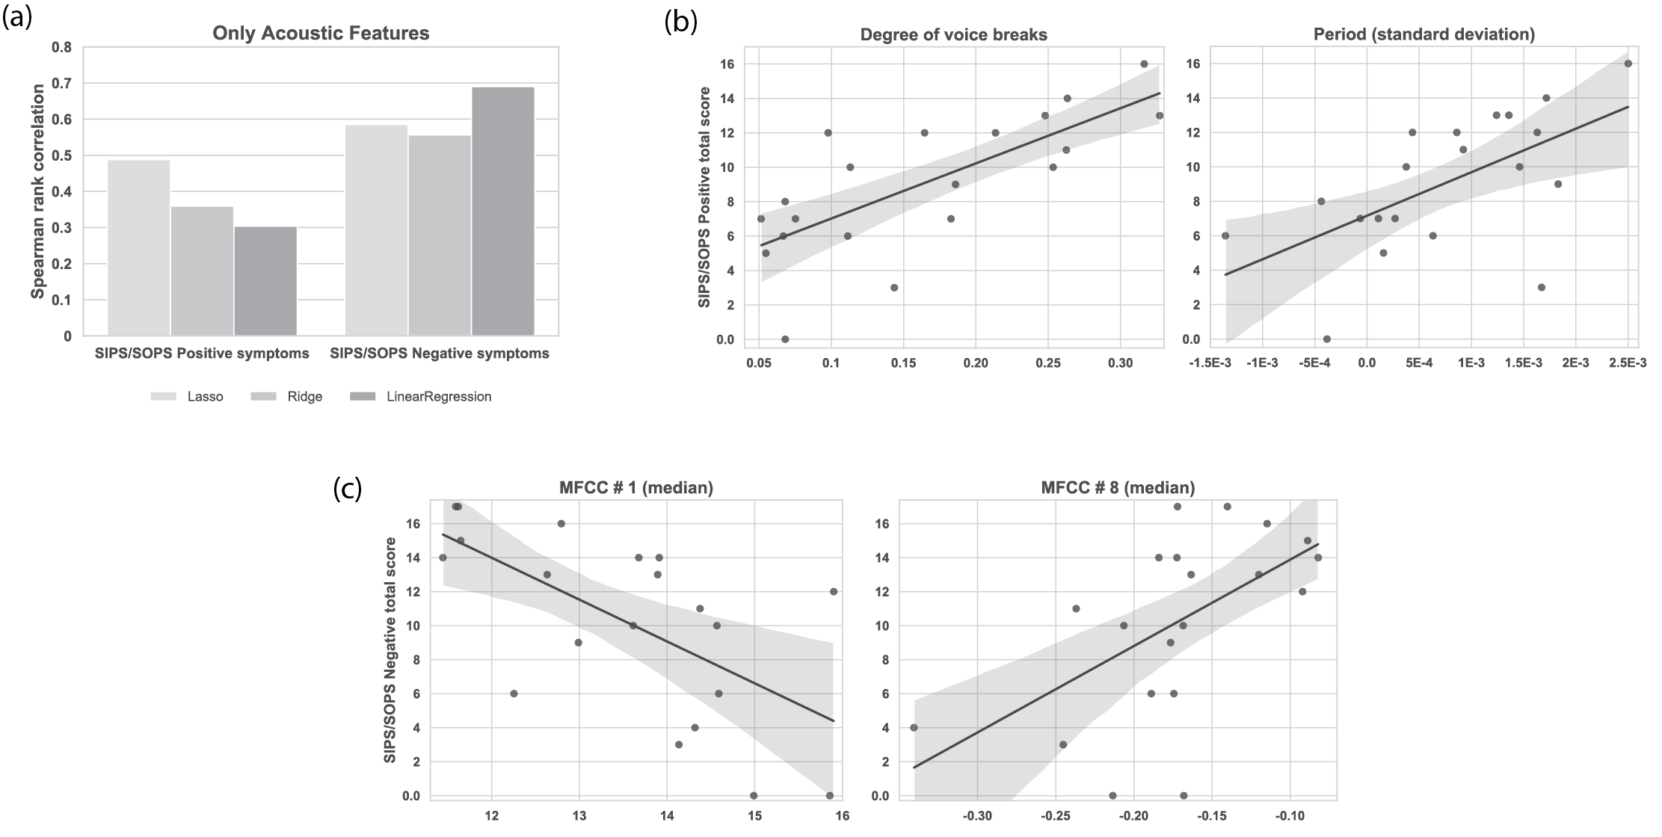
Figure 4 Regression results for acoustic features. a) Performance of the cross-validated models using 3 different machine learning algorithms. b) Relevant features to infer positive symptoms score used in the best model (Lasso). Note that features were corrected by age and education years so values are also shifted to negative values. c) Top features to infer negative symptoms used in the best model (Linear Regression).

