Slide 1
Wordle Encoder
feature map
5×26
hidden layer 1
hidden layer 2
hidden layer 3
v₁
regressor
~
flatten
word
one-hot encode
dim = 130
dim = 100
dim = 100
dim = 50
dim = 10

Slide 2
Attributes Encoder
attribute vector
v₂
frequency score
word
DL-score
scaled
MLP
vowel-score
dim = 3
dim = 10

Slide 3
Semantic Encoder
scaled
word vecter
v₃
word2vec
word
MLP
dim = 300
dim = 10

Slide 4
Wordle Encoder
feature map
v₁
flatten
MLP
one-hot encode
5×26
dim = 130
dim = 10
_{FC layer}
Attributes Encoder
v₂
v₁+αv₂+βv₃
frequency score
attribute vector
classifier
word
MLP
batch norm
dropout
DL-score
scaled
＋
~
vowel-score
dim = 3
dim = 10
dim = 10
ReLU
_{MLP}
Semantic Encoder
word vecter
v₃
hidden layer 1
hidden layer 2
hidden layer 3
hidden layer 4
GoogleNews-vectors-negative300
word2vec
MLP
dim = 300
dim = 10

Slide 5
_{MLP}
hidden layer 1
hidden layer 2
hidden layer 3
hidden layer 4

Slide 6
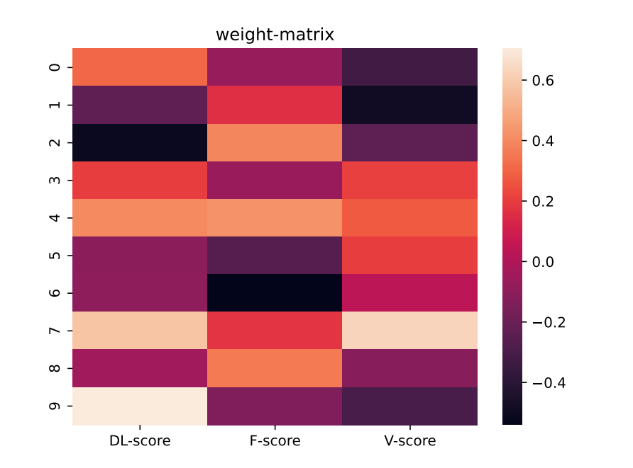
test-network
hidden layer
attributes
output
dim=10

