Slide 1

5G NR Simulation in NS-3 Assignment 13
Authors: Bc. Adam Hora
Bc. Boris Hynšt
Bc. Jan Hrubý
Bc. Václav Pastušek

Slide 2
Introduction
Our project focuses on simulating a 5G-NSA (Non-Standalone) network using the Network Simulator 3 (NS-3) framework.
Contributors will engage in practical exercises to design a detailed network scenario, fine-tune 5G New Radio (NR) parameters, and analyze network performance comprehensively.

Slide 3
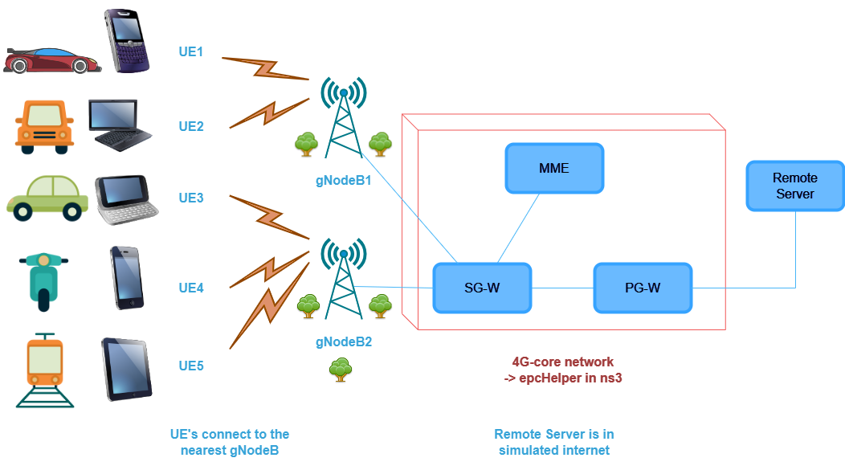
Network design

Slide 4
Launching the Program
Method of launching a program:
“./ns3 run 13th-group_5G-NSA --param=value“
Chosen application parameters (of the 11 total):
• numerologyBandwidth – Set numerology 0 to 4 [-].
• txPower – Set transmitter power [dBm].
• packetSize – Set packet size [Bytes].
• maxPacketSize – Set the max number of packets transmitted per second [-].
• simTime – Set simulation time [sec].

Slide 5
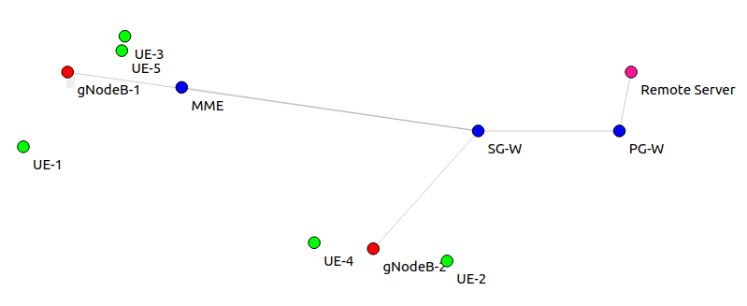
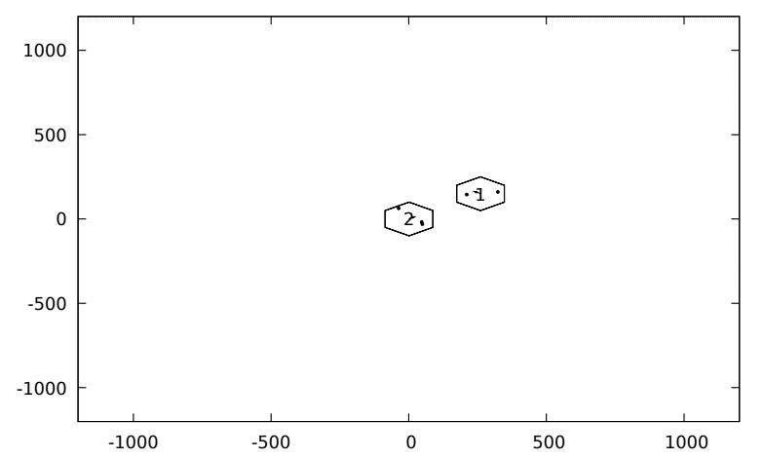
Simulated scenarios for 2 gNodeBs and 5 UEs

Slide 6
Comparison between simulations of the first group
Numerology num. 0
Average sim. throughput [Mbps]: 16.720
Average sim. delay [ms]: 8.321
Numerology num. 4
Average sim. throughput [Mbps]: 16.775
Average sim. delay [ms]: 2.060

Slide 7
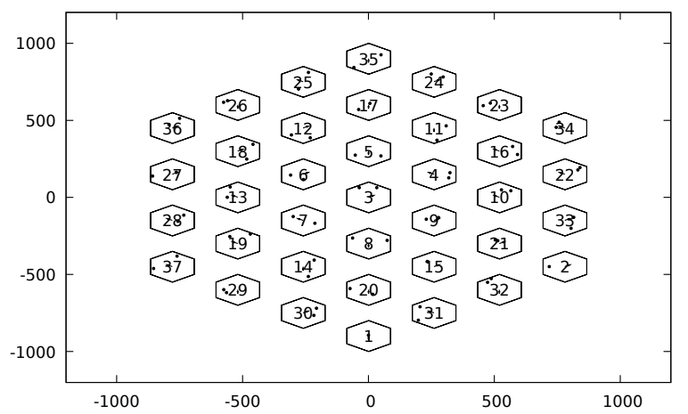
Implementation using maximum numbers of gNodeBs

Slide 8
Problems and future implementation
Problems:
MME – mobility model
HeganalGridHelper documentation -> TODO
Future implementation:
UEs changing speed
UEs handover

Slide 9
Thank you very much for your attention

Slide 10
Questions

