Slide 1
Building a serverless
Python application on AWS
A hands-on webinar, hosted by DEV.BG

Slide 2


About the lecturer
Software Developer @
Django & React 🧡
Interested in cloud computing & dev-ops.

Slide 3
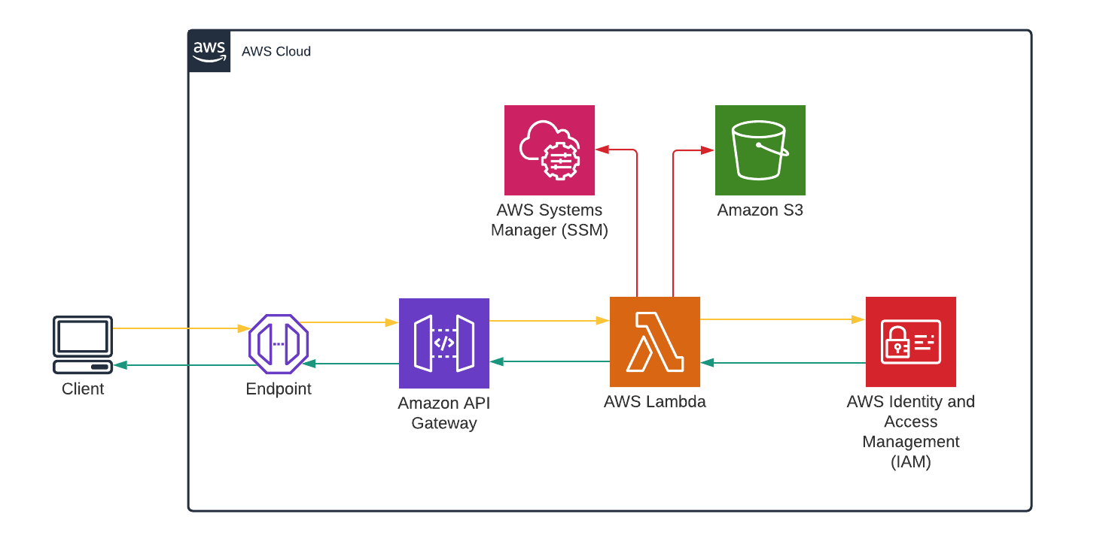
peaks-bucket
/peaks
listPeaks

Slide 4
Simple Storage Service (S3)
Creating a bucket & uploading JSON data.

Slide 5
peaks-bucket
/peaks
listPeaks

Slide 6
API Gateway
Creating an API with a mock response endpoint.

Slide 7
peaks-bucket
/peaks
listPeaks

Slide 8
Lambda
Creating a Lambda function with a Python runtime.

Slide 9
peaks-bucket
/peaks
listPeaks

Slide 10
API Gateway → Lambda
Invoking the Lambda function from the API endpoint.

Slide 11
peaks-bucket
/peaks
listPeaks

Slide 12
Identity & Access Management (IAM)
Allowing the Lambda function to access other AWS services.

Slide 13
peaks-bucket
/peaks
listPeaks

Slide 14
Systems Manager (SSM)
Storing our secrets in a safe place.

Slide 15
peaks-bucket
/peaks
listPeaks

Slide 16
API Gateway → Lambda → S3
Filtering data based on a URL query parameter.

Slide 17
peaks-bucket
/peaks
listPeaks

Slide 18
Resources
IAM roles
S3 Select
Lambda execution context
API Gateway (REST)
SSM Parameter Store
Boto3
https://github.com/wencakisa/devbg-python-serverless

Slide 19
Thank you!
GitHub: @wencakisa | @HackSoftware
LinkedIn: ventsislav-tashev
Следващо събитие:
Заглавие на следващото събитие

