Slide 1


Building a simple serverless Python application on AWS
Django Bulgaria Meetup - Winter edition

Slide 2

About me
Ventsislav Tashev
Software Developer @ HackSoft
Python & Django 🧡
Interested in cloud computing, especially using AWS.

Slide 3
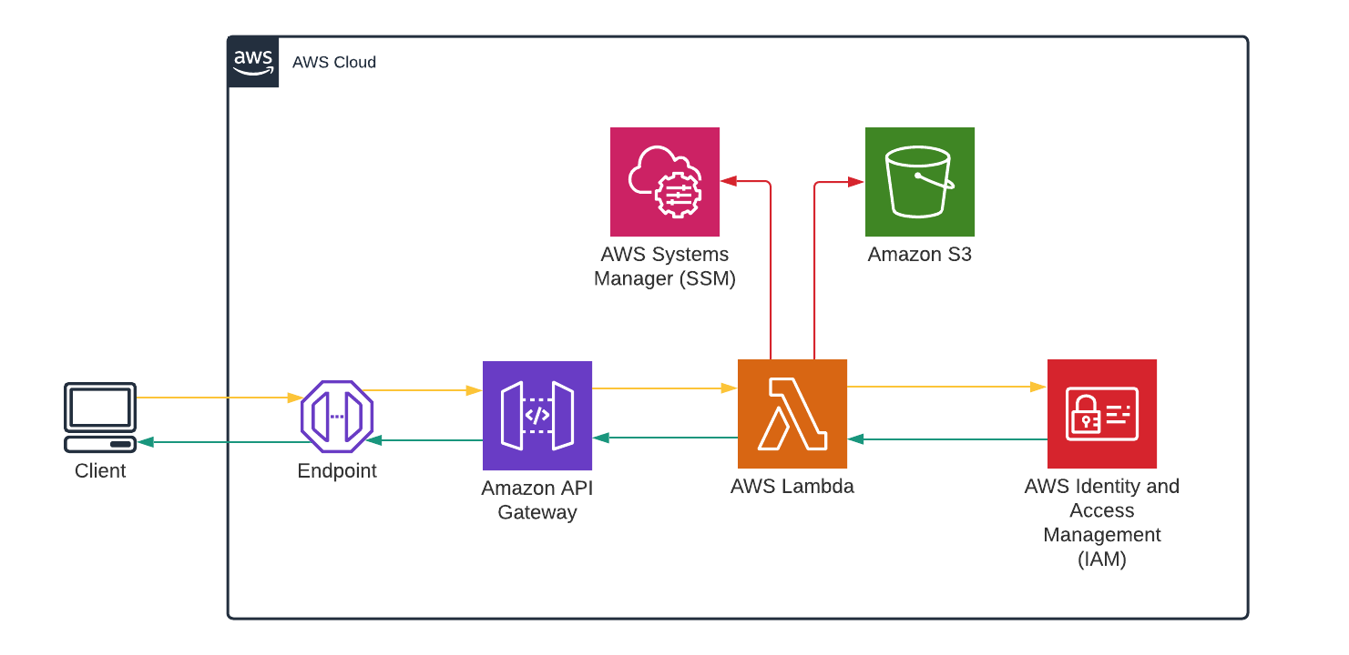
Flow
cars-bucket
/cars
listCars

Slide 4
S3
Creating a bucket & uploading JSON data.

Slide 5
Flow
cars-bucket
/cars
listCars

Slide 6
API Gateway
Creating an API with a mock response endpoint.

Slide 7
Flow
cars-bucket
/cars
listCars

Slide 8
Lambda
Creating a Lambda function using the Python runtime.

Slide 9
Flow
cars-bucket
/cars
listCars

Slide 10
API → Lambda
Invoking the Lambda function from the API endpoint.

Slide 11
Flow
cars-bucket
/cars
listCars

Slide 12
IAM
Allowing the Lambda function to access other AWS services.

Slide 13
Flow
cars-bucket
/cars
listCars

Slide 14
SSM
Storing secrets in a safe place.

Slide 15
Flow
cars-bucket
/cars
listCars

Slide 16
API → Lambda → S3
Filtering data based on a query parameter.

Slide 17
Flow
cars-bucket
/cars
listCars

Slide 18
Resources
IAM roles
S3 Select
Lambda execution context
API Gateway (REST)
SSM Parameter Store
Boto3
https://github.com/wencakisa/django-meetup-serverless

Slide 19

Thanks
Q & A
@wencakisa
@HackSoftware

