Slide 1
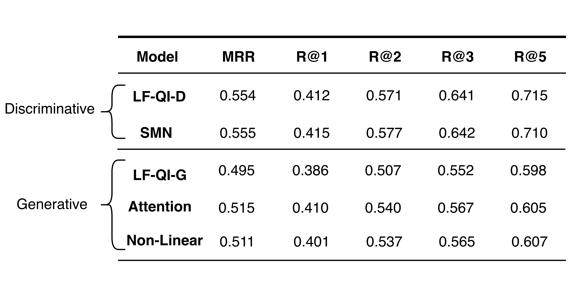
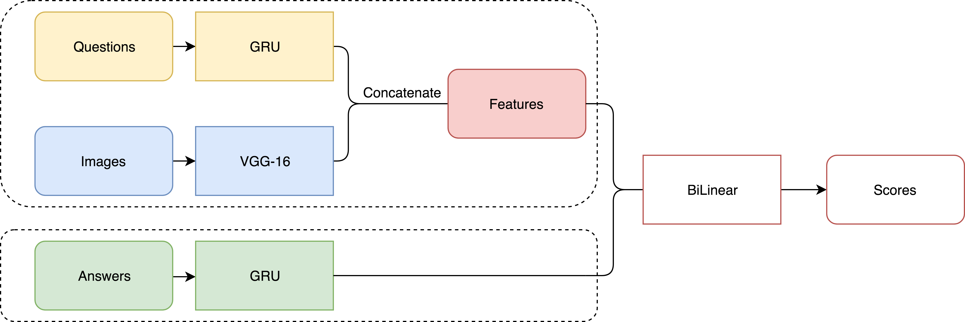
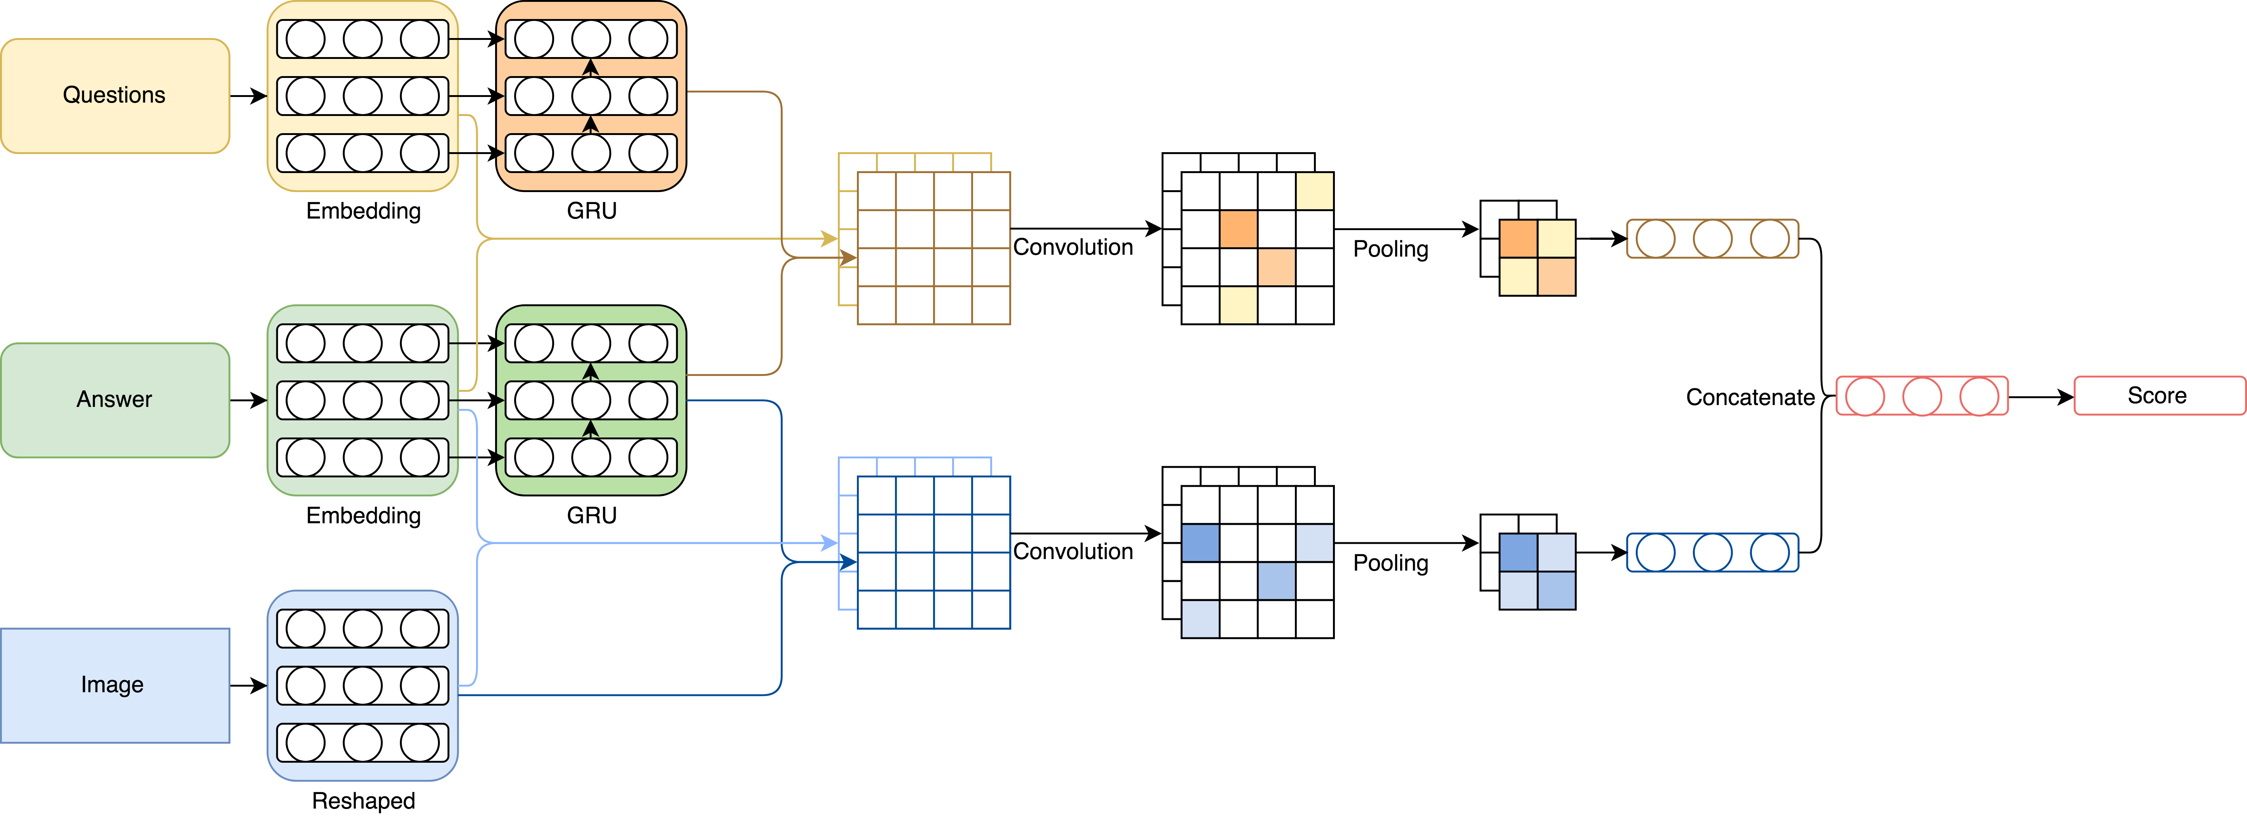
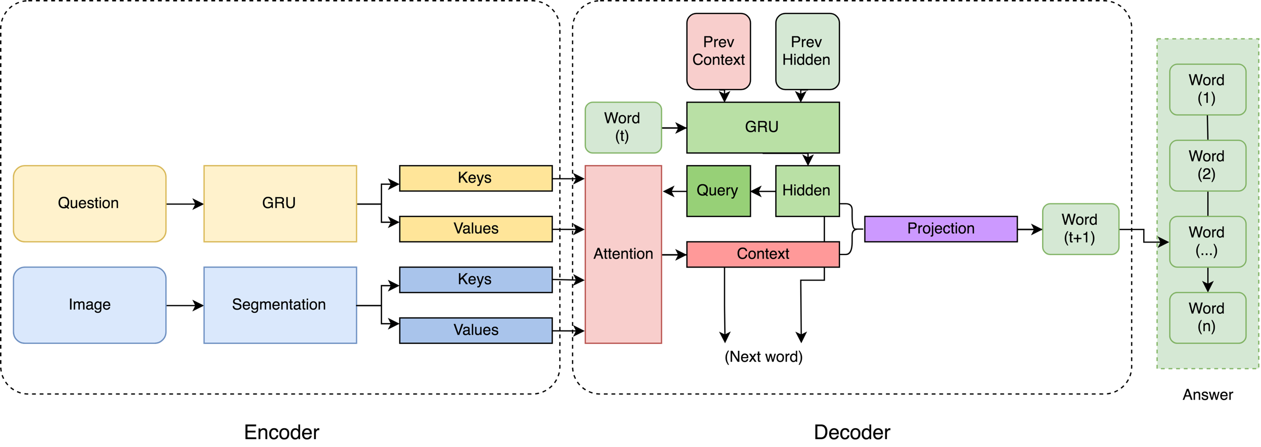
Visual Dialog
Wenchao Du, Hanfu Zhang, Prashant Arunapuram, Tianhao Li
11785 Final Project
Overview
Experiments
The Visual Dialog task has been at the forefront of deep learning research and excellent performance has already been achieved. Visual Dialog is about training a network to learn information about images, and be able to answer questions and have a conversation about those images. It involves being able to encode the relevant information (such as the images, the captions for the images, and the questions and answers about the images) into a meaningful representation, as well as being able to decode that representation and come up with a correct answer.
In our project, we first attempt to reproduce the state-of-the-art method in the widely used Visual Dialog dataset. This method uses a Late Fusion encoder with a discriminative decoder. Because of the memory limitation, we decreased the model size and still obtained comparable results. We further introduce the sequential matching network – a new architecture for multi-turn response selection in retrieval-based visual dialog. Finally, we explore a generative model with attention, which can achieve the conversation based on a given image and outperform the existing methods.
Metrics: We conduct the experiments on the retrieval task, which is evaluated with Mean Reciprocal Rank (MRR) and Recall at N (R@N). Mean Reciprocal Rank will essentially look at what rank the model gave the correct response, and take the mean of all the reciprocals of the ranks given. The higher this value, the better the model performed. Recall at N, the other evaluation metric, looks at whether the correct response exists within the top N ranked responses given by the model.
Constraints: Due to hardware constraints, we use smaller hidden size (200) and word embedding size (200) as opposed to 512 and 300 in Das et al.. We are able to get results that are close to what were reported by the author.
Models
In this project, we introduce a family of neural encoder-decoder models for Visual Dialog with 2 encoders – Late Fusion, Sequential Matching – and 2 decoders (generative and discriminative), which are comparable to a number of sophisticated baselines.
Late Fusion - Discriminative
Evaluation: Our baselines are based on Late Fusion, with the representation of questions and image. Compared to the discriminative baseline, our SMN method improves MRR by 0.18% and R@N by 0.31% on average. In the generative models, our best one improves MRR by 4.04% and R@N by 4.15%.
We first decided to use a Late Fusion Discriminative model as one of the baselines with which we would compare our other models to in terms of performance. This model has an LF Encoder which concatenates the individual representations of the questions and the images, and linearly transforms this input to a desired joint representation of features. The discriminative decoder computes the similarity between the input encoding and the GRU encoding of the answer options to get an evaluation metric.
Data and Technical Requirements
Our Visual Dialog system involves deep learning approaches such as CNNs and RNNs with attention to better understand the images and questions. Therefore, also based on literature research, we decide to deploy the network based on Pytorch with GPUs on Amazon Web Service.
In this project, we use VisDial v0.9 dataset, which contains 83k dialogs on COCO-train and 40K on COCO-val images. We use the 83k as training and split the 40K into 5k for validation and 35k for test.
Our work is based on Pytorch, due to GPU memory limitation, we reduce the size of the hidden layer in GRUCell, aiming to produce the same comparable results with less parameters and further improvements.
Sequential Matching - Discriminative
Conclusion
To summarize, we reproduced an AI task – Visual Dialog, where an AI agent must hold a dialog with a human about visual content. Based on the Late Fusion encoder, we first implemented the discriminative and generative models as our baselines. Then we came up with methods focusing on improving the performance. For example, we applied a sequential matching network into the discriminative model and implemented question & image attention in the generative model.
Our baseline models are comparable to the results in the paper, since we used smaller hidden size and word embedding size. The sequential matching network in the discriminative model can slightly improve the performance, both on MRR and R@N. The attention model takes in the concatenation context of the question and image, which greatly improves the performance. Furthermore, we attempted to add non-linear functions for the context, but the improvement was not significant.
In conclusion, our project demonstrates that sequential matching and attention mechanisms can improve performance on the Visual Dialog dataset according to the MRR and R@N metrics.
The sequential matching network is a new idea in turn-based dialog, whereby questions and answer options are matched in terms of how appropriate the response is to that particular question and image. The model first embeds and passes all three components through an GRU to get a feature representation, then matches each answer to a question and image and scores how appropriate that answer is, after convolving, pooling, and concatenation.
Late Fusion with Attention - Generative
Related Work
Akshay Kumar Gupta. Survey of visual question answering: Datasets and techniques. CoRR, abs/1705.03865, 2017.
Abhishek Das, Satwik Kottur, Khushi Gupta, Avi Singh, Deshraj Yadav, Jose ́ M. F. Moura, Devi Parikh, and Dhruv Batra. Visual dialog. IEEE Conference on Computer Vision and Pattern Recognition, CVPR 2017.
Yu Wu, Wei Wu, Ming Zhou, and Zhoujun Li. Sequential match network: A new architecture for multi-turn response selection in retrieval-based chatbots. CoRR, abs/1612.01627, 2016.
Acknowledgement
We would like to thank Professor Bhiksha Raj and all teaching assistants, for all the supports and suggestions during this semester.
Author
In this part, we implement the generative model with the attention-based word decoder. At every output step, the model produces a probability distribution over the next word conditioned on all the words seen previously. The context vector is produced by an attention mechanism, where the question is converted with GRU and MLP while the image is segmented first then converted with MLP. With keys and values, and the transformation of encoder features, the contexts can be created. Then we concatenate these two parts and input them along with the hidden vector into the projection to get the final distribution.
Wenchao Du, LTI, SCS, wenchaod@andrew.cmu.edu
Hanfu Zhang, ISR, SCS, hanfuz@andrew.cmu.edu
Prashant Arunapuram, ECE, CIT, parunapu@andrew.cmu.edu
Tianhao Li, ISR, SCS, tianhaol@andrew.cmu.edu

