Slide 1
Interactional arrangement
HQ
Monitor
Monitor
FR
accept/reject
Agent
plan/re-plan

Slide 2
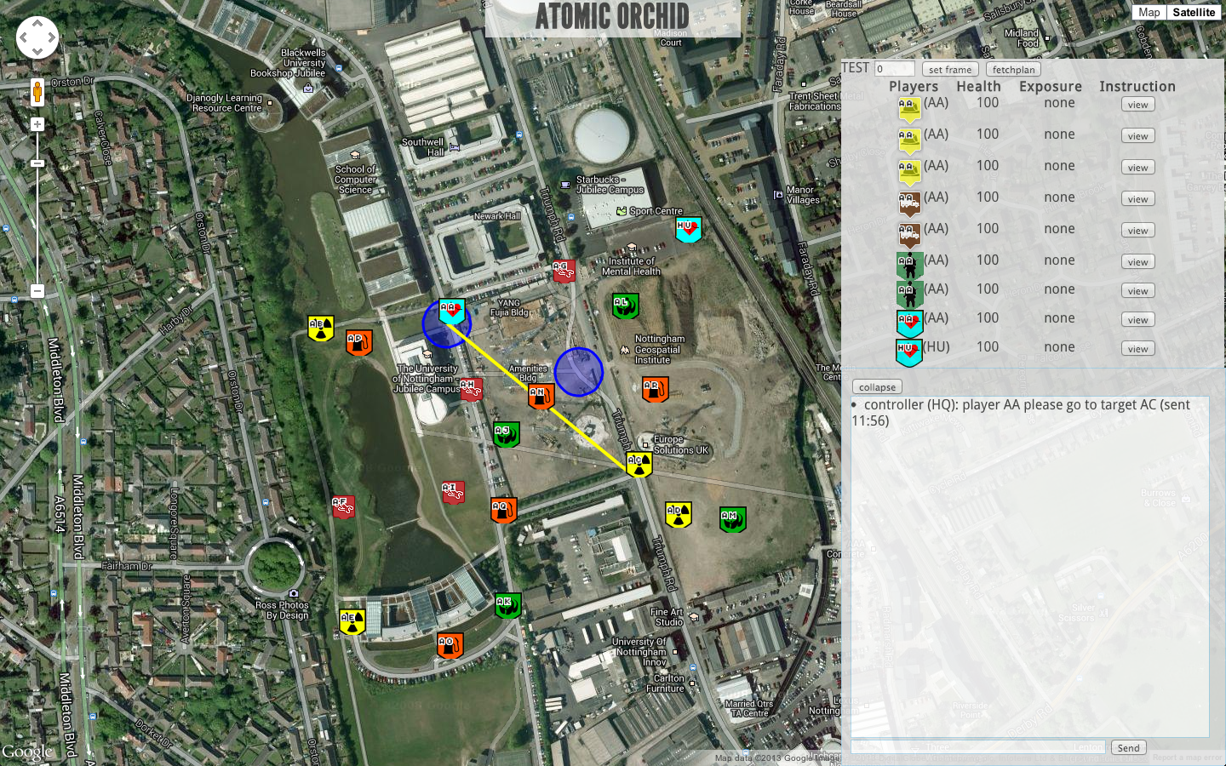

Slide 3
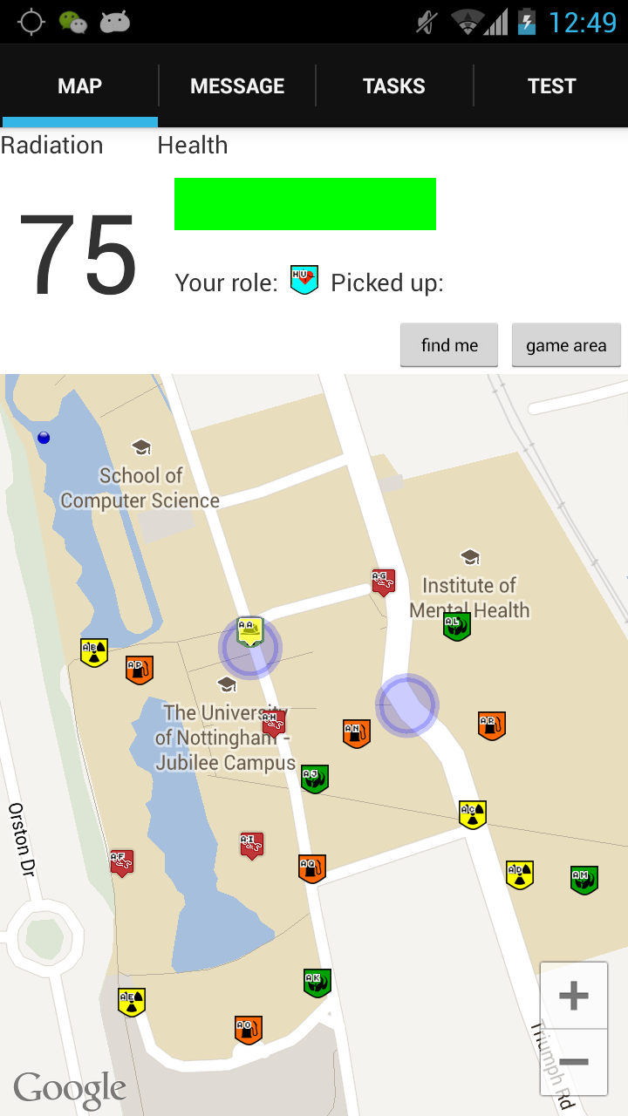
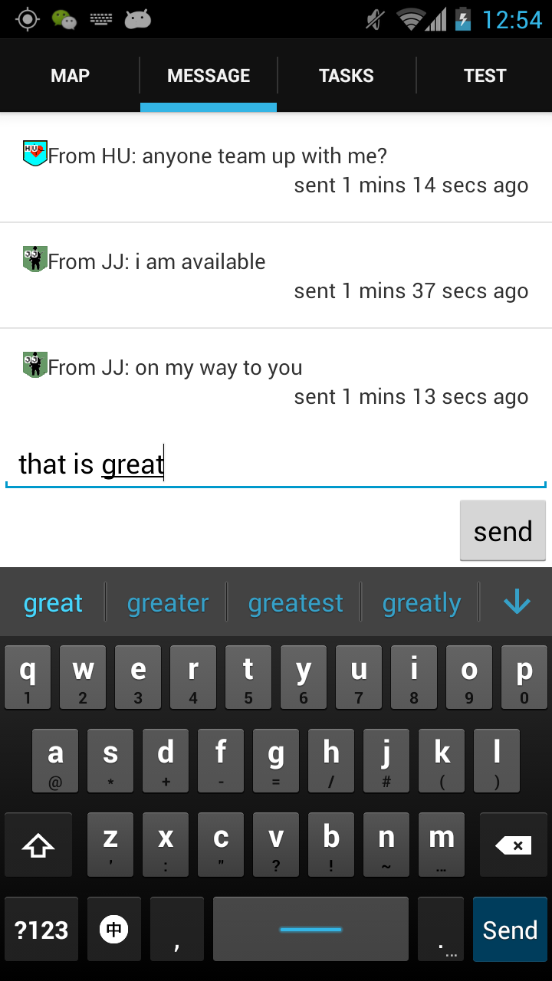

Slide 4
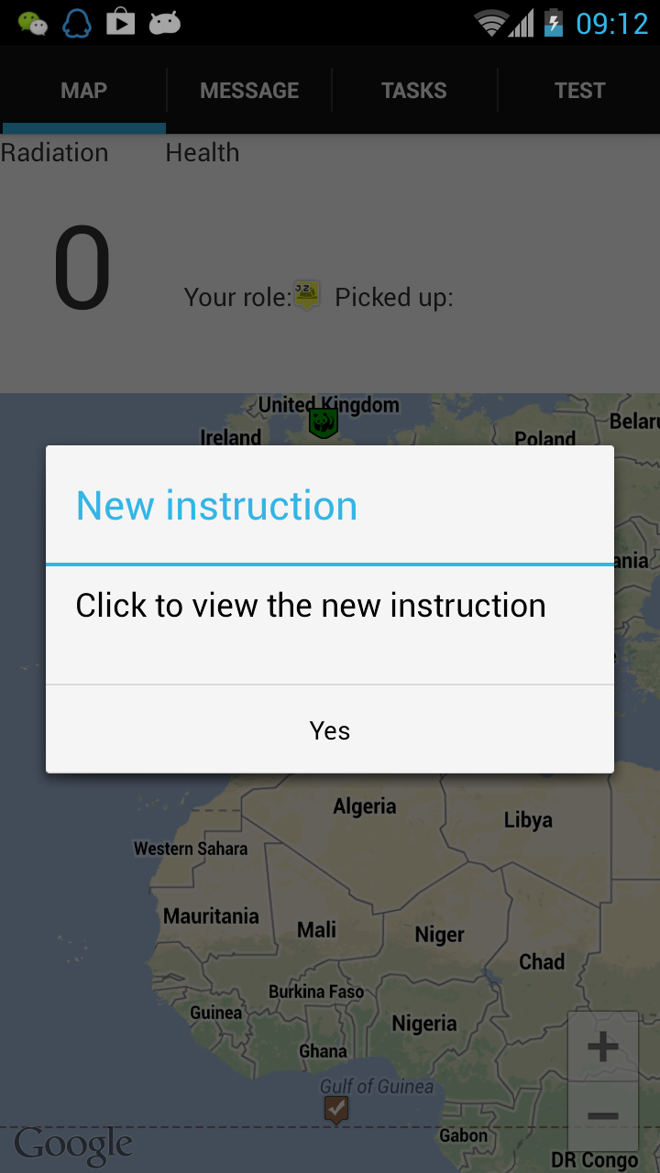
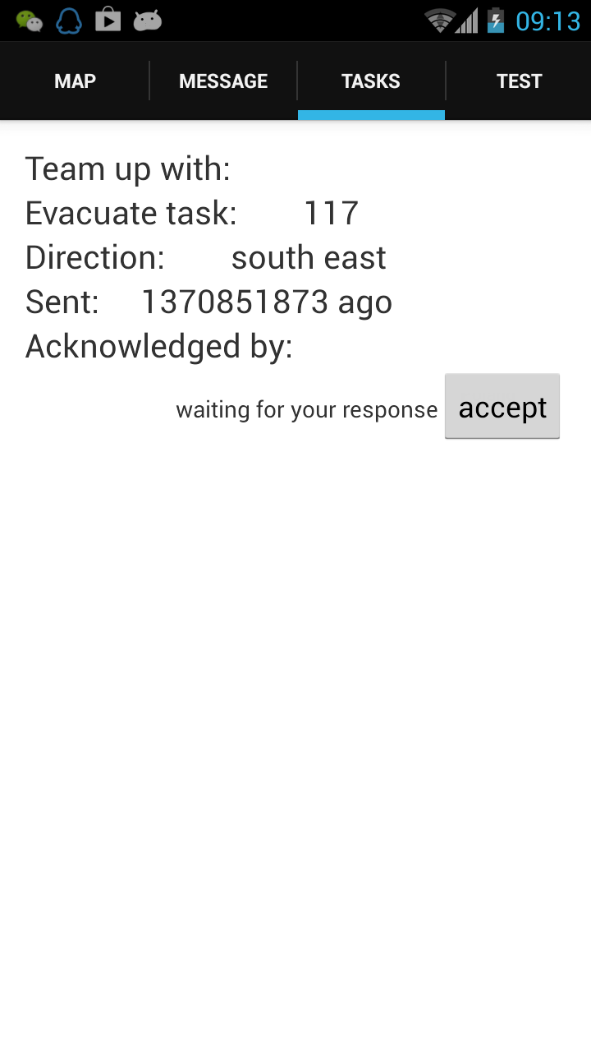

13 sec

Slide 5
Life circle of a plan
discarded
Generated
Being reviewed by HQ
Agreed by some FRs
Part of plan being executed
Agreed by All FRs
Plan being executed
Current agentd | Given game state, generate plan
Type 2 agent | Given game state, generate plan Assess plan execution and decide to intervene when necessary (warning, re-plan) Taken into account intentions of human

Slide 6
Agent
Pull instruction from agent
(HTTP POST with game state)
Atomic Orchid
HQ interface
(unimplemented)
Push instruction to mobile
Accept/reject instruction
Mobile

