Slide 1
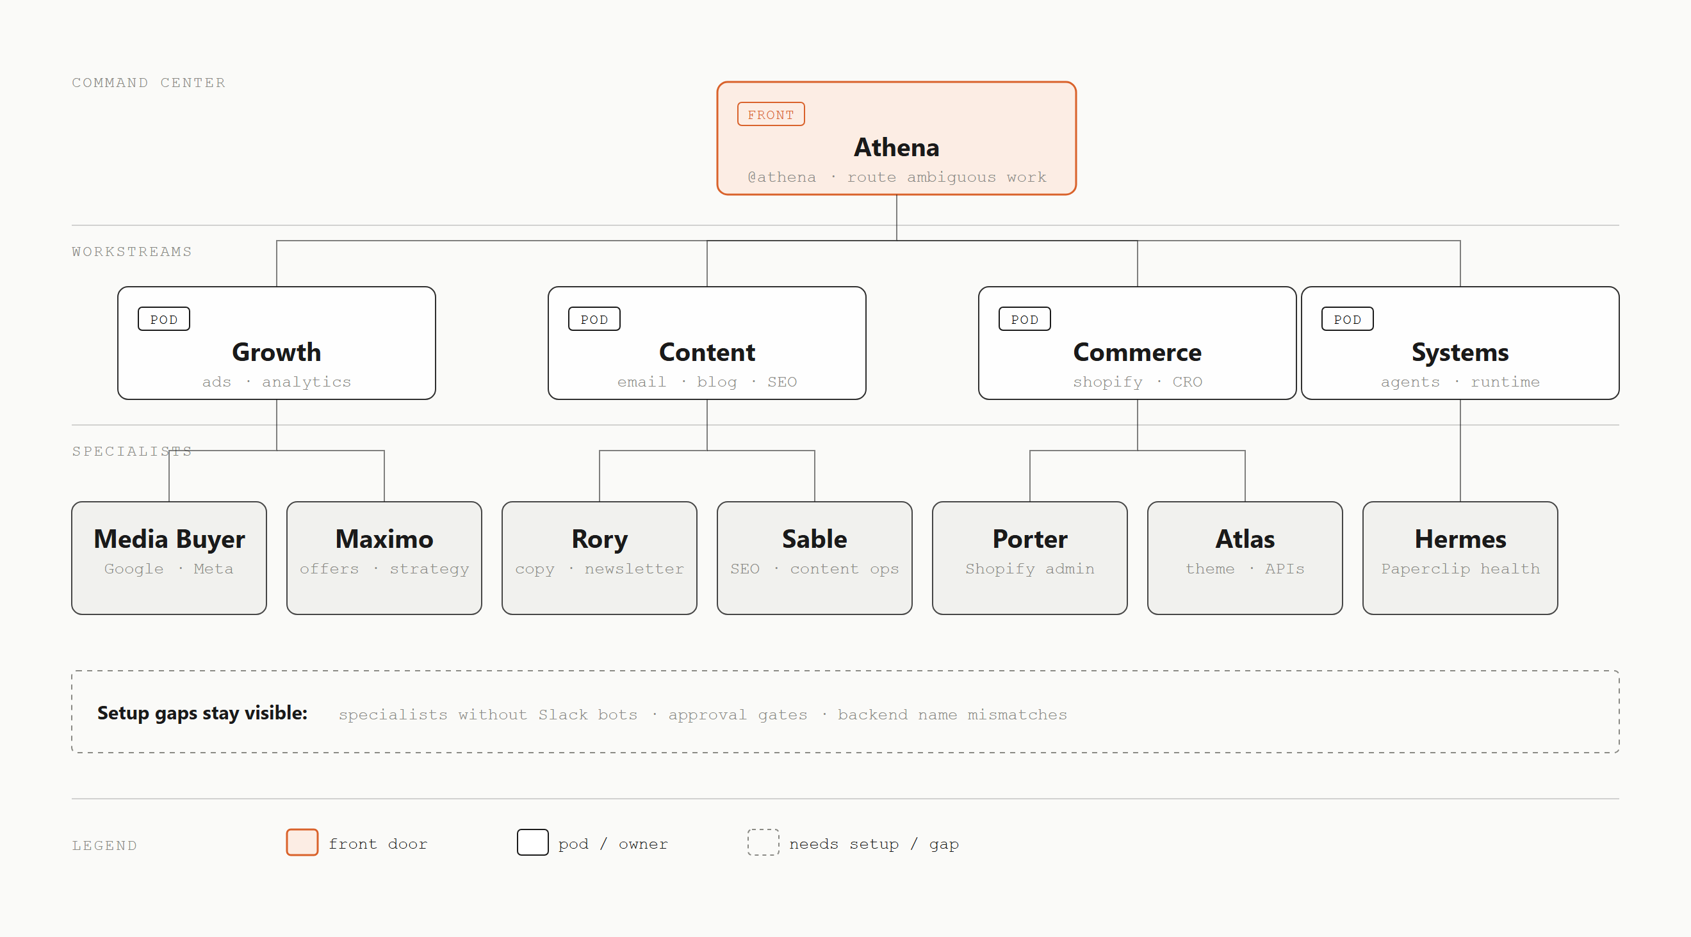
Command Center Org Chart
Notes:
Demo diagram generated by skill-document-diagram-design, redrawn from cathrynlavery/diagram-design's org-chart example in the shared style-guide (single accent color reserved for the front-door node, hairline borders, no shadows).

Slide 2
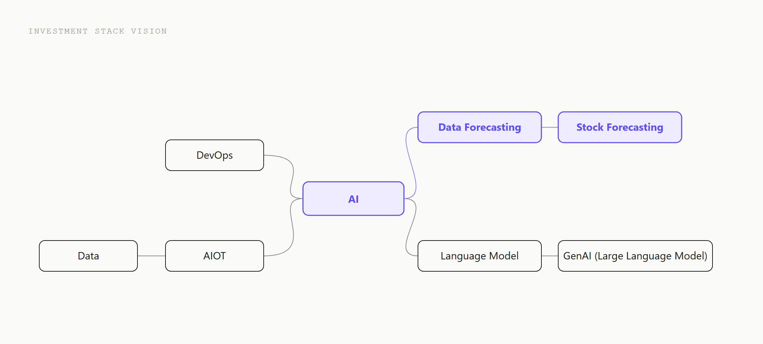
Investment Stack Vision
Notes:
Migrated from mkdocs-investment/docs/InvestmentStackVision.planuml (PlantUML mindmap, previously rendered via plantuml.com proxy). Parsed with scripts/import_plantuml_mindmap.py, redrawn as native SVG: the MediumPurple emphasis subtree (AI -> Data Forecasting -> Stock Forecasting) keeps the single accent color, other branches use neutral ink.

