Slide 1


Slide 2
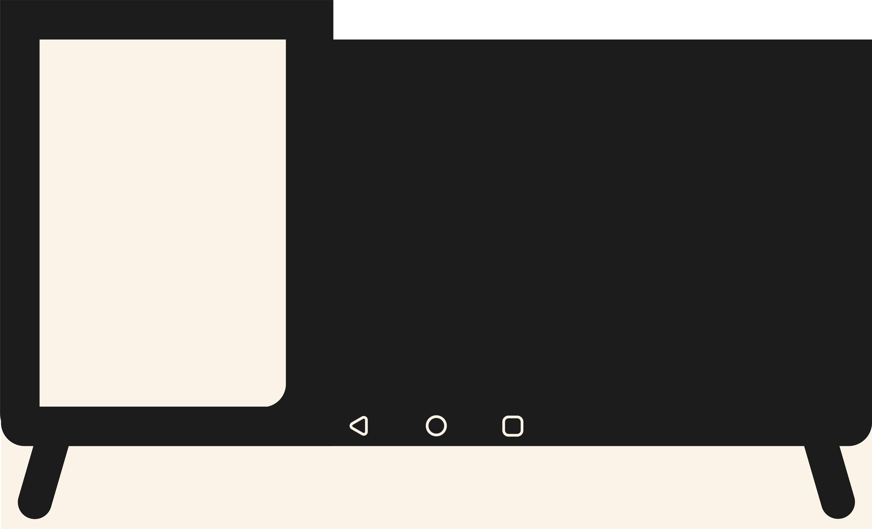

Table of Contents
-Brainstorming
-Research
-Execution
-Demo

Slide 3


Slide 4


Slide 5
Requirements
Raspberry pi with Wi-Fi
Micro SD-card
BalenaEtcher
Android TV software
USB-stick
Google apps package

