Slide 1
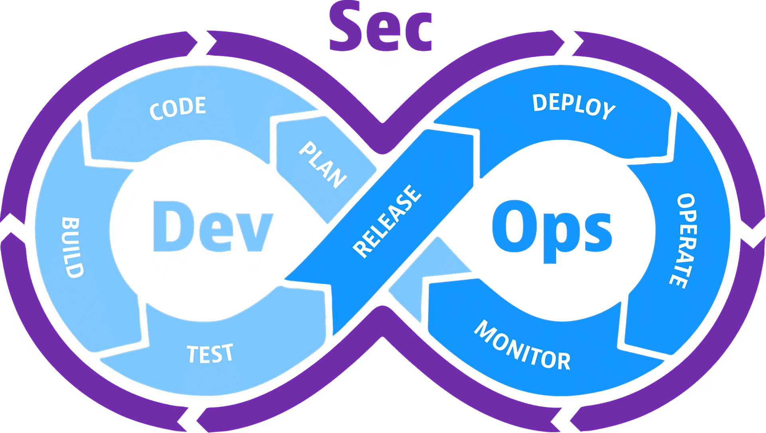

Notes:
https://cdn.dm.dynatrace.com/assets/Marketing/content-images/_1920x1088_crop_center-center_100_line/devsecops-image-2000-6557ba1b00.png.webp

