Slide 1
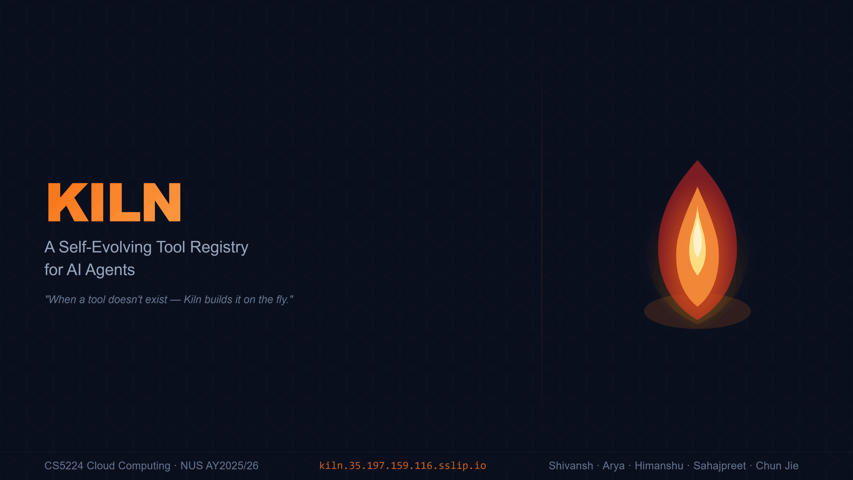
Notes:
Kiln is a self-evolving tool registry for AI agents. The core idea: when an AI agent needs a capability it doesn't have, Kiln builds it on the fly — no restarts, no redeployment. We built this end-to-end as a cloud-native system on GKE for CS5224.

Slide 2
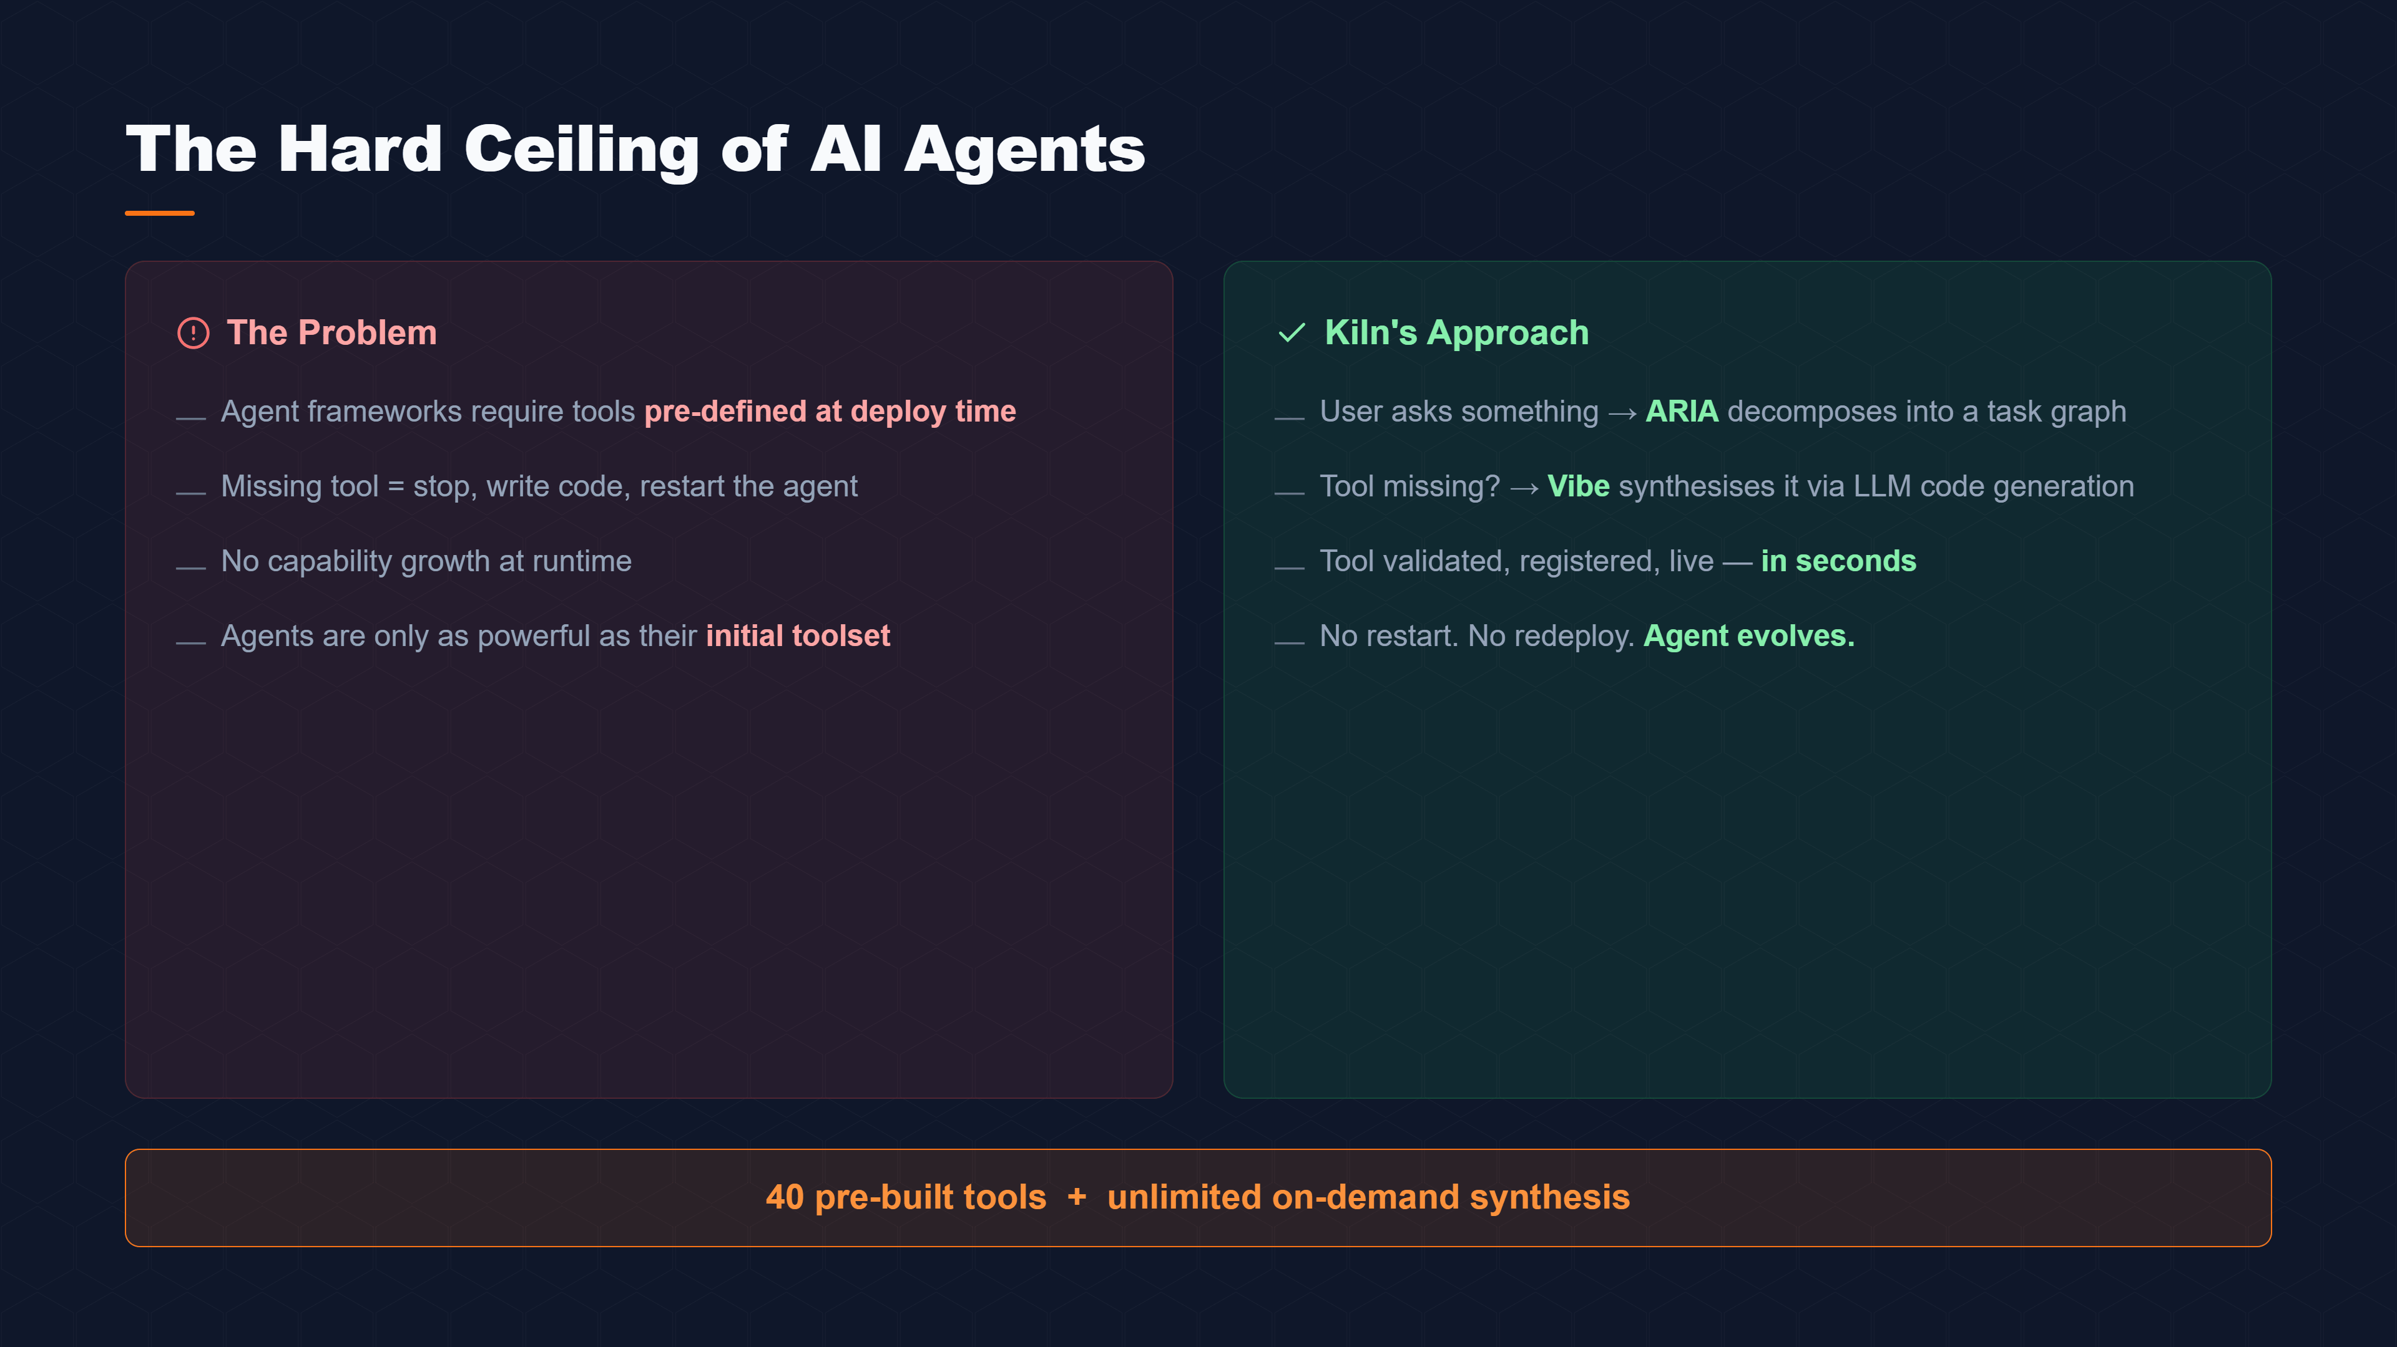
Notes:
Today's agent frameworks have a hard ceiling. You define your tools at deploy time, and if something's missing, you stop, write code, and restart. Kiln breaks that ceiling. Our ARIA planner decomposes user requests into task graphs, and when a tool is missing, our Vibe synthesiser generates it via LLM code generation — validated and live in seconds. We ship with 40 tools out of the box, plus unlimited on-demand synthesis.

Slide 3
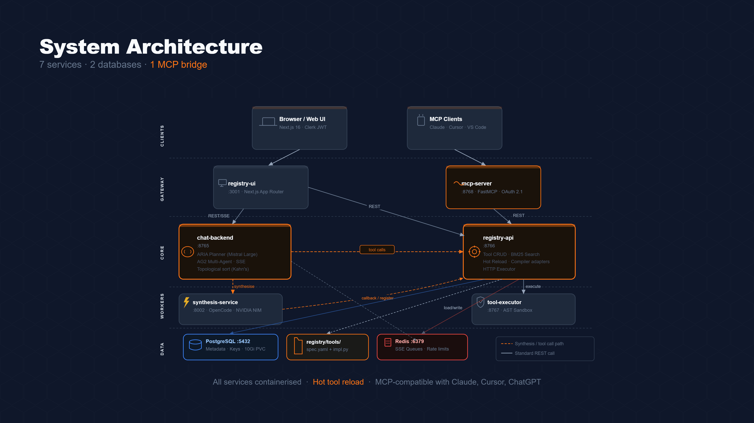
Notes:
Here's the architecture. Six microservices talk over REST and SSE. The chat-backend runs ARIA and coordinates multi-agent execution. The registry-api manages tool storage, search, and hot reload. The synthesis-service is where Vibe generates new tools. Everything is MCP-compatible, so it works with Claude Desktop, Cursor, and ChatGPT out of the box.

Slide 4
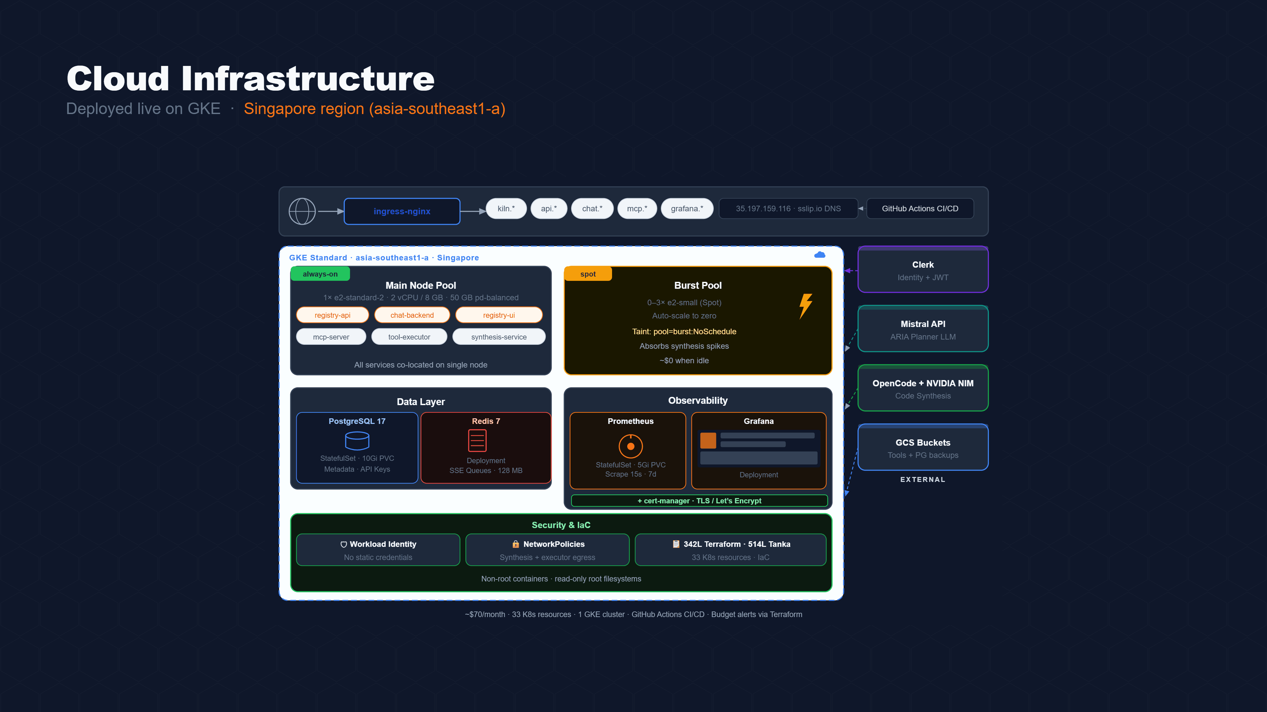
Notes:
We deployed this live on Google Kubernetes Engine in Singapore. A single always-on node runs all six services, and a spot-instance burst pool scales to zero when synthesis is idle. External services like Clerk, Mistral, and GCS are wired in via Workload Identity Federation — no static credentials anywhere. The whole infrastructure is defined as code: Terraform plus Tanka Jsonnet.

Slide 5
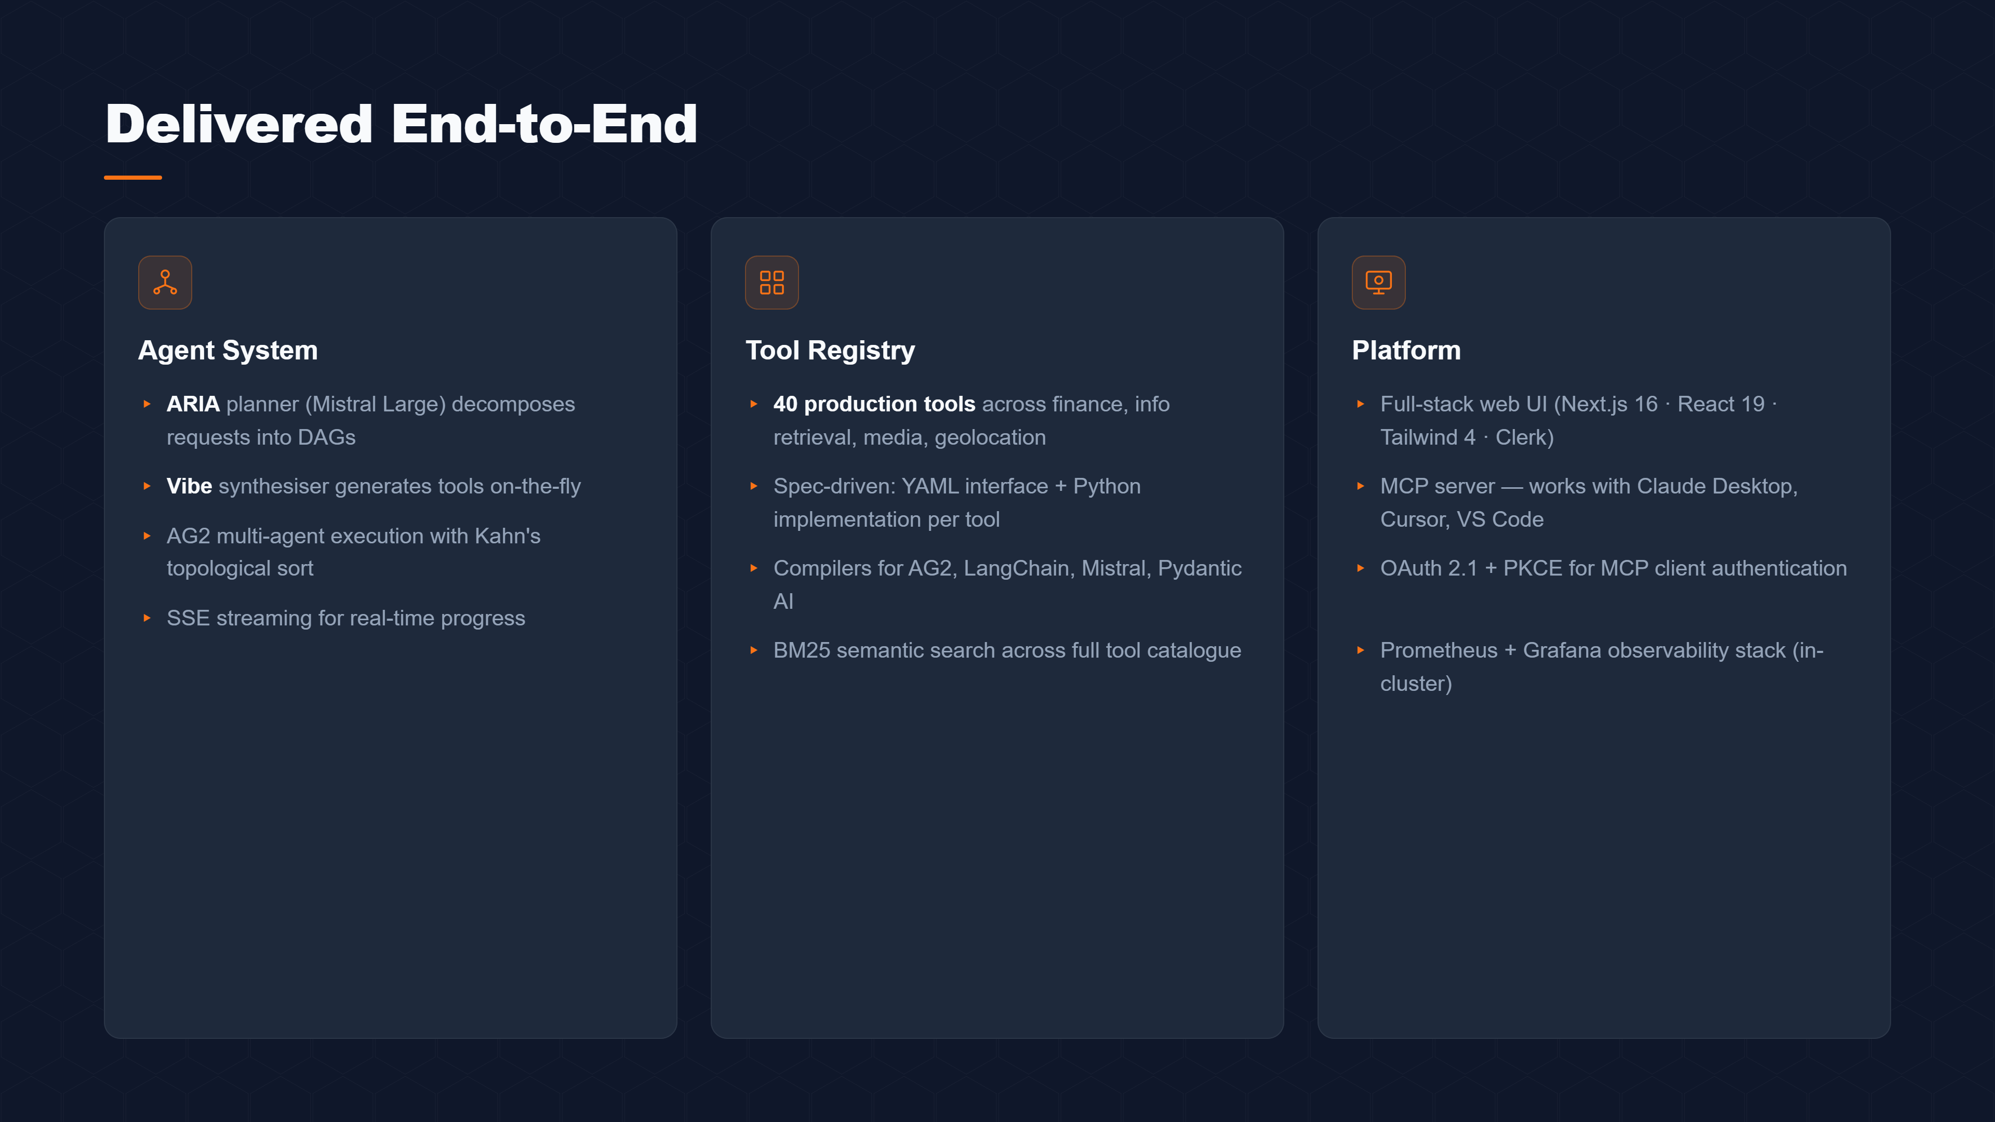
Notes:
In terms of what we actually shipped: on the agent side, ARIA builds DAGs from natural language and executes them with topological sort. On the registry side, 40 production-ready tools with BM25 search and hot reload. And on the platform side, a full Next.js web UI, an MCP server, OAuth 2.1 authentication, and a full Prometheus-Grafana observability stack — all running in-cluster at zero extra cost.

Slide 6
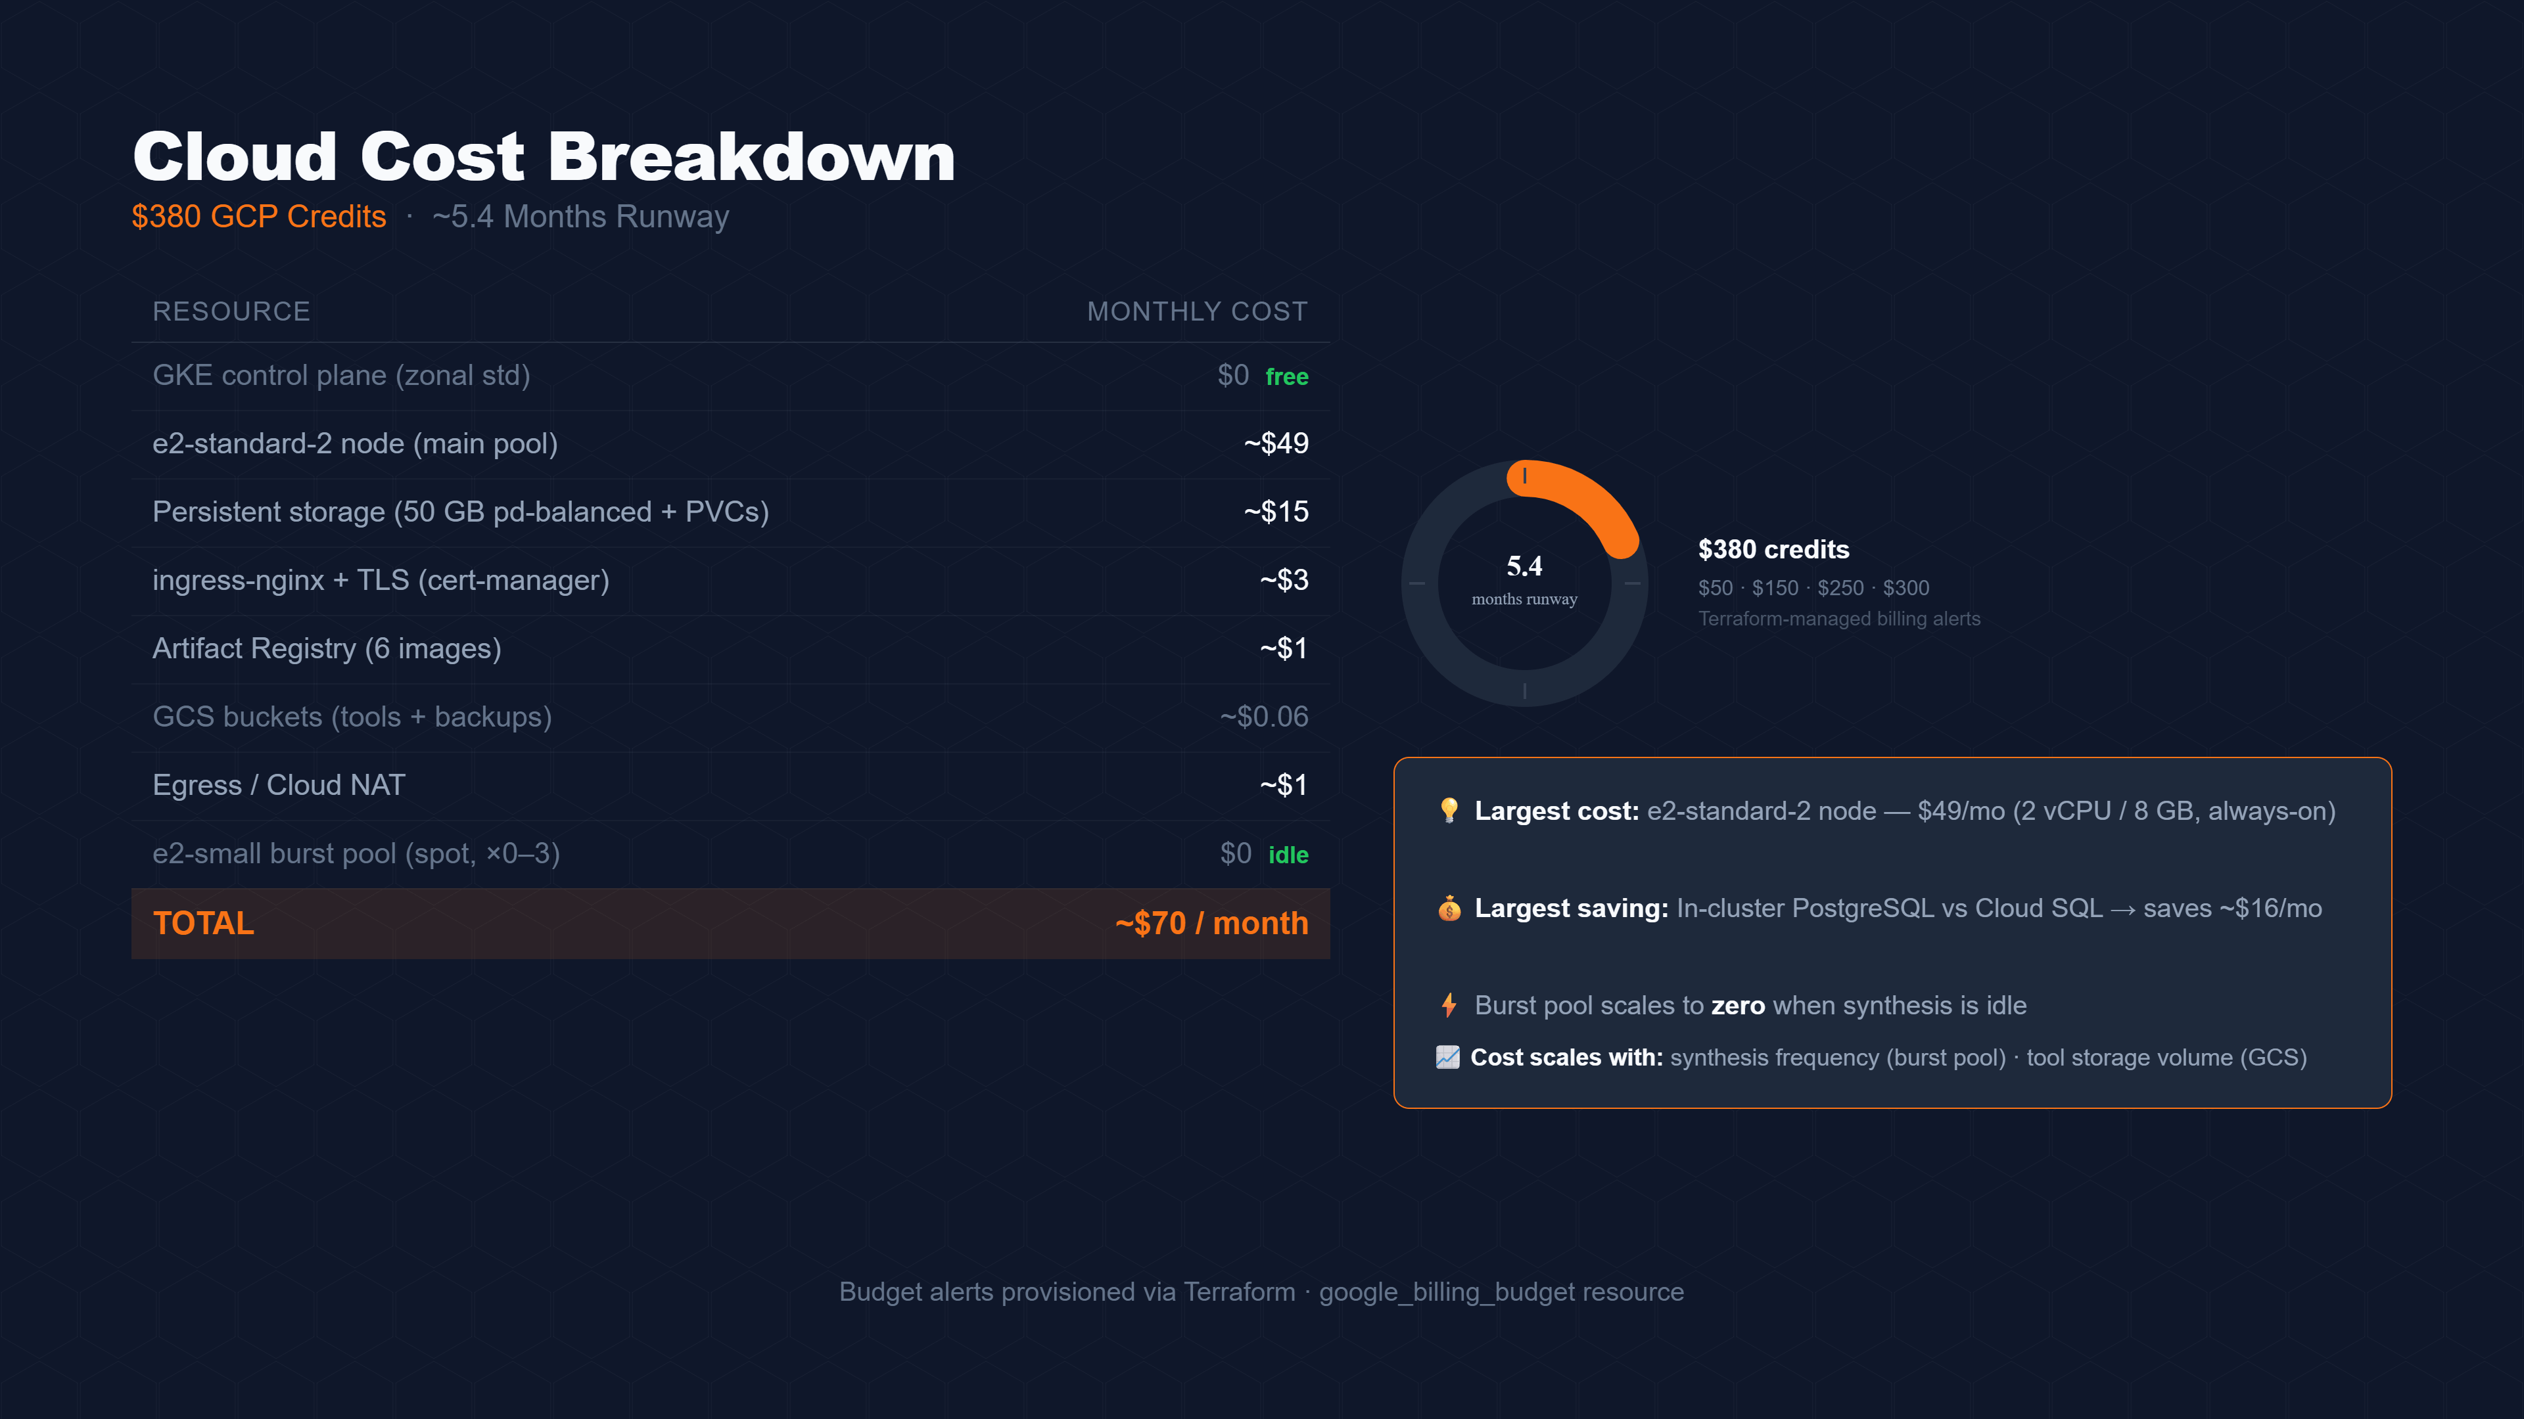
Notes:
Cloud costs are lean. We're running at roughly seventy dollars a month against three-eighty in GCP credits — about five and a half months of runway. The biggest line item is the load balancer at eighteen dollars, which is fixed regardless of traffic. We cut sixteen dollars a month by running PostgreSQL in-cluster instead of Cloud SQL. All billing alerts are provisioned via Terraform.

Slide 7
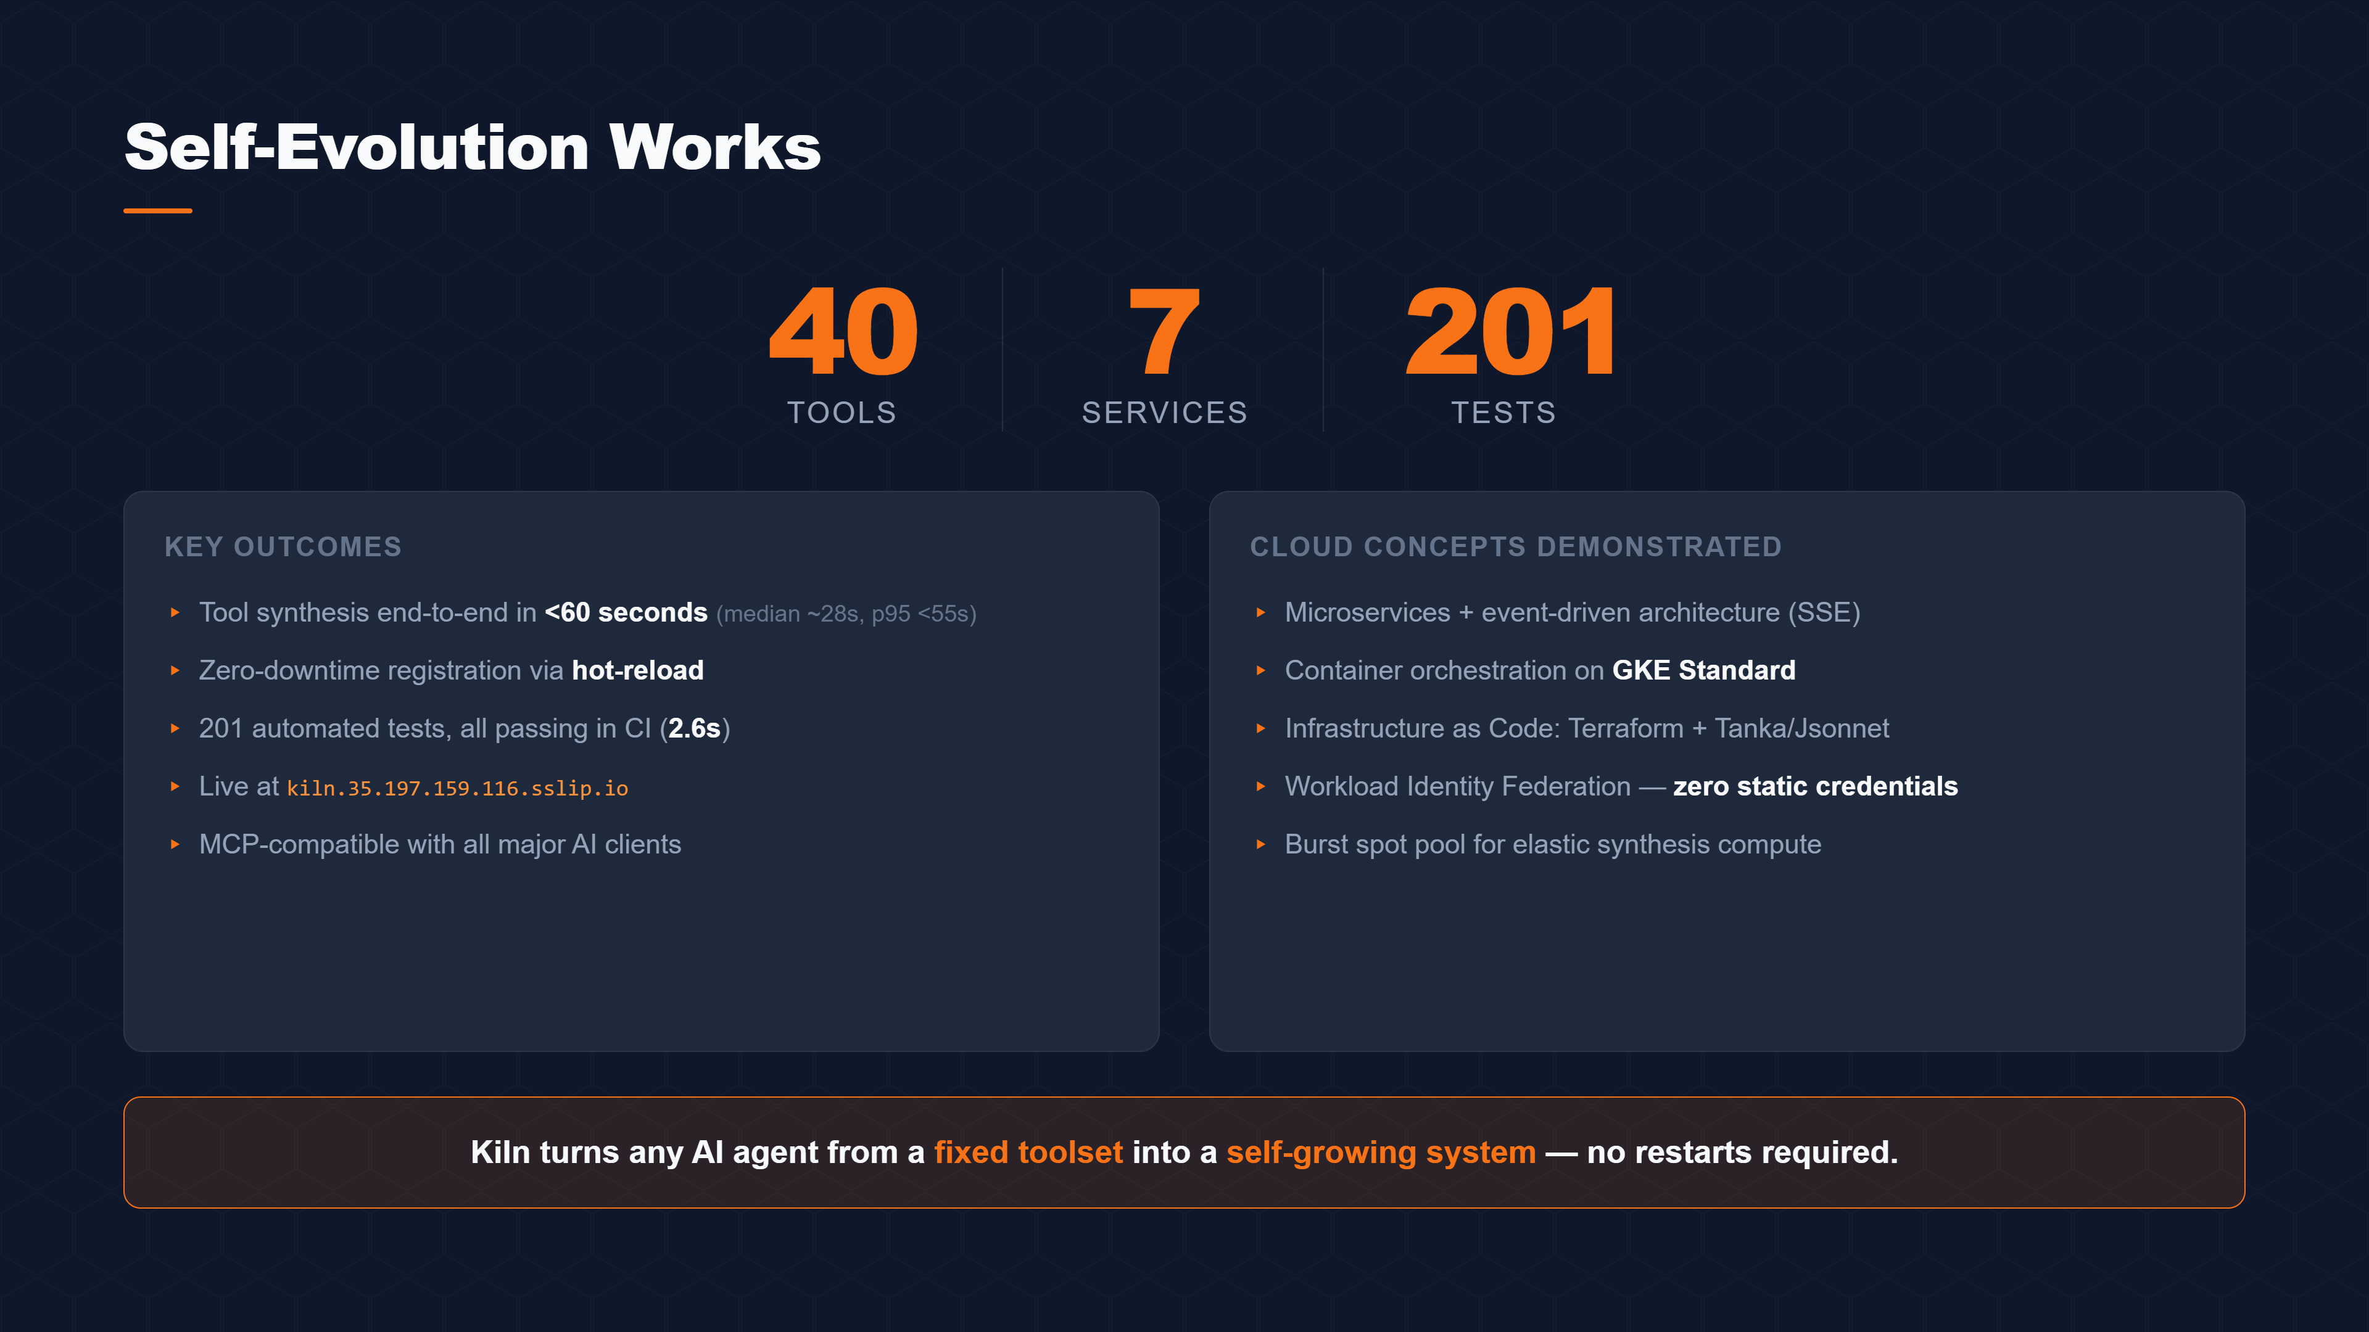
Notes:
The results: forty tools, seven services, two hundred and one tests — all passing in CI in 2.6 seconds. Median synthesis time is around 28 seconds. The system is live right now at kiln dot 35 dot 197 dot sslip dot io. Kiln demonstrates that you don't need a static toolset — with the right architecture, your agent can grow its own capabilities at runtime.

Slide 8
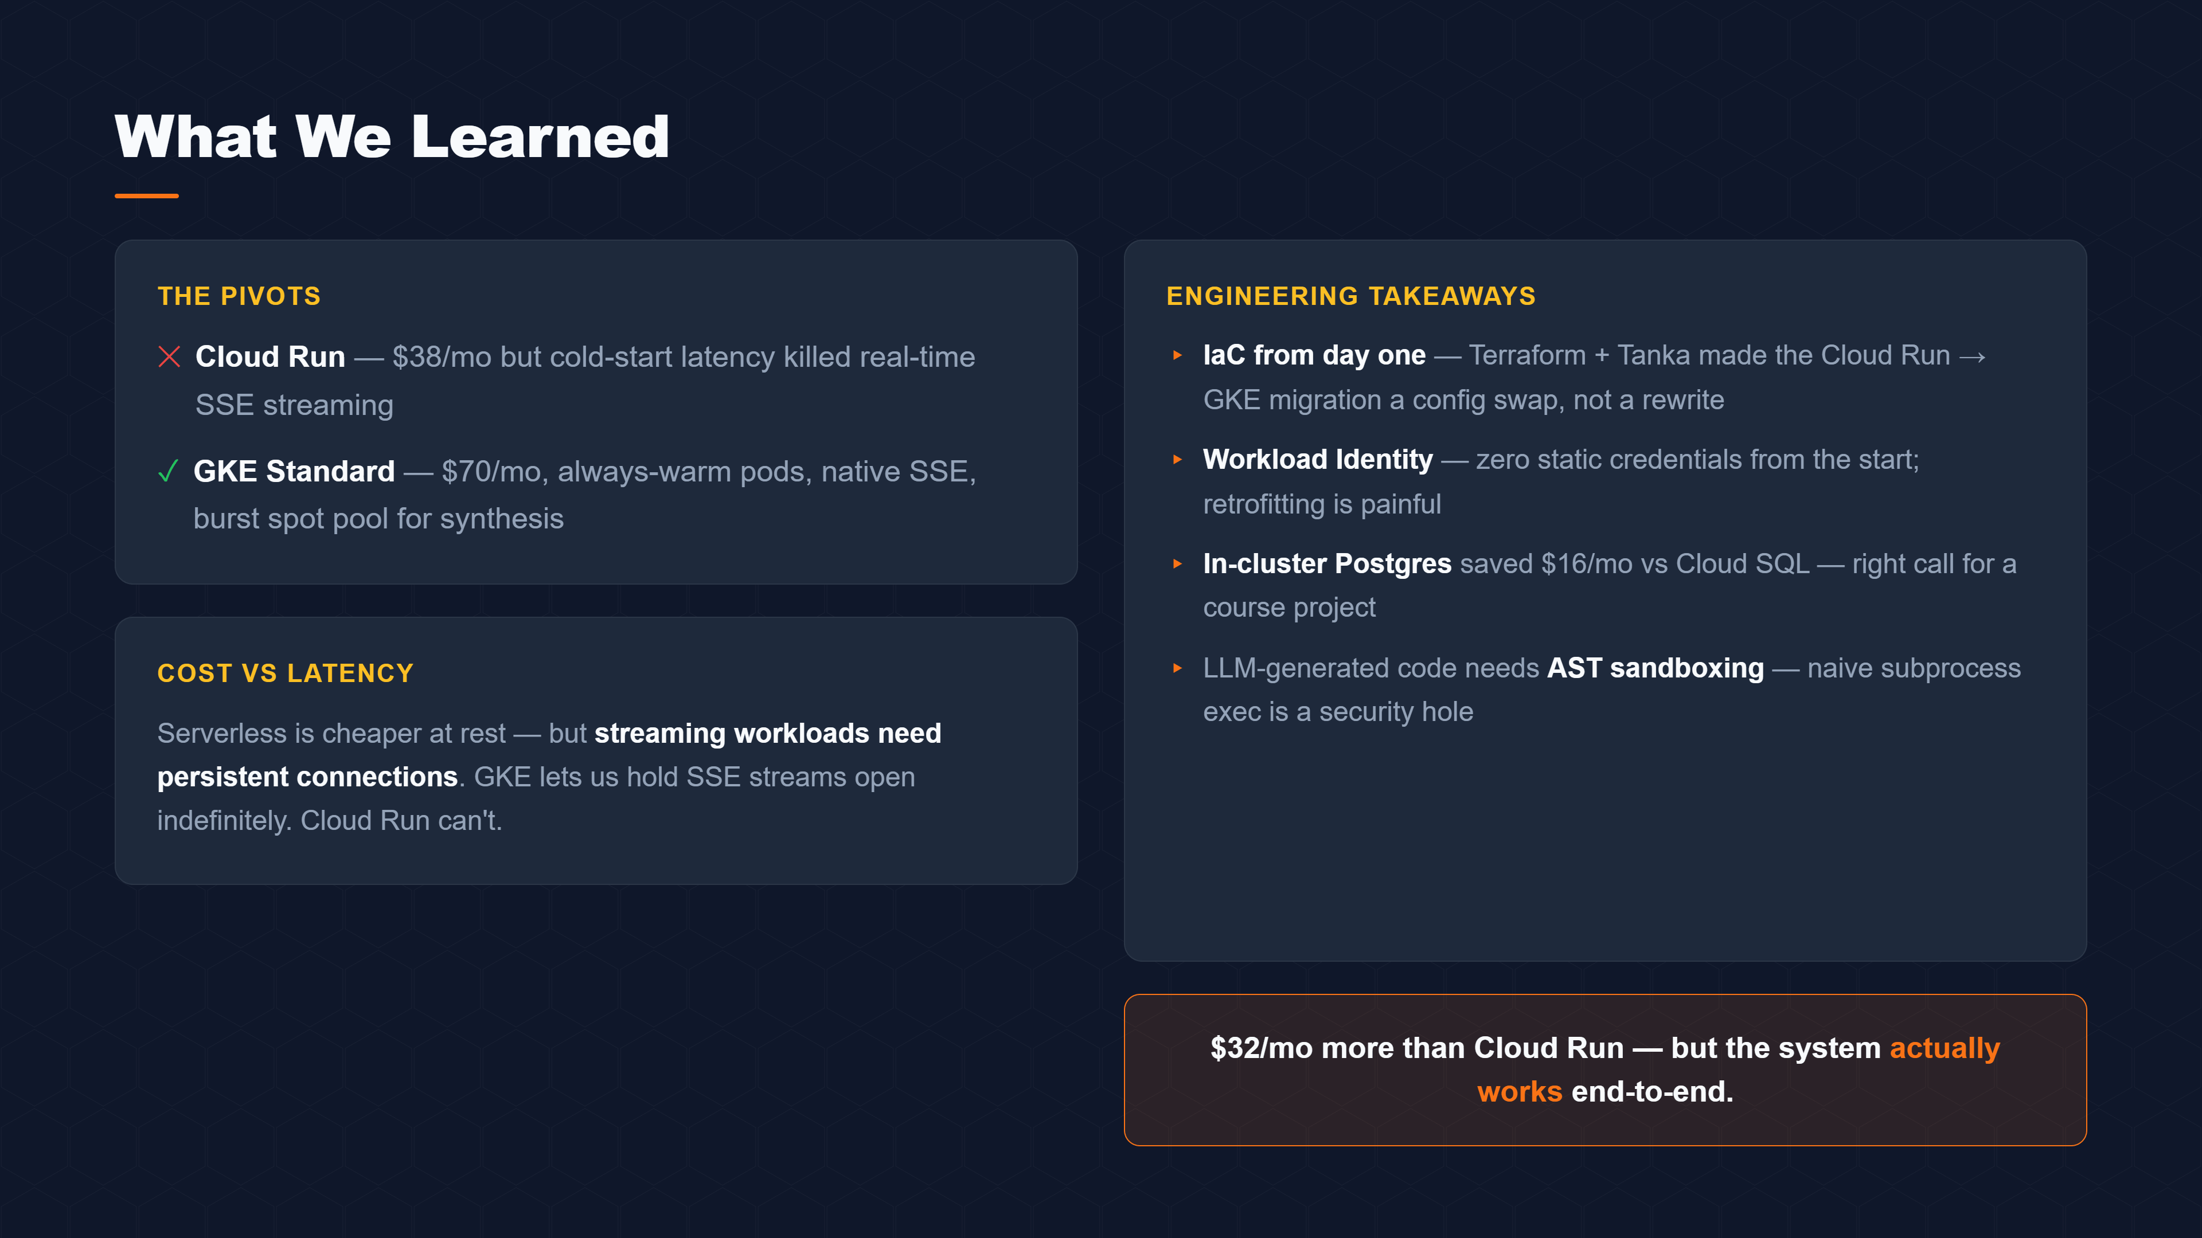
Notes:
One honest engineering story worth sharing: we started on Cloud Run at 38 dollars a month. But Cloud Run can't hold persistent SSE connections open, which broke our real-time streaming. So we pivoted to GKE Standard — 70 a month, 32 more, but everything works end-to-end. Infrastructure as Code made that migration a config swap rather than a rewrite. That's the lesson: design for the workload, not the price tag. Thank you.

