Slide 1
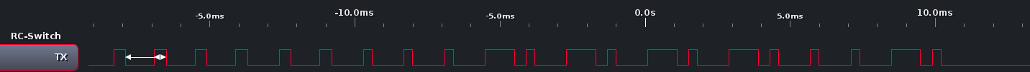
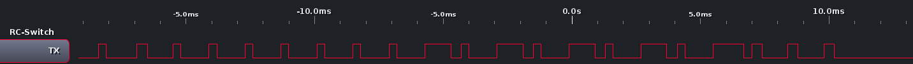
11111 A 1 (Turn address 11111 channel A on)
11111 A 1 (Turn address 11111 channel A on)
...
0
0
0
0
F
F
F
F
0
F
Sync
Address 11111 → 00000
Channel A = 1 → 0FFFF
On = 1 → 0F
11111 A 0 (Turn address 11111 channel A off)
...
0
0
0
0
F
F
F
F
F
0
Sync
Address 11111 → 00000
Channel A = 1 → 0FFFF
Off = 0 → F0
Address Bit | Tri-State
0 | F
1 | 0
Channel | Tri-State
A/1 | 0FFFF
B/2 | F0FFF
C/3 | FF0FF
D/4 | FFF0F
Status | Tri-State
Off/0 | 0F
On/1 | F0
Tri-State | Wave-Form
0 | _| |___| |___
1 | _| |_| |___
F | _| |___| |_

