Slide 1
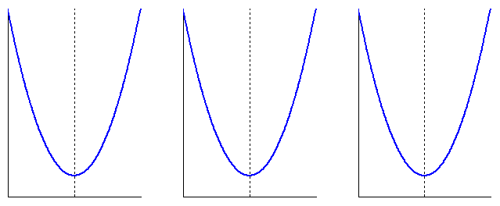






$$E$$
$$E$$
$$E$$
$$w$$
$$w$$
$$w$$

Slide 2
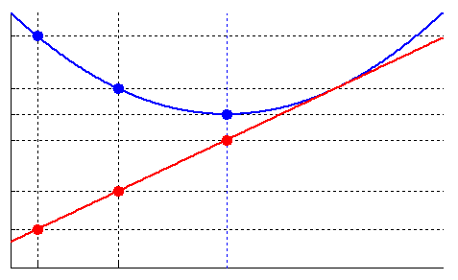













$E$and $\frac{∂E}{∂w}$
$$E[t−1]$$
$$E[t]$$
$$E[t+1]$$
$$\frac{∂E}{∂w}\left[t+1\right]=0$$
$$k$$
$$\frac{∂E}{∂w}\left[t\right]$$
$$\frac{∂E}{∂w}\left[t−1\right]$$
$$k$$
$$w[t−1]$$
$$w[t]$$
$$w[t+1]$$
$$w$$

Slide 3
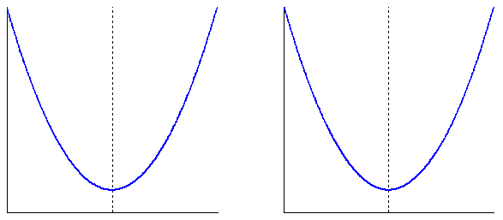


















$$E$$
$$\frac{∂E}{∂w}\left[t−1\right]<0$$
$$E$$
$$\frac{∂E}{∂w}\left[t−1\right]>0$$
$$\frac{∂E}{∂w}\left[t\right]<0$$
$$\frac{∂E}{∂w}\left[t−2\right]<0$$
$$set \frac{∂E}{∂w}\left[t\right]=0$$
$$θ\left[t−1\right]>θ\left[t\right]$$
$$θ\left[t\right]<θ\left[t−1\right]=−θ\left[t−2\right]$$
$$w$$
$$w\left[t−2\right]$$
$$w\left[t+1\right]$$
$$w$$
$$w\left[t−1\right]$$
$$w\left[t\right]$$
$$w\left[t+1\right]$$
$$w\left[t−1\right]$$
$$w\left[t\right]$$

Slide 4
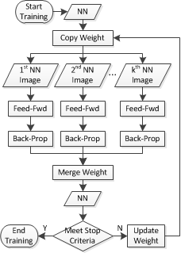

Slide 5



























feed-forward
input layer
Hidden layer 1
Hidden layer 2
Output layer
$$w$$
$$w$$
$$w$$
$$p$$
$$Σ$$
$$f\left(∙\right)$$
$$Σ$$
$$f\left(∙\right)$$
$$Σ$$
$$f\left(∙\right)$$
$$t$$
$$p$$
$$Σ$$
$$f\left(∙\right)$$
$$Σ$$
$$f\left(∙\right)$$
$$Σ$$
$$f\left(∙\right)$$
$$t$$
…
…
…
…
…
…
$$p$$
$$Σ$$
$$f\left(∙\right)$$
$$Σ$$
$$f\left(∙\right)$$
$$Σ$$
$$f\left(∙\right)$$
$$t$$
back-propagation
target layer

Slide 6


























input node abs-layer
$$x_{0}$$
weight abs-layer
$$x_{10}$$
neuron abs-layer
$$o_{1}$$
target node abs-layer
$$f_{10}\left(∙\right)$$
$$δ_{10}$$
$$δ_{1}$$
$$p$$
$$f_{0}\left(∙\right)$$
$$f_{10}\left(∙\right)$$
$$p$$
$$f_{0}\left(∙\right)$$
$$f_{10}\left(∙\right)$$
$$Σ$$
$$f_{1}\left(∙\right)$$
$$f_{t}\left(∙\right)$$
$$t$$
$$f_{10}\left(∙\right)$$
$$Σ$$
$$f_{1}\left(∙\right)$$
$$f_{t}\left(∙\right)$$
$$t$$
$$f_{1b}\left(∙\right)$$
$$1$$
$$f_{b}\left(∙\right)$$
$$x_{b}$$
$$f_{1b}\left(∙\right)$$
$$x_{1b}$$
bias abs-layer
weight abs-layer
$$δ_{1b}$$
classic layer without abstraction

Slide 7
attach
neural abs-layer
weight abs-layer
recurrent NN without bias
input abs-layer
weight abs-layer
neuron abs-layer
target abs-layer
2-layer NN with bias
bias abs-layer
weight abs-layer
detach

Slide 8









output
$$Σ$$
input
output
$$Σ$$
input
$$f\left(∙\right)$$
output
$$Σ$$
input
…
feed-forward
…
output
node
$$Σ$$
input
input
$$Σ$$
output
…
back-propagation
…
input
$$Σ$$
output
$$f^{′}\left(∙\right)$$
input
$$Σ$$
output
input
$$Σ$$
output

Slide 9
run-time generalization
compile-time generalization
compiling period
compile code
compile code
deduce type
running period
compile code
run code
deduce type
multiple epochs
multiple epochs
multiple runs
multiple runs

Slide 10
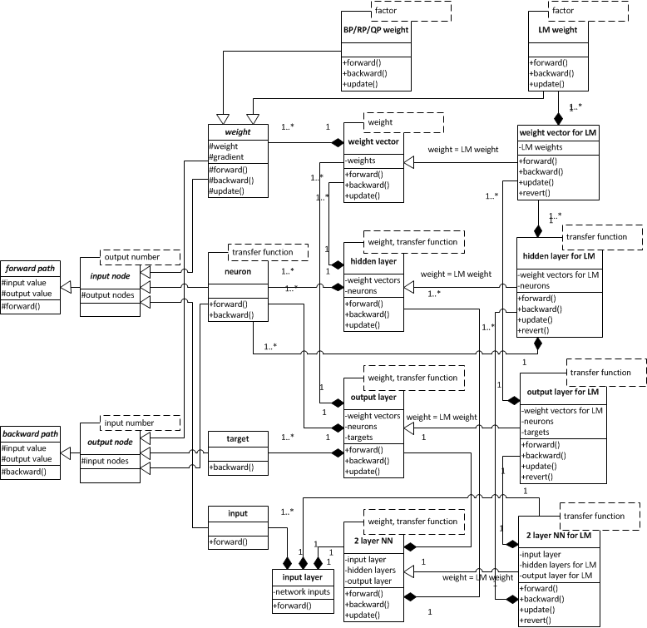
propagation module:
scalable for other back-propagation algorithms
input and output utility module:
scalable for other system models
topology module:
scalable for other network topologies

Slide 11
