Slide 1
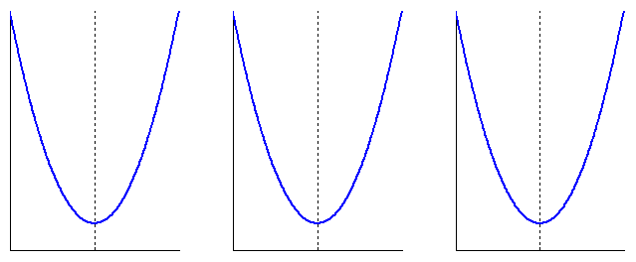






$$E$$
$$E$$
$$E$$
$$w$$
$$w$$
$$w$$

Slide 2
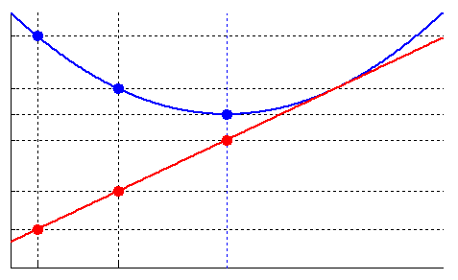













$E$and $\frac{∂E}{∂w}$
$$E[t−1]$$
$$E[t]$$
$$E[t+1]$$
$$\frac{∂E}{∂w}\left[t+1\right]=0$$
$$k$$
$$\frac{∂E}{∂w}\left[t\right]$$
$$\frac{∂E}{∂w}\left[t−1\right]$$
$$k$$
$$w[t−1]$$
$$w[t]$$
$$w[t+1]$$
$$w$$

Slide 3
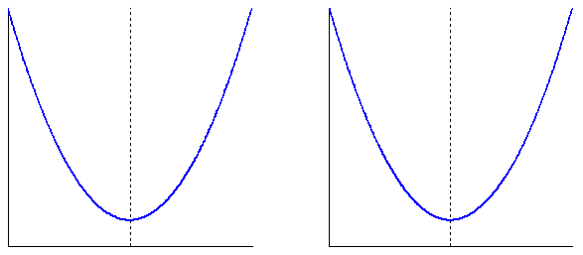


















$$E$$
$$\frac{∂E}{∂w}\left[t−1\right]<0$$
$$E$$
$$\frac{∂E}{∂w}\left[t−1\right]>0$$
$$\frac{∂E}{∂w}\left[t\right]<0$$
$$\frac{∂E}{∂w}\left[t−2\right]<0$$
$$set \frac{∂E}{∂w}\left[t\right]=0$$
$$θ\left[t−1\right]>θ\left[t\right]$$
$$θ\left[t\right]<θ\left[t−1\right]=−θ\left[t−2\right]$$
$$w$$
$$w\left[t−2\right]$$
$$w\left[t+1\right]$$
$$w$$
$$w\left[t−1\right]$$
$$w\left[t\right]$$
$$w\left[t+1\right]$$
$$w\left[t−1\right]$$
$$w\left[t\right]$$

Slide 4



























feed-forward
input layer
hidden layer 1
hidden layer 2
output layer
$$w$$
$$w$$
$$w$$
$$p$$
$$Σ$$
$$f\left(∙\right)$$
$$Σ$$
$$f\left(∙\right)$$
$$Σ$$
$$f\left(∙\right)$$
$$t$$
$$p$$
$$Σ$$
$$f\left(∙\right)$$
$$Σ$$
$$f\left(∙\right)$$
$$Σ$$
$$f\left(∙\right)$$
$$t$$
…
…
…
…
…
…
$$p$$
$$Σ$$
$$f\left(∙\right)$$
$$Σ$$
$$f\left(∙\right)$$
$$Σ$$
$$f\left(∙\right)$$
$$t$$
back-propagation
target layer

Slide 5


























input node abs-layer
$$x_{0}$$
weight abs-layer
$$x_{10}$$
neuron abs-layer
$$o_{1}$$
target node abs-layer
$$f_{10}\left(∙\right)$$
$$δ_{10}$$
$$δ_{1}$$
$$p$$
$$f_{0}\left(∙\right)$$
$$f_{10}\left(∙\right)$$
$$p$$
$$f_{0}\left(∙\right)$$
$$f_{10}\left(∙\right)$$
$$Σ$$
$$f_{1}\left(∙\right)$$
$$f_{t}\left(∙\right)$$
$$t$$
$$f_{10}\left(∙\right)$$
$$Σ$$
$$f_{1}\left(∙\right)$$
$$f_{t}\left(∙\right)$$
$$t$$
$$f_{1b}\left(∙\right)$$
$$1$$
$$f_{b}\left(∙\right)$$
$$x_{b}$$
$$f_{1b}\left(∙\right)$$
$$x_{1b}$$
bias abs-layer
weight abs-layer
$$δ_{1b}$$
classic layer without abstraction

Slide 6
attach
LM
neuron abs-layer
weight abs-layer
replace
linear
LM
recurrent NN
BP
input abs-layer
weight abs-layer
neuron abs-layer
target abs-layer
log-sig
1-layer NN
bias abs-layer
weight abs-layer
replace
BP
linear
detach

Slide 7









output
$$Σ$$
input
output
$$Σ$$
input
$$f\left(∙\right)$$
output
$$Σ$$
input
…
feed-forward
…
output
node
$$Σ$$
input
input
$$Σ$$
back-propagation
output
…
…
input
$$Σ$$
output
$$f^{′}\left(∙\right)$$
input
$$Σ$$
output
input
$$Σ$$
output

Slide 8
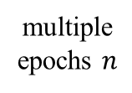
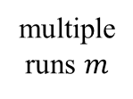
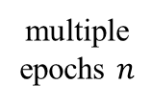
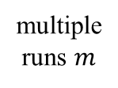
run-time generalization
compile-time generalization
compile code
deduce type (learning algorithm, transfer function, error function, network topology)
compiling period
compile code
run code
deduce type (learning algorithm, transfer function, error function, network topology)
running period
run code
multiple epochs $n$
multiple epochs $n$
multiple runs $m$
multiple runs $m$

Slide 9
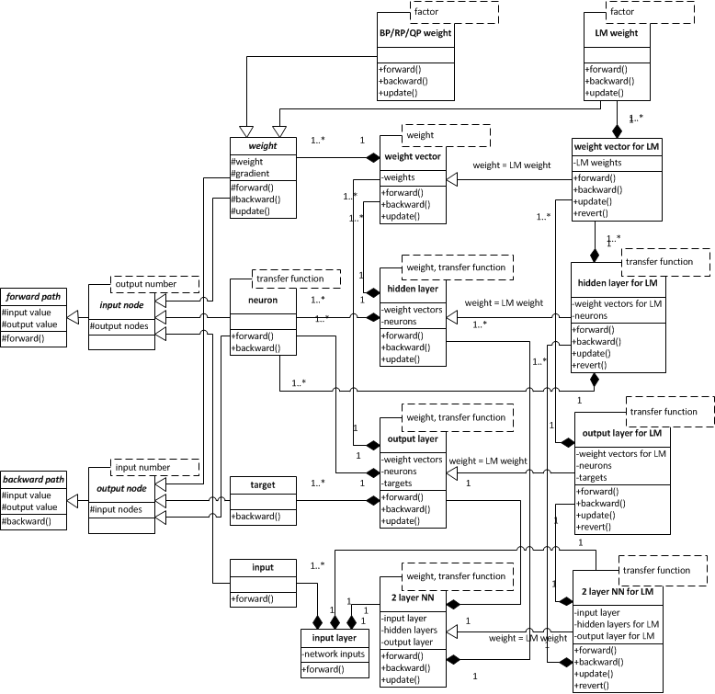
propagation module:
scalable for other back-propagation algorithms
input and output utility module:
scalable for other system models
topology module:
scalable for other network topologies

Slide 10
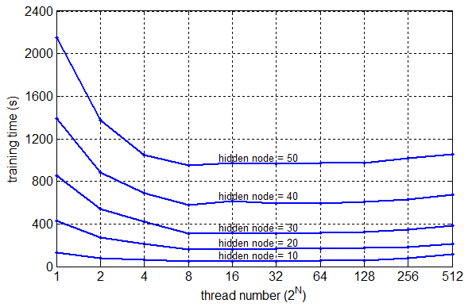

Slide 11
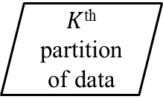
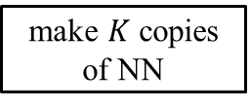
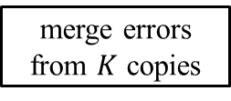

start training
make $K$ copies of NN
1st copy of NN
feed-forward
$K$^{th} copy of NN
feed-forward
1st partition of data
…
$K$^{th}
partition of data
calculate errors
calculate errors
merge errors from $K$ copies
update weights using back-prop
end training
output NN
meet stop criteria
NN with updated weights
Y
N

