Slide 1


Ethylene/Ethane Separation in Metal-Organic Frameworks by Computational Modeling
PhD Thesis Defense Presentation
Wenqin You
Georgia Institute of Technology
10/31/2019
Advisor: Dr. David S. Sholl
Committee Members: Dr. Krista S. Walton
Dr. Matthew J. Realff
Dr. Ryan P. Lively
Dr. Eric Vogel
Notes:
Good afternoon everyone, welcome to my PhD defense presentation. My thesis is about ethylene/Ethane Separation in Metal-Organic Frameworks by Computational Modeling

Slide 2
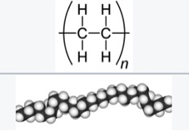
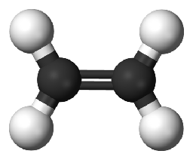
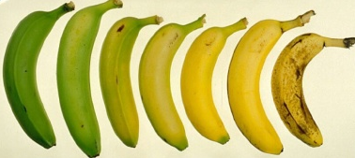
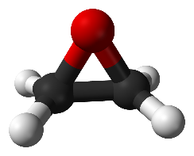
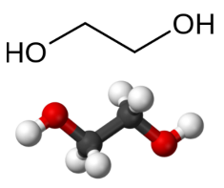
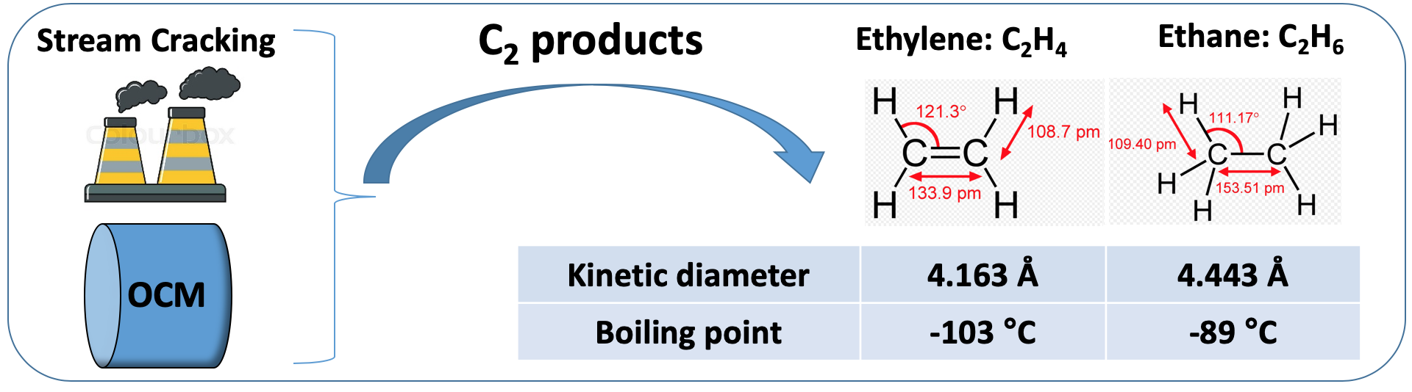

Chapter 1: Motivation for C₂H₄/C₂H₆ Separation
Polyethylene:
plastic
Plant hormone:
ripen fruits
Ethylene oxide:
Ethylene glycol
C₂H₄
>150 million tonnes in 2016
(Raw material)
A key step in producing ethylene is the separation of ethylene from ethane
Notes:
As we know, Ethylene is widely used in the chemical industry, and its worldwide production exceeds all other organic compounds. Much of this production goes toward polyethylene, a widely used plastic. Ethylene is also an important natural plant hormone and is used in agriculture to ripen the fruits. Additionally, it’s the raw material for producing ethylene oxide and ethylene glycol.
Ethylene is mainly generated by steam cracking. The C2 products contain mostly ethylene and ethane.
Another alternative industrial process, oxidative coupling of methane (OCM), can produce ethylene from methane.
As a result, a key step in producing ethylene is the separation of ethylene from ethane. However, ethylene and ethane have similar kinetic diameters and boiling points, which made them difficult for separation.

Slide 3
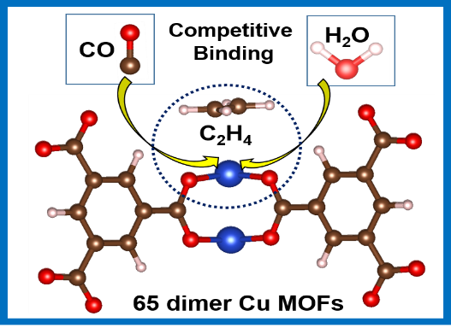
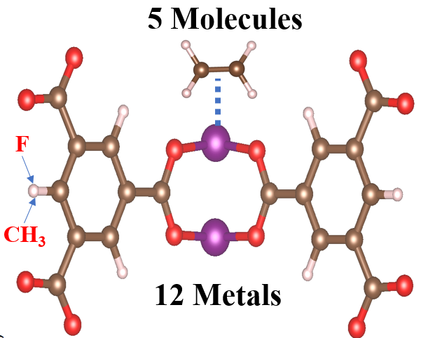
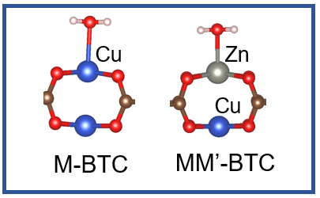
MOFs with OMS: Adsorption-based C₂H₄/ C₂H₆ Separation
Chapter 2 (Published)
Competitive binding of H₂O, CO, and C₂H₄ in 65 dimer Cu MOFs^{[1]}
Chapter 3 (Published)
Tune the binding tendencies by metal substitution and linker functionalization^{[2]}
Chapter 4 (Done)
Performance of the mixed-metal MOFs
[1] You, W.; Liu, Y.; Howe, J. D.; Sholl, D. S., J. Phys. Chem. C 2018, 122 (16), 8960-8966.
[2] You, W.; Liu, Y.; Dai T.; Howe, J. D.; Sholl, D. S., J. Phys. Chem. C 2018, 122(48),27486-27494
Notes:
For the ethylene/ethane separation, today’s talk will focus on two topics. The first is the competitive binding in 65 dimer Cu MOFs. The second is to tune the binding tendencies at open metal sites.

Slide 4
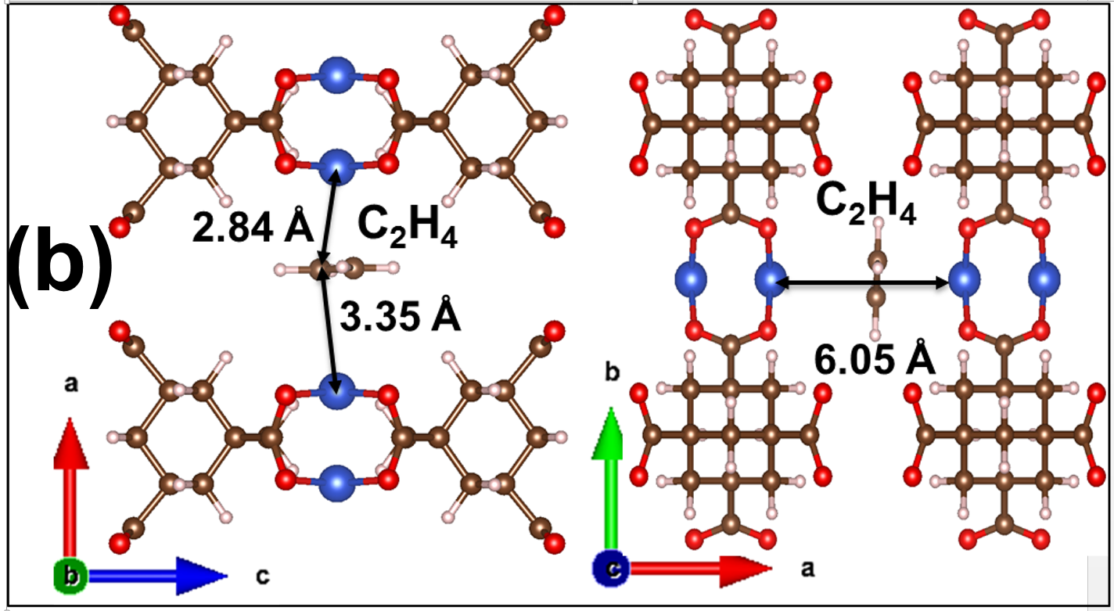
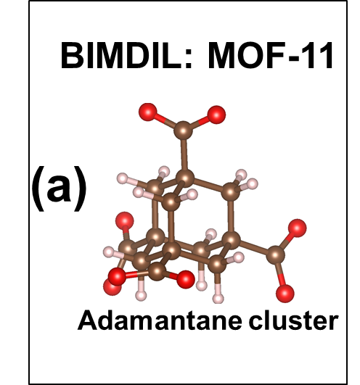
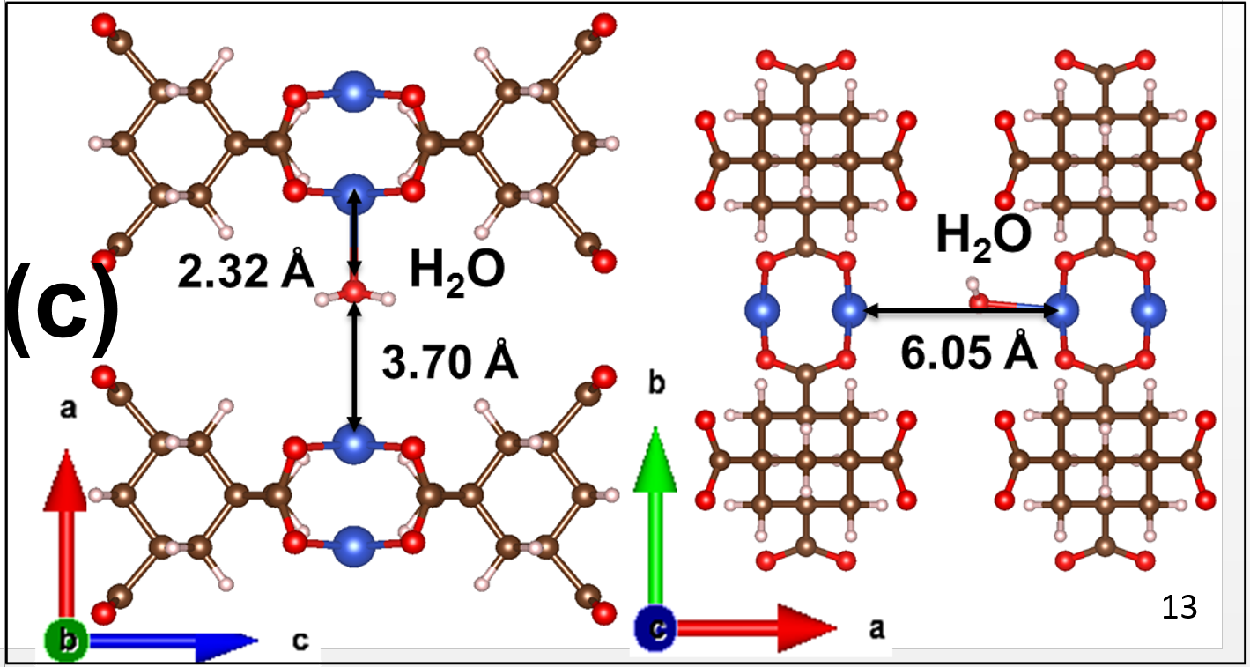
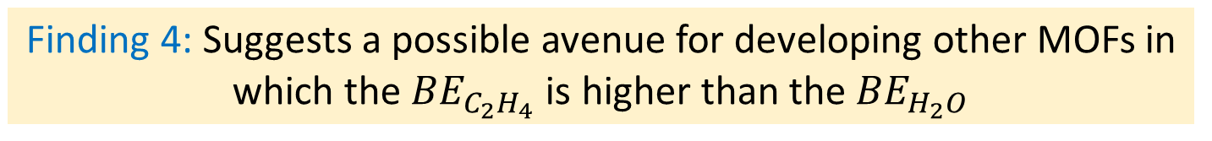
Chapter 2: Two Top Ethylene-Selective MOFs
[2]
[1]
Notable dual
site binding
Negligible dual
site binding
Finding 4: Suggests a possible avenue for developing other MOFs in which the ${BE}_{C_{2}H_{4}}$ is higher than the ${BE}_{H_{2}O}$
[1] Chen, Banglin, et al. Journal of the American Chemical Society 122.46 (2000): 11559-11560.
[2] You, W.; Liu, Y.; Howe, J. D.; Sholl, D. S., J. Phys. Chem. C 2018, 122 (16), 8960-8966.
Notes:
The calculation also identified two MOFs that bind ethylene stronger than water. Take the mof-11 as an example, we analyzed the origins of these unusual relative binding energies. These figures show that mof-11 has a narrow pore in which the distance between two Cu atoms in different dimer is 6A. As a result, MOF-11 defines a “dual-binding” site for ethylene, which interacts favorably with two cu atoms on separate cu dimers. However, this mechanism doesn’t apply to water, which is too small to interact favorably with two dimers at the same time.
Although the relative binding energies of water and ethylene in these materials are interesting, the absolute binding energies (> 70 kJ/mol for ethylene) are large. This observation is likely to make these materials unsuitable in many practical applications, since moderate heats of adsorption are favored to allow cost-effective desorption of adsorbed molecules and regeneration of sorbents.

Slide 5
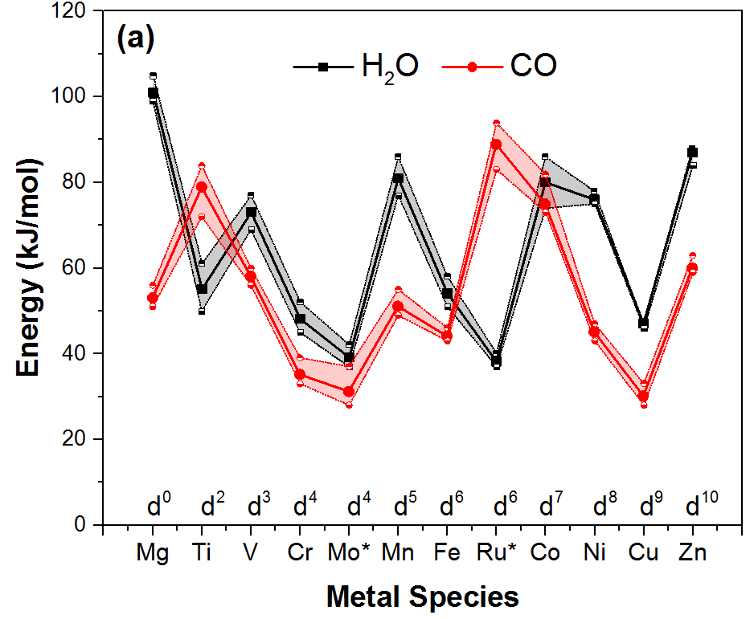
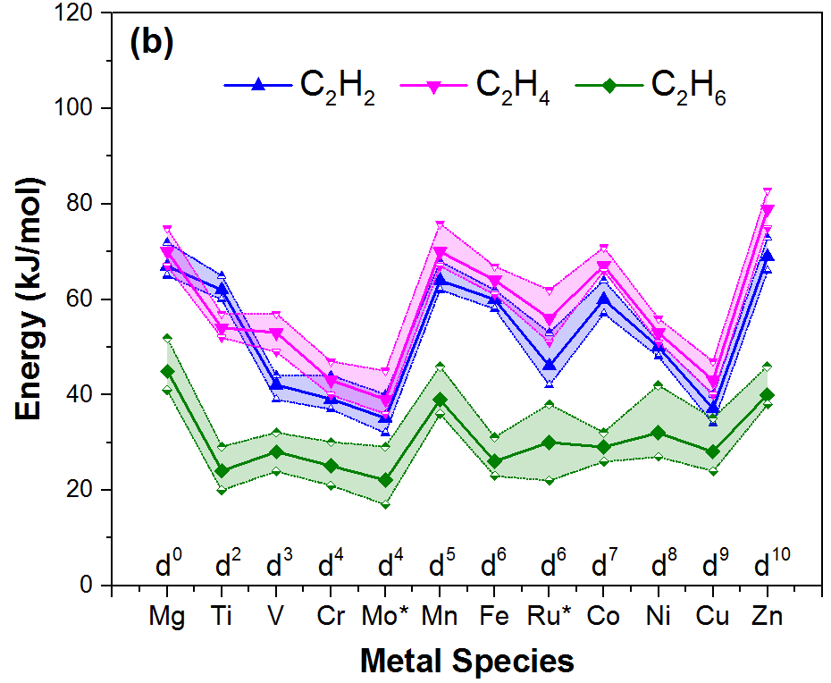
Chapter 3: Metal-Substitution on Isostructural MOFs
Each data point shows average of 5 MOFs.
The energy variation due to metals is stronger than the identity of linker
C₂H₆ has the lowest binding affinity in all cases.
You, W.; Liu, Y.; Dai T.; Howe, J. D.; Sholl, D. S., J. Phys. Chem. C 2018, 122(48),27486-27494
Notes:
The left figure shows the binding energies of water and co for the 12 metal species. And the right shows that for c2h2, c2h4, c2h6. Each solid data point stands for average value of 5 MOFs. As you can see, there is large variation of binding energy depending on the metal species whereas the linkers have minimal influence. For H₂O, binding energies are from ~35-100 kJ/mol, for C2h4, it goes from ~40-80 kJ/mol. C₂H₆ has the lowest binding affinity in every case.
Because of this relatively weak binding at the OMS, the C­₂H₆ binding energies are more strongly influenced by dispersion interactions associated with linkers than the other molecular species and therefore show a wider range of binding energies among MOFs with a common metal center.
1. the variation in binding energies associated with changing the metal center is considerably stronger than variations due to the identity of the MOF linker.

Slide 6
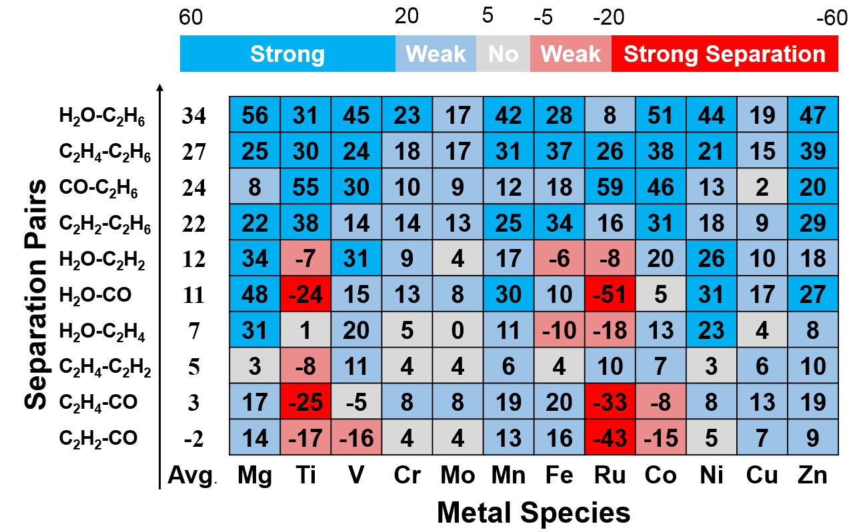
Chapter 3: Relative Binding Energies in 12-metal MOFs
You, W.; Liu, Y.; Dai T.; Howe, J. D.; Sholl, D. S., J. Phys. Chem. C 2018, 122(48),27486-27494
Notes:
In terms of adsorption selectivity, the binding energy differences are more important than the absolute binding energies. This figure summarizes the binding energy differences for each of the ten binary pairs that can be considered with the 5 molecules we examined. Energy differences are color coded using the scale shown at the top of the figure. Both dark blue and red mean strong separation. Molecular pairs are ordered vertically in increasing order of the energy difference averaged over all materials.
If one is interested in only binary separations, this figure captures the full range of separations that can be achieved with this set of materials. For the top 4 pairs, every MOF is selective for the first species because of the inability of C₂H₆ to complex with OMS. however, there are still significant differences in relative binding energies for varied metal centers. For example, for H₂O-C₂H₆, the binding energy difference in Mg and Co MOFs is > 50 kJ/mol but in Mo, Ru, and Cu MOFs is < 20 kJ/mol.

Slide 7
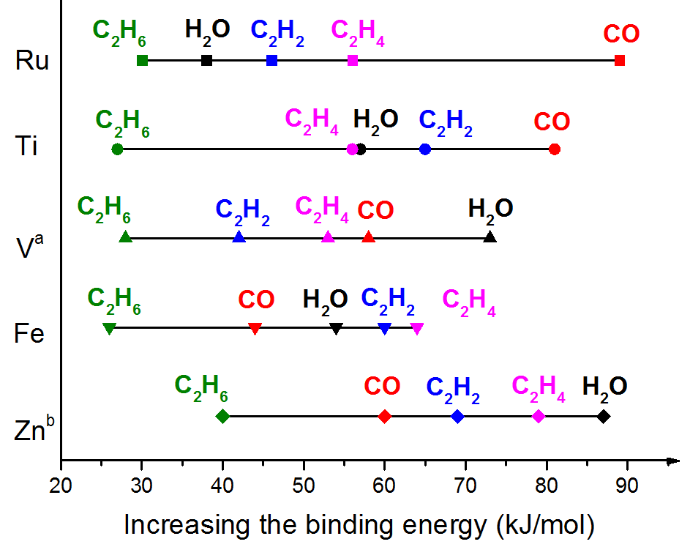
Chapter 3: Five Types of Binding Tendencies
You, W.; Liu, Y.; Dai T.; Howe, J. D.; Sholl, D. S., J. Phys. Chem. C 2018, 122(48),27486-27494
Notes:
To consider separations involving more than two adsorbing components, it is useful to classify OMS in terms of the binding energy order for the entire group of molecules we studied. there are five different orders of binding energies in the set of MOFs. The most common situation is the one shown for Zn OMS, with binding energies in the order H₂O > C₂H₄ > C₂H₂ > CO > C₂H₆. This ordering is shared by MOFs with these metal centers. However, a useful observation from our data is that other orderings are possible. Two striking examples are MOFs with Ru and Ti OMS, for which our calculations predict that CO is the strongest binding species.

Slide 8
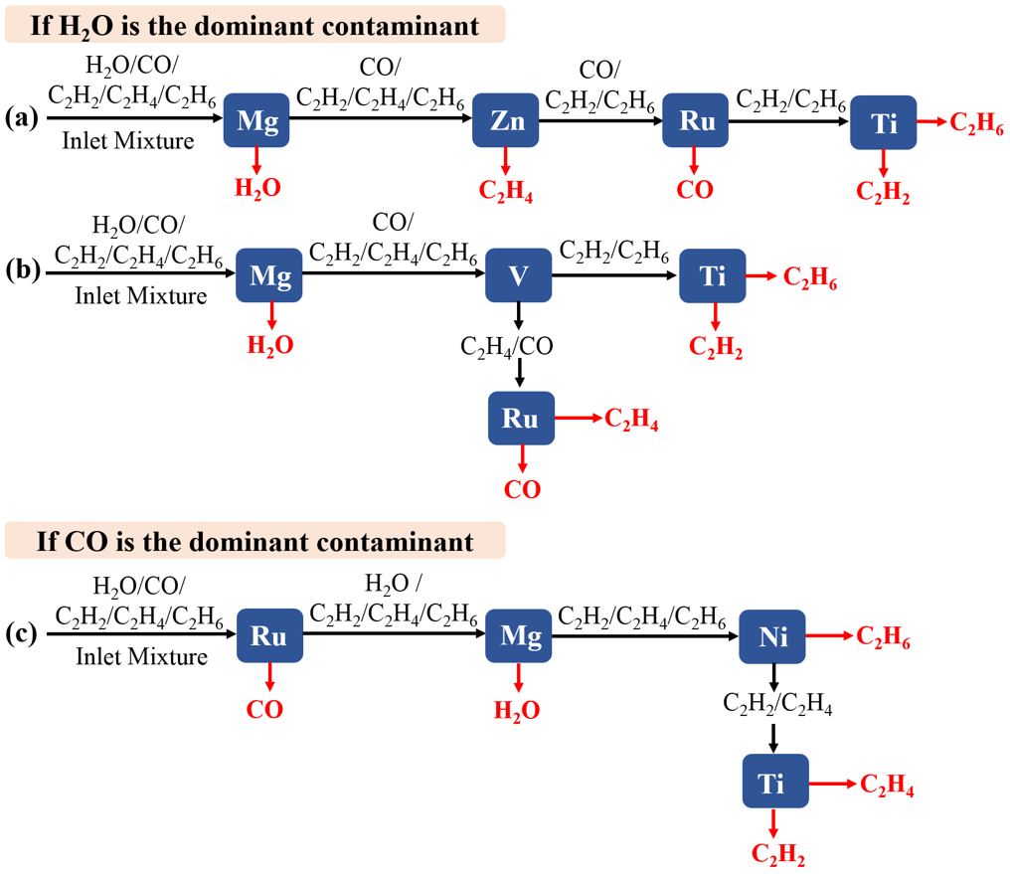
Chapter 3: Separation Strategies
You, W.; Liu, Y.; Dai T.; Howe, J. D.; Sholl, D. S., J. Phys. Chem. C 2018, 122(48),27486-27494
Notes:
Here we show three examples about how to purify a stream that initially contains all five components. In each example, each filled box indicates a packed bed or similar unit operation containing a MOF. If H₂O is the dominant contaminant, two possible separation sequences are shown. You can first use a Mg OMS MOF to remove water. This step could of course also potentially be achieved using well known hydrophilic adsorbents such as zeolite 13X. Then two alternative separation strategies can be used to purify the remaining four components. If CO is the dominant contaminant, we can use this strategy. These separation strategies shown here are of course highly schematic, but they illustrated how the information from previous slide can be used to select suitable adsorbents for a wide range of multicomponent separations.
We emphasize that our approach is only intended to indicate the order in which components would appear in a breakthrough experiment.

Slide 9
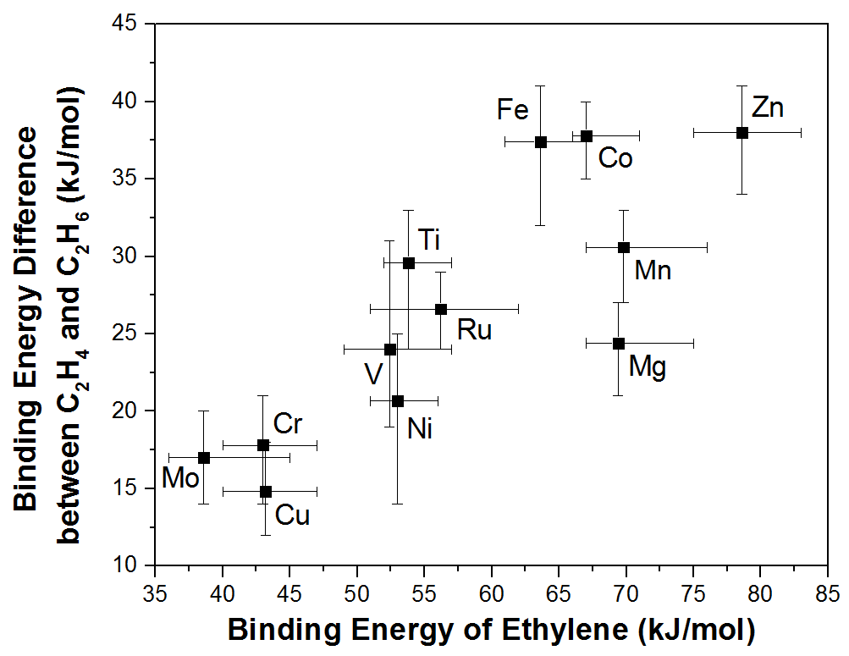
Chapter 3: Ethylene/Ethane Selectivity
Target
Trade off between larger $∆E(C_{2}H_{4}−C_{2}H_{6})$ and smaller $E_(C_{2}H_{4})$
You, W.; Liu, Y.; Dai T.; Howe, J. D.; Sholl, D. S., J. Phys. Chem. C 2018, 122(48),27486-27494
Notes:
The regenerability of adsorption can be decided by the absolute binding energy of the strongest binding species in a mixture. It is energy-intensive to desorb the strongly bonded adsorbates. In general, there is a tradeoff between finding materials with large binding energy differences and finding materials with moderate absolute binding energies, because it is easier to have a large binding energy difference if one species binds very strongly. This tradeoff is illustrated for ethylene-ethane mixtures. With the increase of binding energy of ethylene, the binding energy difference of ethylene and ethane also increase. So the ideal metal should be in this area.
The difference of binding energies between ethylene and ethane as a function of the average binding energy of ethylene in MOFs with 12 metal centers. The variation in energies among the linkers in Figure 1 are indicated by error bars.

Slide 10
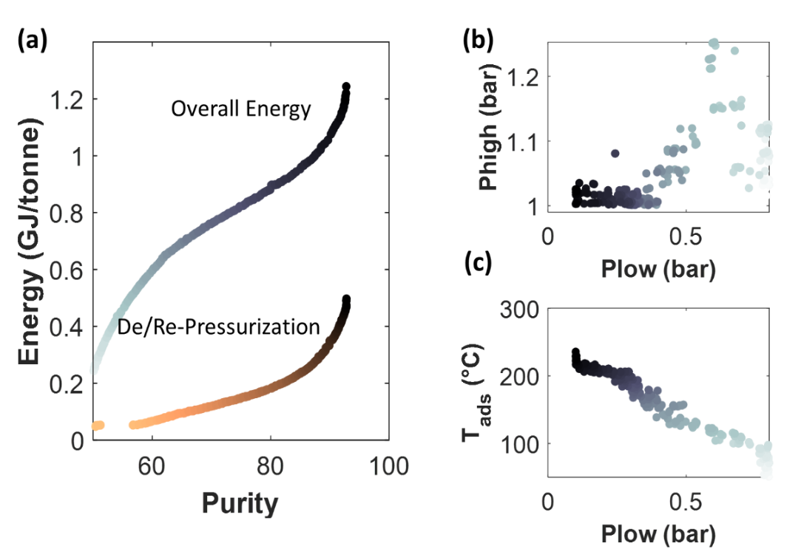
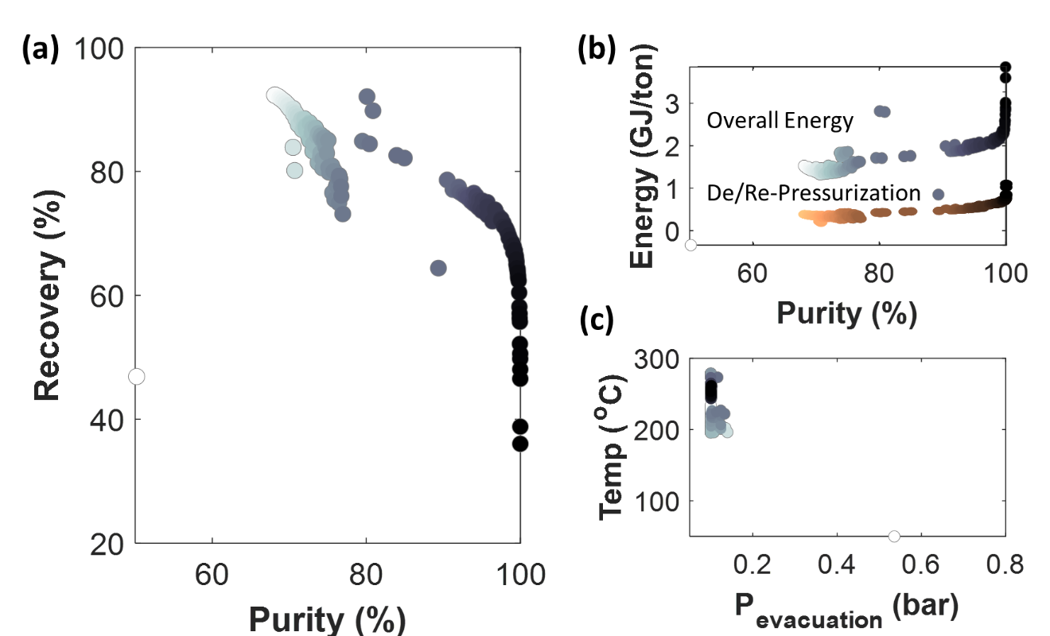
Chapter 4: Optimization of the Adsorption Process
Case Study for the Zn-BTC
Simplified Model
Full Process Model
Finding: Although the simple model underestimates the maximum possible purity and the energy consumed, it still provides a useful general estimate of optimal operating conditions and process performance.

Slide 11
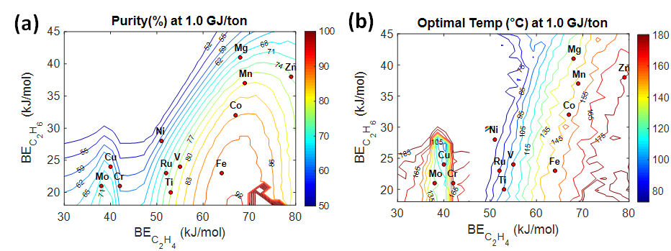
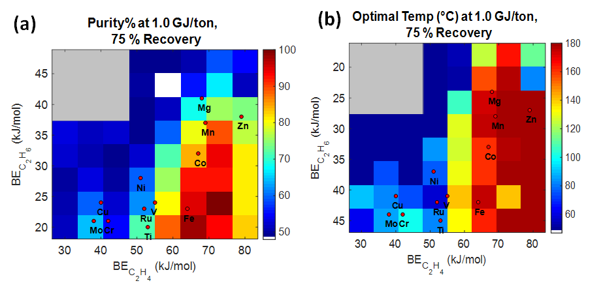
Chapter 4: Performance of Pure Metal MOFs
Simplified Model
Full Process Model

