Slide 1
Structure information
in CoRE MOF database
Isotherms in NIST
NIST: 6000 adsorbents
Zeolites
MOFs
200 MOFs has
matched structure info.
200 initial MOFs
w/ isotherms
Activated carbon
Other adsorbents
Initial test cases

Slide 2
Workflow:
Reduce the size of the adsorbents in NIST
Remove some non-MOFs based on the keywords, such as Zeolites or AC
Find ~200 MOFs can have both isotherms and structure information
Use these 200 MOFs for initial analysis
We aim to analynize five adsorbates, first focus on N₂
Define the feature vector with proper structure information
Each MOF can be represented by PLD, LCD, SA, VF and density et.
Principle Component Analysis on the feature vectors
Dimension reduction can save the computational time
Isotherm classification
We use three isotherm models to fit the data in NIST and label each MOF with its best-fit model by regression
Predict saturation loading, isosteric heat of adsorption, and isotherm model for each selected adsorbate on MOFs
Input will be the feature vector of MOF structure
Establish model for each adsorbate to predict entire isotherms in “T-P form”
Input will be the feature vector of MOF structure, isotherm model, Temp., Pres.
Outputs are the entire isotherm curve

Slide 3

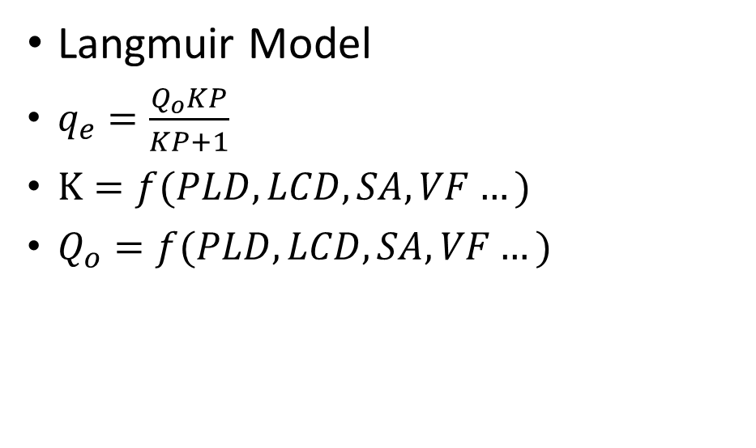

Examples
Langmuir Model
$q_{e}=\frac{Q_{o}KP}{KP+1}$
$K=f(PLD,LCD, SA,VF…)$
$Q_{o}=f(PLD,LCD, SA,VF…)$
$${K or Q}_{o }predicted$$
$${K or Q}_{o }known$$

