Slide 1

The prediction of Gas Isotherms by the Structures of Metal-Organic Frameworks
Group 6:
Wenqin You
Zhe Liu
04/17/2018

Slide 2
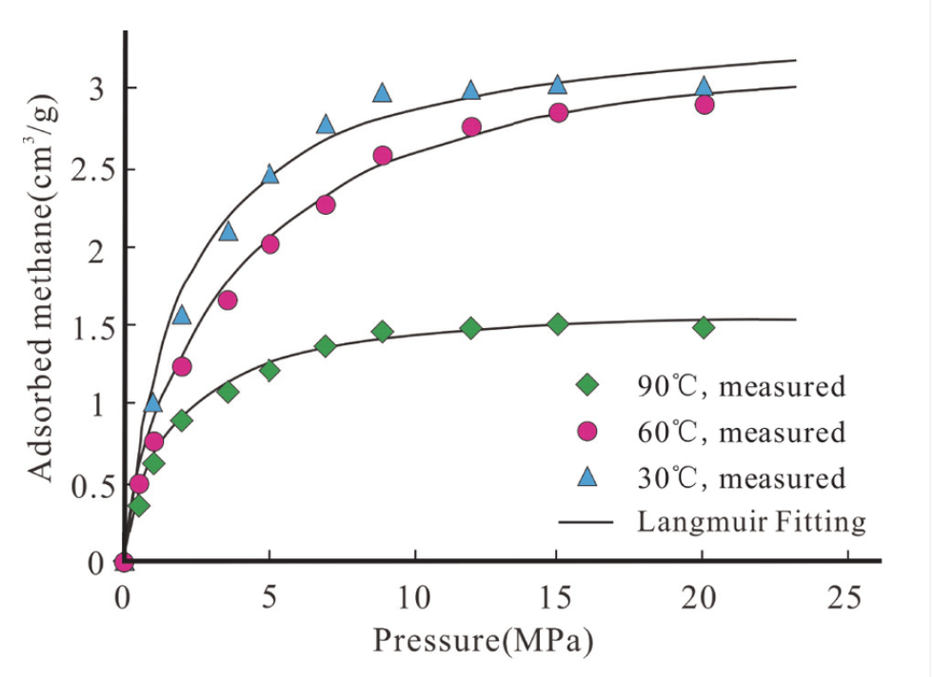
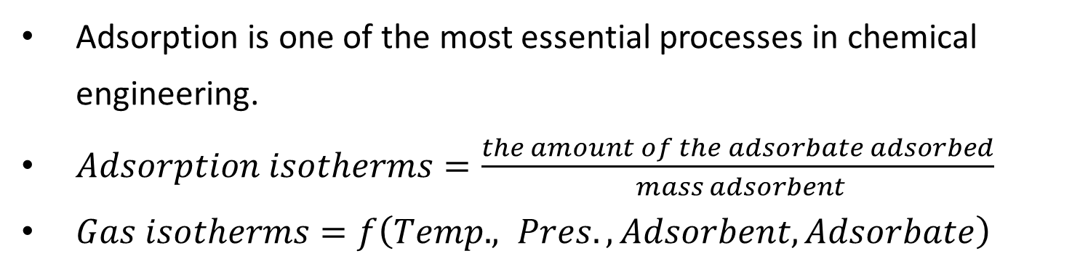
Background: Gas Adsorption
Adsorption is one of the most essential processes in chemical engineering.
$Adsorption isotherms=\frac{the amount of the adsorbate adsorbed}{ mass adsorbent}$
$Gas isotherms=f\left(Temp., Pres., Adsorbent, Adsorbate\right)$

Slide 3
Background: Metal-Organic Frameworks
MOFs are good candidates for gas adsorption:
High surface area, porosity, and functionality
Applications for adsorptive separation:
Energy issue: CH₄ uptake
Global warming issue: CO₂ capture
Industrial example: C₂H₄/C₂H₆ separation
The search for the optimal MOF requires aggressive screening of a variety of MOFs

Slide 4
Motivation of the prediction of the isotherm
Experimental Measurement
Measurement takes long time
Synthesis of new MOFs : >12h
Accuracy depends on exp. conditions
Grand canonical Monte Carlo(GCMC)
Couple hours
Require accurate force field
Prediction by
machine learning
A few seconds/minutes
Rapid screening
Advice for material design
Goal: Isotherm = f(structure info …) without exp. or GCMC

Slide 5
Workflow for Data Cleaning and Retrieval
Isotherms in NIST
adsorption database
Structure information
in computational-ready experimental (CoRE)
MOFs database
Remove non-MOFs, such as Zeolites and AC
Convert pressure unit and adsorption unit
1. Remove MOFs with missing structure properties
NIST: 6000 adsorbents
MOFs not matched
Zeolites
MOFs
124 MOFs have
matched structure info.
124 MOFs
w/ isotherms
Activated Carbon
Other adsorbents
Training/Test Examples
Notes:
Remove non-MOFs, such as Zeolites and AC
Convert pressure unit and adsorption unit
Remove MOFs with missing structure properties

Slide 6
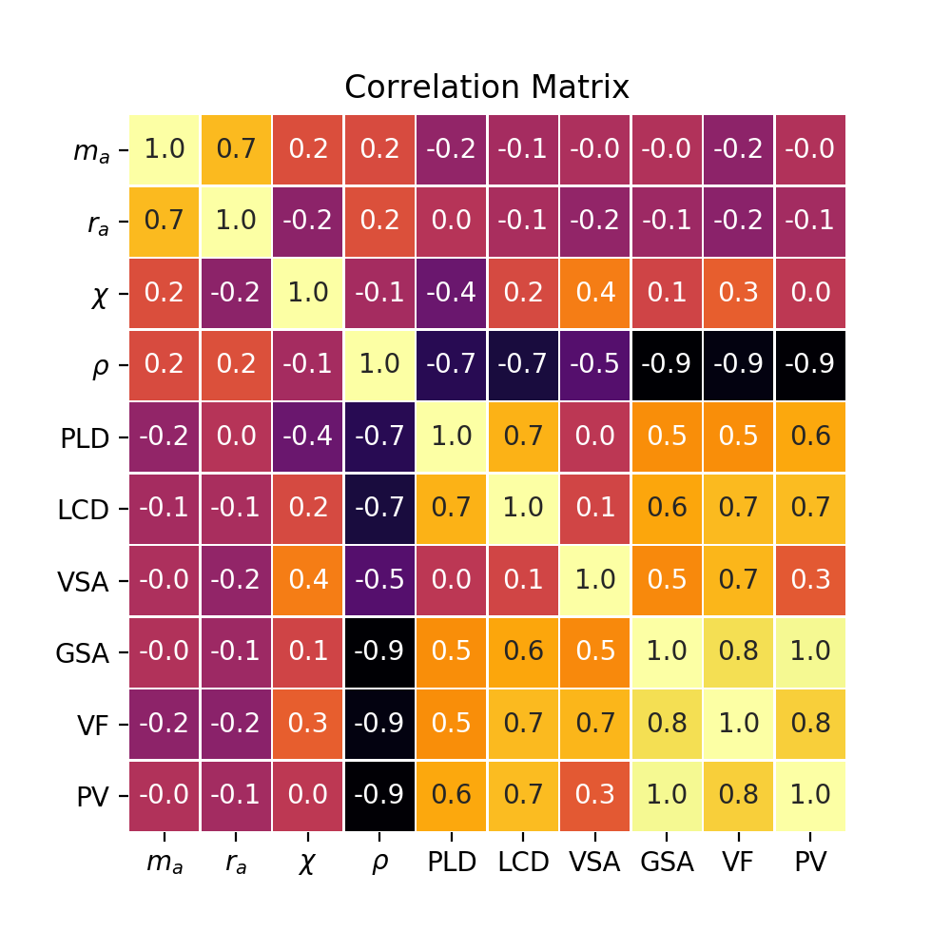
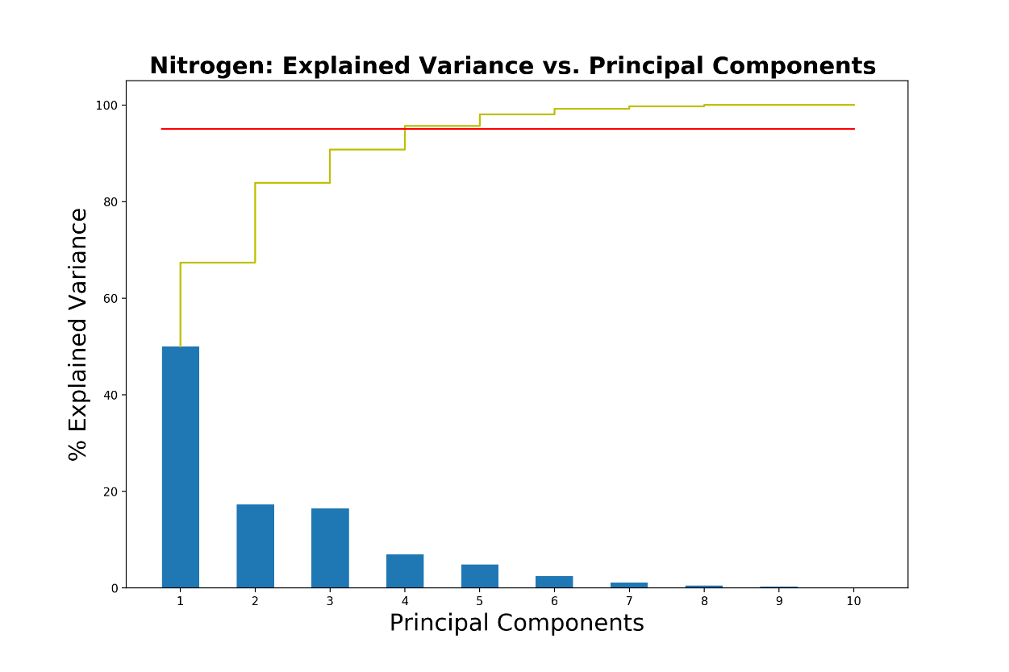
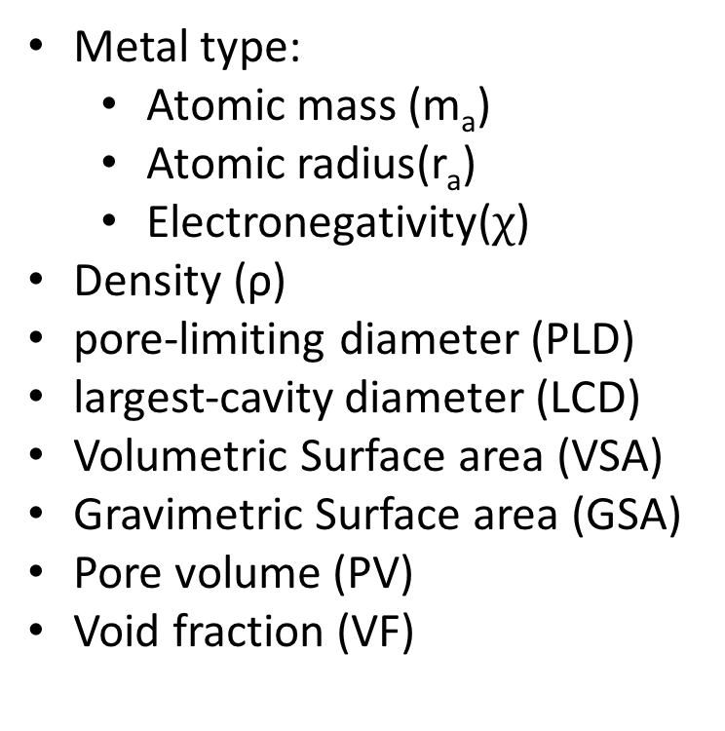
Workflow for CoRE MOFs Database
Define the feature vectors
Each MOF can be represented by PLD, LCD, SA, VF and density etc.
Metals type as numerical variables
Principle Component Analysis
Calculate the explained variance
Minimum # of principle components
Metal type:
Atomic mass (m_{a})
Atomic radius(r_{a})
Electronegativity($χ$)
Density (ρ)
pore-limiting diameter (PLD)
largest-cavity diameter (LCD)
Volumetric Surface area (VSA)
Gravimetric Surface area (GSA)
Pore volume (PV)
Void fraction (VF)

Slide 7
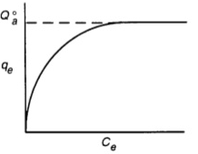
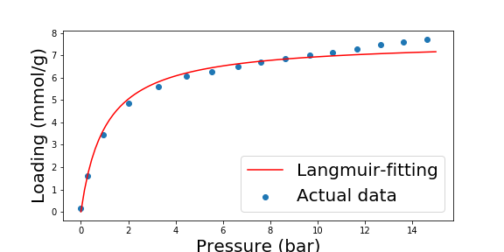
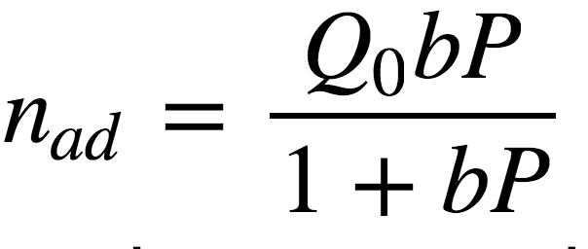
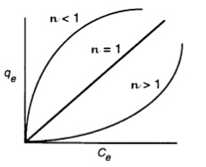
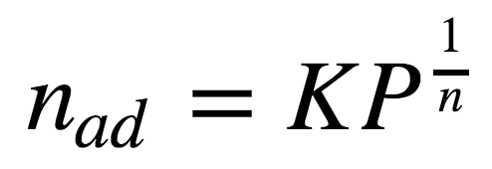
Workflow for NIST Adsorption Database
Linear Regression on Isotherms
Curve-fit isotherm data
Isotherm Type Assignment
Assign model based on R2 value
Keep R2 higher than 0.95 (cutoff value)
Langmuir: (Q_{0,} b)
CuBTC
CO₂
276K
Freundlich: (K, n)
Notes:
Q0Q0 is maximum monolayer coverage capacities, b is Langmuir isotherm constant
K is Freundlich isotherm constant related to adsorption capacity.

Slide 8

Workflow for machine learning
Results from NIST:
MOFs labeled with model, and corresponding parameters
Machine
Learning
Results from CoRE MOFs
MOFs and their structure properties after PCA
Final Model
Classification:
$$Model=f(PLD, LCD, SA, VF…)$$
Regression:
Langmuir:
$$Q_{0}=f\left(PLD, LCD, SA, VF…\right)$$
$$b=f\left(PLD, LCD, SA, VF…\right)$$
Freundlich:
$$K=f\left(PLD, LCD, SA, VF…\right)$$
$$n=f\left(PLD, LCD, SA, VF…\right)$$
Notes:
Adsorbates:
CO₂
CH₄
N₂
H₂
O₂

Slide 9
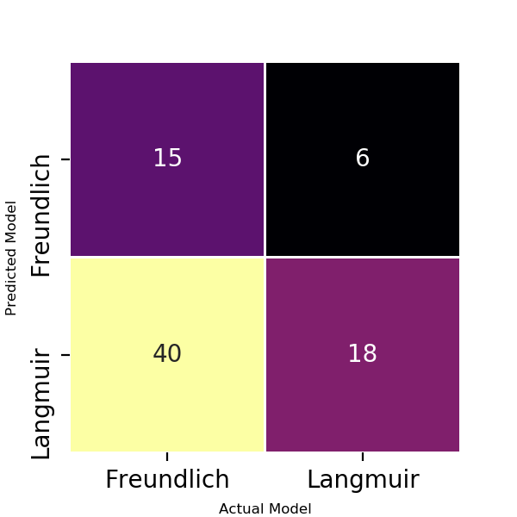
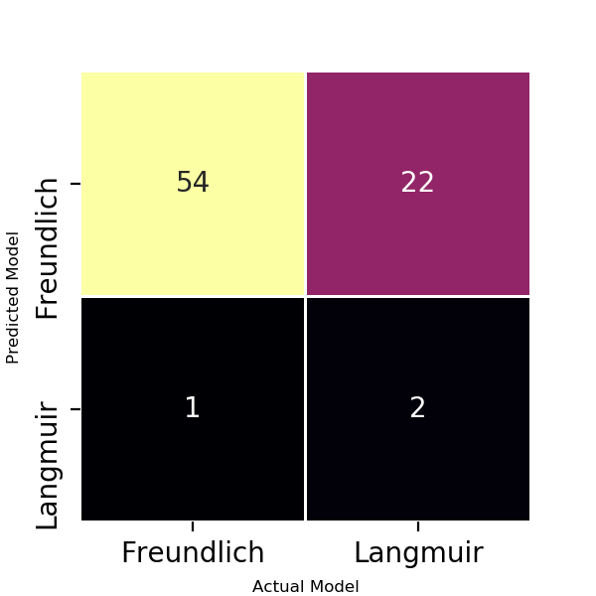
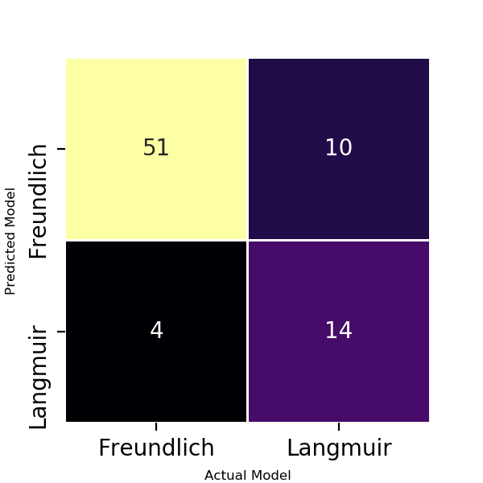
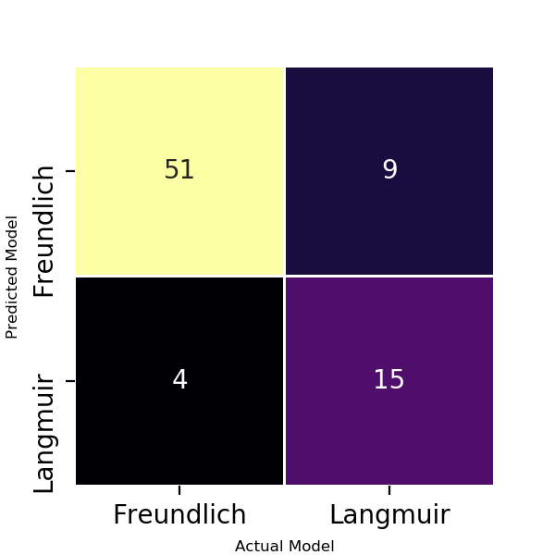
Result 1: Isotherm classification for N₂
$$Isotherm Model=f(PLD, LCD, SA, VF…)$$
Methods | Logistic | LDA | KNN | Kernel SVC
Accuracy | 41.8% | 70.9% | 82.3% | 83.5%
Cross Validation | 24.1% | 67.0% | 82.3% | 74.7%

Slide 10
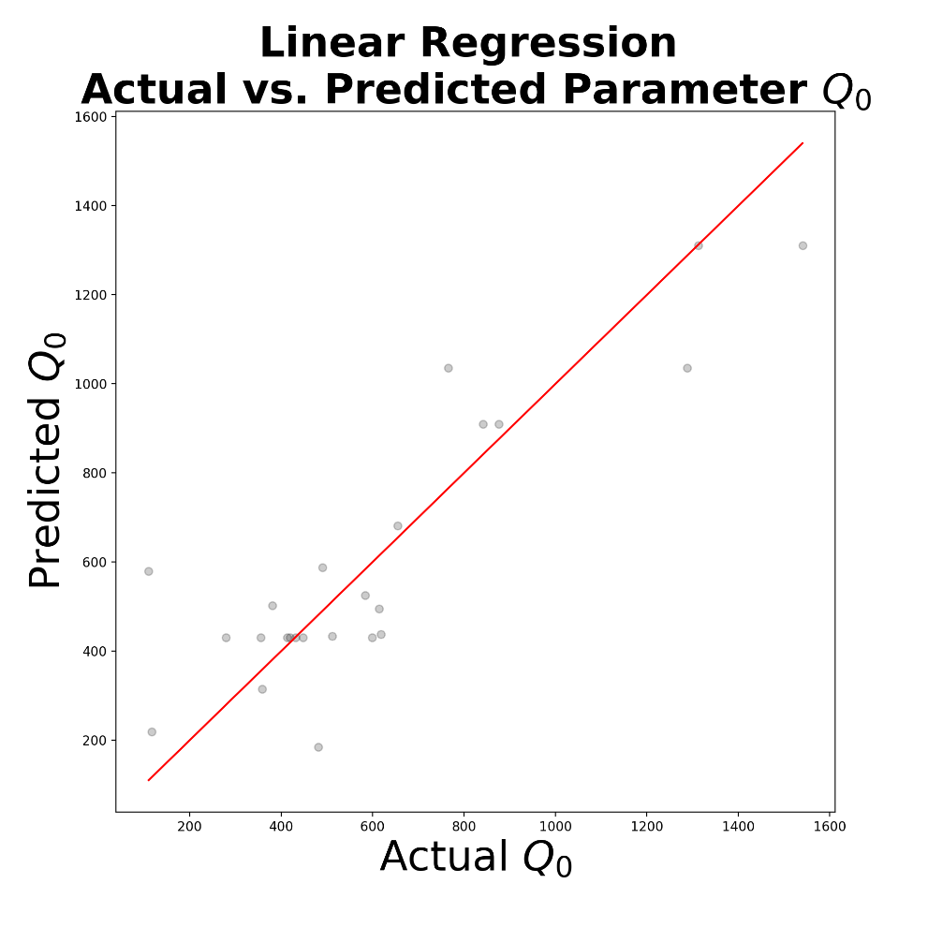
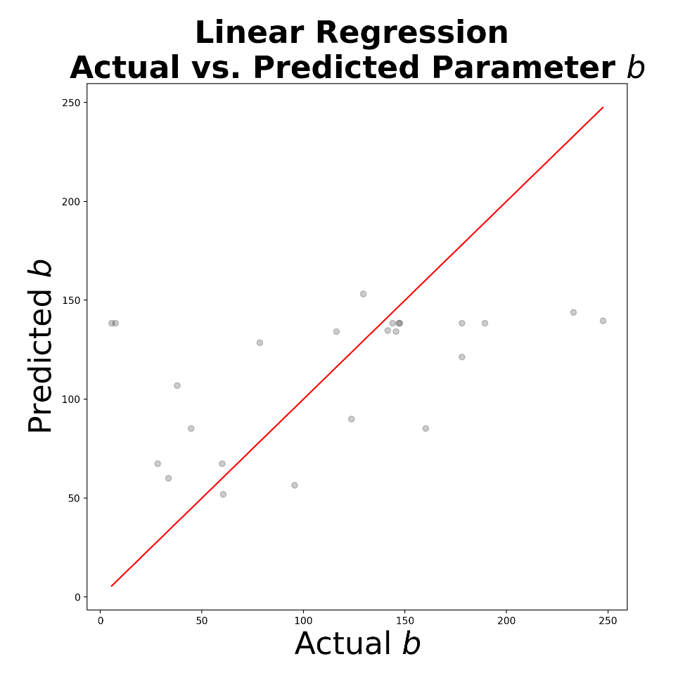
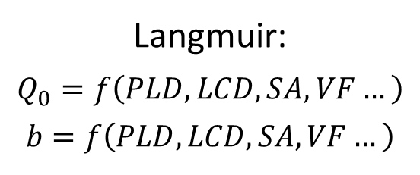
Result 2: Regression of N₂ by Linear Regression
Langmuir:
$$Q_{0}=f\left(PLD, LCD, SA, VF…\right)$$
$$b=f\left(PLD, LCD, SA, VF…\right)$$
Parameters by LR | R2 | CV mean relative error
Q₀ | 0.78 | 1.02
b | 0.24 | 3.02

Slide 11
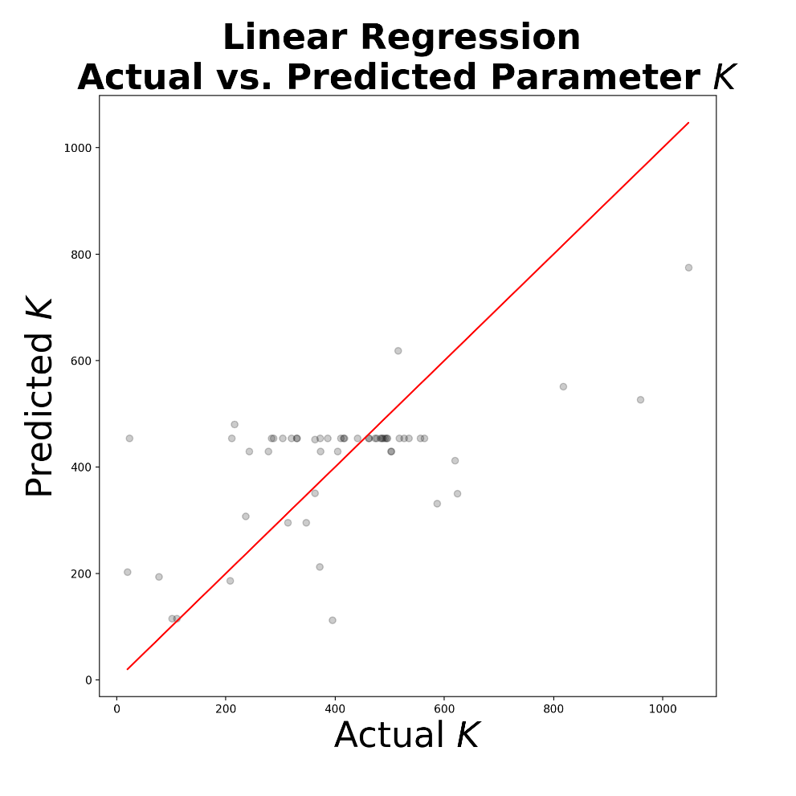
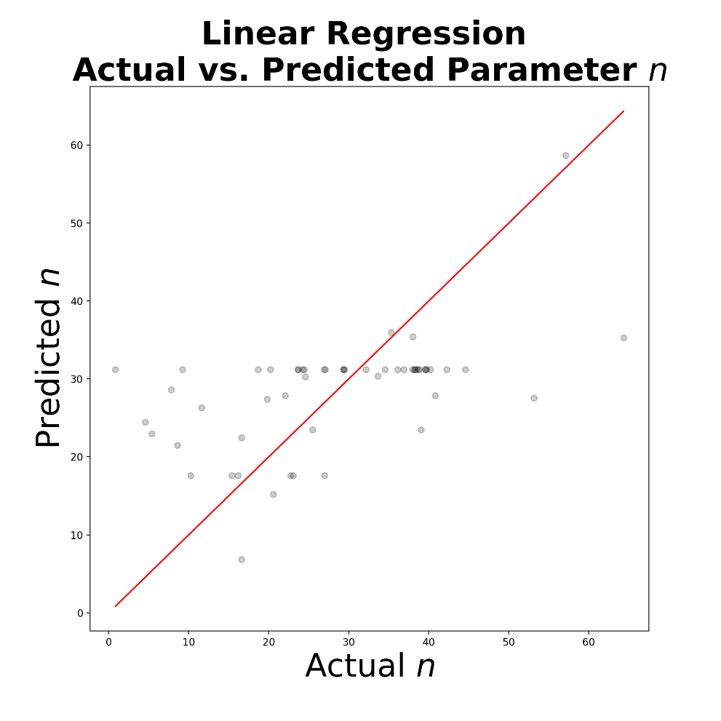
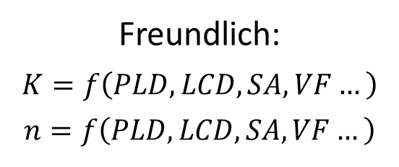
Result 2: Regression of N₂ by Linear Regression
Freundlich:
$$K=f\left(PLD, LCD, SA, VF…\right)$$
$$n=f\left(PLD, LCD, SA, VF…\right)$$
Parameters by LR | R2 | CV mean relative error
K | 0.38 | 0.85
n | 0.29 | 1.22

Slide 12
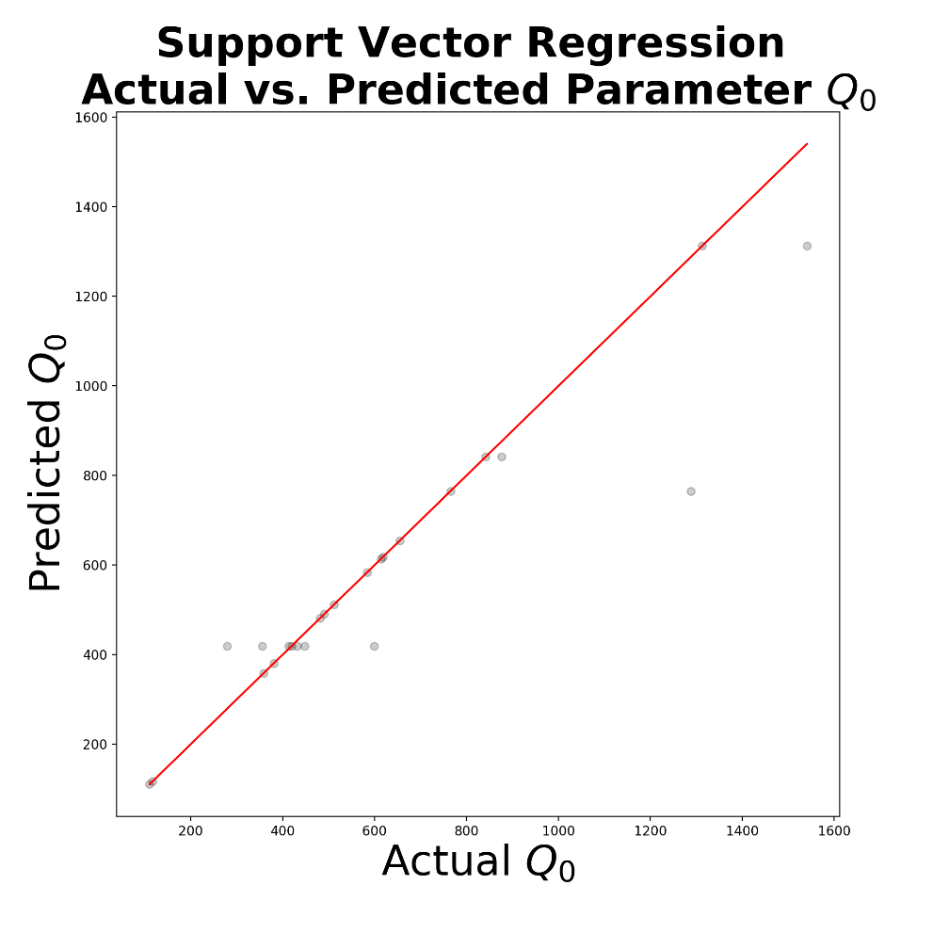
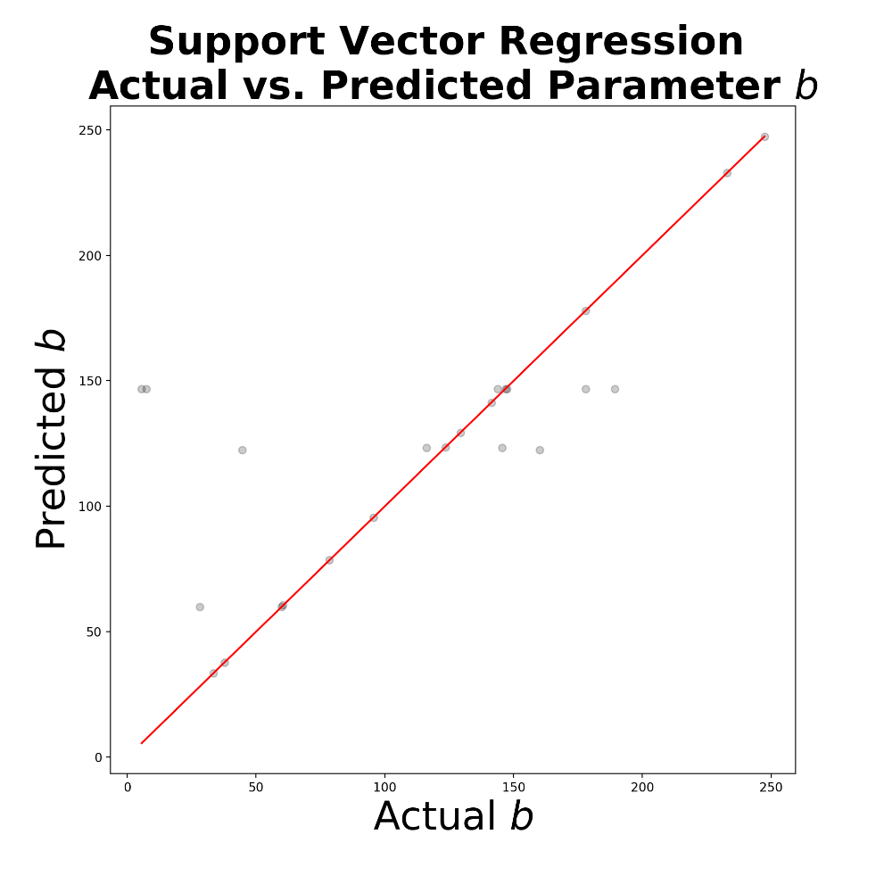
Result 3: Regression of N₂ by Kernel SVR, RBF
Langmuir:
$$Q_{0}=f\left(PLD, LCD, SA, VF…\right)$$
$$b=f\left(PLD, LCD, SA, VF…\right)$$
Parameters by SVR | R2 | CV mean relative error
Q₀ | 0.87 | 0.53
b | 0.53 | 2.44

Slide 13

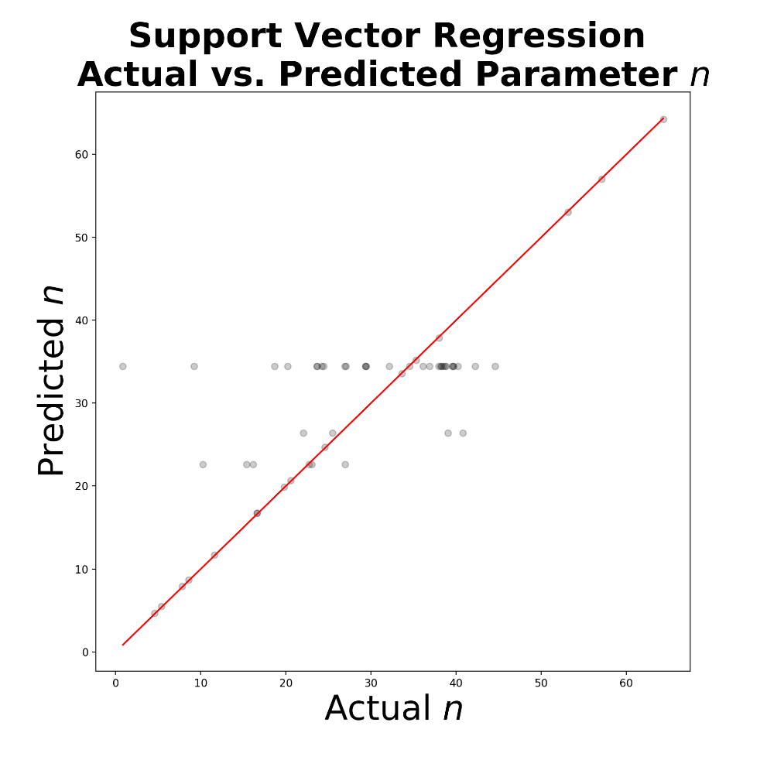
Result 3: Regression of N₂ by Kernel SVR, RBF
Freundlich:
$$K=f\left(PLD, LCD, SA, VF…\right)$$
$$n=f\left(PLD, LCD, SA, VF…\right)$$
Parameters by SVR | R2 | CV mean relative error
K | 0.75 | 1.10
n | 0.60 | 1.35

Slide 14
Discussion and Conclusions
Classification of isotherm models:
Tried Logistic, LDA, KNN, SVC method to classify
Both KNN and SVC work well. (KNN:82.3% mean accuracy, CV)
Regression of isotherm parameters for each model:
Tried linear regression and support vector regression with RBF
SVR works well with higher R2 and lower CV mean relative error
Analysis on Data source :
Same MOF has different isotherm results
Training examples are not large enough (124 matched MOFs)
Future plan:
Adding more isotherm types during the model assignment
Gather more matched MOFs manually to increase the training set
Consider the chemical information of MOFs as the feature vector: use more variables to describe metals and organic linkers
Notes:
Assignment of adsorption models for each isotherm
Aim: predict isotherms by the structure info. of MOFs
Input (feature vector): MOF structure information
Output is category: classification of isotherm models
Output is number: regression of isotherm parameters
Data source:
NIST adsorption data is not good enough.
Empty data points
Negative pressure or adsorption
Same MOF has different isotherm results.
GCMC calculation can provide more accurate isotherm database.
Future prediction of isotherm by ML can base on GCMC.

Slide 15

Questions

Slide 16
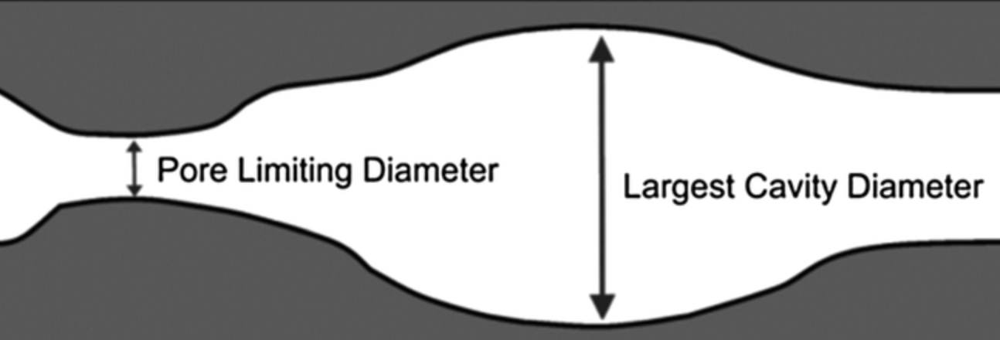
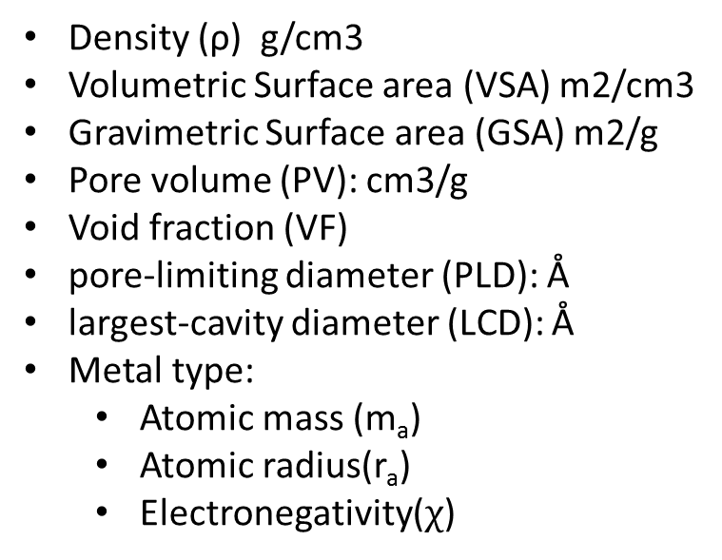
Backup: Adsorbent Structural Descriptors
Density (ρ) g/cm3
Volumetric Surface area (VSA) m2/cm3
Gravimetric Surface area (GSA) m2/g
Pore volume (PV): cm3/g
Void fraction (VF)
pore-limiting diameter (PLD): Å
largest-cavity diameter (LCD): Å
Metal type:
Atomic mass (m_{a})
Atomic radius(r_{a})
Electronegativity($χ$)

Slide 17
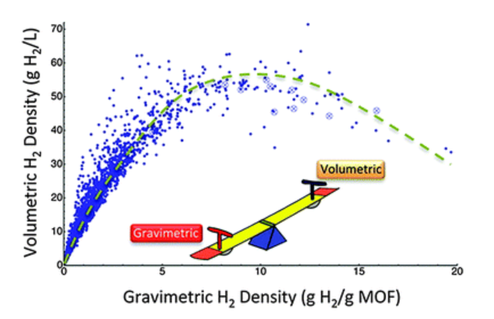
Backup: These authors also explored the trade-off between volumetric capacity and gravimetric capacity. The results show a concave downward relationship between volumetric and gravimetric storage capacities.

