Slide 1
Fantasy Fumball: Using Machine Learning to Predict NFL Player Rank
Wendy Yang
February 14, 2018
Data Science Part Time Course

Slide 2
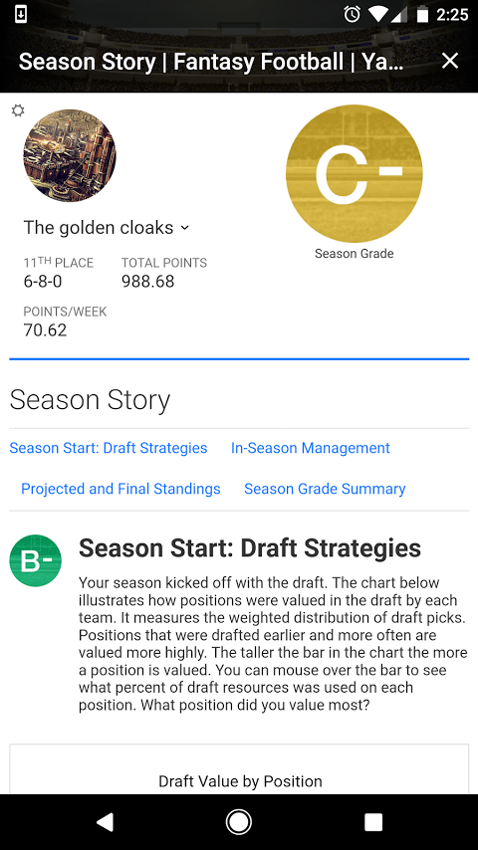
Why do we care?
The Fantasy Sports industry is estimated at over $7B per year
The ability to predict player rank accurately can lead to better drafting and ultimately winning the fantasy league
Personally took 11th place in my fantasy league this year ☹
Notes:
https://qz.com/1068534/how-the-7-billion-us-fantasy-football-industry-makes-its-money-in-2017/

Slide 3
Fantasy Football Background
Fantasy Football teams are comprised of players from all teams in the NFL.
Players in the following positions may be drafted: Quarterback (QB), Running back (RB), Wide Receiver (WR), Tight End (TE), and Kicker (K).
Each player may only be drafted onto one fantasy team per league.
Each player in the league drafts one fantasy player for their team in rounds until the fantasy teams are filled.

Slide 4
Hypothesis
An NFL player’s fantasy football rank can be predicted based on their fantasy football stats/points earned from a previous season
Why does this matter? Drafting players with the best rank should allow for the highest scoring team.

Slide 5
Data Collection
https://github.com/BurntSushi/nflgame
This pulls JSON files from NFL API
ESPN.com for 2016 top 300 fantasy player rank

Slide 6
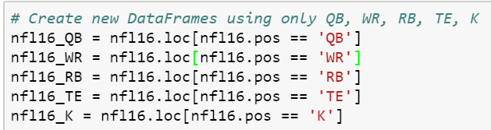
Data exploration
This data set contained all players in the NFL, I was only interested in QB, RB, WR, TE, K
I also ignored defensive players since we draft entire team defenses rather than individual defensive players
Notes:
Look again at the beginning class – how to create a good project. Need hypothesis etc.
What’s my hypothesis? Players with better stats in useful features will be ranked higher/more desirable to draft to my fantasy team.

Slide 7
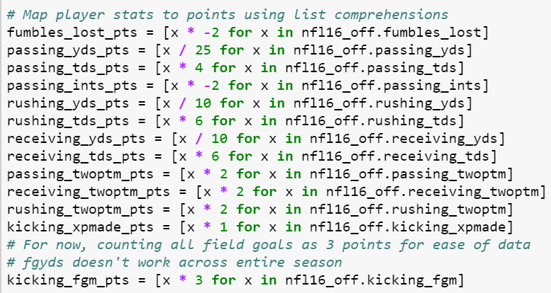
Fantasy Football Scoring
Offensive Players • Passing Yards: 1 point per 25 yards • Passing Touchdowns: 4 points • Passing Interceptions: -2 points • Rushing Yards: 1 point per 10 yards • Rushing Touchdowns: 6 points • Receptions: 1 points (only if using PPR scoring) • Receiving Yards: 1 point per 10 yards • Receiving Touchdowns: 6 points • 2-Point Conversions: 2 points • Fumbles Lost: -2 points • Fumble Recovered for a Touchdown: 6 points Kicking • Point After Touchdown (PAT) Made: 1 point • Field Goal (FG) Made (0-49 yards): 3 points • FG Made (50+ yards): 5 points

Slide 8
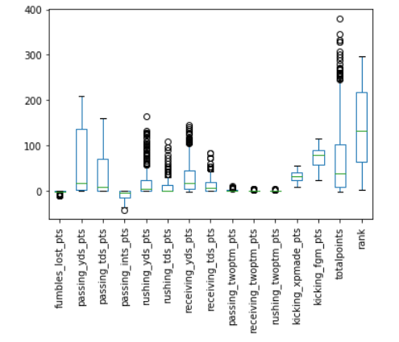
Visualizing Data
Plotted all of the points as box plots to see if anything was an obvious predictor.
Seems like Total Points has the most outliers along with rushing/receiving yards and touchdowns

Slide 9
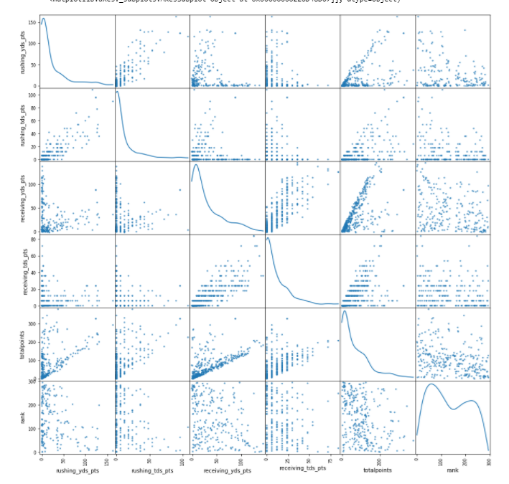
Visualizing Data Correlations
Looked at correlations across variables that seemed to have the most variance
Rushing yds/tds and Receivng yds/tds are positively correlated
Notes:
But that’s an obvious conclusion.

Slide 10
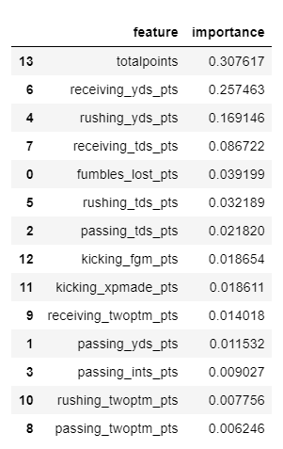
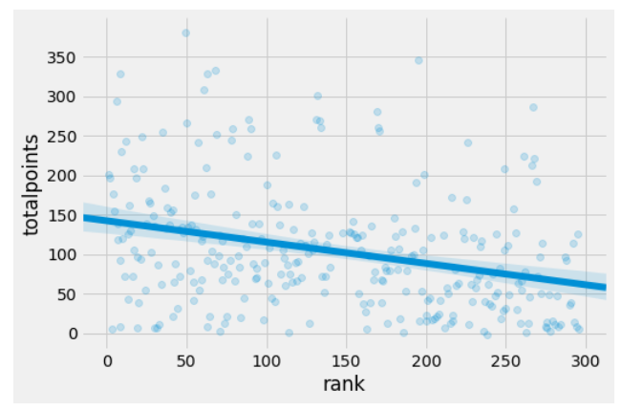
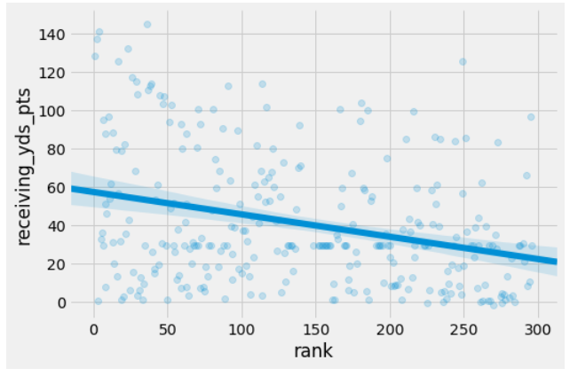
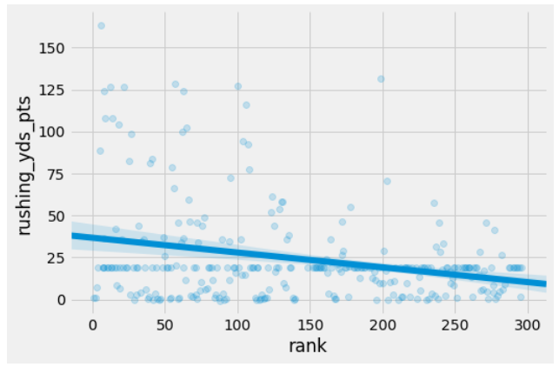
Random Forest
Random Forest is a quick preliminary model that can determine important features without having to do feature scaling.
Totalpoints, receiving yards, and rushing yards are the most important features in this set. All appear to be negatively correlated with rank.

Slide 11
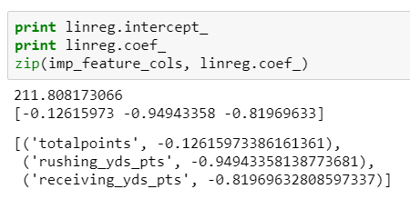
Linear Regression
RMSE = 74.76
Null RMSE = 80.80
My model does better than null!

Slide 12
Conclusions
Random forest was able to determine the most important features
Linear regression was able to predict how player’s performance may change player rank by interpreting the coefficients.
A player would have to gain ~1 rushing or receiving yard point to improve their rank by 1. Based on the point mapping, that means they would have to gain at least 10 more yards to improve their rank.
A players would have to gain ~8 total points in order to improve their rank by 1.

Slide 13
Future Work
See if I can predict improvement in players across years.
Split apart field goals into 3 and 5 points. For now, just scored all field goals made as 3 points since I did not want to loop through all kickers of each game across the entire season to determine which kicks were longer than others.
Aggregate individual players into team defenses and pull a full team score across the season to further improve my rank predictions.
Try to draft position rank besides positions (e.g. WR1, WR2)
Turn this into a product with a user interface to select a player and determine their rank against other players. (Unfortunately, while a good lesson, "who should I pick" already exists as a product)

