Slide 1
Predicting rank of players in NFL
Wendy Yang
January 17, 2018
Data Science Part Time Course

Slide 2
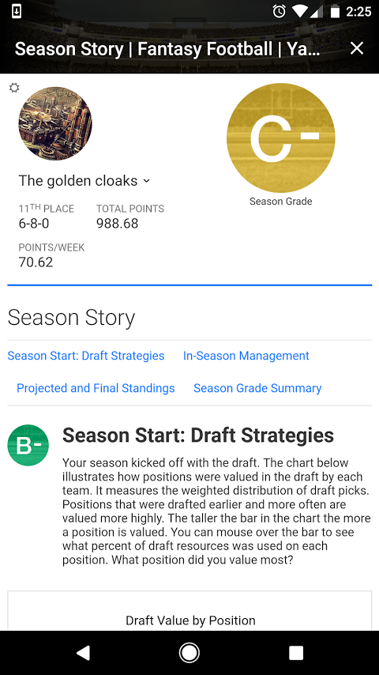
Why do we care?
Fantasy Football Market is estimated at over $7B per year
Personally took 11th place in my fantasy league this year ☹
Notes:
https://qz.com/1068534/how-the-7-billion-us-fantasy-football-industry-makes-its-money-in-2017/

Slide 3
How do we measure player rank?
This is a continuous variable
Assumptions
Looking at offense only
Looking at ending stats across entire season

Slide 4
Where is data from?
https://github.com/BurntSushi/nflgame
This pulls JSON files from NFL API
I pulled season stats from 2010 and 2016
Data Cleaning
-had to file a bug, someone removed set[] and changed it to a dictionary which does not have the feature “adds”
-not convinced I actually pulled total season stats, still playing in data

Slide 5
Data exploration
What are the features?
Passing yards, rushing yards, touchdowns
Which features are most useful?
Still determining this
Notes:
Look again at the beginning class – how to create a good project. Need hypothesis etc.
What’s my hypothesis? Players with better stats in useful features will be ranked higher/more desirable to draft to my fantasy team.

Slide 6
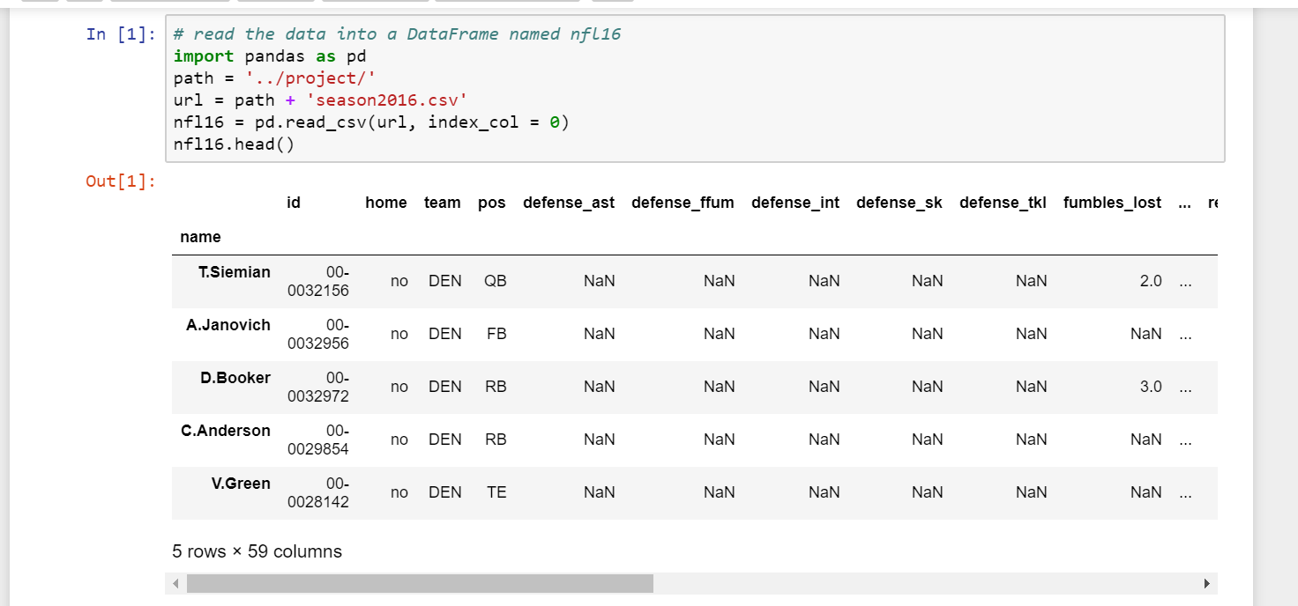

Slide 7
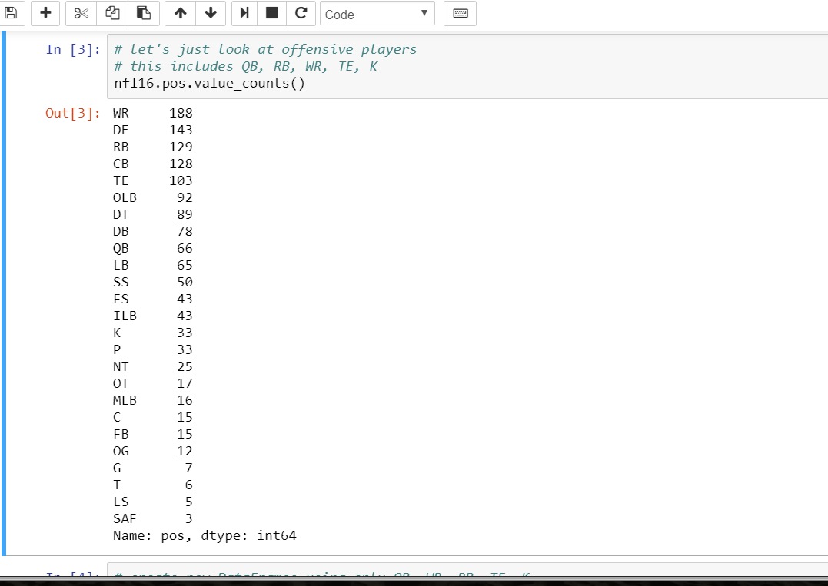

Slide 8
What’s next?
Must figure out best features to use
Can do this using bar graphs or scatterplots for macro level
Will try KNN like in NBA exercise – this probably won’t work since that was for position rather than rank
May try regressions instead
Was also looking around to try double layered neural networks but no idea how to explore

