Slide 1
HW-tableau
File created on: 5/18/2019
Wendy Chau

Slide 2
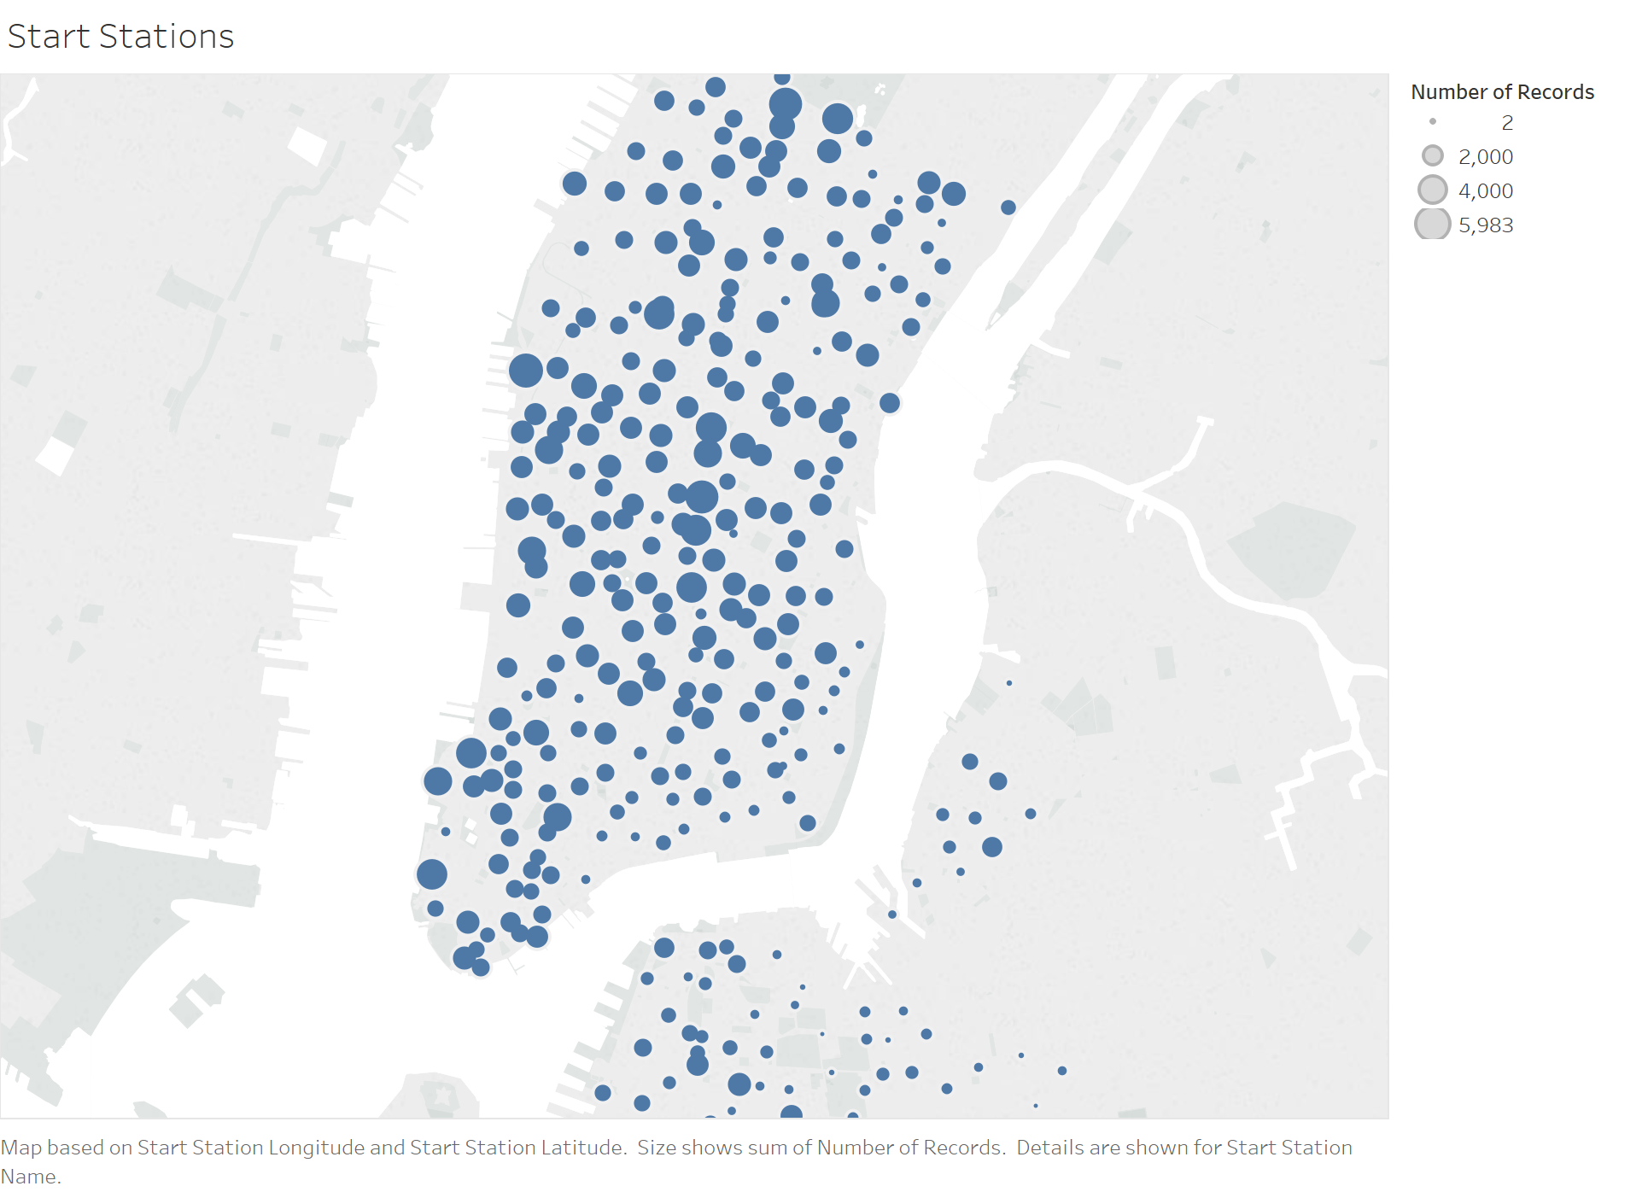

Slide 3
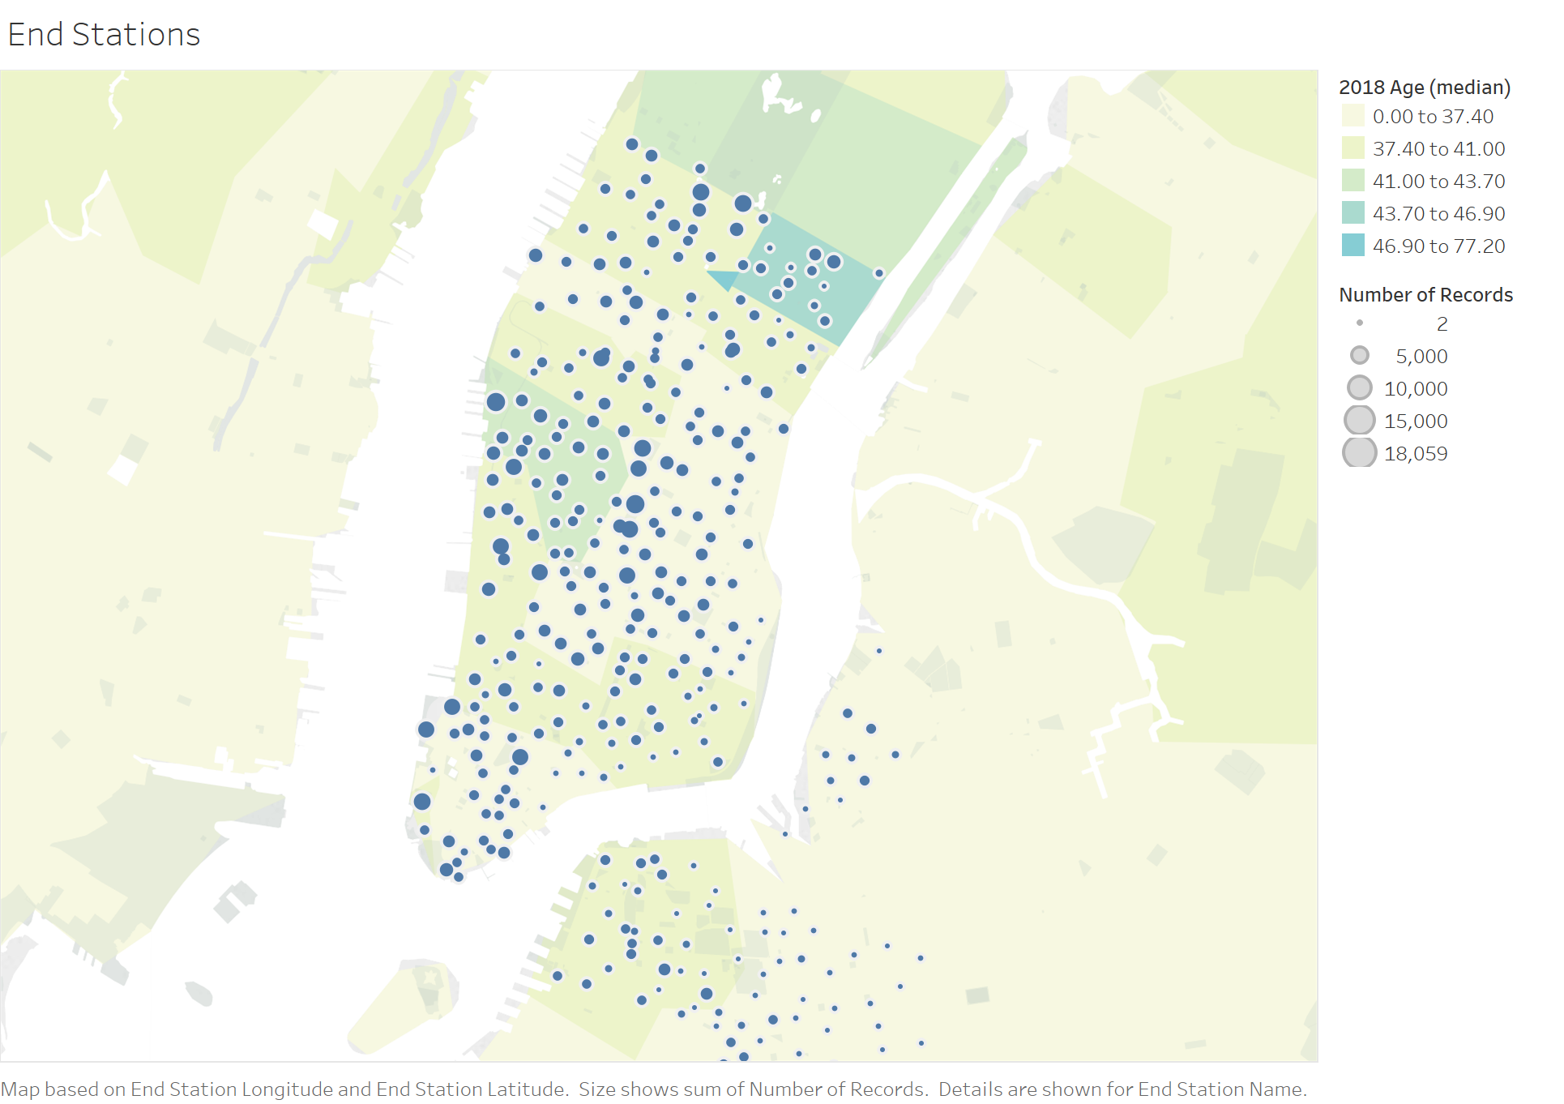

Slide 4
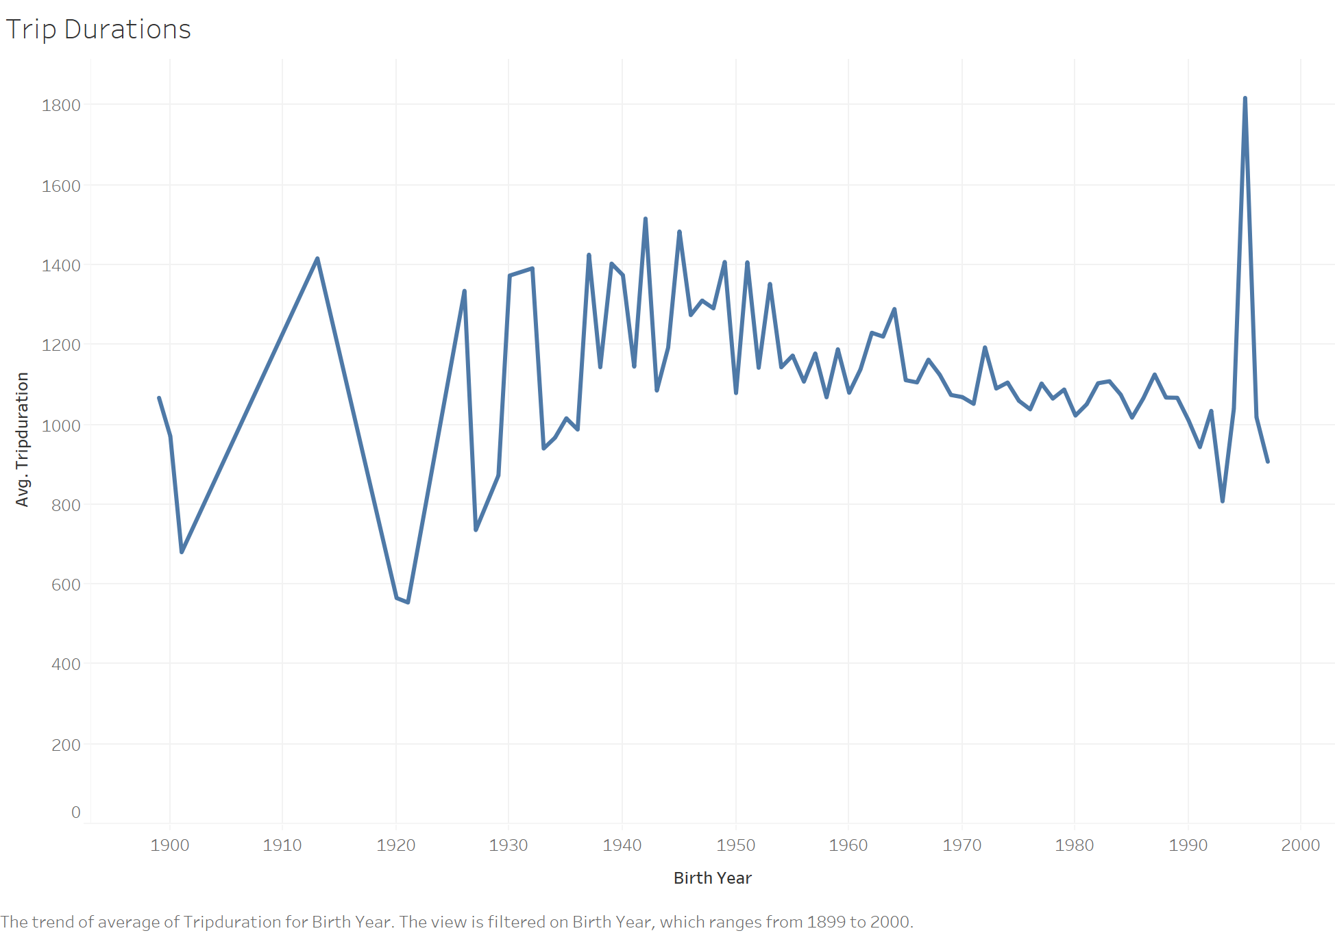

Slide 5
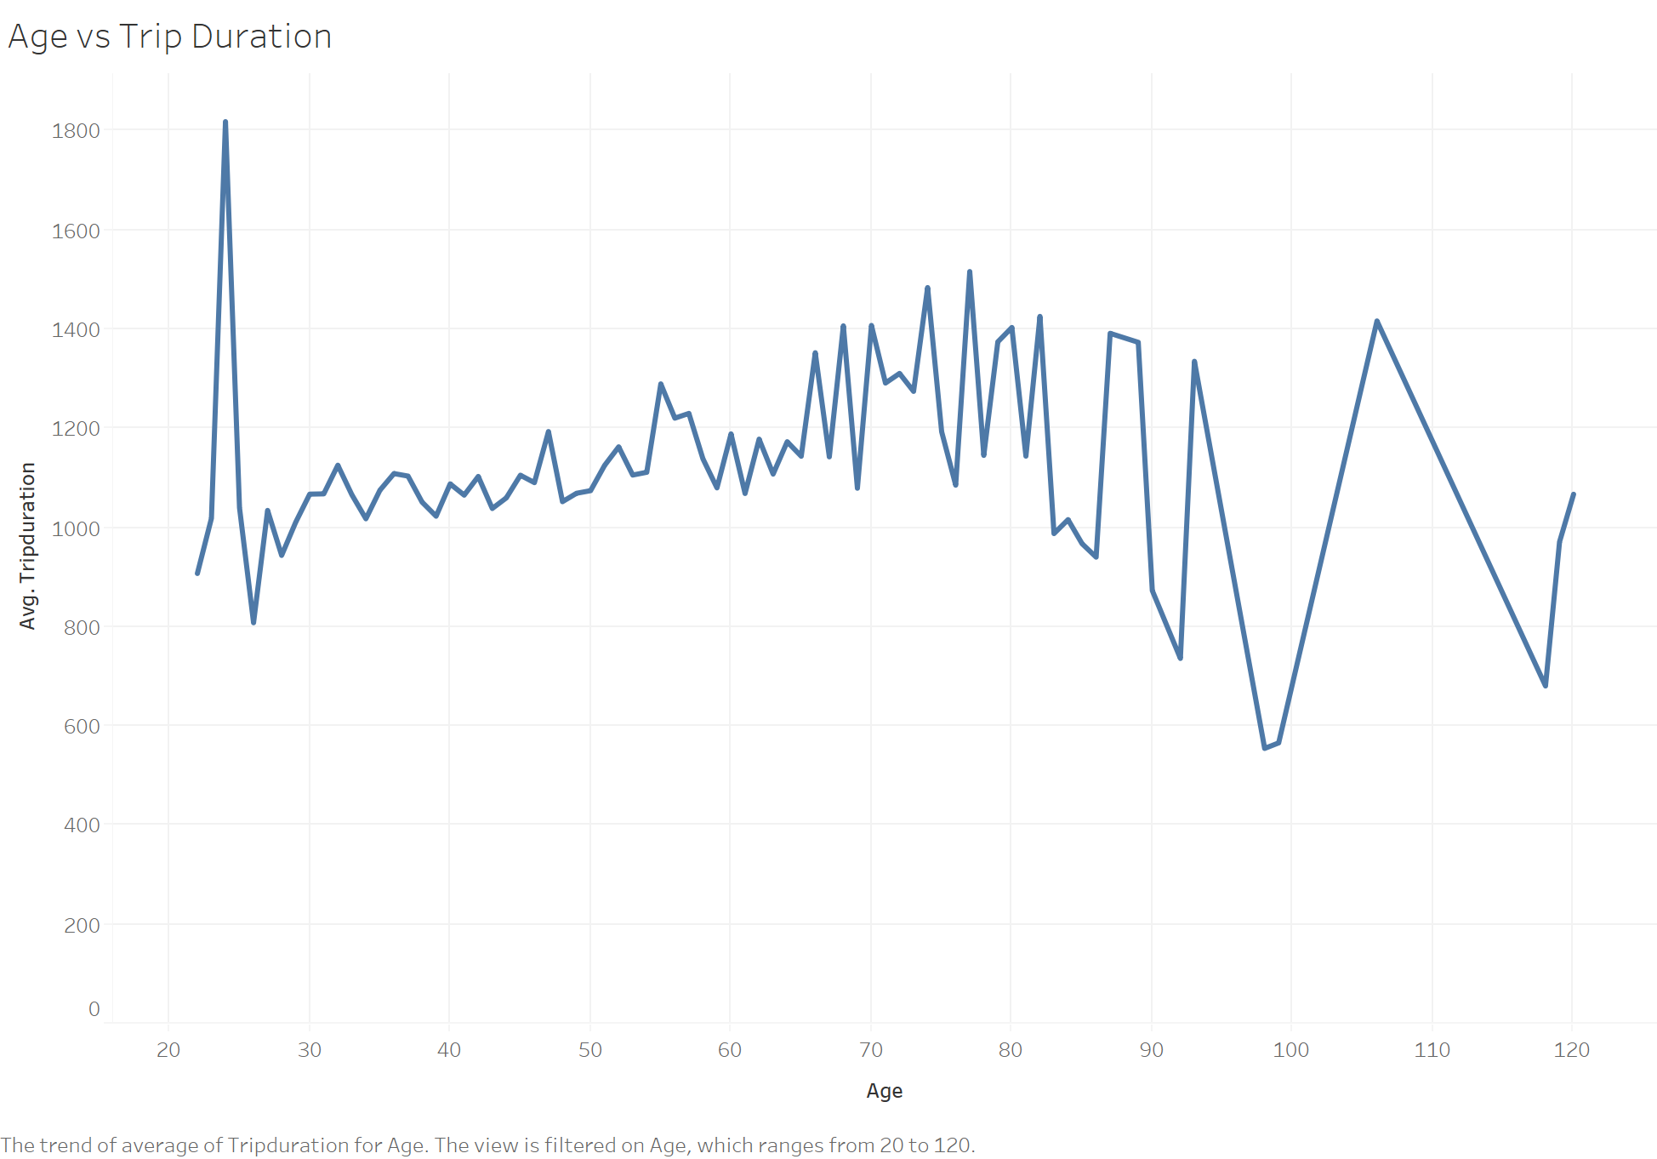

Slide 7


Slide 8
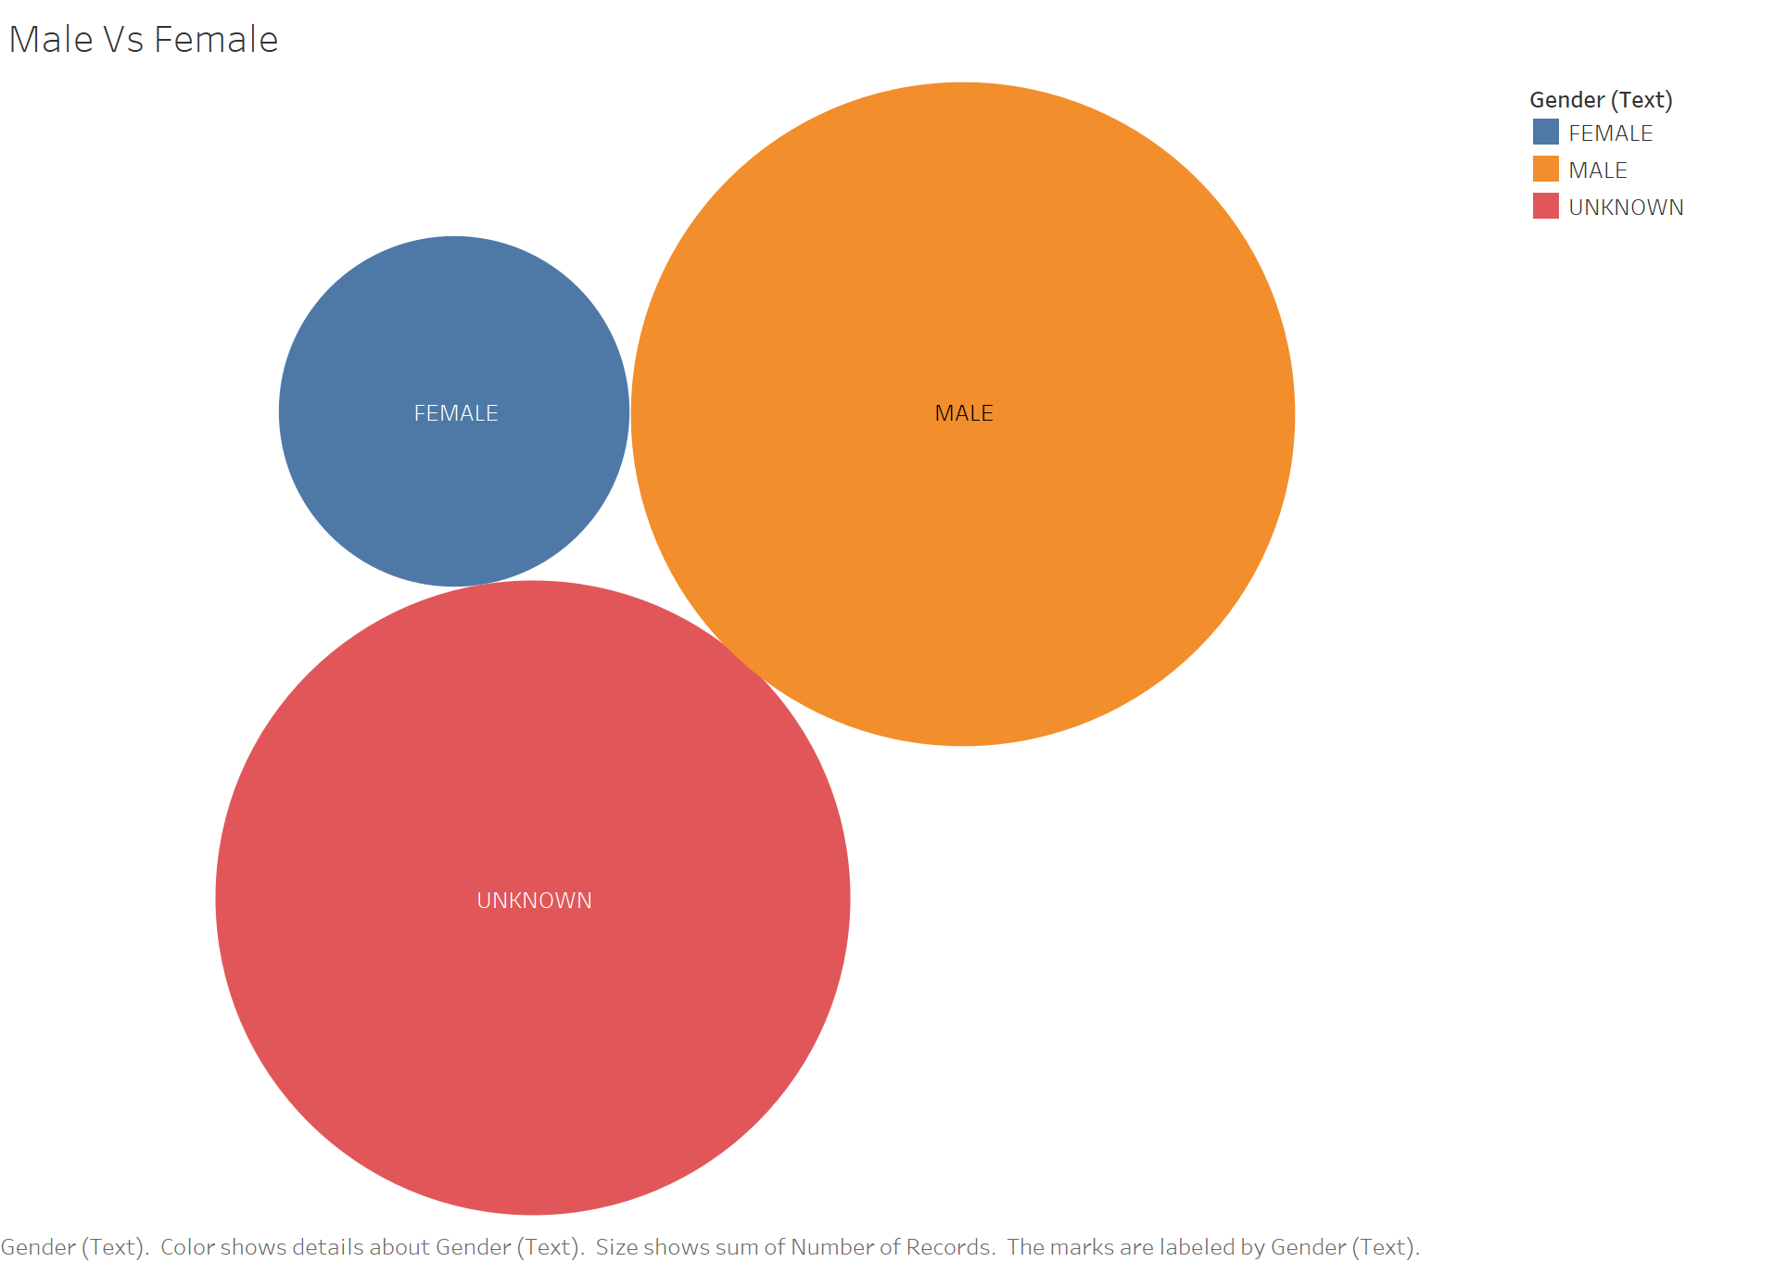

Slide 9
