Slide 1
♠♥♣ ♦ Four Card Poker
an analysis by
Wendy Chau

Slide 2
♠♥♣ ♦ What is Four Card Poker?
Popular casino game, owned by Shuffle Master
You form your best 4 cards from a 5 card hand; dealer forms their best 4 cards from a 6 card hand
Hand rankings:
Four of a kind (ranked higher than straight flush)
Straight flush (no such thing as Royal Flush)
Three of a kind
Flush
Straight (A-2-3-4 is lowest straight)
Two pair
One pair
High card(s)

Slide 3
♠♥♣ ♦ What is Four Card Poker?
House edge of 2.79% when played optimally → Compare to: blackjack ~0.5%, baccarat ~1.06%
How do you play optimally?
Beginner Strategy
Raise 3X with a pair of tens or higher
Raise 1X with a pair of twos to nines
Fold all other
Advanced Strategy
Pair of Aces or better: Bet 3X
Pair of Ks: Bet 3X, except bet 1X against an Ace and you don't have an Ace nor 4.
Pair of Js or Qs: Bet 3X, except bet 1X if the dealer's card outranks pair your pair rank and does not match a singleton in your hand.
Pair of 9s or 10s: Bet 3X, except bet 1X if dealer card outranks your pair rank.
Pair of 8s: Bet 1X, except bet 3X against a 2
Pair of 4s thru 7s: Bet 1X
Pair of 3s: Bet 1X, except fold against a Jack if your highest kicker is a 10 or lower
Pair of 2s or AKQ: Fold, except bet 1X if dealer card matches a rank in your hand
AKJT: Fold, except bet 1X against a Jack
AKJ9 or lower: Fold
Sauce: https://wizardofodds.com/games/four-card-poker/

Slide 4
♠My project
------------------------------
Four Card Poker
------------------------------
Dealer Always Qualifies
Player Wins Ties
------------------------------
Minimum: $5
------------------------------
-- Ante Bonus Pay Table --
Hand Payout
Four of a Kind 25
Straight Flush 20
Three of a Kind 2
------------------------------
-- Aces Plus Pay Table --
Hand Payout
Four of a Kind 50
Straight Flush 40
Three of a Kind 8
Flush 5
Straight 4
Two Pair 3
Pair of Aces 1
------------------------------
-- Bad Beat Pay Table --
Hand Payout
Four of a Kind 25000
Straight Flush 10000
Three of a Kind 100
Flush 25
Straight 6
Two Pair 4
------------------------------
Complete simulation of Four Card Poker in Python
Initial betting
Cards are shuffled (random) & dealt to player; player can see hand + automatic analysis of best 4 cards; dealer’s up-card is visible
Your hand: ['Q♡', 'Q♣', '9♣', '2♢', '6♢’]
Dealer's up-card: 6♣
You have one pair – Q’s;
Your best four cards: ['Q♡', 'Q♣', '9♣', '6♢']
Rank metadata: [3, 12, 9, 6]

Slide 5
♠My project
Player has to raise (1, 2, or 3× ante bet) or fold
Dealer’s hand + best 4 cards is revealed
Dealer's hand: ['5♡', 'J♣', '6♡', '5♢', '4♡', '6♣’]
Dealer has two pair - 6's & 5's ;
Dealer's best four cards: ['6♡', '6♣', '5♡', '5♢’]
Rank metadata: [4, 6, 5]
Result:
Dealer wins
Player pushes/wins/loses on various bets & has option to continue

Slide 6
♥What’s the point?
For people unfamiliar w/ the game or those with poor decision-making skills (like me!) to run simulations to practice in a risk-free environment & get acclimated to more educated betting behaviors
Final results: 100000 hands
Four of a kind: 0.0%
Straight flush: 0.1%
Three of a kind: 2.3%
Normal flush: 4.5%
Normal straight: 4.0%
Two pair: 4.8%
One pair: 40.2%
High card: 44.1%
15.7% bet 3×
← breakdown: 11.5% bet 3×, 28.7% bet 1×
← fold ☹

Slide 7
♥What’s the point?
The hands are fixed but the amount of money you end up with depends whether you raise (and by how much) or fold.
Player’s hand & dealer’s up-card can be made static while looping through many variations of the dealer’s potential hands to estimate odds of winning.
Final results: 10000 runs
Player wins: 5825
Dealer wins: 4175
Your hand has a ~58.2% chance of beating the dealer’s.
*Margin of error ±0.5%
Other uses:
Conditional betting behaviors + looping through games without human input to see how quickly one can lose money
Filtering concept can be easily adapted to other card games

Slide 8
♣Then what?
“When I’m at the casino I have too many drinks & forget everything”
🤓 IDEA: image recognition of hand + live analysis
“That’s not practical”
🤓 IDEA: casino security cameras can look at player’s hands, do live analysis, build a loyalty card profile based on betting behaviors then target certain players w/ marketing or comps
Two images
Early in the game: Dealer’s up-card
Towards end of the game: Player’s hand, ante bet, & raise amount
& this is where I started having issues …

Slide 9
♣Then what?
Attempt #1: tesseract (text from images OCR for Python)
problem: doesn’t pick up suits?
Attempt #2: imageAI (keras based, Python script)
had to run in Google Colab
took pictures, sorted them into test/train * 52 folders, a few Epochs later …
loss: 4.3127 - acc: 0.0192 - val_loss: 4.2686 - val_acc: 0.0192

Slide 10
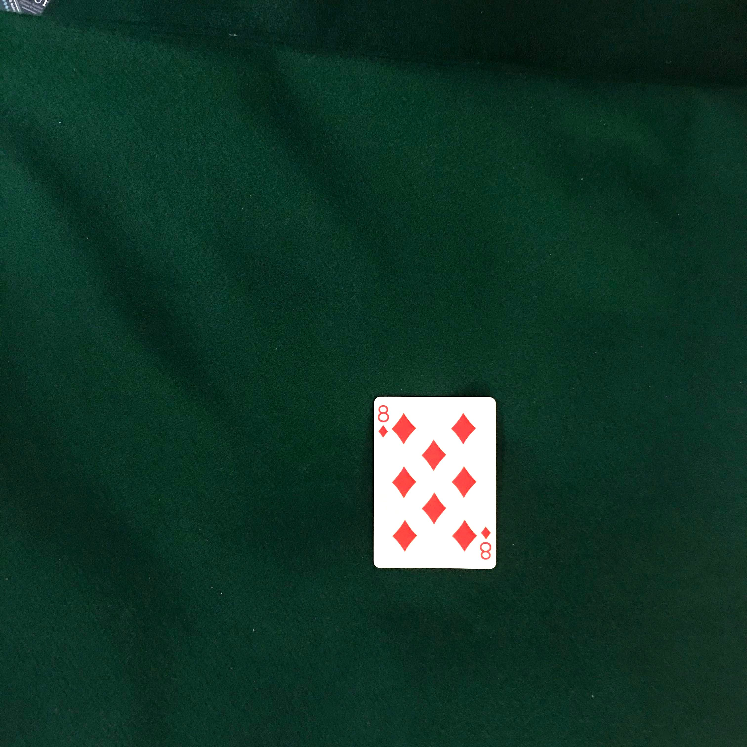
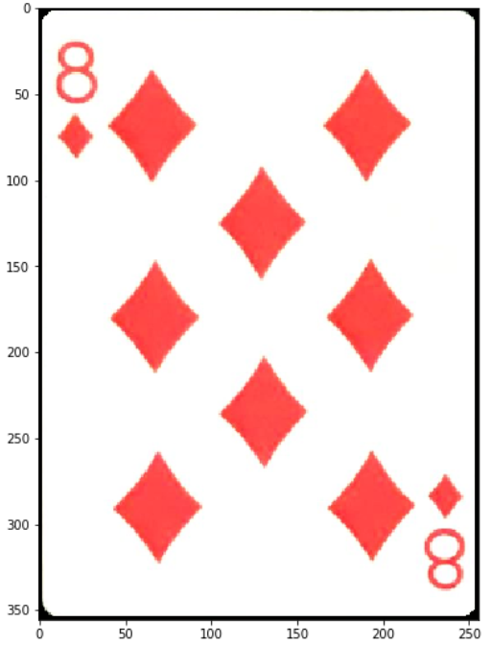
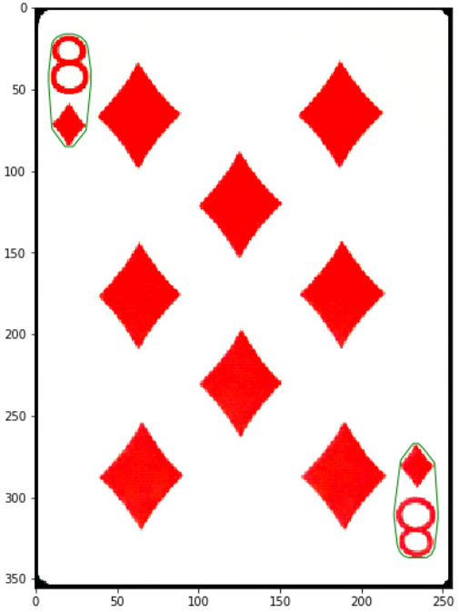
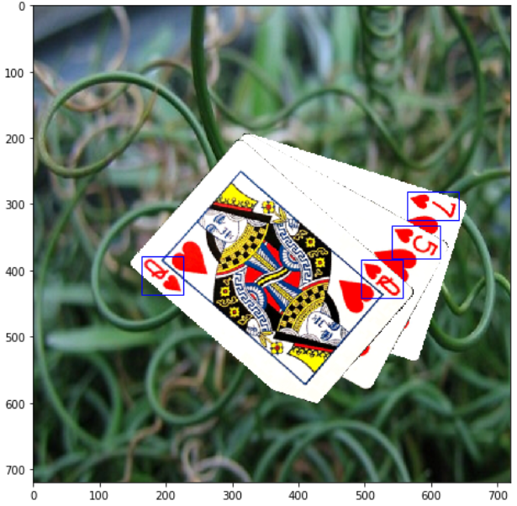
♣Then what?
Attempt #3: (in progress) I’m currently going through a tutorial by geaxgx on creating a playing card dataset to train YOLO
problem: turns out iPhone 7 is a poor choice for camera
certain cards refuse to be read: K♠, K♣, Q♣, J♣, K♦

Slide 11
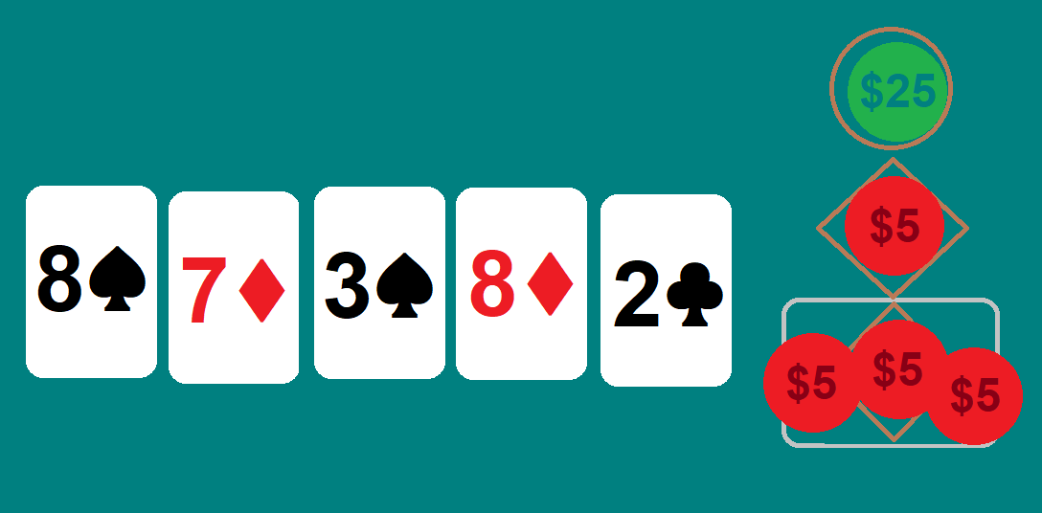
♦ Conclusion
Spent too much time setting up the simulation
Will continue to train with different cameras, card decks, settings
= Give this person a spice rack

