Slide 1
Coder Academy April 2020
portfolio website
PRESENTED BY WENDY DOAN

Slide 2
DEMO
FEATURES & RESPONSIVENESS

Slide 3
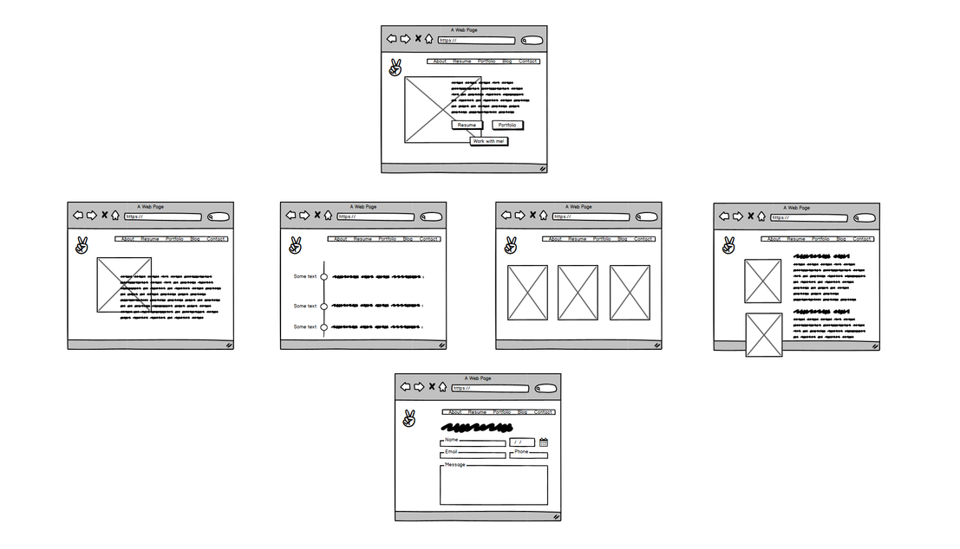

Slide 4
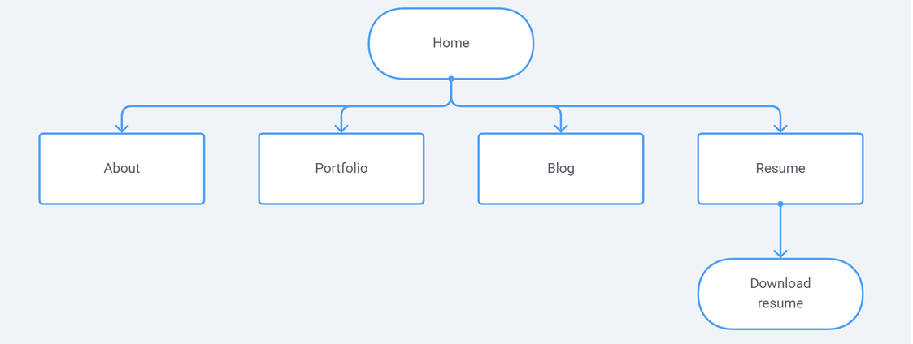

Slide 5
PHASE 1
Inspiration
PHASE 2
Planning site and mapping pages
PHASE 3
Write HTML and then CSS
Project
implementation
PHASE 4
Refine and deploy
PROCESS PLAN

Slide 6
Challenges
LAYOUT
RESPONSIVENESS
DRY
STRUCTURING CODE

Slide 7

Learnings
HTML & CSS CONCEPTS
FOCUS ON BASICS
PLAN CODE
JS IN CONTEXT

Slide 8
Thank you!

