Slide 1
Simple Linux operating system Real Mode switch to protected mode

Slide 2
Environment/Builds
Virtual Machine/Ubuntu 14.04
QEMU or Bosch
NASM
GMP, MPFR, LIBMPC, (dependency packages)
MAKE, FLEX, TEXINFO, BISON
Binutils – 2.30
Cross-Compiler – i686-elf-gcc

Slide 3
Bootloader
Is a small program that is executed under boot up in 16-bit Real Mode. It is very small, in fact, it is only 512 bytes and it resides on the very first sector of a boot device. The bootloader is used to load more complex programs like an OS Kernel. The 512 byte bootloader code is stored with the Master Boot Record (MBR) and is loaded by the Basic Input/Output System (BIOS) via Interrupt.

Slide 4
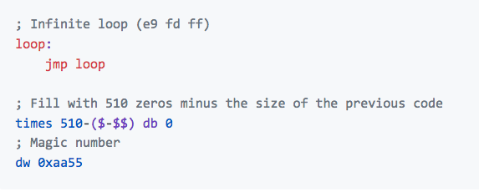
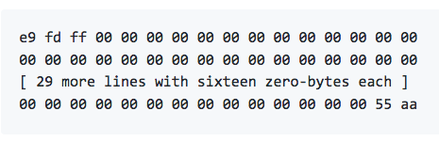
Simplest boot sector ever
location is the first sector of the disk (cylinder 0, head 0, sector 0) and it takes 512 bytes.
To make sure that the "disk is bootable", the BIOS checks that bytes 511 and 512 of the alleged boot sector are bytes 0xAA55

Slide 5
What are interrupts?
The hardware of a computer provides a mechanism called interrupts to handle events.
For example, when a mouse is moved, the mouse hardware interrupts the current program to handle the mouse movement (to move the mouse cursor, etc.) Interrupts cause control to be passed to an interrupt handler.
Interrupt handlers are routines that process the interrupt. Each type of interrupt is assigned an integer number. At the beginning of physical memory, a table of interrupt vectors resides that contain the segmented addresses of the interrupt handles. The number of interrupt is essentially an index into this table.

Slide 6
RAM MEMORY
Bootloader executing at 0x7c00
Jumps to 0x1000 to execute kernel
Kernel
BIOS
ROM
CHIP
Bootloader
MAX:
512 bytes
BIOS reads the bootable device and loads the bootsector to address 0x7c00 in RAM memory and jumps to 0x7c00 to execute it
Bootloader is programmed so that it loads the kernel residing on FAT formatted bootable drive onto RAM memory address 0x1000 and jumps to 0x1000 to execute kernel

Slide 7
32-bit protected mode switch-over
Disable interrupts using the cli (clear interrupt). CPU will simply ignore any future interrupts that may happen, at least until interrupts are later enabled.
Tell the CPU about the GDT. i.e. lgdt [gdt_descriptor]
(The Global Descriptor Table contains entries telling the CPU about memory segments. )
3. Once both the GDT and the GDT descriptor have been prepared within our boot sector, we are ready to instruct the CPU to switch from 16-bit real mode into 32-bit protected mode.

Slide 8
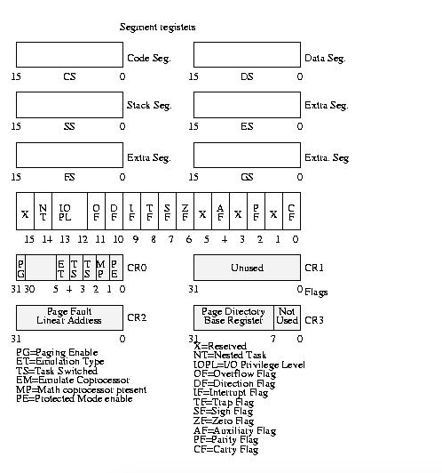

Slide 9
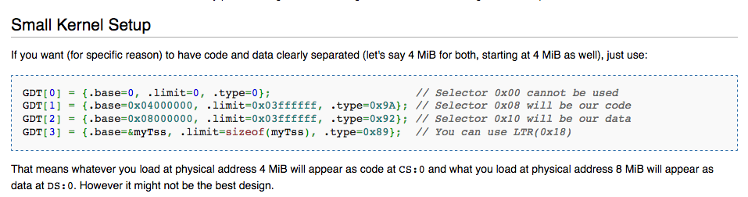
Kernel entry point code
jmp $
[bits 32] ; protected mode by now , so use 32-bit instructions.
(Call kernel.c file which currently only prints a string msg)
[extern main] ; Declare that we will be referencing the external symbol ’main ’,
define call point

Slide 10
Monolithic Kernel
Monolithic kernels, which have traditionally been used by Unix-like operating systems, contain all the operating system core functions and the device drivers (small programs that allow the operating system to interact with hardware devices, such as disk drives, video cards and printers). Modern monolithic kernels, such as those of Linux and FreeBSD, both of which fall into the category of Unix-like operating systems, feature the ability to load modules at runtime, thereby allowing easy extension of the kernel's capabilities as required, while helping to minimize the amount of code running in kernel space.

Slide 11
Monolithic Structure of an OS
app
app
app
app
Each App in it’s own hardware address space
OS
Services and Device drivers
(dynamic allocation of memory for apps, filesystem, sending message in the network, CPU, )
OS in it’s own hardware address space
Hardware
Managed by the OS

Slide 12
Executing our Kernel Code
Write and compile the kernel code.
Write and assemble the boot sector code
Create a kernel image that includes not only our boot sector but our compiled kernel code
Load our kernel code into memory
Switch to 32-bit protected mode
Begin executing our kernel code

Slide 13
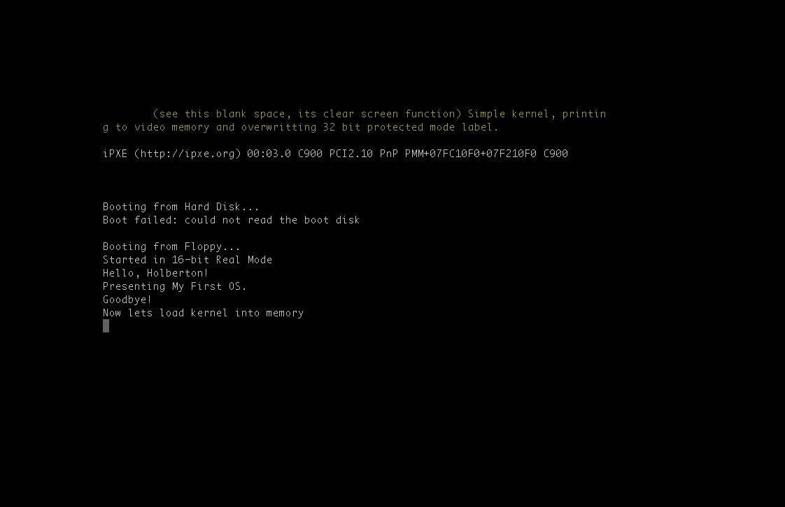

Slide 14
references
http://fisnikhasani.com/building-your-own-bootloader/
https://github.com/cfenollosa/os-tutorial/
http://www.cs.bham.ac.uk/%7Eexr/lectures/opsys/10_11/lectures/os-dev.pdf
https://wiki.osdev.org/BIOS#Common_functions
http://www.pravaraengg.org.in/Download/MA/assembly_tutorial.pdf
https://www.geek.com/chips/difference-between-real-mode-and-protected-mode-574665/

